Slide 1
Chapter 1
Units, Physical Quantities, and Vectors
Modifications by Mike Brotherton

Slide 2
Goals for Chapter 1
  Three fundamental quantities of physics: meters, kilograms, and seconds
  To keep track of significant figures in calculations
  To understand vectors and scalars and how to add vectors graphically
  To determine vector components and how to use them in calculations
  To understand unit vectors and how to use them with components to describe vectors
  To learn two ways of multiplying vectors

Slide 3
Standards and units
  Length, time, and mass are three fundamental quantities of physics.
  The International System (SI for Système International) is the most widely used system of units.
  In SI units, length is measured in meters, time in seconds, and mass in kilograms.
  Sorry – I know engineers sometimes (often?) use other units!

Slide 4
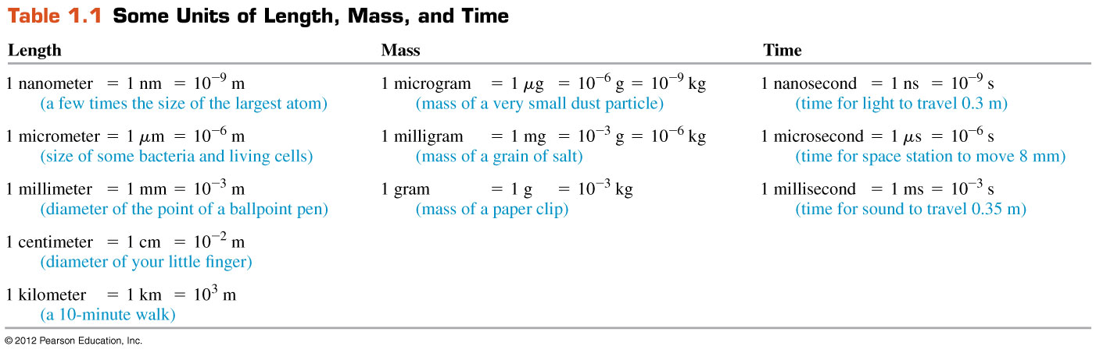
Unit prefixes
Table 1.1 shows some larger and smaller units for the fundamental quantities.

Slide 5
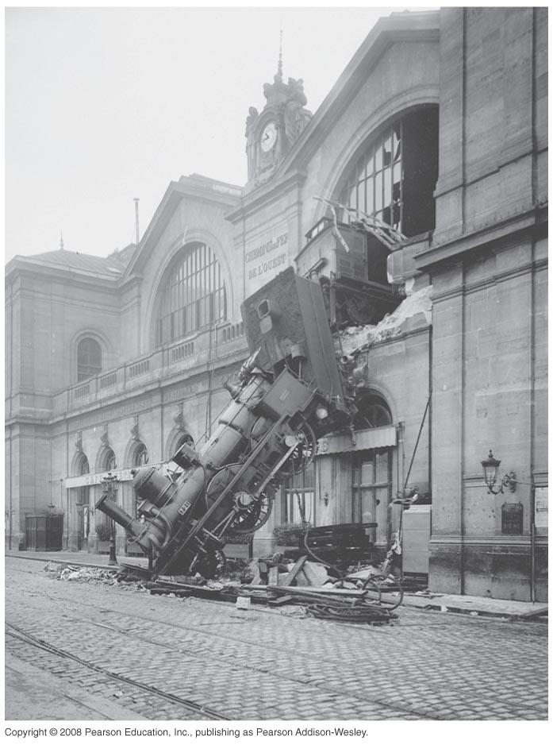
Uncertainty and significant figures—Figure 1.7
  The uncertainty of a measured quantity is indicated by its number of significant figures.
  For multiplication and division, the answer can have no more significant figures than the smallest number of significant figures in the factors.
  For addition and subtraction, the number of significant figures is determined by the term having the fewest digits to the right of the decimal point.
  As this train mishap illustrates, even a small percent error can have spectacular results!

Slide 6
Unit consistency and conversions
An equation must be dimensionally consistent. Terms to be added or equated must always have the same units. (Be sure you’re adding “apples to apples.”)
Always carry units through calculations.
How many seconds in a light year?

Slide 7

Vectors and scalars
A scalar quantity can be described by a single number.
A vector quantity has both a magnitude and a direction in space, or…
In this book, a vector quantity is represented in boldface italic type with an arrow over it: A.
The magnitude of A is written as A or |A|.
→
→
→

Slide 8
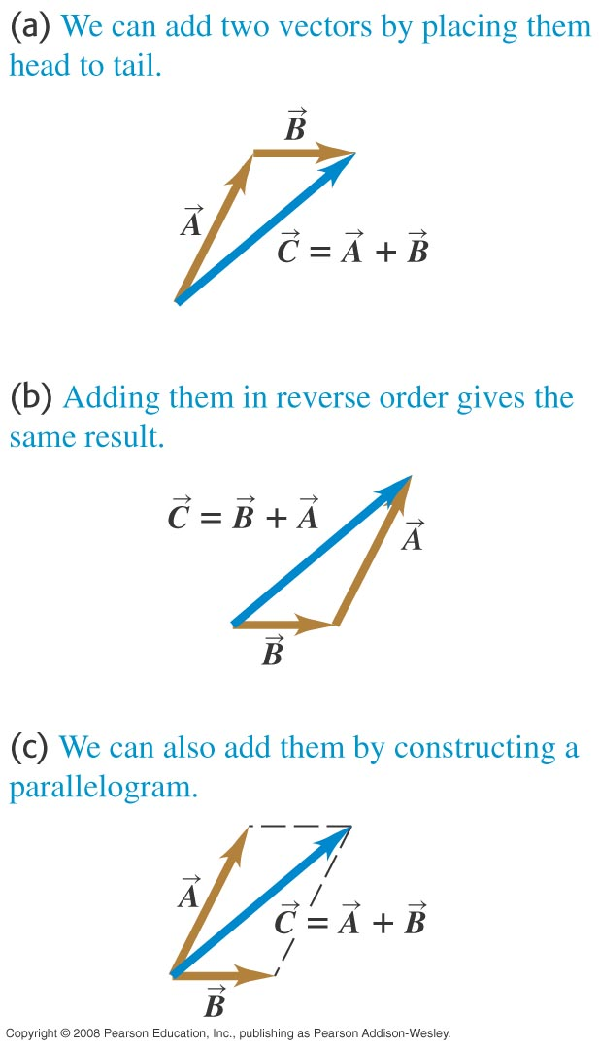
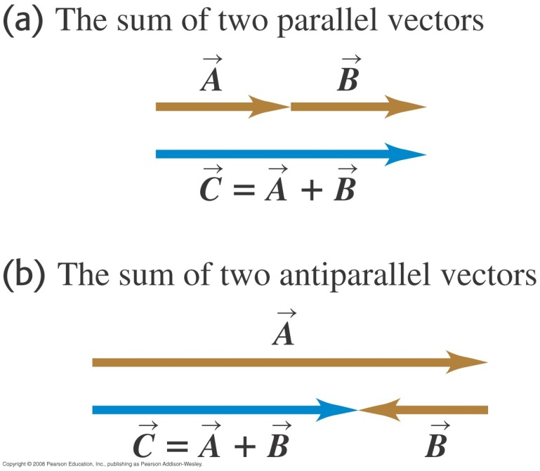
Adding two vectors graphically—Figures 1.11–1.12
Two vectors may be added graphically using either the parallelogram method or the head-to-tail method.

Slide 9
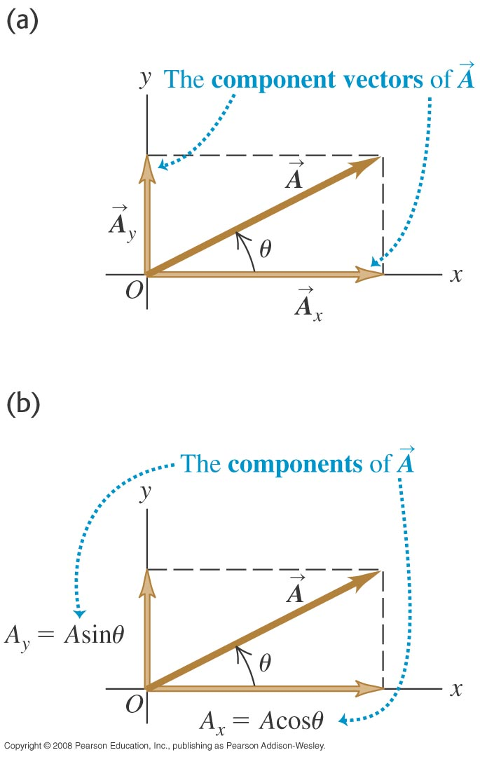
Components of a vector—Figure 1.17
Adding vectors graphically provides limited accuracy. Vector components provide a general method for adding vectors.
Any vector can be represented by an x-component A_{x} and a y-component A_{y}.
Use trigonometry to find the components of a vector: A_{x} = Acos θ and A_{y} = Asin θ, where θ is measured from the +x-axis toward the +y-axis.

Slide 10
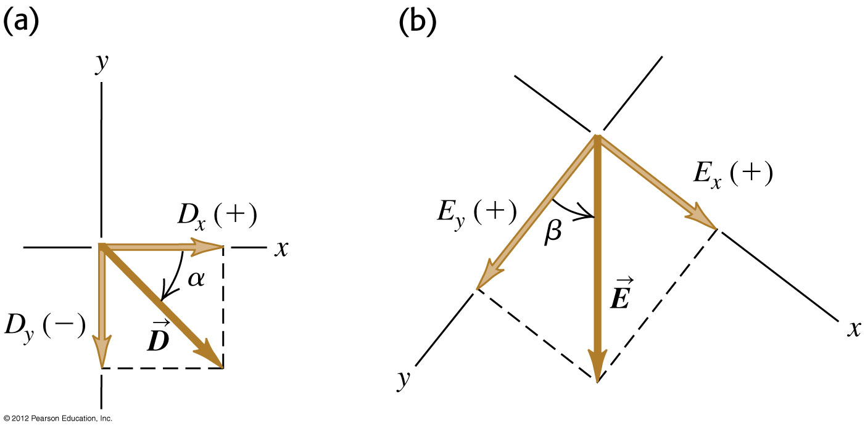
Finding components—Figure 1.19
We can calculate the components of a vector from its magnitude and direction.
Follow Example 1.6.

Slide 11
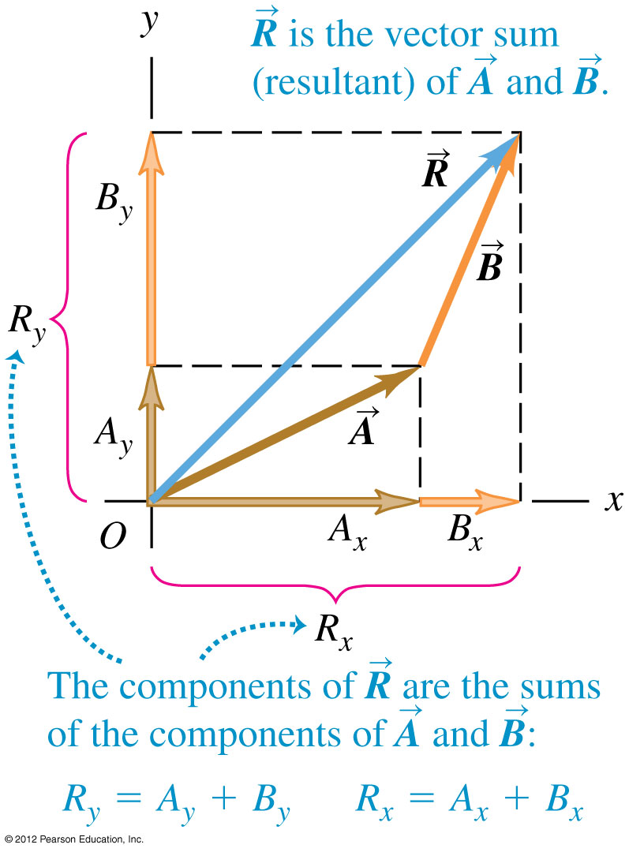
Calculations using components
We can use the components of a vector to find its magnitude and direction:
We can use the components of a set of vectors to find the components of their sum:

Slide 12
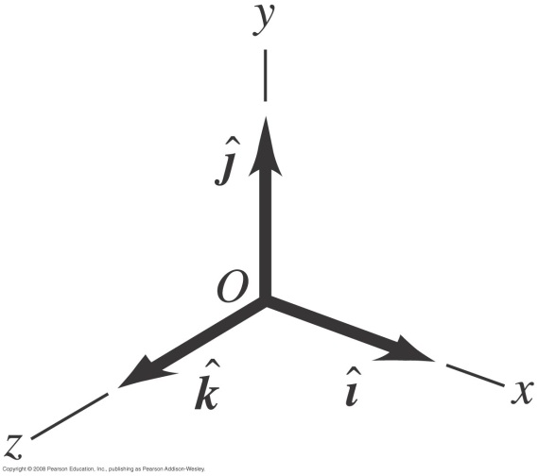
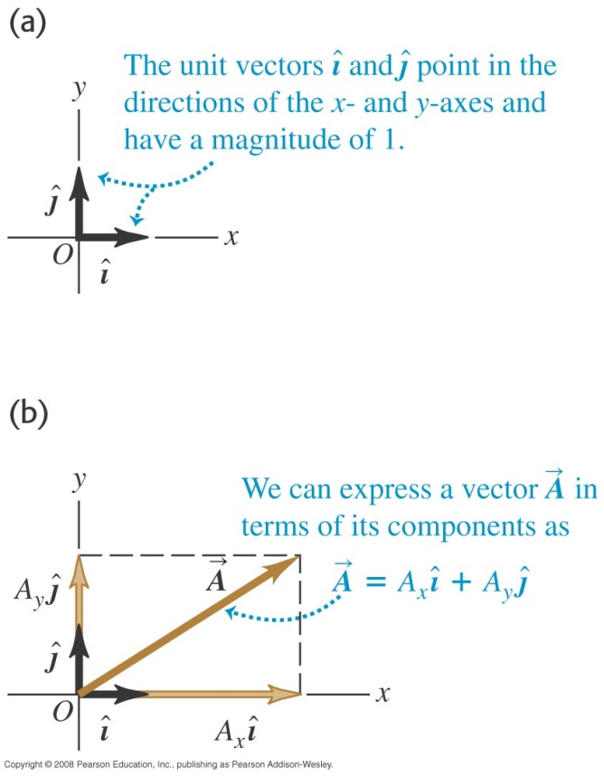
Unit vectors—Figures 1.23–1.24
A unit vector has a magnitude of 1 with no units.
The unit vector î points in the +x-direction, points in the +y-direction, and points in the +z-direction.
Any vector can be expressed in terms of its components as
A =A_{x}î+ A_{y} + A_{z} .
→

Slide 13
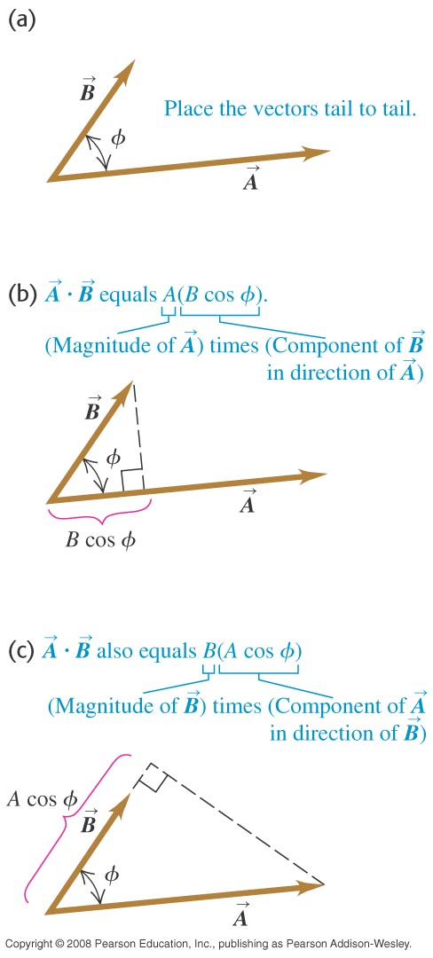
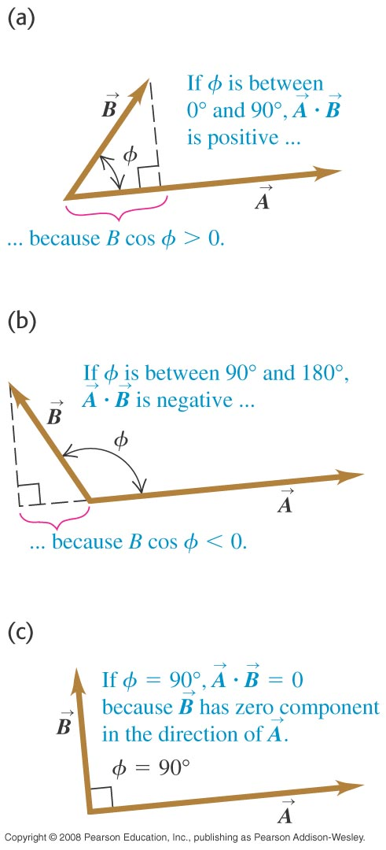
The scalar product—Figures 1.25–1.26
The scalar product (also called the “dot product”) of two vectors is
Figures 1.25 and 1.26 illustrate the scalar product.

Slide 14
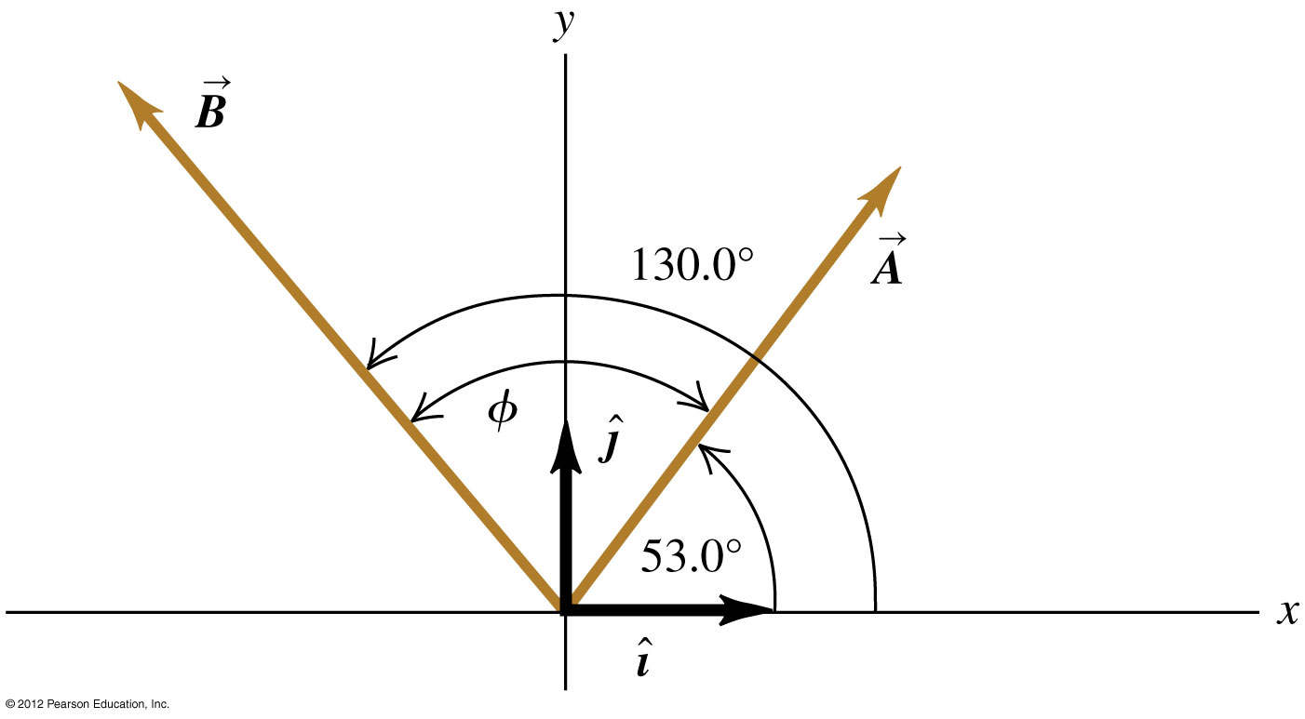
Calculating a scalar product
In terms of components,
Example 1.10 shows how to calculate a scalar product in two ways.
[Insert figure 1.27 here]

Slide 15
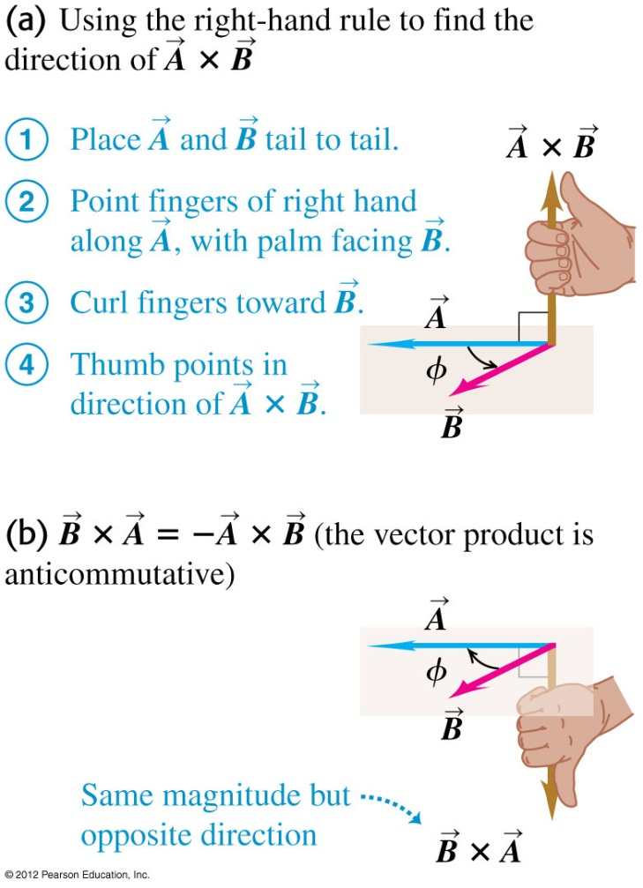
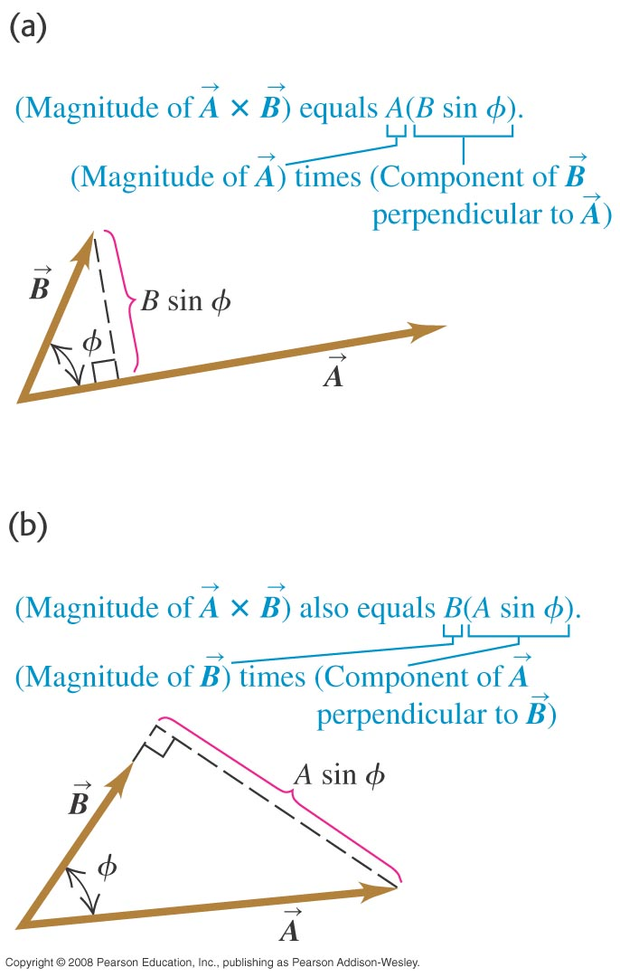
The vector product—Figures 1.29–1.30
The vector product (“cross product”) of two vectors has magnitude
and the right-hand rule gives its direction. See Figures 1.29 and 1.30.

Slide 16
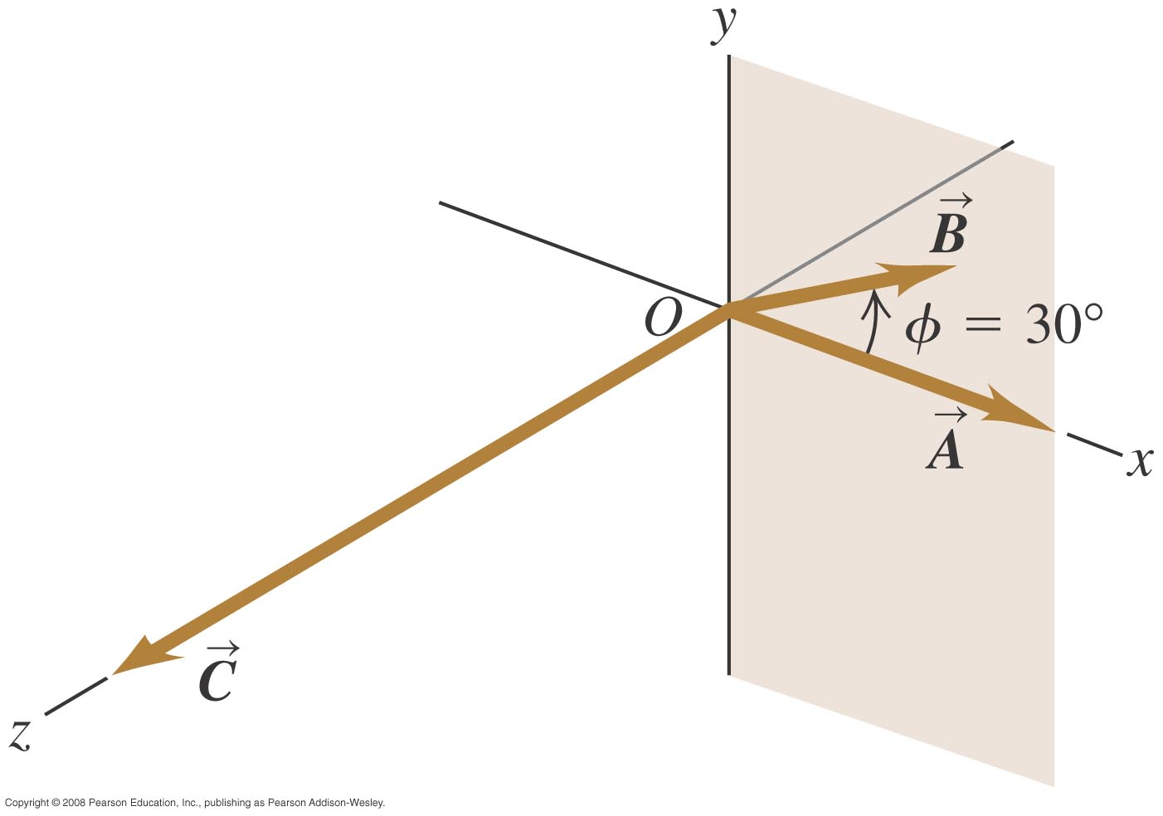
Calculating the vector product—Figure 1.32
Use ABsinφ to find the magnitude and the right-hand rule to find the direction.
Refer to Example 1.12.

