Slide 1

How to Better Weigh a Black Hole and Other Adventures in Quasar Physics
Michael Brotherton

Slide 2
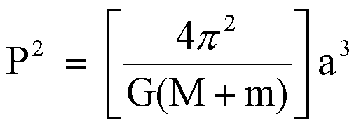
How Can We Measure Masses in space?

Slide 3
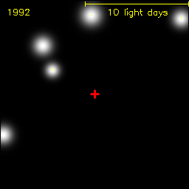
From our sun to the galactic core
Groups at Max Planck and UCLA have been observing the center of the Milky Way for over two decades, tracing the orbits of stars. The mass of the central dark object lurking there is about 4 million solar masses.

Slide 4
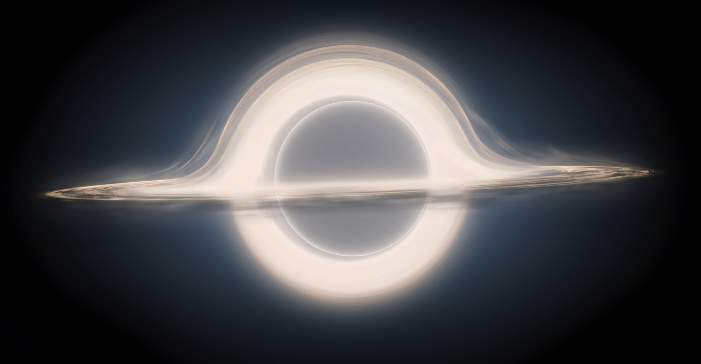
“Gargantua” from interstellar
100 Million Solar Masses

Slide 5
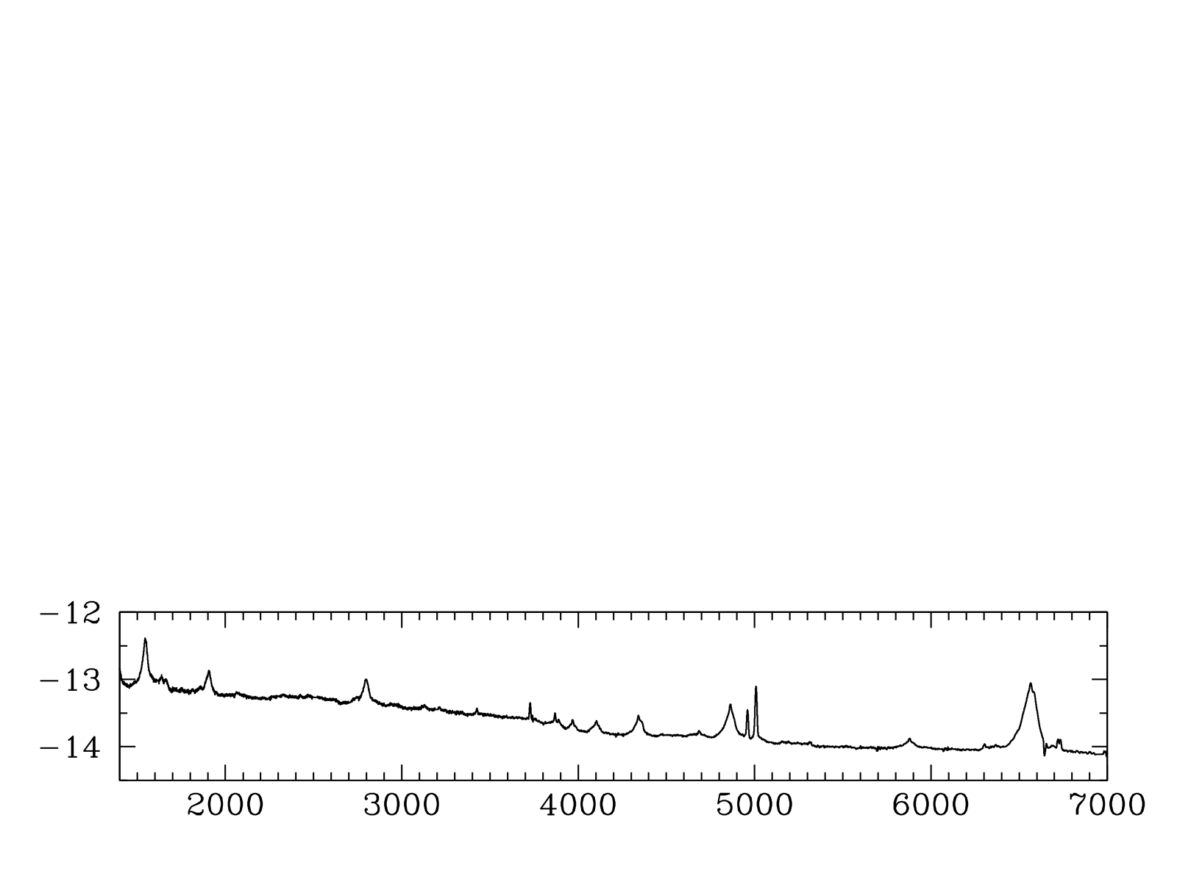
Virial Black Hole Masses in Quasars
e.g., Vestergaard et al. (2006, 2009)
Hα
Hβ
log(F_{λ})
C IV
Mg II
Rest λ (Angstroms)
Notes:
Another important parameter in AGN is the black hole mass, which isn’t necessarily a typical SED project but I can really get at this with my quasi-simultaneous spectra.
How do you measure M in AGN?
Spectrum, CIV at high redshift and Hβ at low.
Ideally measurements using these lines in the same object would agree, but there’s scatter of a factor of a few between them.
I’m interested in understanding this scatter so that I can reduce it.

Slide 6
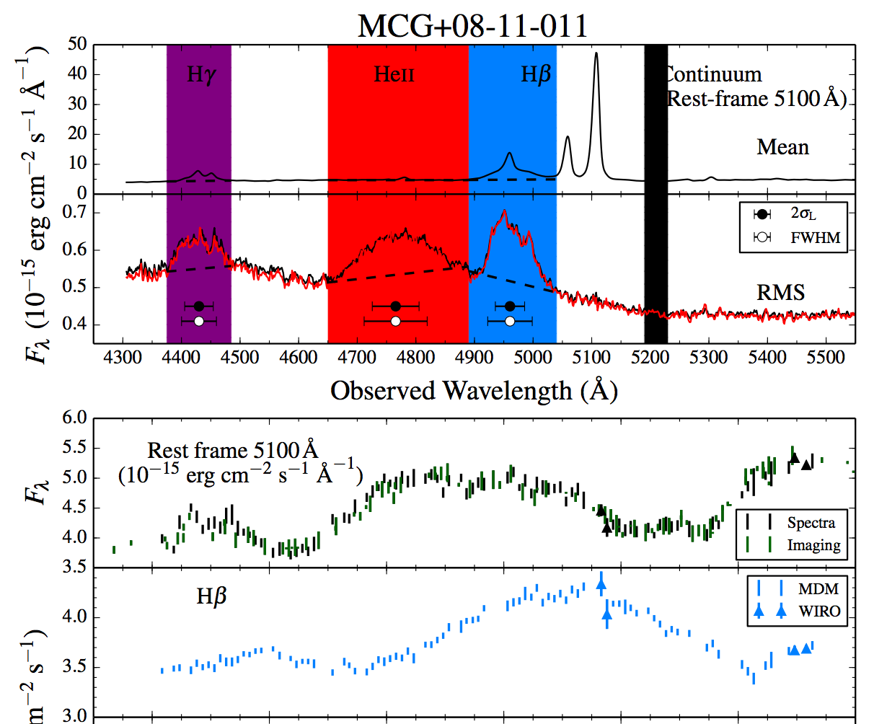
Reverberation Mapping (RM)
Fassnaugh et al. (2016)
Broad lines are photoionized by the central continuum, which varies. The line flux follows the continuum with a time lag t which is set by the size of the broad-line emitting region and the speed of light. Recombination timescales are very short, BLR stable, and continuum source small and central.

Slide 7
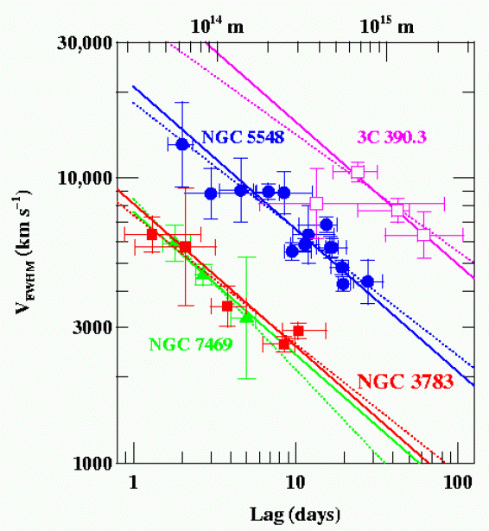
Does the BLR obey the Virial Theorem?
Four well studied AGNs, RM of multiple emission lines shows the expected relationship (slope = -2) between time lags and velocities (note each of the three will have different central black hole masses).
NGC7469: 8.4x10⁶ M☼
NGC3783: 8.7x10⁶ M☼
NGC5548: 5.9x10⁷ M☼
3C 390.3: 3.2x10⁸ M☼
Peterson (2011)

Slide 8
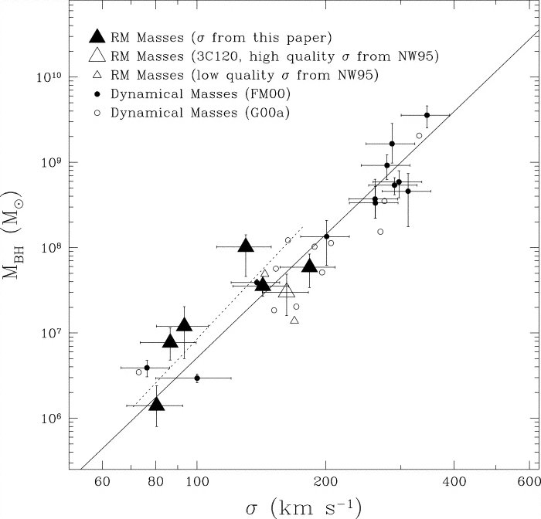
How to calibrate the (average) f factor?
RM-derived masses follow the same M-sigma relationship (fitting f) as seen for normal galaxies that have black hole masses measured from HST spatially resolved gas or stellar dynamics.
Good to 0.5 dex in plot, 0.3 dex in more recent work.
Ferrarese et al. (2001)

Slide 9
Expect that BLR Scales With Luminosity
Photoionization Models (Baldwin et al. 1996) suggest that strong selection effects make line emission come from gas with the same physical conditions (same U, n)
U = Q(H)/4πR²n_{H}c ~ L/n_{H}R²
  So, for same U, n_{H}, then expect that…
  R ~ L^{0.5}
If it works empirically, single epoch (SE) masses viable.

Slide 10
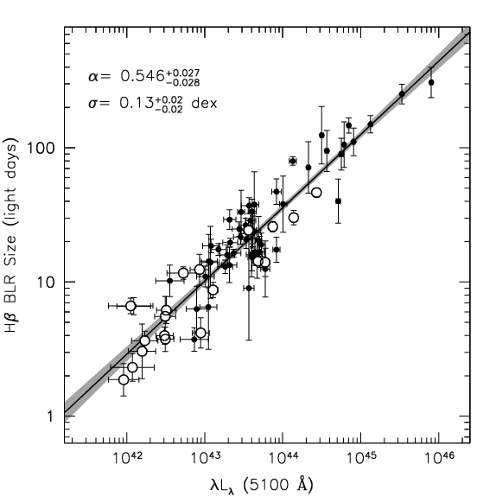
Empirically BLR Scales With Luminosity
Bentz et al. (2013): R ~ L^{0.5}

Slide 11
Black Hole Mass from Quasar Spectra
e.g., Vestergaard et al. (2006, 2009)
Hα
Hβ
log(F_{λ})
C IV
Mg II
Rest λ (Angstroms)
Notes:
Another important parameter in AGN is the black hole mass, which isn’t necessarily a typical SED project but I can really get at this with my quasi-simultaneous spectra.
How do you measure M in AGN?
Spectrum, CIV at high redshift and Hβ at low.
Ideally measurements using these lines in the same object would agree, but there’s scatter of a factor of a few between them.
I’m interested in understanding this scatter so that I can reduce it.

Slide 12
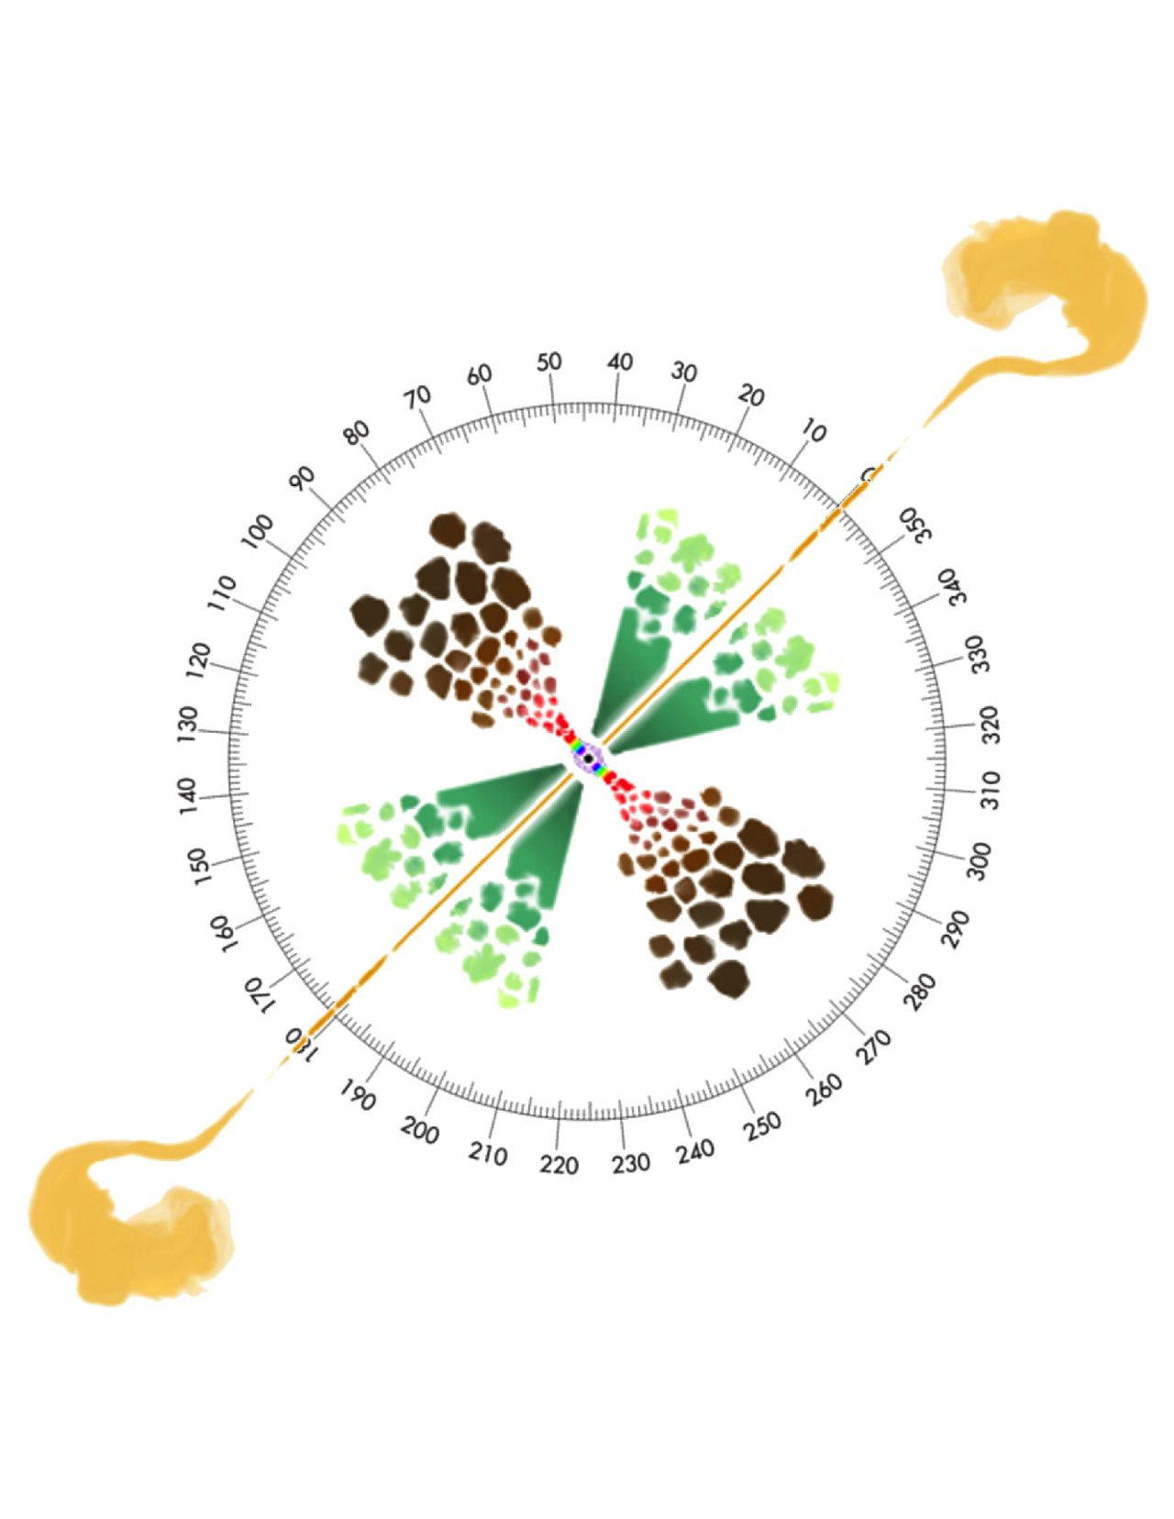
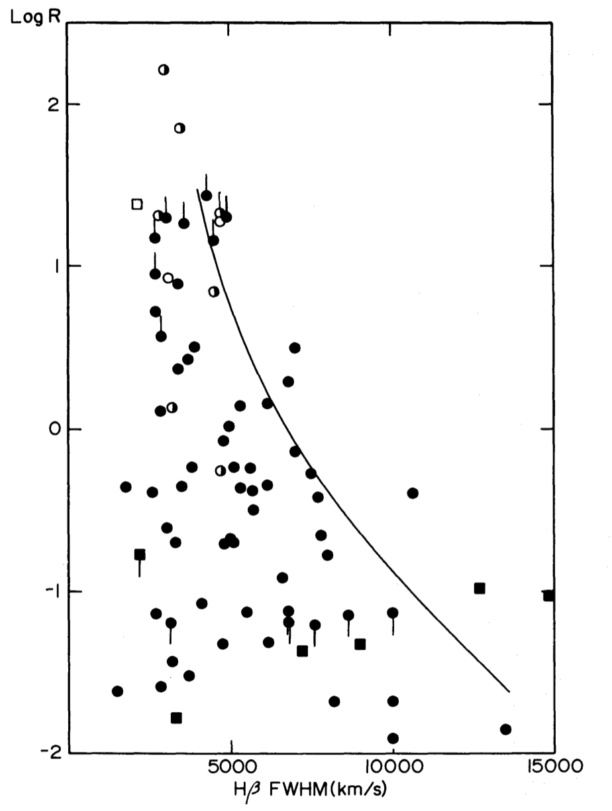
M_{BH} from Hβ: Orientation Issues
Face On
Edge On
Marin (2016)
Wills and Browne (1986)

Slide 13
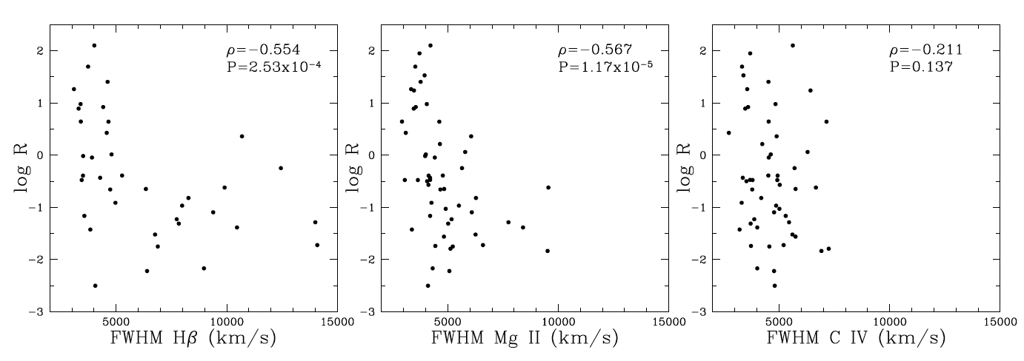
M_{BH} from Hβ: Orientation Issues
Runnoe et al. (2013a)
Face On
Face On
Edge On
Edge On

Slide 14
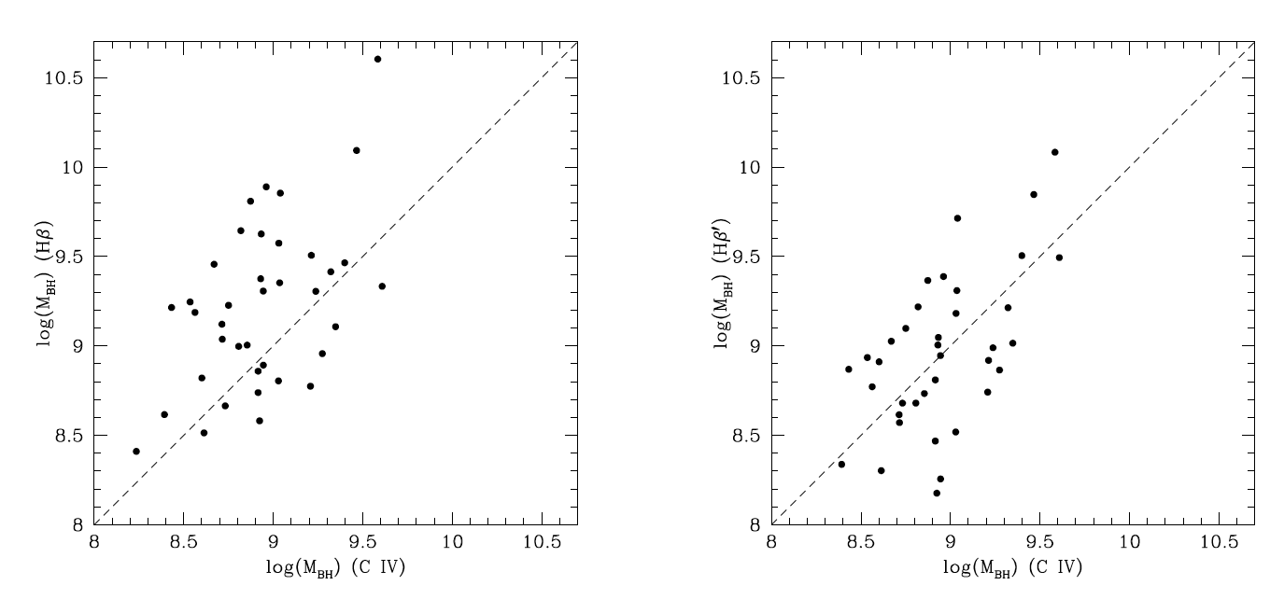
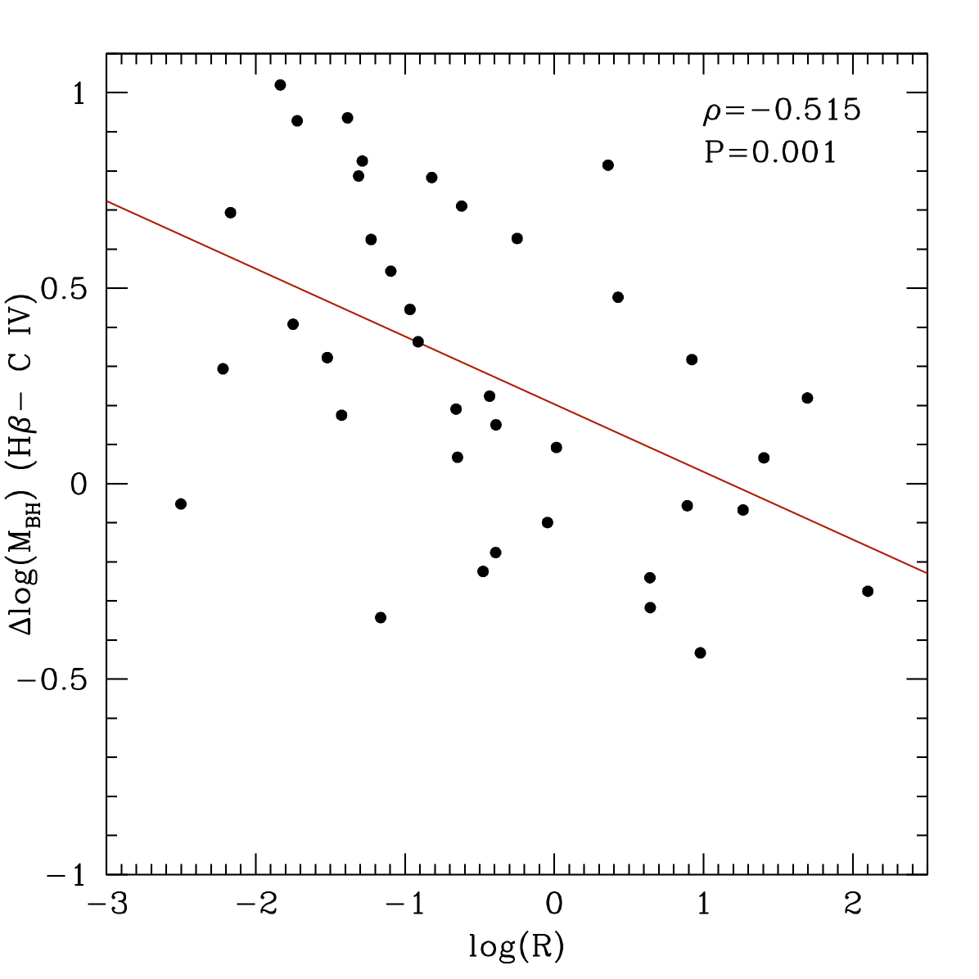
M_{BH} from Hβ: Orientation Issues
Runnoe et al. (2013a)
M_{BH} Residuals (Hβ-CIV)
Using Vestergaard et al. SE Scaling Relations
Edge On
Face On

Slide 15
M_{BH} from Hβ: Orientation Issues
Runnoe et al. (2013a)
M_{BH} Residuals (Hβ-CIV)
Using Runnoe et al. Hβ based masses corrected for log R.
Edge On
Face On

Slide 16
M_{BH} from Hβ: Orientation Issues
After Brotherton, Singh, & Runnoe (2015)
How to look for Hβ-based black hole mass orientation bias when C IV is not available?
Use stellar velocity dispersion, here estimated for about 150 radio-loud quasars with z < 0.75 from [O III] FWHM in SDSS spectra. Log R from FIRST (note issues, e.g., Jackson & Browne 2012, CSS sources). Need VLA.
Biased Hβ mass is normalized via the M-sigma relation (McConnell & Ma 2013) to create an orientation measure that correlates with log R (r = 0.53).
Face On
Edge On

Slide 17
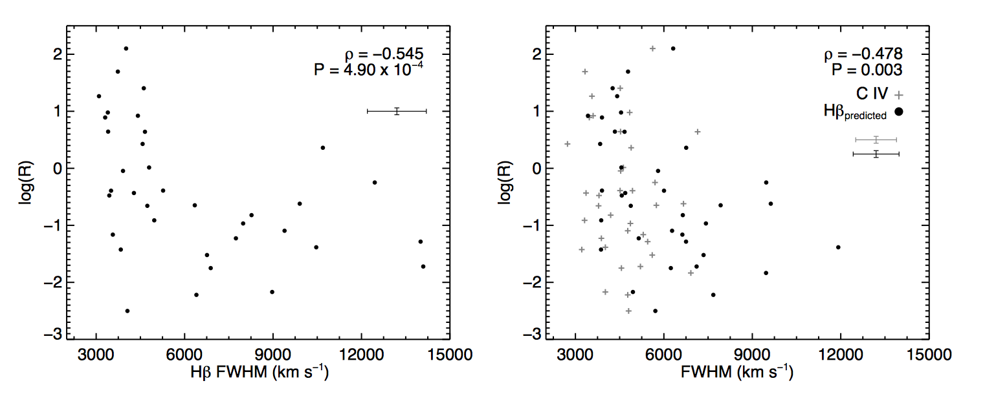
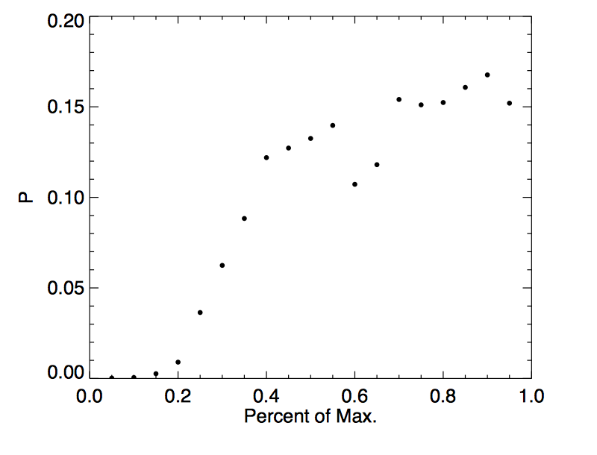
An aside: C IV Orientation Issues
Runnoe et al. (2014)
Probability of log R vs V correlation as a function of peak fraction. The broad wing component behaves like Hbeta.
For a new HST Radio-loud sample, original Wills-Browne plot on left, new version on right using a formula to predict Hbeta FWHM based on C IV FWHM and EV1 proxy peak 1400/C IV (to measure contamination).

Slide 18
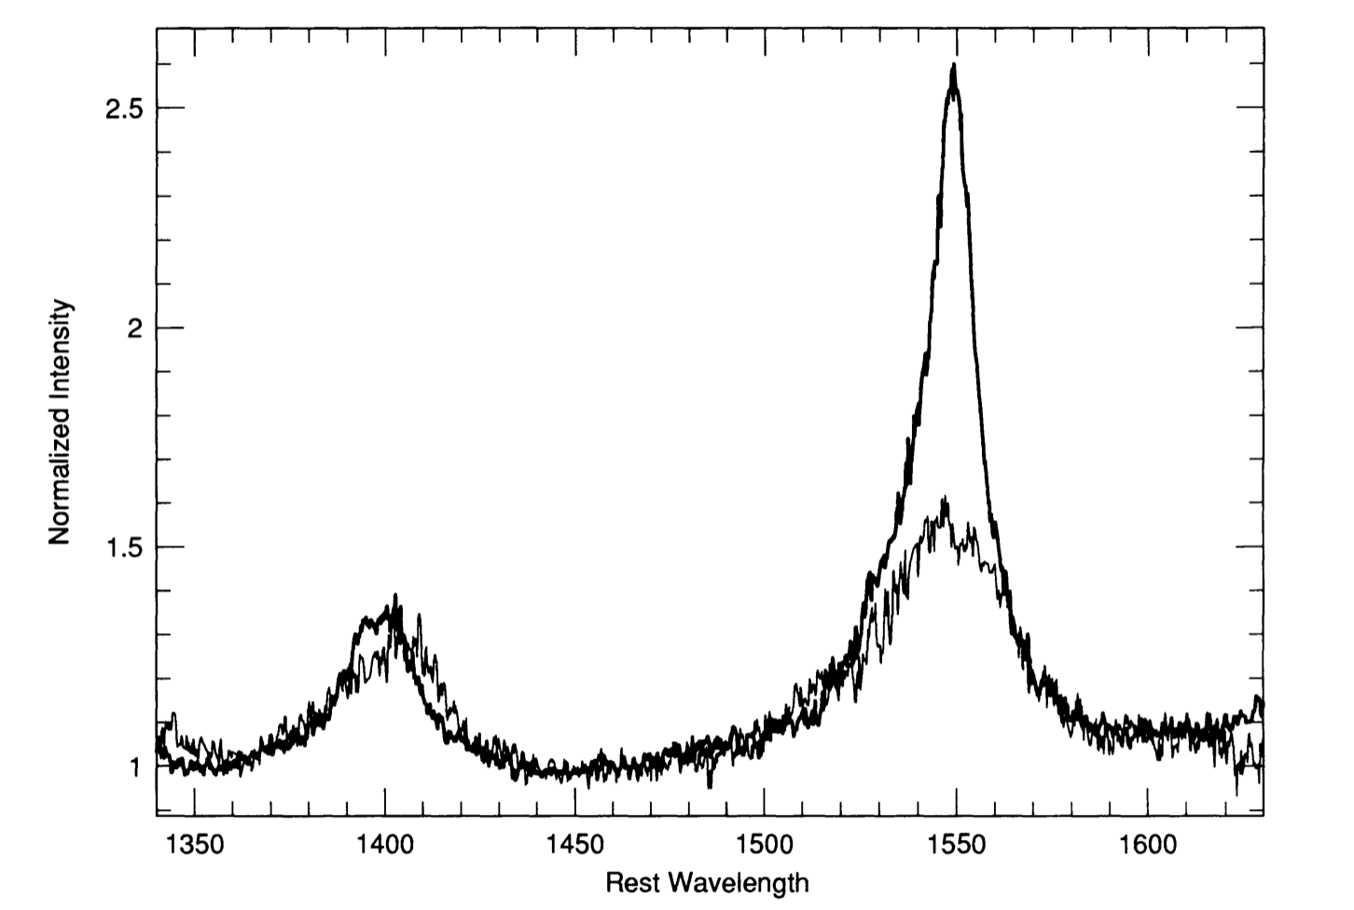
M_{BH} from C IV: Intermediate Line Region
Wills et al. (1993), Brotherton et al. (1994)
Continuum-normalized composite spectra with different average FWHM C IV. Difference is due to change in low-velocity emission (i.e. the “Intermediate Line Region” or ILR, part of EV1).

Slide 19
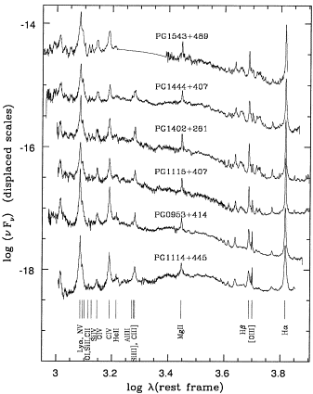
M_{BH} from C IV: Eddington Fraction Issues
Problems with Single-Epoch C IV Line
  Reverberation Mapping shows that C IV is broader than Hβ
  Often in single-epoch spectra, C IV is NARROWER than Hβ
  Part of “Eigenvector 1” relationships, correlates with optical narrow line region (NLR) emission, also with other parameters
  Low-velocity C IV gas does not reverberate (not virial) -> scatter in SE FWHM of C IV
Notes:
I’m developing a correction to the CIV mass
FWHM and Mbh before and after
FWHM: 10%
Mbh: 20%
Look for this on astro-ph in a month or so!

Slide 20
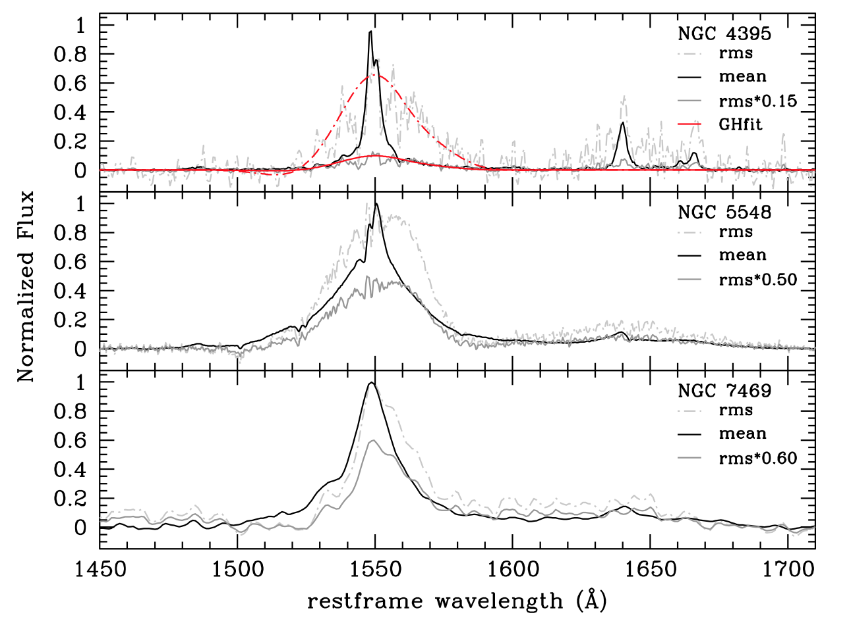
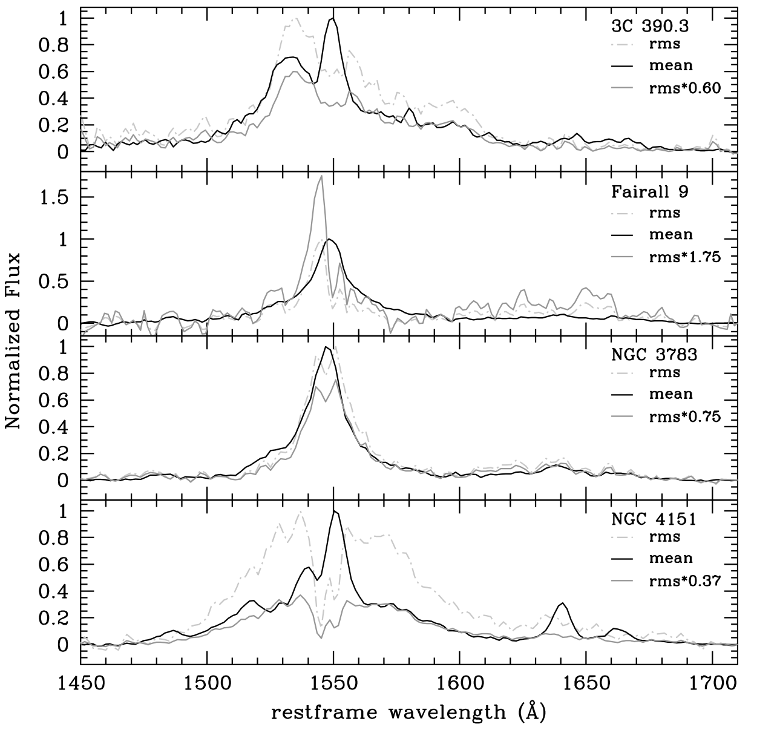
M_{BH} from C IV: non-Virial “ILR”
Denney (2012)
C IV rms profiles broader than mean profiles (Denney 2012).

Slide 21
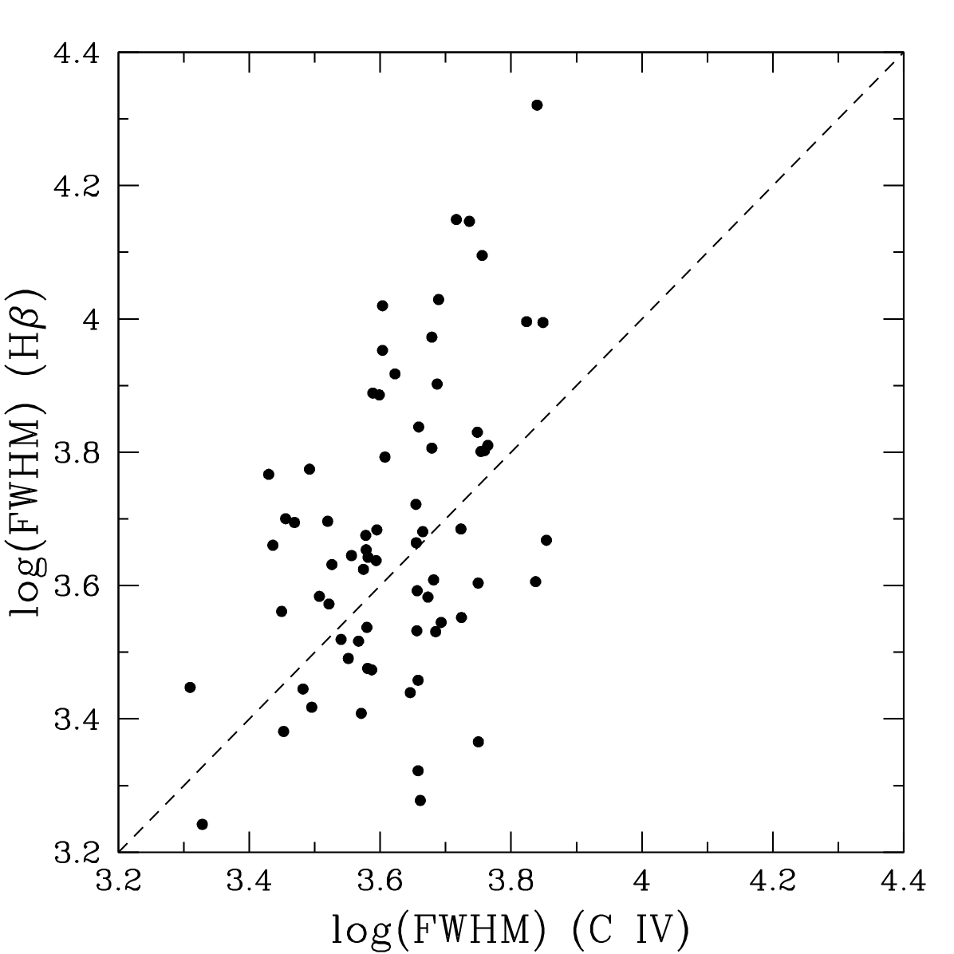
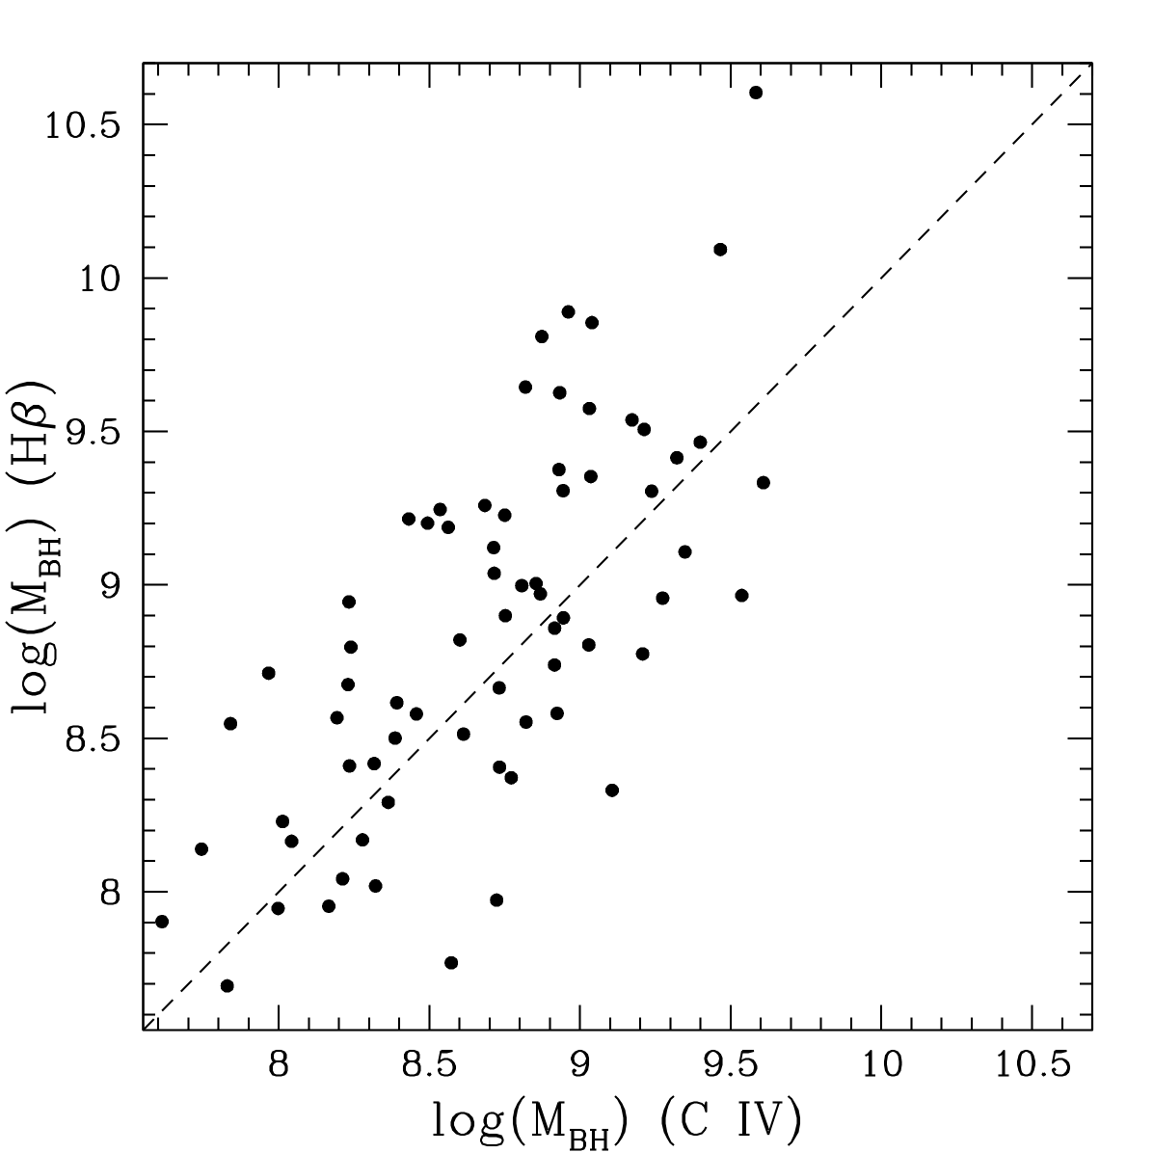
M_{BH} from C IV: ILR Correction
Runnoe et al. (2013b)
Line widths correlated, but not well. Difference correlates with Peak 1400/C IV.
Scatter: 0.40 dex

Slide 22
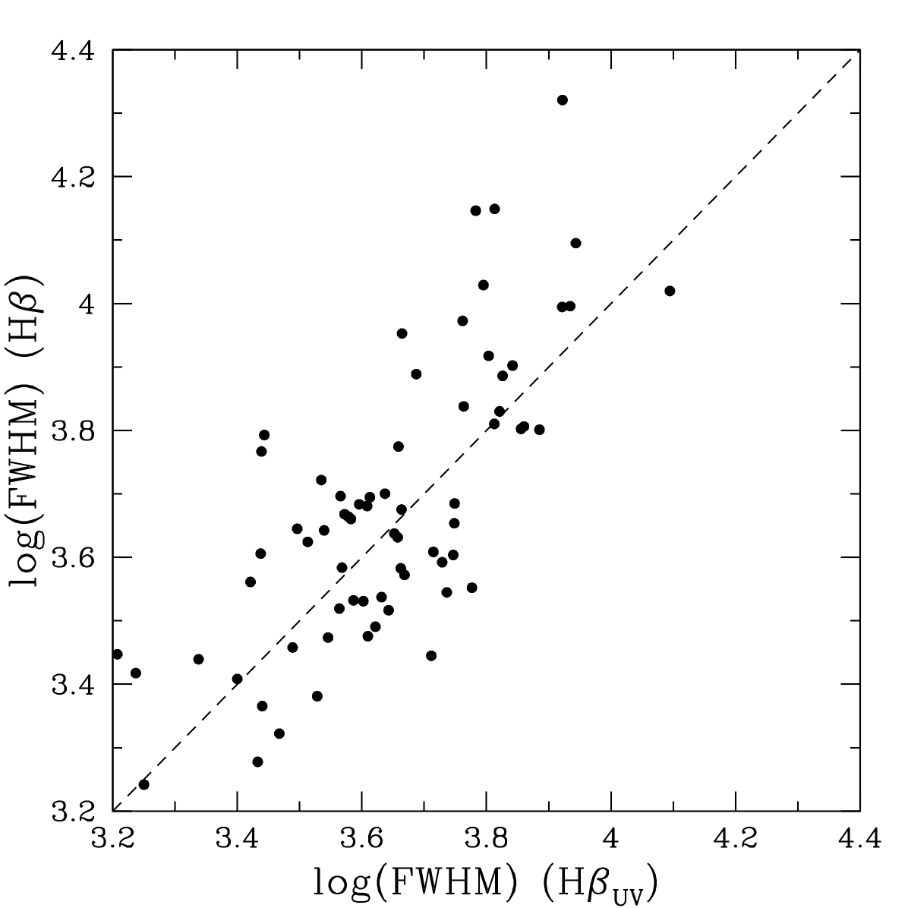
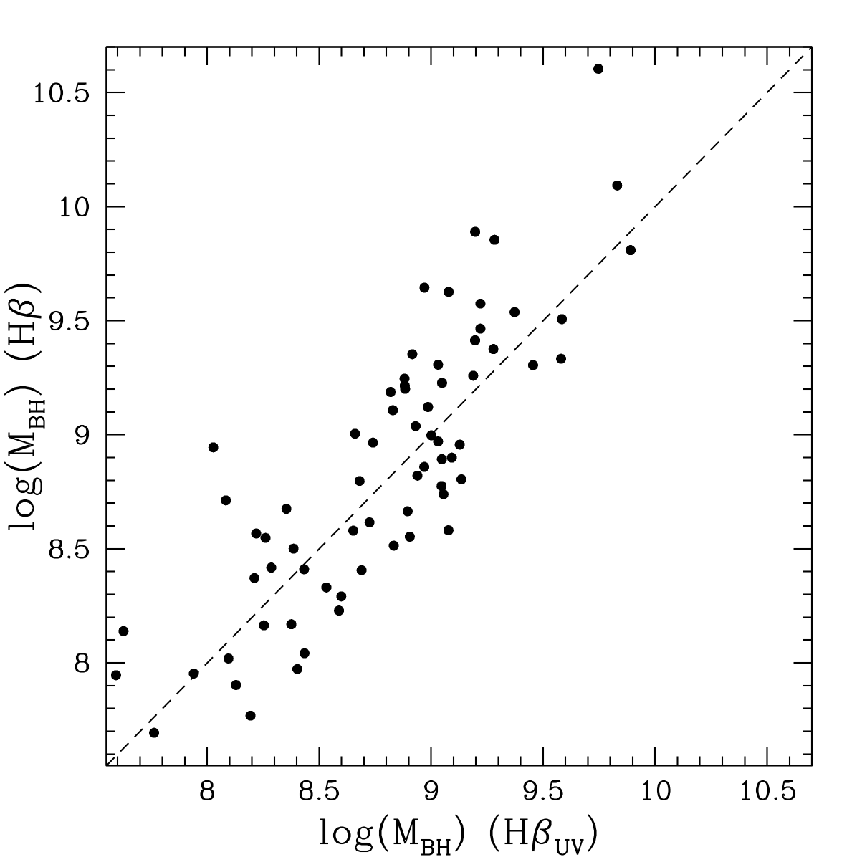
M_{BH} from C IV: ILR Correction
Runnoe et al. (2013b)
Using FWHM C IV and Peak 1400/C IV to predict FWHM Hβ works much better! Resulting mass estimate also better.
Scatter: 0.32 dex

Slide 23
More Practical:
Single-Epoch C IV Masses vs. Mg II
SE C IV masses too large compared to Mg II masses by almost a factor of two, due to EV1 mismatch between RM samples and luminous high-z SDSS quasars.

Slide 24
Single-Epoch C IV Masses vs. Mg II
The C IV FWHM and EW – which correlate with Eddington fraction, also strongly correlate with the mass differences.
The Mg II line profile properties do NOT correlate with the mass differences.
Weak Line Quasars (WLQs) do not fit the trends.
Radio properties matter a bit.

Slide 25
SE C IV Mass Corrections (vs. Mg II)
SE C IV masses too large (~0.3 dex) compared to Mg II masses by almost a factor of two, due to EV1 mismatch between RM samples and luminous high-z SDSS quasars.

Slide 26
SE C IV Mass Corrections (vs. Mg II)
Can correct for EV1 effects using C IV profile measurements alone. RL and RQ need slightly different corrections (likely blazar continuum). Does not work for WLQs. Brotherton et al. (2016).

Slide 27
M_{BH} in Quasars: Summary
Orientation effects exist, likely a sin i factor due to the inner BLR being a flattened disk of some sort. This affects Hβ strongly, but only the broad, virial part of C IV (Runnoe et al. 2014). This can be corrected for in radio-loud quasars, and perhaps also radio-quiet quasars in the future.
Eigenvector 1 (i.e., the amount of contamination of a non-virial ILR component in C IV, correlated with the Eddington fraction) creates scatter and biases in black hole mass estimates. Can be corrected for by using EV1 indicators in optical and/or UV.
Can we get SE masses within a factor of 2?

Slide 28


Slide 29
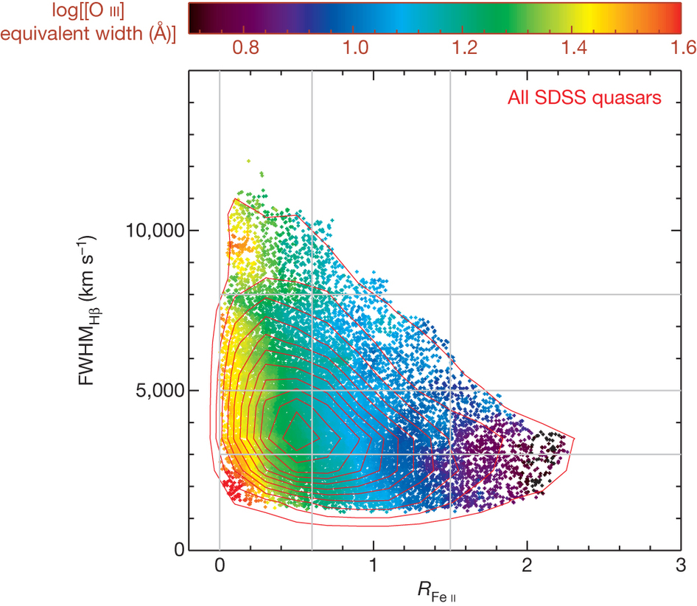
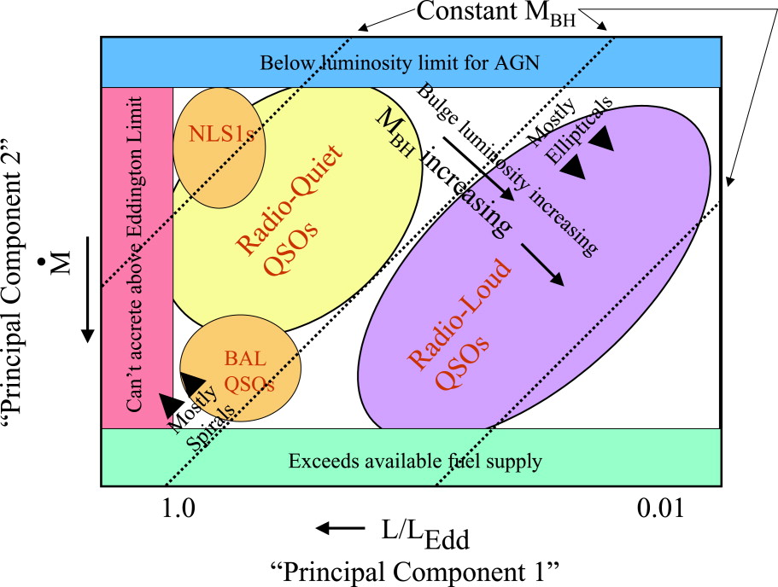
Eddington Fraction Relationships
Shen & Ho (2014)
Boroson (2002)

Slide 30
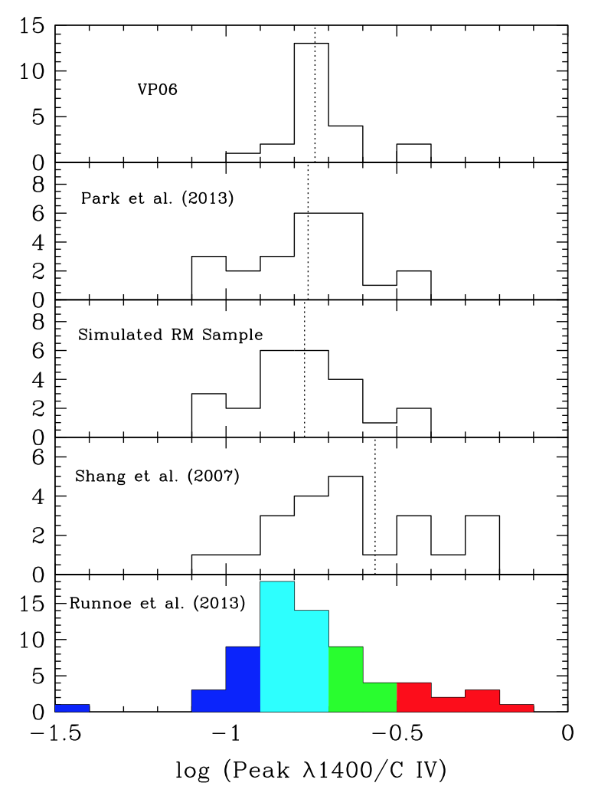
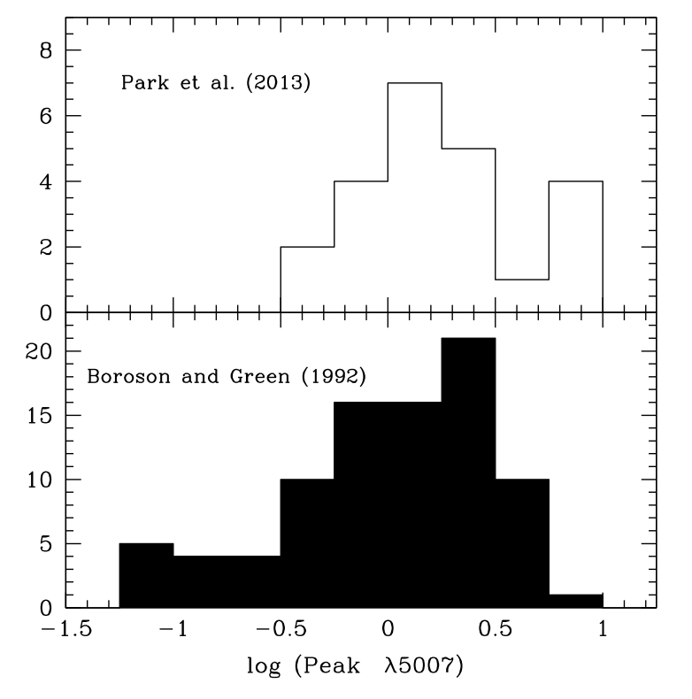
M_{BH} from C IV: Eigenvector 1 in RM Samples
Brotherton et al. (2015)
RM samples for C IV based black hole mass estimation are biased toward large [O III]/Fe II values.
RM samples for C IV based black hole mass estimation are biased toward small 1400/C IV values.

Slide 31
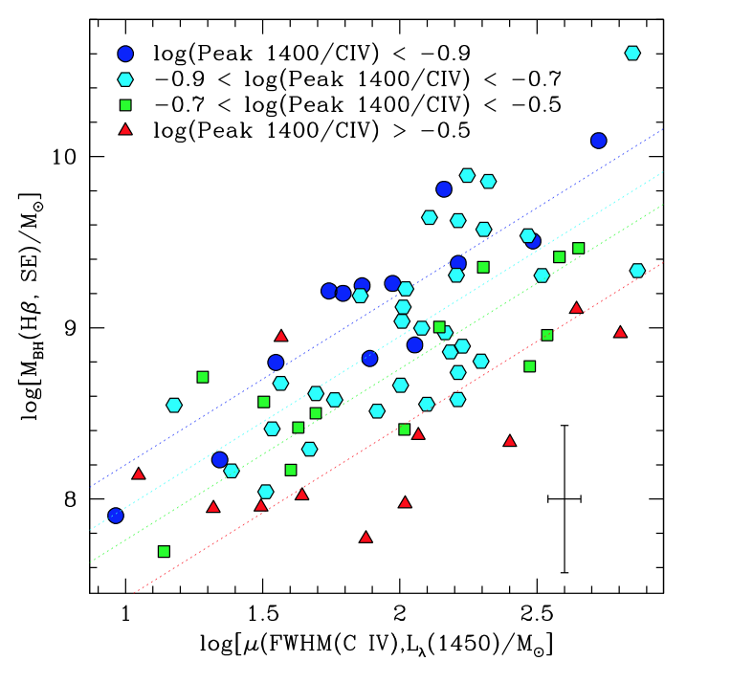
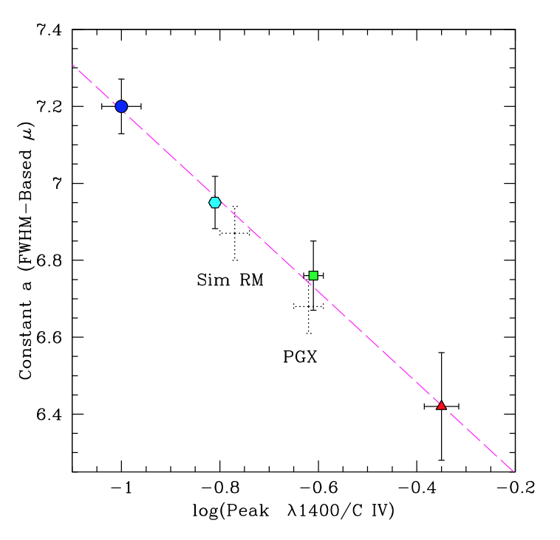
M_{BH} from C IV: Eigenvector 1 in RM samples
Brotherton et al. (2015)
A sample bias in EV1 creates a corresponding shift in black hole masses. For Vestergaard & Peterson (2006) and Park et al. (2013) the C IV scaling relations predict masses about 0.2 dex or 50% too high.

