Slide 1
Supermassive Black Holes
Michael Brotherton

Slide 2
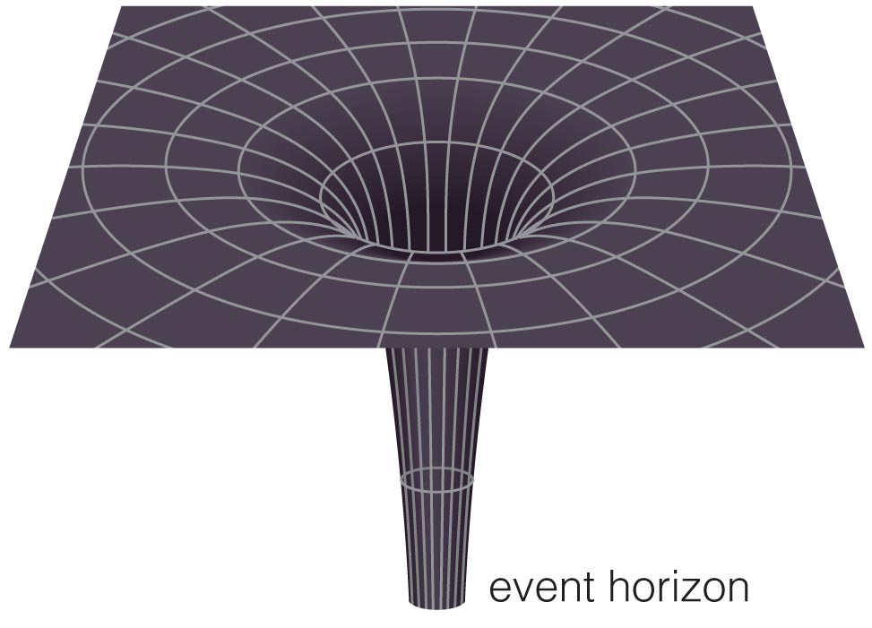
What is a Black Hole?

Slide 3
What is a Black Hole?
A black hole is an object whose gravity is so powerful that not even light can escape it.

Slide 4
Escape Velocity
A black hole is an object whose gravity is so powerful that not even light can escape it.

Slide 5
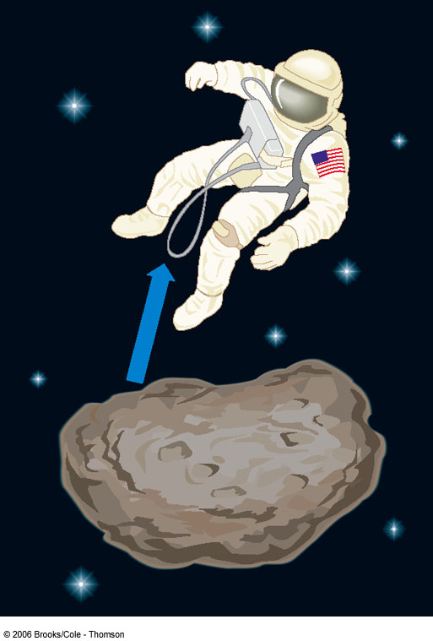
Escape Velocity
Velocity needed to escape Earth’s gravity from the surface: v_{esc} ≈ 11.6 km/s.
v_{esc}
Now, gravitational force decreases with distance (~ 1/d²) => Starting out high above the surface => lower escape velocity.
v_{esc}
If you could compress Earth to a smaller radius => higher escape velocity from the surface.
v_{esc}

Slide 6
The Schwarzschild Radius
=> There is a limiting radius where the escape velocity reaches the speed of light, c:
2GM
V_{esc} = c
R_{s} =
____
c²
G = gravitational constant
M = mass
R_{s} is called the Schwarzschild radius.

Slide 7
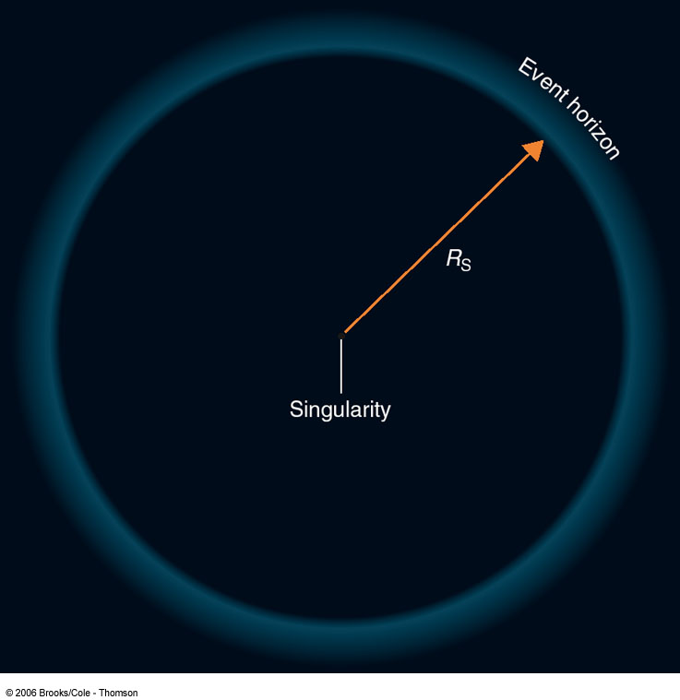
Schwarzschild Radius and Event Horizon
No object can travel faster than the speed of light
So nothing (not even light) can escape from inside the Schwarzschild radius
“Event horizon”
Cool effects near event horizon like time dilation, gravitational redshift, etc., but we will focus on mass.

Slide 8
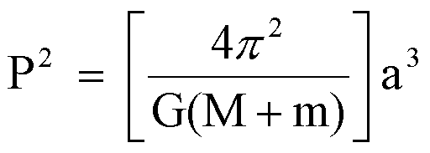
How Can We Measure Mass in space? Kepler’s 3rd Law:
So, if you can measure an orbital size and period (or equivalently a velocity), you can derive a mass M.

Slide 9
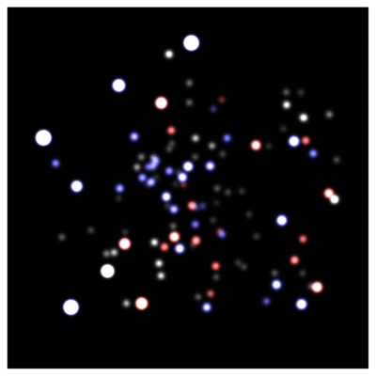
From our sun to the galactic core
Groups at Max Planck and UCLA have been observing the center of the Milky Way for over two decades, tracing the orbits of stars using the Keck and VLT telescopes. The mass of the central dark object lurking there is about 4 million solar masses. That’s SUPERMASSIVE! And also worth the Nobel Prize in Physics in 2020.

Slide 10
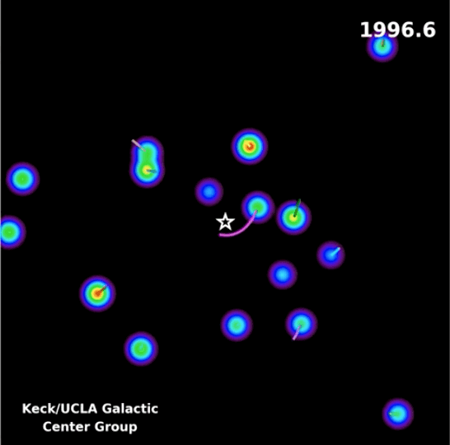
From our sun to the galactic core
Groups at Max Planck and UCLA have been observing the center of the Milky Way for over two decades, tracing the orbits of stars using the Keck and VLT telescopes. The mass of the central dark object lurking there is about 4 million solar masses. That’s SUPERMASSIVE! And also worth the Nobel Prize in Physics in 2020.

Slide 11
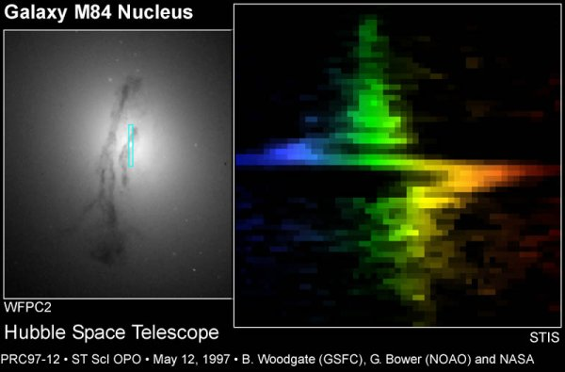
Hubble Doing its Job for Other Galaxies
About 300 million solar masses. That’s even more SUPERMASSIVE!

Slide 12
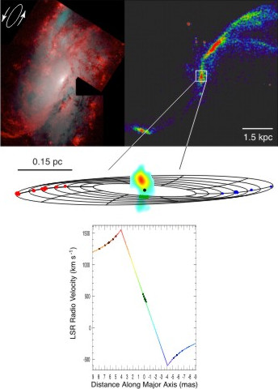
The Water Maser Disk in NGC 4258
NRAO/Greenhill. About 36 million solar masses. Still SUPERMASSIVE!

Slide 13
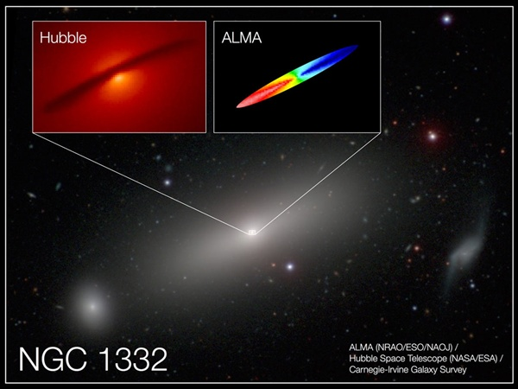
AlMA Resolves Molecular Gas (CO) in NGC 1332
Barth et al (2016). About 660 million solar masses. SUPERMASSIVE!

Slide 14
The Key to Measuring Black Hole Masses In the Milky Way and Other Galaxies?
Spatial Resolution!
The Hubble Space Telescope,
Keck and VLT (using Adaptive Optics)
Very Long Baseline Interferometry in Radio,
ALMA (Interferometry at millimeter wavelengths)
More Challenging in Distant Active Galaxies, the Quasars….They’re generally too far away to resolve their solar-system-sized structures.

Slide 15
“Pictures” of Active Galactic Nuclei or Quasars
100 Million Solar Masses

Slide 16
“Pictures” of Active Galactic Nuclei or Quasars

Slide 17
“Gargantua” from interstellar
100 Million Solar Masses

Slide 18
More Scientifically Accurate “Gargantua” from interstellar (James et al. 2015)
100 Million Solar Masses

Slide 19
The real thing: m87 with the Event Horizon Telescope
~6 Billion Solar Masses, about 40 micro-arseconds across

Slide 20
Science & Science Fiction
M87: Event Horizon Telescope (2019)
Double Negative artists/DNGR/TM &
© Warner Bros. Entertainment (2014)

Slide 21
Black Hole Masses in Quasars from their Spectral Broad Emission Lines
e.g., Vestergaard et al. (2006, 2009)
Hα
Hβ
log(F_{λ})
C IV
Mg II
Rest λ (Angstroms)
Notes:
Another important parameter in AGN is the black hole mass, which isn’t necessarily a typical SED project but I can really get at this with my quasi-simultaneous spectra.
How do you measure M in AGN?
Spectrum, CIV at high redshift and Hβ at low.
Ideally measurements using these lines in the same object would agree, but there’s scatter of a factor of a few between them.
I’m interested in understanding this scatter so that I can reduce it.

Slide 22
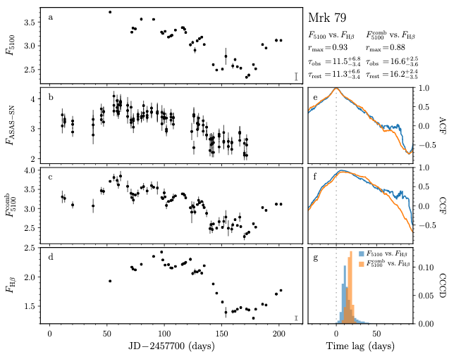
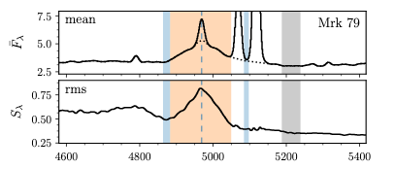
My own Reverberation Mapping (RM)
Brotherton et al. (2020)
Broad lines are photoionized by the central continuum, which varies. The line flux follows the continuum with a time lag t which is set by the size of the broad-line emitting region and the speed of light. Recombination timescales are very short, BLR stable, and continuum source small and central. Mrk 79 ~ 80 million solar masses!

Slide 23
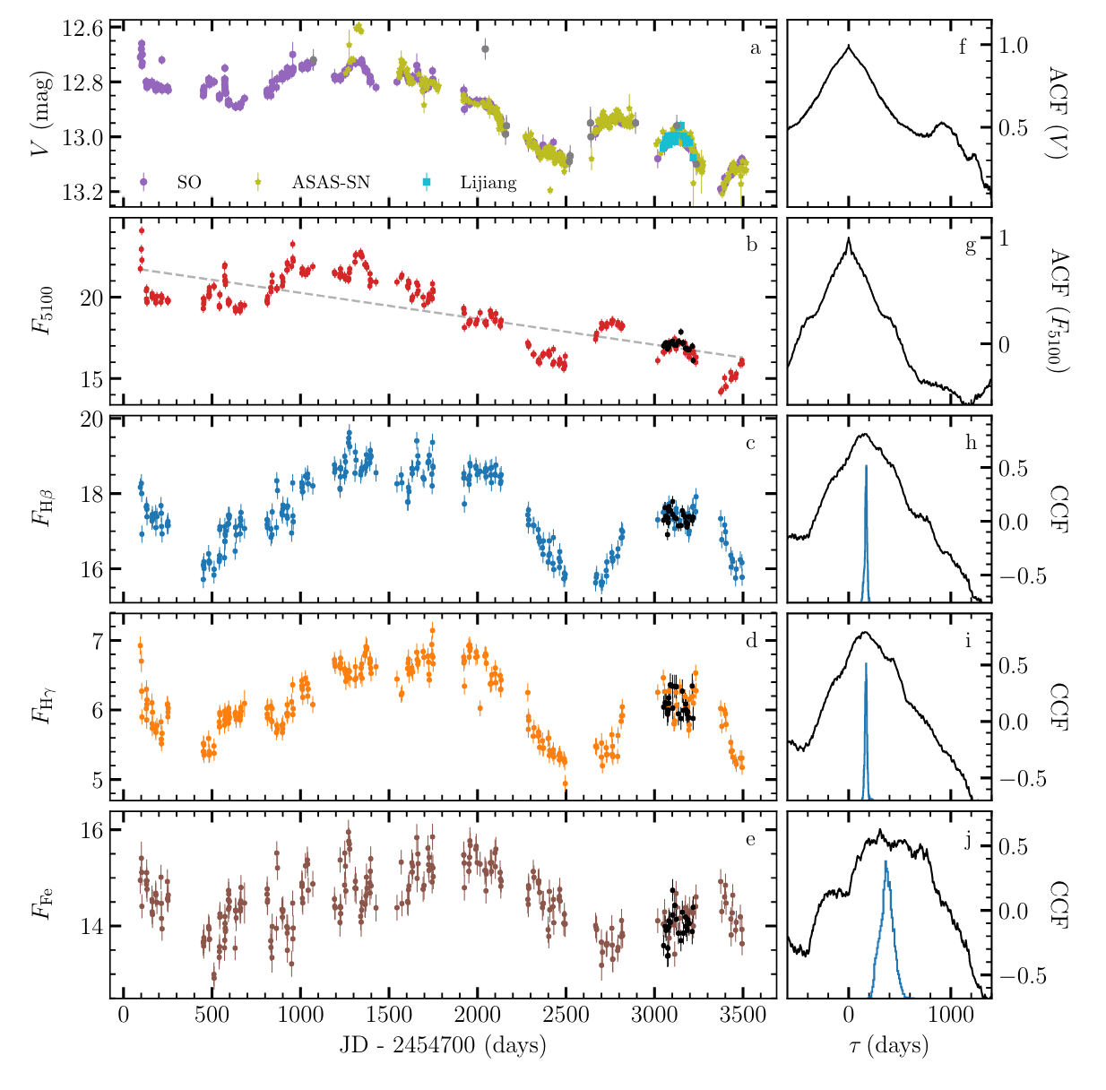
A Decade of Reverberation Mapping of 3c 273
Zhang et al. (2018)
Hydrogen broad line region size about 147 light-days, plus or minus 10%

Slide 24
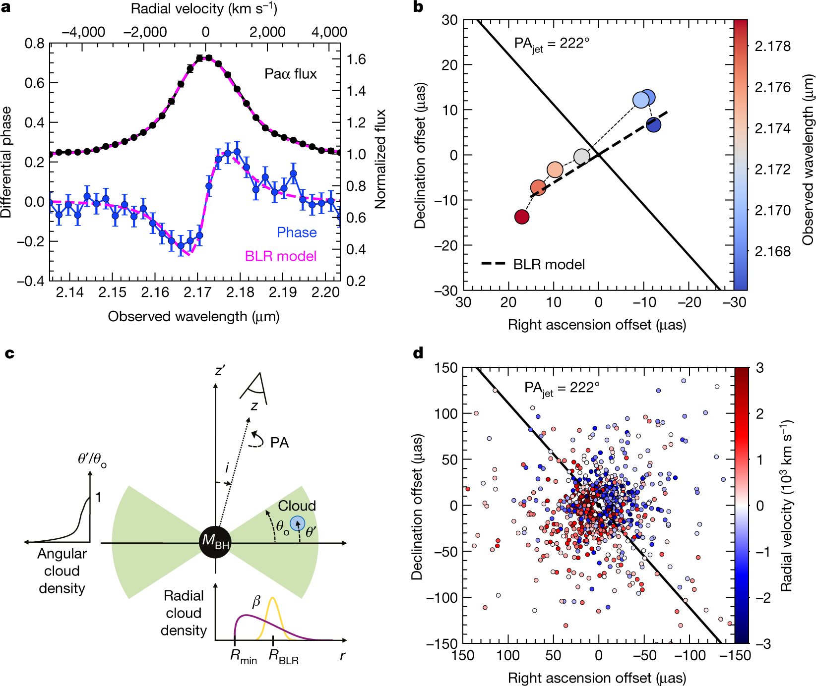
VLT Interferometry of Hydrogen in 3c 273
The GRAVITY Collaboration. (2018)
Hydrogen broad line region size about 150 light-days, the same! At its distance requires 10 micro arcsecond spatial resolution!!! 300 million solar mass black hole.

Slide 25
AWESOME TECHNOLOGICAL PROGRESS BUT Big Questions remain
Supermassive black holes in the form of quasars seen in the very early universe (< 1 billion years old).
How did such black holes form so fast?
Did they precede galaxy formation, or form within young galaxies?
No, they won’t suck in their host galaxies!!!
But maybe Matthew McConaughey…THANK YOU!

Slide 26
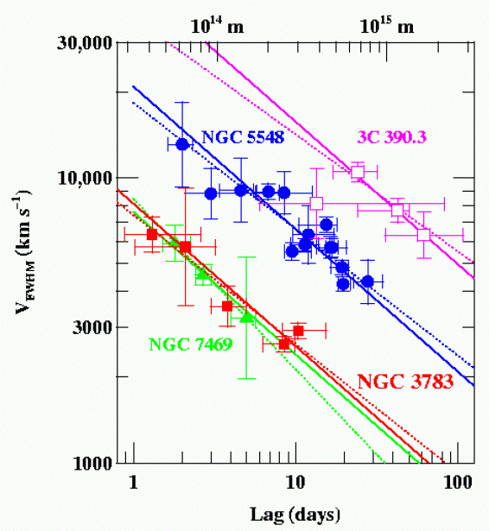
Are Different Lines Consistent?
Four well studied AGNs, RM of multiple emission lines shows the expected relationship (slope = -2) between time lags and velocities (note each of the three will have different central black hole masses).
NGC7469: 8.4x10⁶ M☼
NGC3783: 8.7x10⁶ M☼
NGC5548: 5.9x10⁷ M☼
3C 390.3: 3.2x10⁸ M☼
Peterson (2011)

Slide 27
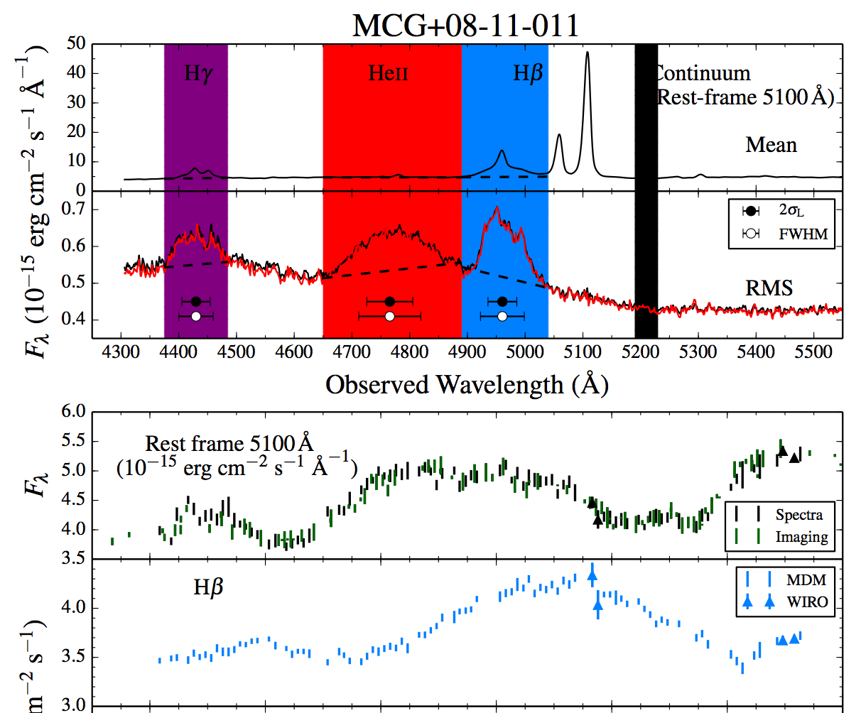
Reverberation Mapping (RM)
Fassnaugh et al. (2016)
Broad lines are photoionized by the central continuum, which varies. The line flux follows the continuum with a time lag t which is set by the size of the broad-line emitting region and the speed of light. Recombination timescales are very short, BLR stable, and continuum source small and central.

Slide 28
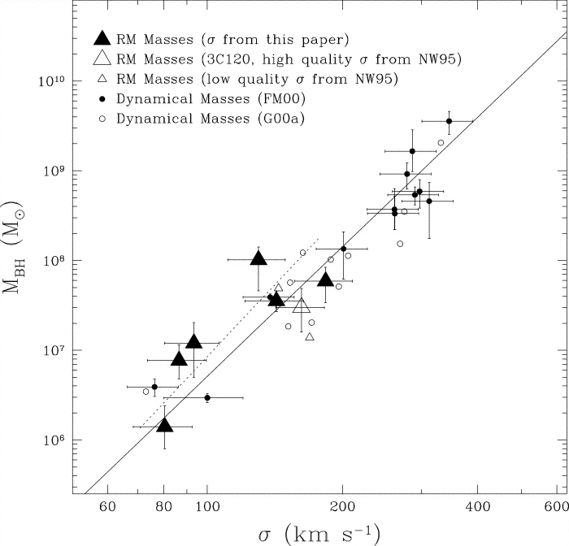
How to calibrate the (average) f factor?
RM-derived masses follow the same M-sigma relationship (fitting f) as seen for normal galaxies that have black hole masses measured from HST spatially resolved gas or stellar dynamics.
Good to 0.5 dex in plot, 0.3 dex in more recent work.
Ferrarese et al. (2001)

