Slide 1

How I spent my Sabbatical in Fall 2024
Mike Brotherton
University of Wyoming
October 31, 2025

Slide 2
Sabbaticals…the Pros and Cons
Eligible to apply after every six years of service
One semester off teaching with full pay or two semesters at 60%
Many purposes to sabbaticals, ideally enabling activities difficult to accomplish with regular duties (e.g., travel, develop new research directions, etc.)
But you have to write a report and give a seminar to your department about your activities…!

Slide 3
Key activities:
Visited collaborator Jaya Maithil at the Harvard-Smithsonian Center for Astrophysics in Cambridge, MA to work on a funded Hubble Space Telescope Project to develop improved black hole mass prescriptions using UV spectroscopy.
Visited collaborator Ohad Shemmer at the University of North Texas to work on a near-infrared spectroscopic survey of moderate redshift quasars using the Gemini-North telescope and to work on an NSF proposal to support the project. Top ranked but declined.
Submission of a $389,000 NSF proposal to support continuing Wyoming AGN Reverberation Mapping (WARM), which was funded.

Slide 4
Virial Black Hole Masses (AGN/Quasars)
V obtained from width of Doppler-broadened broad line like Hbeta.
The factor f is a geometric parameter dependent on orientation
R is the emissivity-weighted radius of the line-emitting region, which is too small to resolve typically, need time-resolution to measure

Slide 5
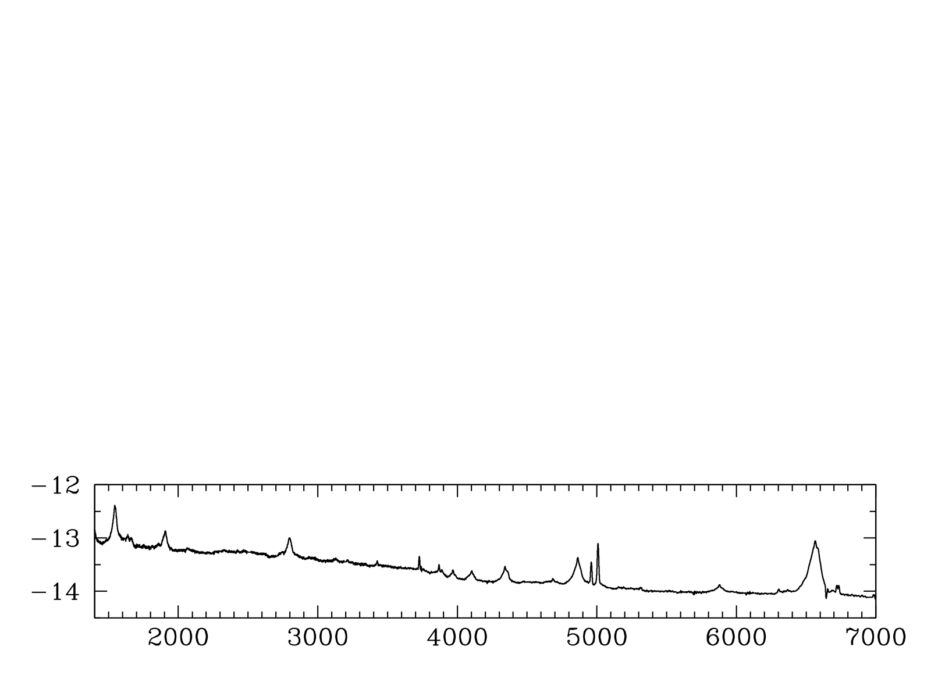
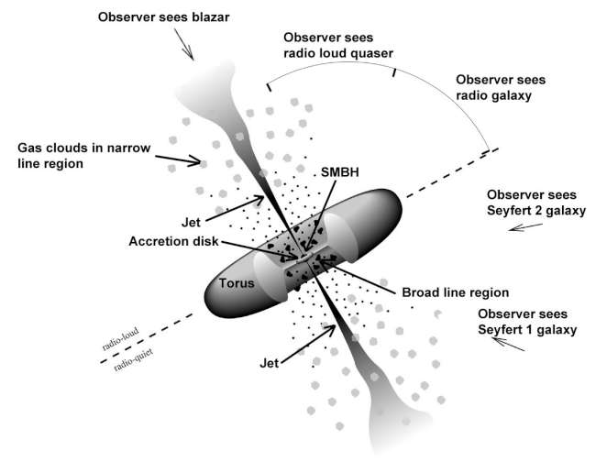
UV-Optical Quasar Spectrum+Structure
log(F_{λ})
Rest λ (Angstroms)
Dance your PhD
Since 2008

Slide 6
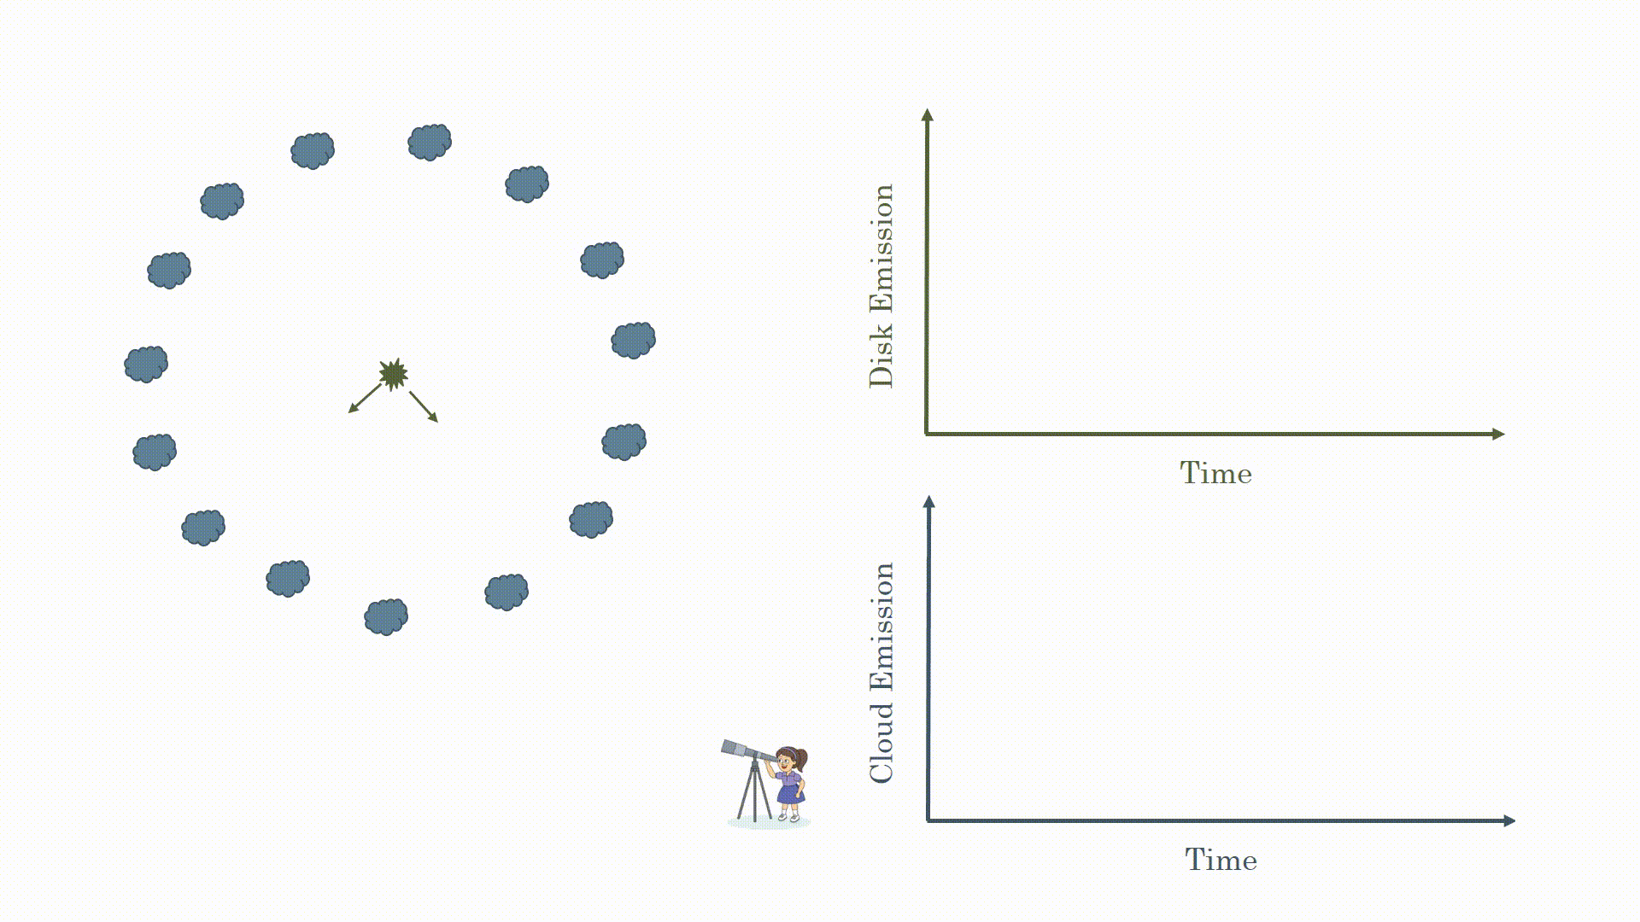
Reverberation Mapping to get R (c𝛕)
Hoorman animations

Slide 7
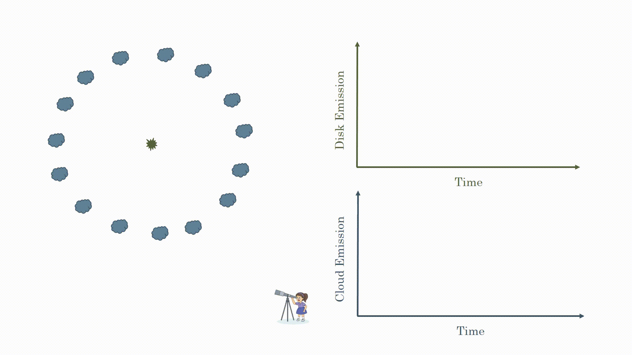
Reverberation Mapping to get R (c𝛕)
Hoorman animations

Slide 8
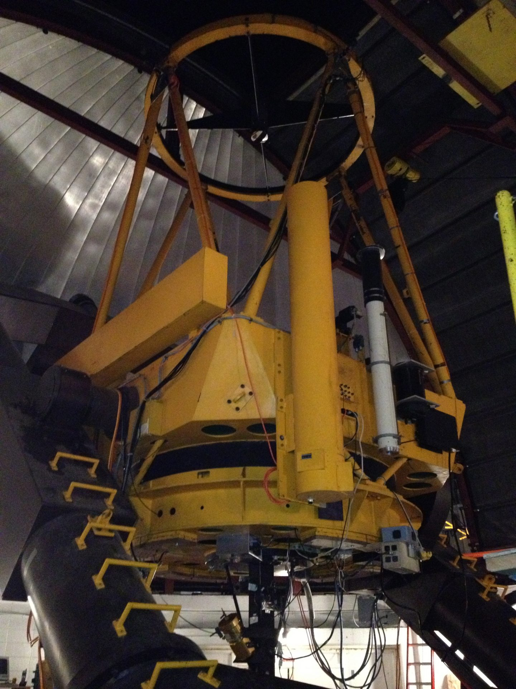
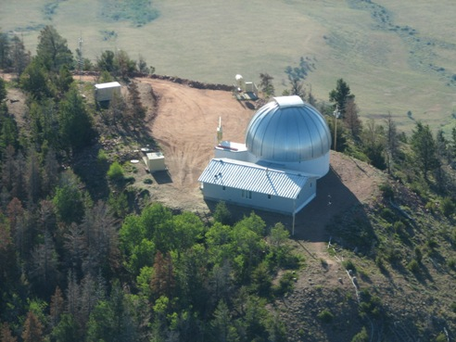
Wyoming AGN Reverberation Mapping
Let’s keep WARM!
Wyoming Infrared* Observatory (WIRO)
2.3 meter telescope
Wide slit, longslit spectroscopy
1.5 Angstrom/pix, 4000-7000A
Dec 2016-May 2023 so far.
Combine with ASAS-SN or ZTF photometry
High-Fidelity reverberation mapping
(High Cadence, Long Duration)
Nearly 100 Targets
Velocity-Resolved Time Lags,
2D Velocity Delay Maps, & Dynamical Models
BLR geometry, kinematics, evolution
Sub-Parsec Binary Black Holes?

Slide 9
Wyoming AGN Reverberation Mapping
Let’s keep WARM!
IHEP: Jian-Min Wang, Pu Du, Yan-Ron Li, Ming Xiao, Dongwei Bao, Chen Hu, Fenga Fang
WY: Jacob McLane, Theodora Zastrocky, Kianna Olson, Liam Royale-Grimes, Kaiwen Zhang, Mila Myers, Sadie Hiner
Other student observers in Beijing and Wyoming

Slide 10
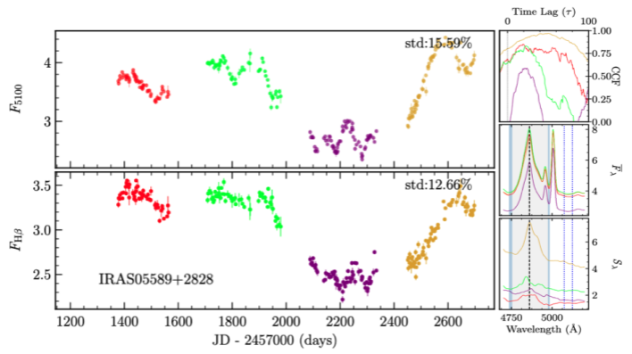
Reverberation Mapping: WIRO Example
Published in Zastrocky et al. (2024)

Slide 11
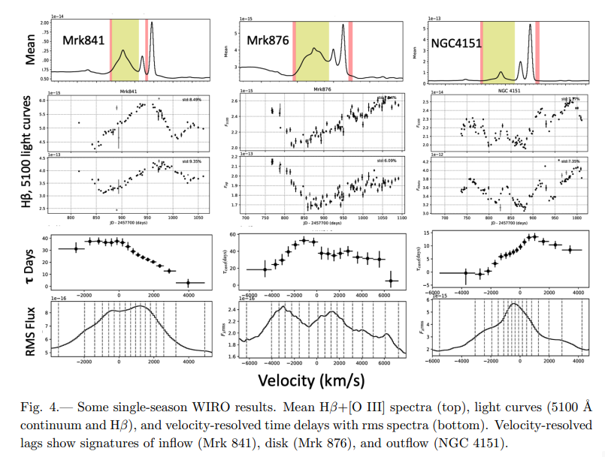
Velocity-Resolved Reverberation Mapping

Slide 12
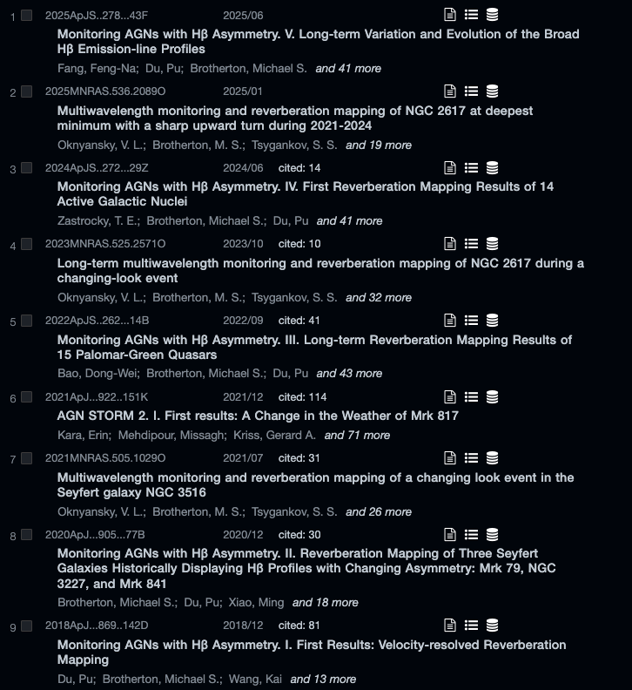
Key WARM papers with WIRO data
Over ten papers published so far, with many more to come.
Over 300 citations to date
Over 30 AGN reverberation mapping results published
Several PhD theses
Dozens of students, both graduate and undergraduate students, are authors on these papers

Slide 13
Some current work with archival WARM data
Changing Look AGN/Quasars
  Previously NGC 2617, NGC 3516 (Oknyansky et al.)
  PG 1149-110
  NGC 3227 (Kaiwen Zhang)
Binary Candidate PG 1302-102 (Liam Royale-Grimes)
  Testing the Doppler-Boosting Hypothesis

Slide 14
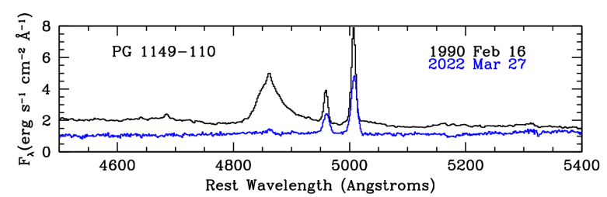
Changing Look Quasar: PG 1149-110

Slide 15
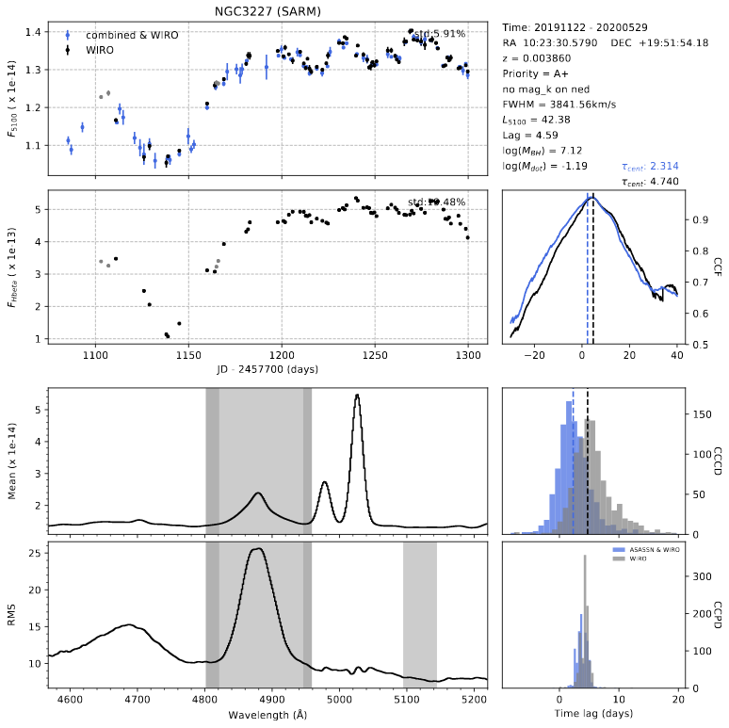
WIRO Campaign Dec. 2019-May 2019
Changing Look Quasar: NGC 3227
For reference on these plots 1100 = JD – 2457700 is November 12, 2019
Blue cont. points from ASAS-SN Sky Patrol
Overall result is a time lag of about 3-5 days for Hbeta after the 5100 Angstrom cont. including ASAS-SN
Data shown here includes a contribution of host galaxy

Slide 16
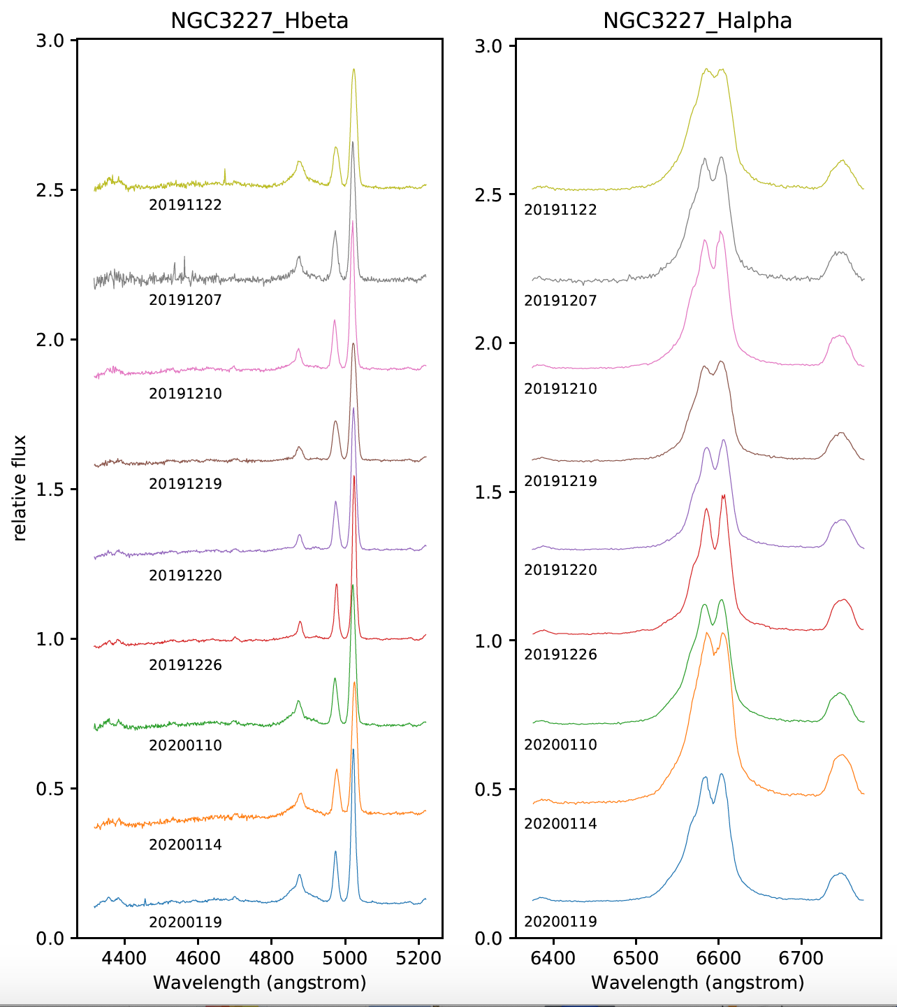
Zoom in for Hbeta and Halpha
Changing Look Quasar: NGC 3227
Broad lines apparent in early December, early January
Essentially gone Dec. 19-20, 2019
Seyfert 1.5 changes class within a few weeks, recovers in a few weeks

Slide 17
WIRO Campaign Dec. 2019-May 2019
Changing Look Quasar: NGC 3227
For reference on these plots 1100 = JD – 2457700 is November 12, 2019
Blue cont. points from ASAS-SN Sky Patrol
Overall result is a time lag of about 3-5 days for Hbeta after the 5100 Angstrom cont. including ASAS-SN
Data shown here includes a contribution of host galaxy

Slide 18
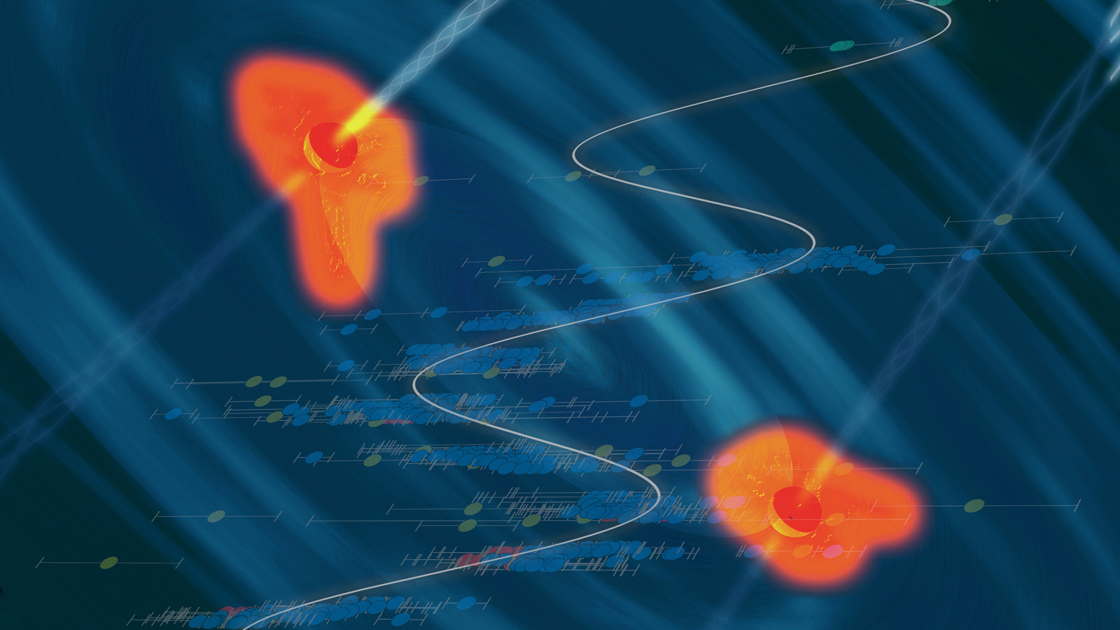
Binary Candidate PG 1302-102
Light curve of PG 1302-102 from Graham et al. (2015).
An artist's conception of a black hole binary in a heart of a quasar, with the data showing the periodic variability superposed. Credit: Santiago Lombeyda/Caltech Center for Data-Driven Discovery.

Slide 19
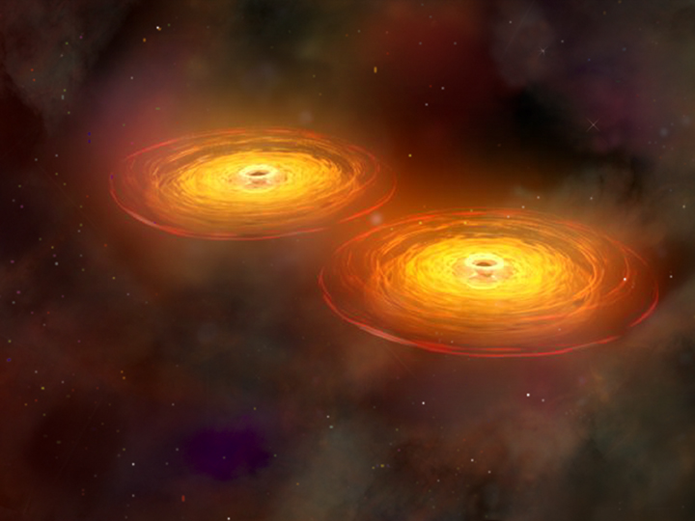
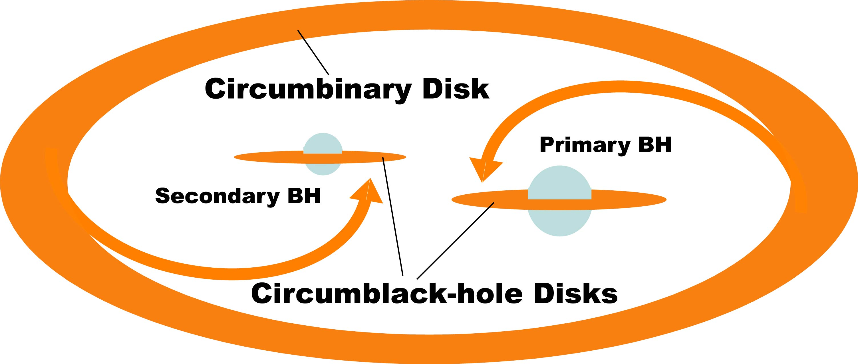
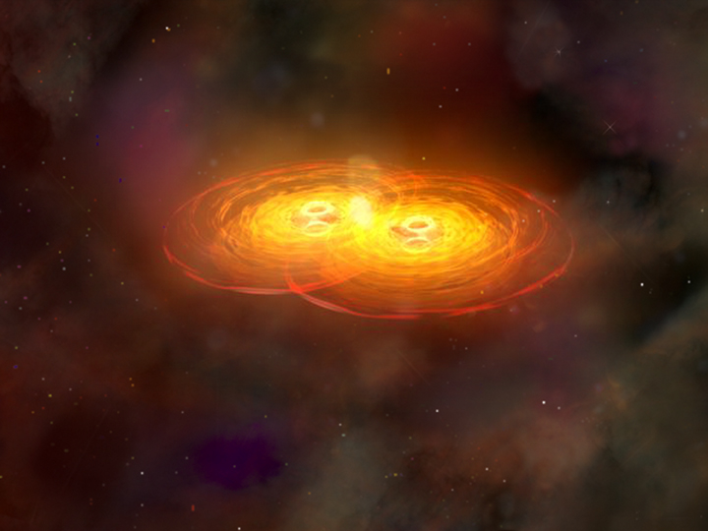
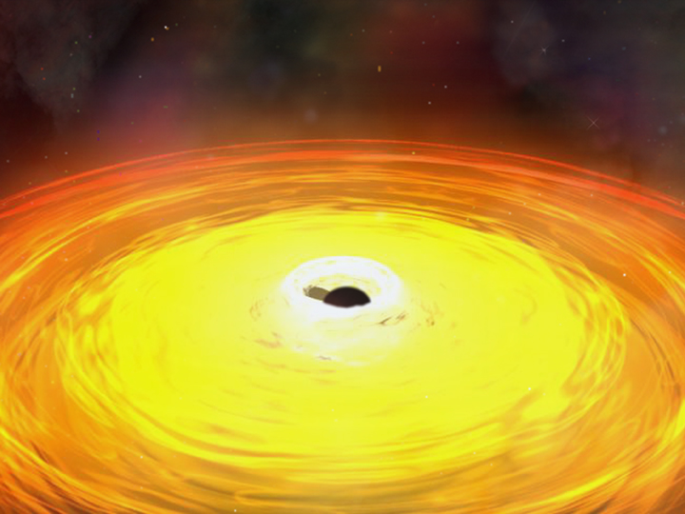
Close (sub-parsec) Binary Supermassive Black Holes?

Slide 20
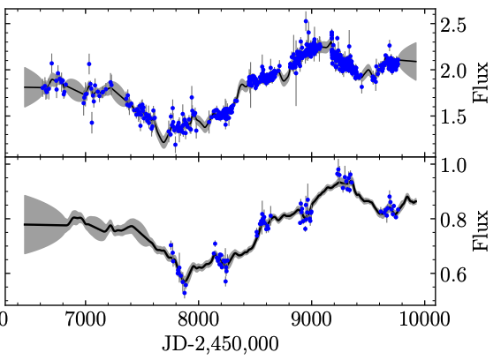
Binary Candidate PG 1302-102
Left, Top: Continuum using WIRO, ASAS-SN, and ZTF photometry; Bottom, Hβ light curve. Right, Top: Mean Hβ spectra for each season; Bottom, rms Hβ profiles for each season.
Modeling of the continuum and Hβ light curves using MICA (Li et al. 2016), a Bayesian code using a damped random walk helpful for intelligently interpolating across the seasonal gaps and determining time lags.

Slide 21
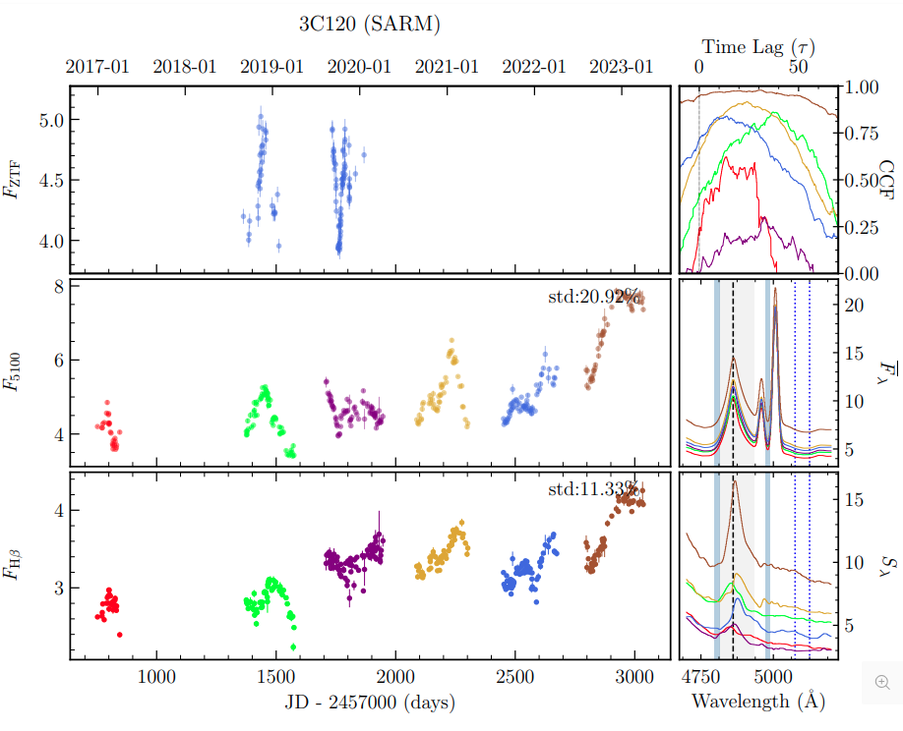
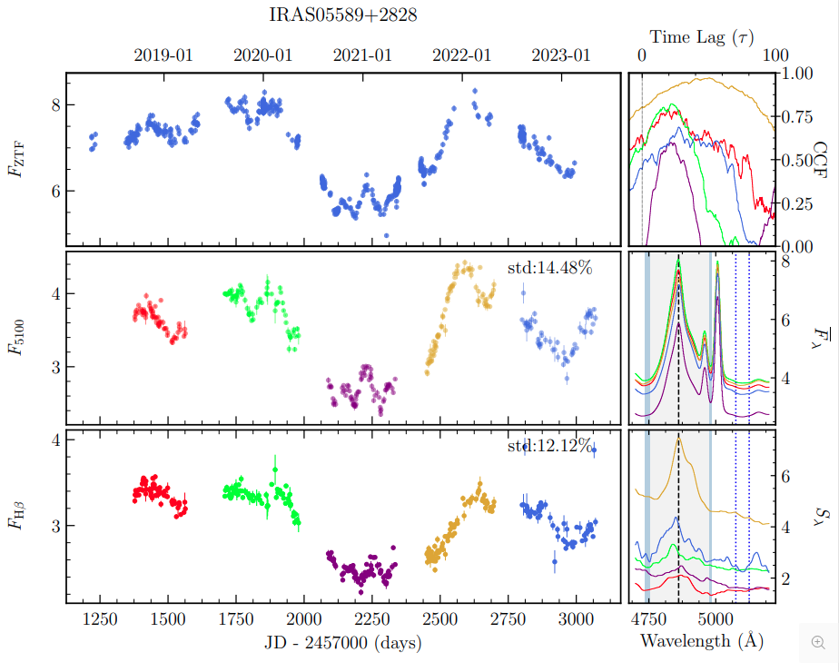
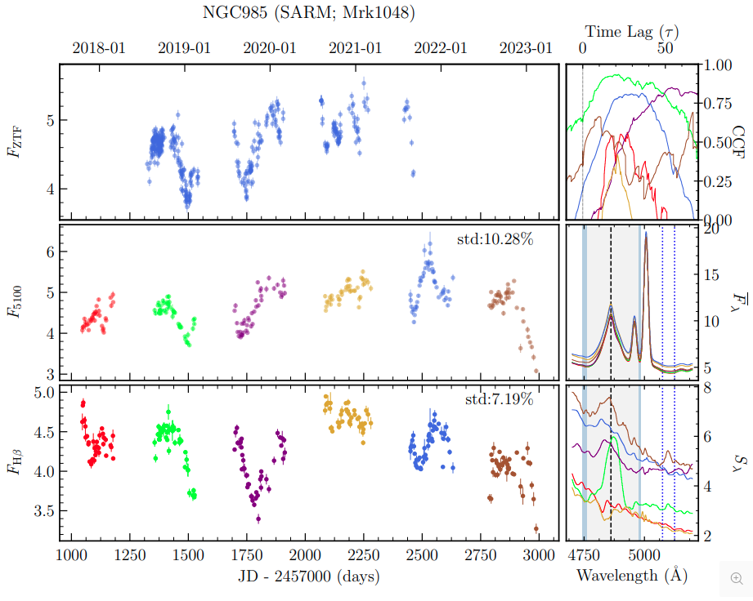
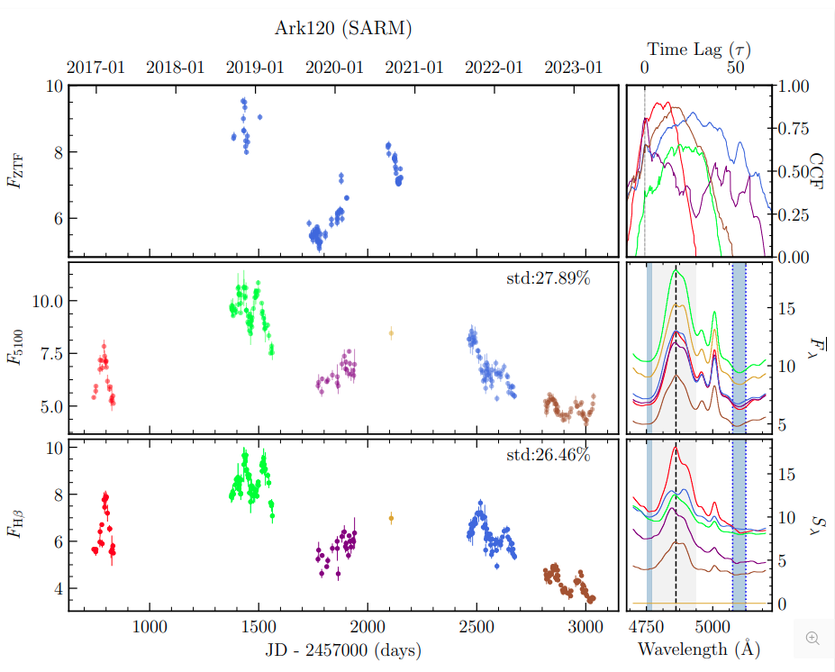
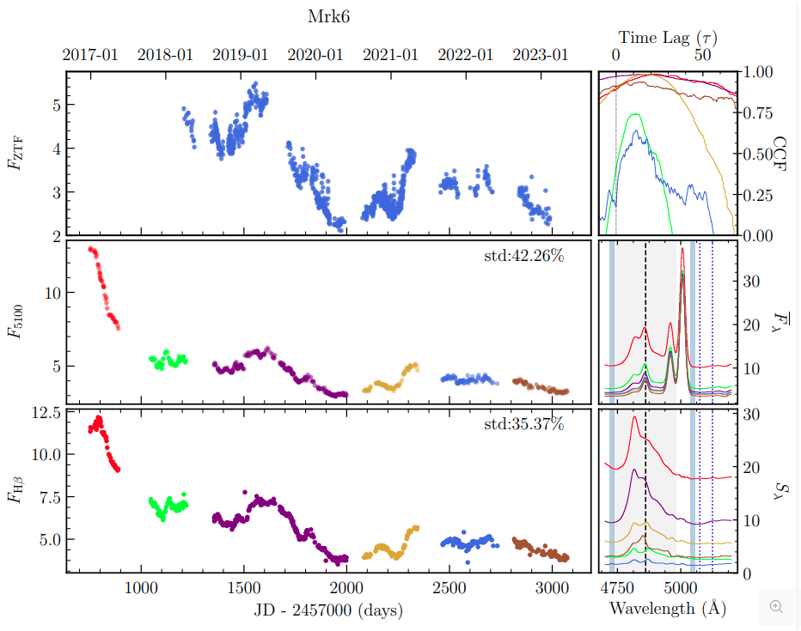
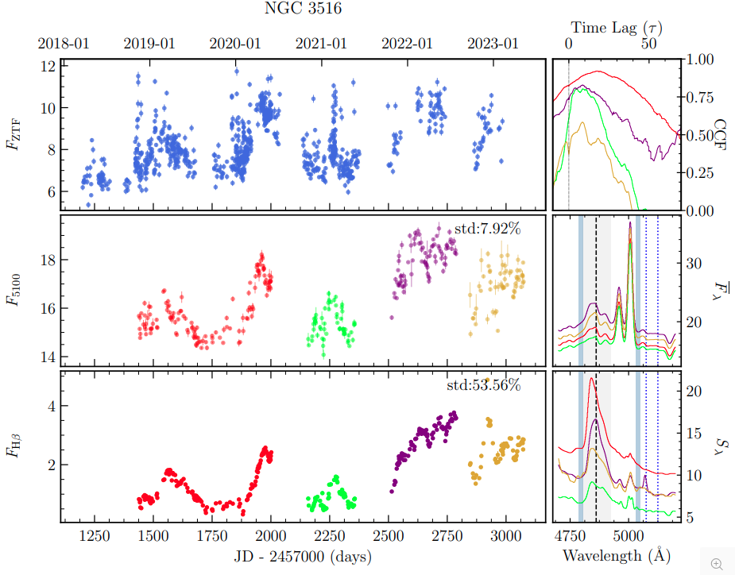
Geometric Dilution and the Radius-Luminosity Relationship

Slide 22
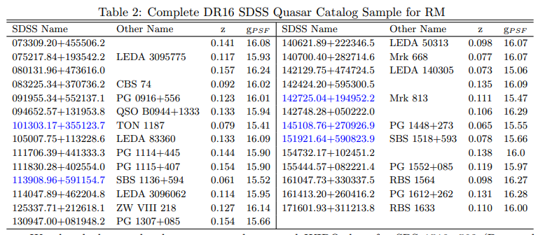
A Complete Sample for the f-factor

Slide 23
Sabbatical Requirement Completed!
Thank You!
Happy Halloween
Happy Anniversary

Slide 24
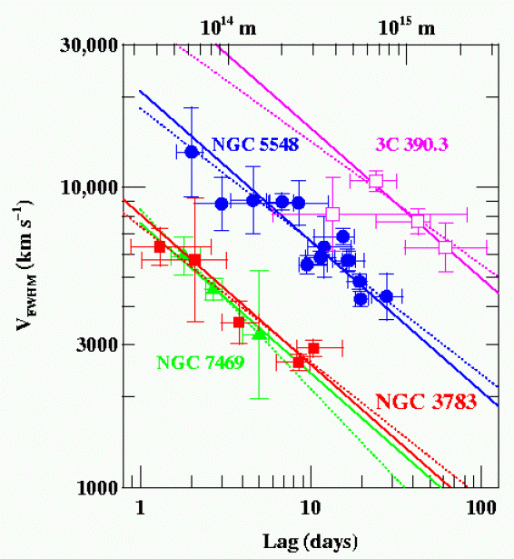
Does the BLR obey the Virial Theorem?
Four well studied AGNs, RM of multiple emission lines shows the expected relationship (slope = -2) between time lags and velocities (note each of the three will have different central black hole masses).
NGC7469: 8.4x10⁶ M☼
NGC3783: 8.7x10⁶ M☼
NGC5548: 5.9x10⁷ M☼
3C 390.3: 3.2x10⁸ M☼
Peterson (2011)

Slide 25
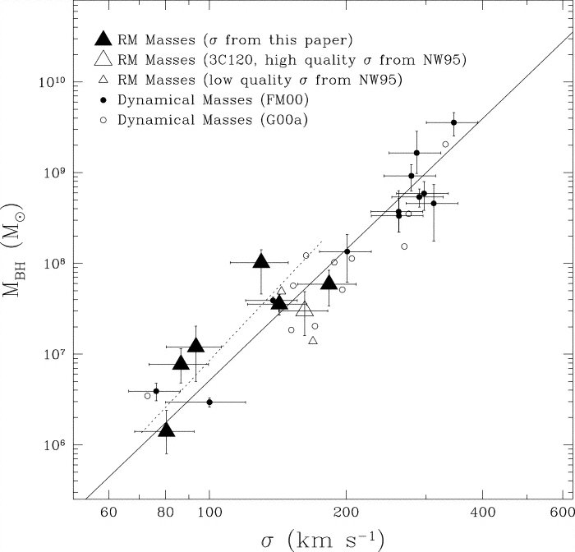
How to calibrate the (average) f factor?
RM-derived masses follow the same M-sigma relationship (fitting f) as seen for normal galaxies that have black hole masses measured from HST spatially resolved gas or stellar dynamics.
Good to 0.5 dex in plot, 0.3 dex in more recent work.
Ferrarese et al. (2001)

Slide 26
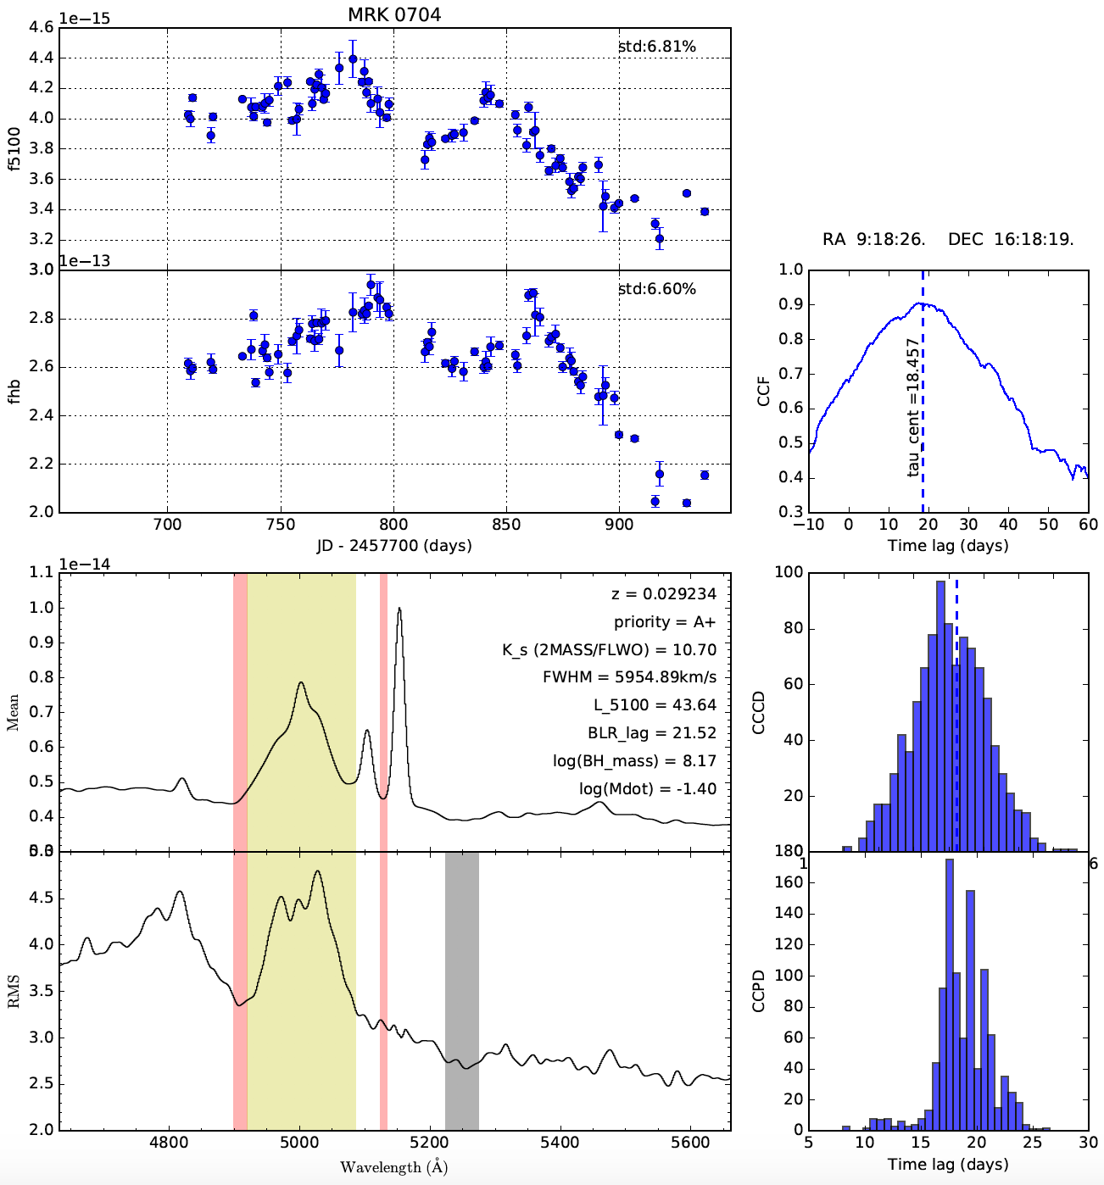
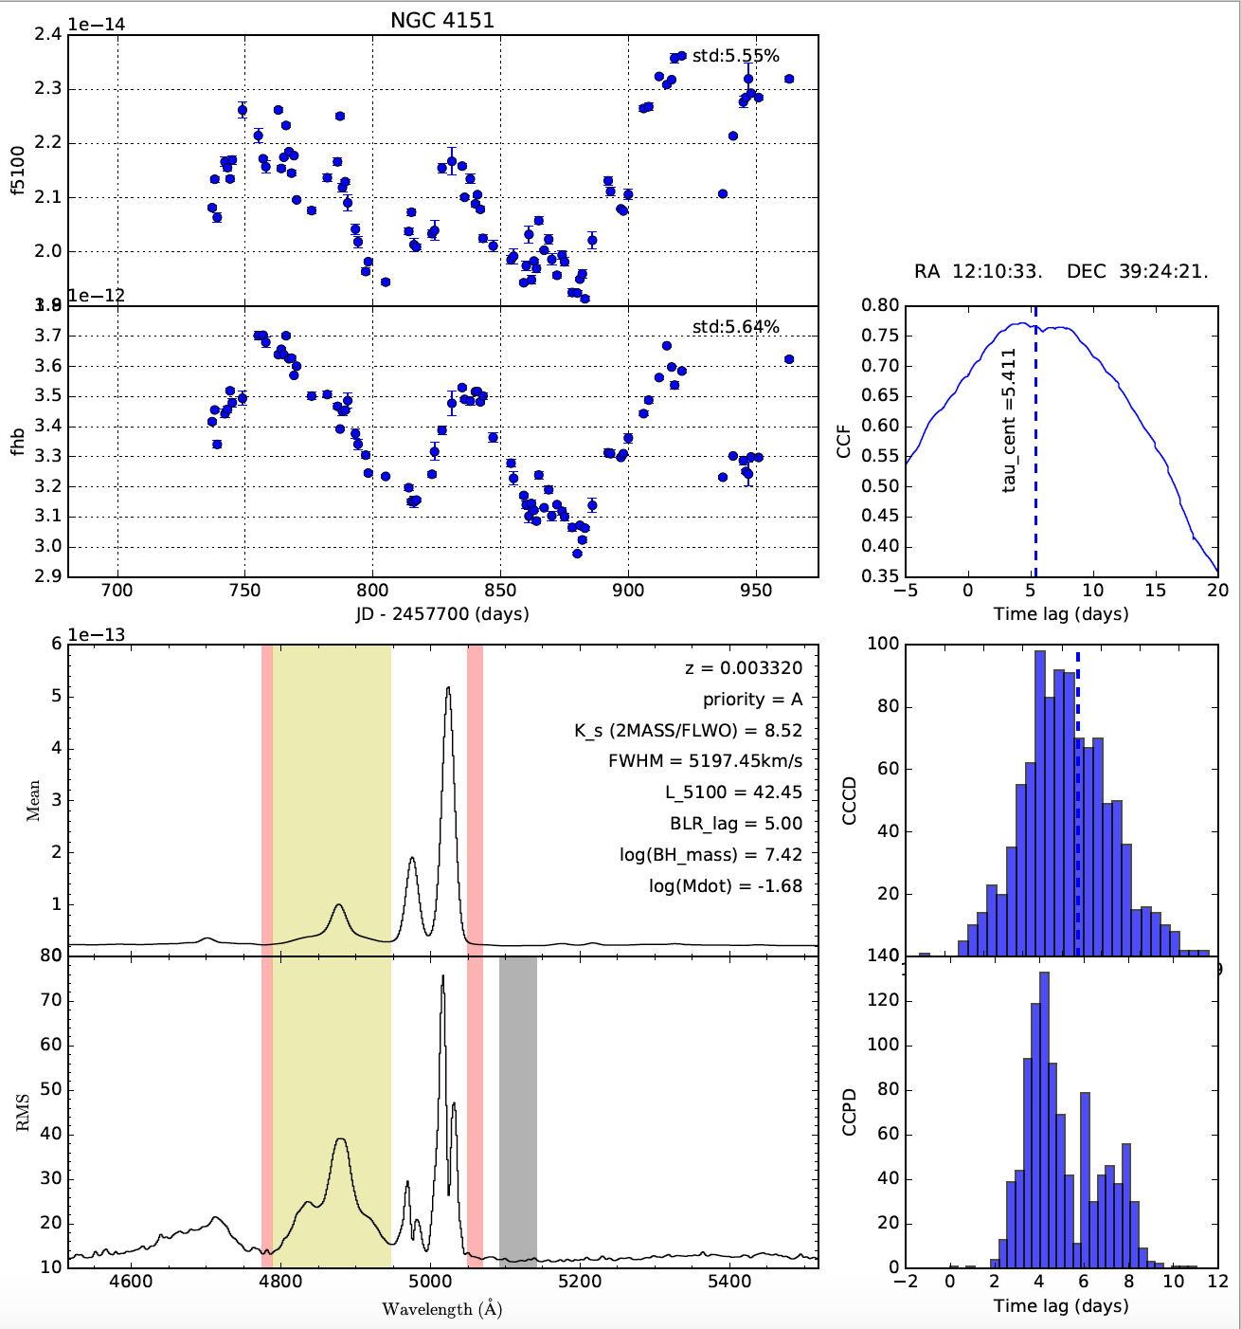
Recent Wyoming Reverberation Mapping
Mrk 704 NGC 4151

