Slide 1
ASTR 2320 General Astronomy II
Professor Mike Brotherton
Dobson Chapter 18, Ryden & Peterson Chapter 21
Active Galaxies
“Do you even know what a quasar is?”

Slide 2
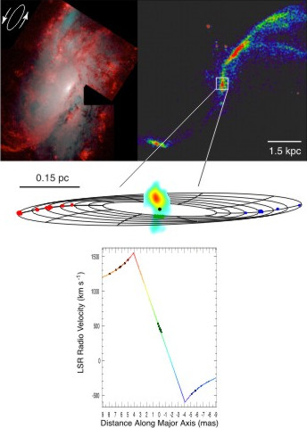
The Water Maser Disk in NGC 4258
NRAO/Greenhill. About 36 million solar masses. SUPERMASSIVE!

Slide 3
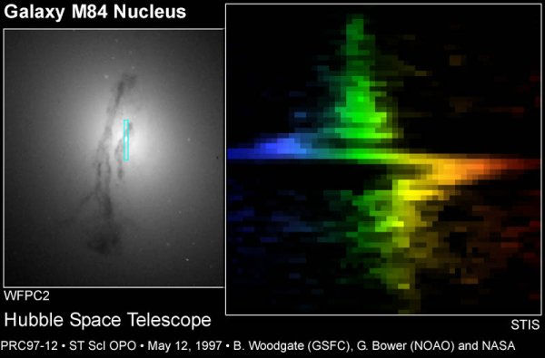
Hubble Doing its Job for Other Galaxies
About 300 million solar masses. That’s MORE SUPERMASSIVE!

Slide 4
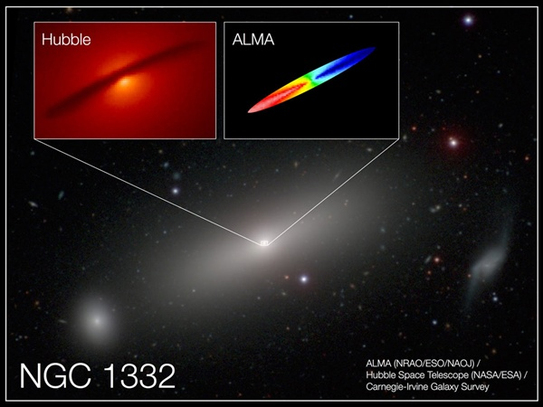
ALMA Resolves Molecular Gas (CO) in NGC 1332
Barth et al (2016). About 660 million solar masses. SUPERMASSIVE!

Slide 5
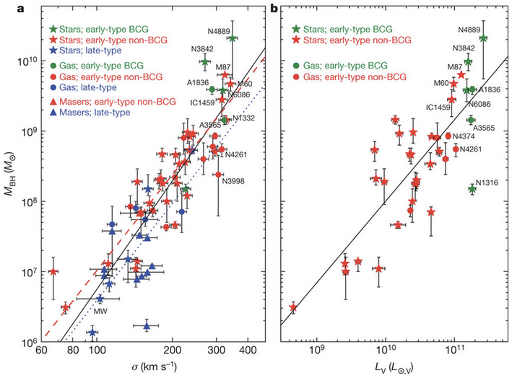
Black hole mass galaxy scaling relationships
McConnel et al. (2011) versions.
M-sigma relationship, and a variation of the “Magorrian relationship” which is black hole mass vs. bulge luminosity.
The central black hole mass is about 0.0015 that of the galaxy spheroidal component. Implies host galaxy and black hole growth are related. Studied under the term “AGN feedback.”
Big galaxies have big black holes, small galaxies have small black holes. Not profound, but unexpected by theorists.
luminosity vs.

Slide 6
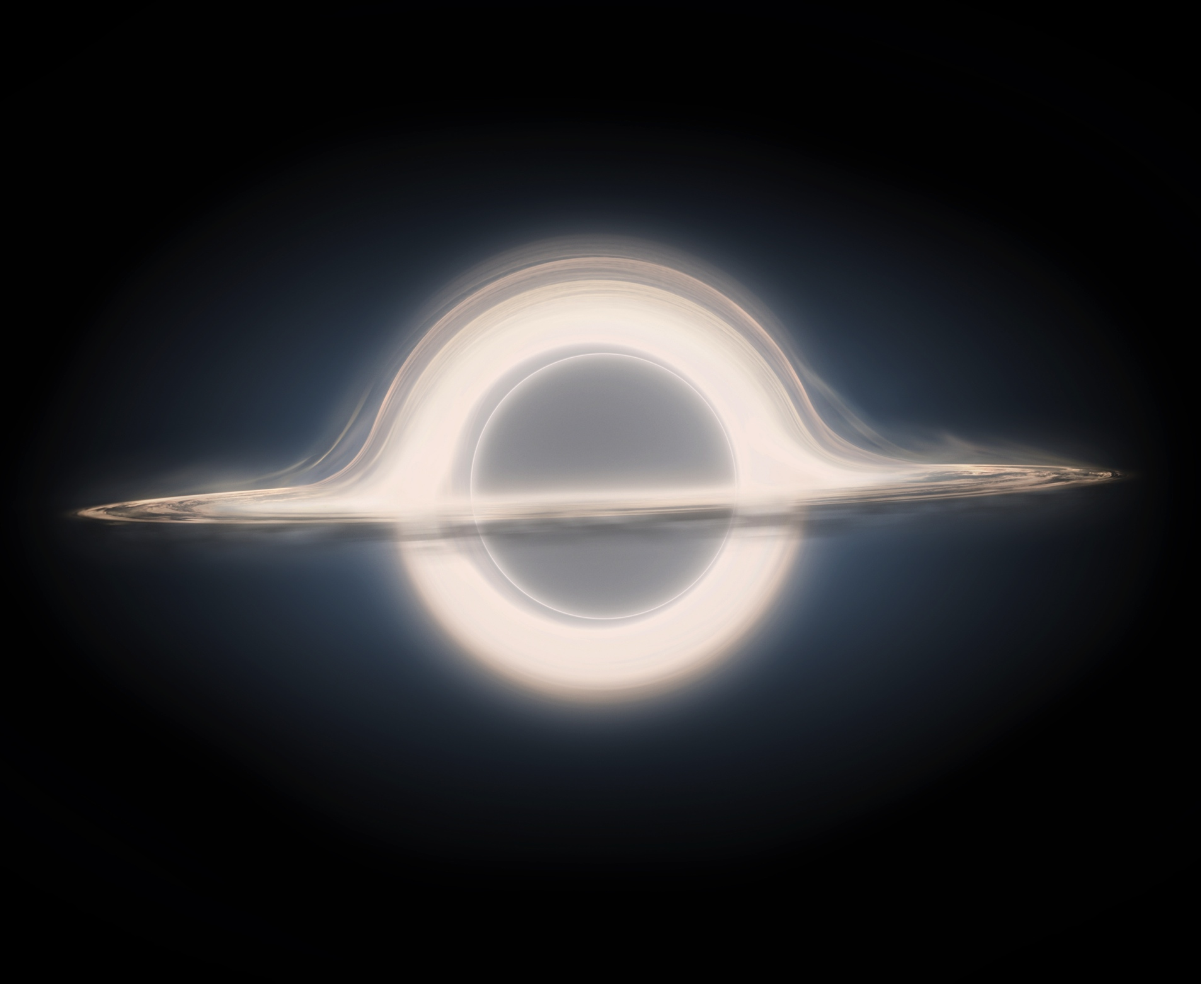
“Gargantua” from Interstellar
100 Million Solar Masses

Slide 7
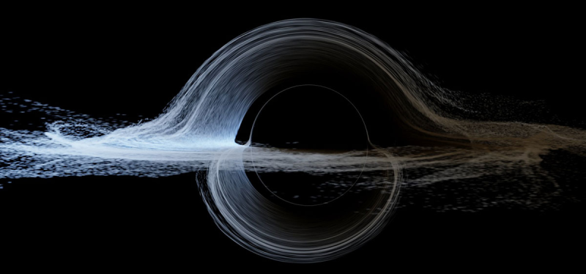
More Scientifically Accurate “Gargantua” from Interstellar (James et al. 2015)
100 Million Solar Masses

Slide 8
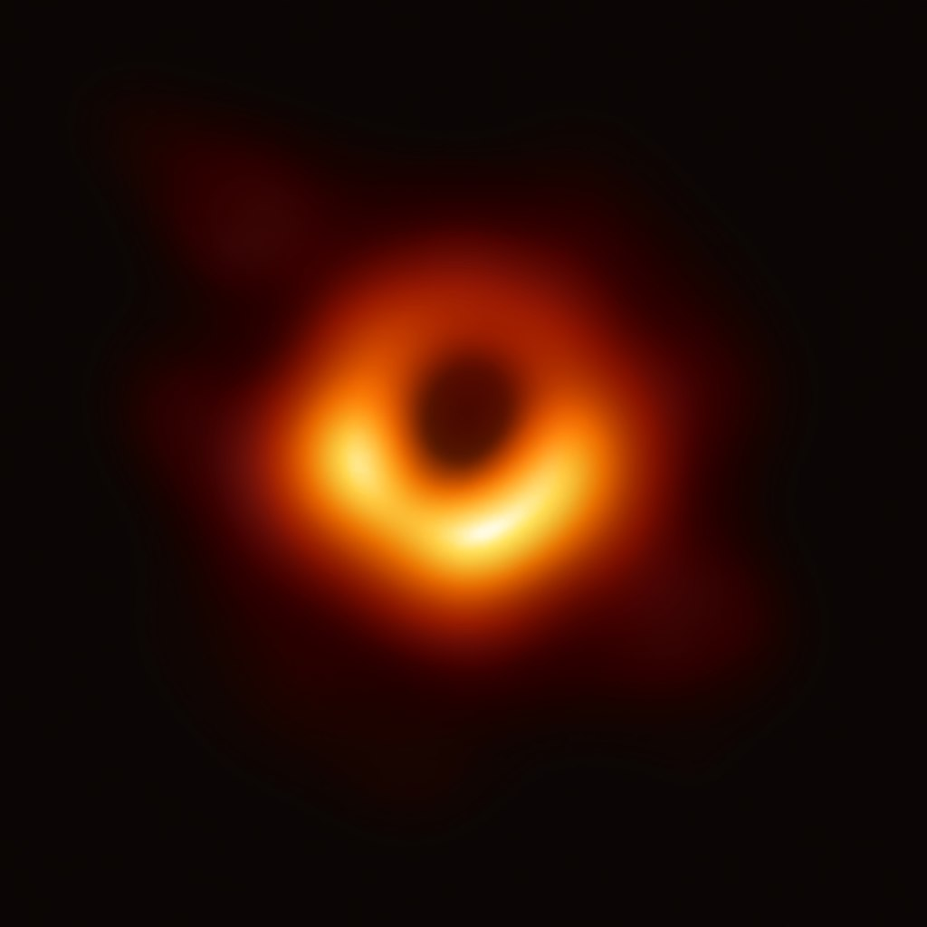
The real thing:
M87 with the Event Horizon Telescope
~6 Billion Solar Masses, about 40 micro-arcseconds across!

Slide 9
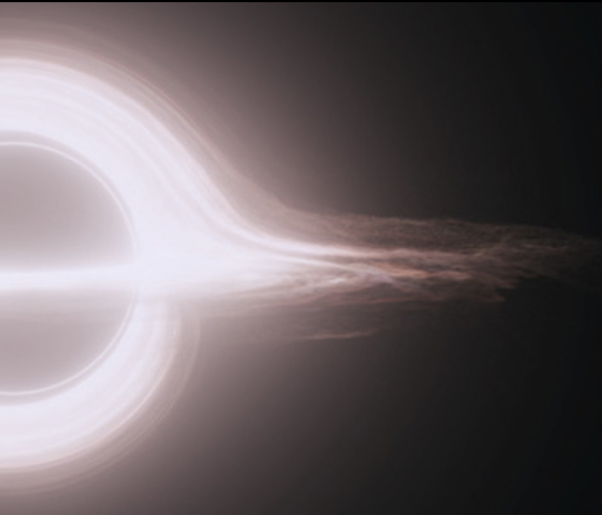

Science & Science Fiction
M87: Event Horizon Telescope (2019)
Double Negative artists/DNGR/TM &
© Warner Bros. Entertainment (2014)

Slide 10
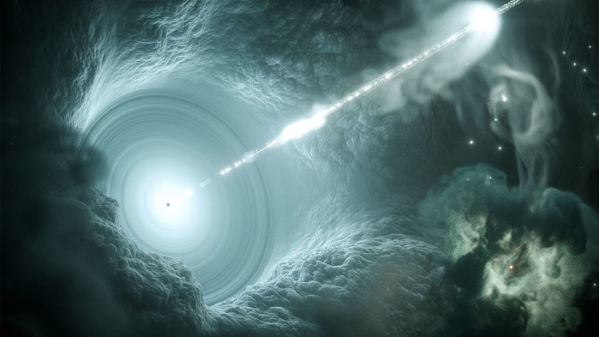
Quasars and AGNs
Some supplemental reading: compilation of review articles at http://nedwww.ipac.caltech.edu/level5/active_galaxies.html
Why quasars are so awesome! (11 minute video)

Slide 11
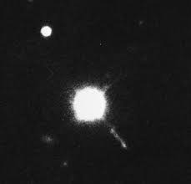
“Quasar” 3C 273, Zoomed In…
What the heck is that?!
Not exactly a point source, is it?!

Slide 12
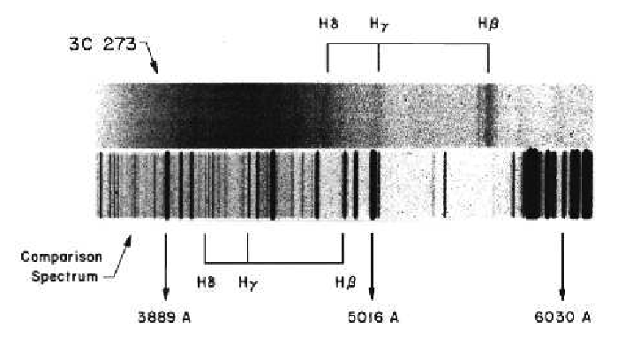
Maarten Schmidt used the Palomar 200” to get spectra, wanted faint “jet” but only 10” from bright 13 mag “star”…what are the lines?

Slide 13
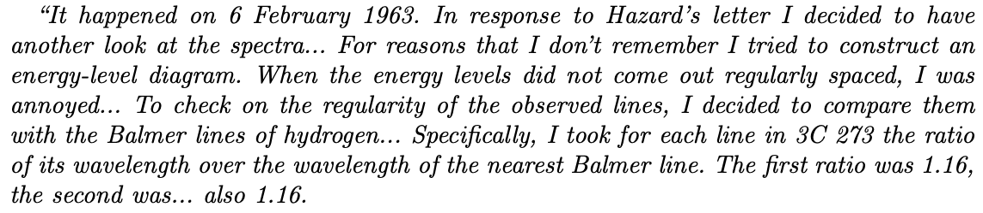
Maarten Schmidt (2011):

Slide 14
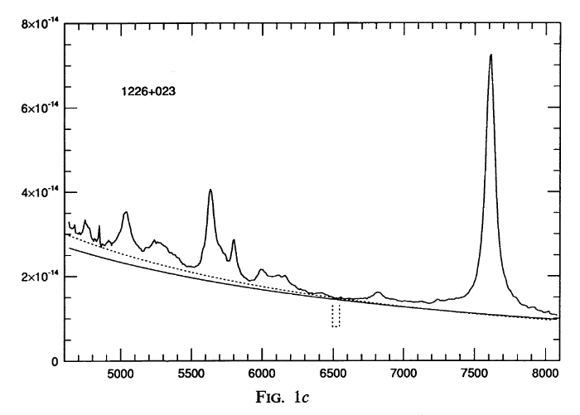
A modern spectrum from Thompson (1992) using McDonald Observatory 2.1 meter

Slide 15
3C 273 Redshift
Emission line wavelength ratios invariant with redshift:
z = 0.158!!!

Slide 16
Interpret Redshift as Cosmological (Hubble 1929)

Slide 17
Distance to 3C 273
From Hubble’s Law…. D(Mpc) = v/H₀ = cz/H₀
z = 0.158, so using a Hubble constant of 72 km/s/Mpc…

Slide 18
Distance to 3C 273
From Hubble’s Law…. D(Mpc) = v/H₀ = cz/H₀
z = 0.158, so using a Hubble constant of 72 km/s/Mpc…
D = 658 Mpc!

Slide 19

Absolute Magnitude/Luminosity of 3C 273
Distance Modulus:
Distance d is in parsecs…solving for Mv…

Slide 20
Absolute Magnitude/Luminosity of 3C 273
Distance Modulus:
Distance d is in parsecs…solving for Mv…use Av = 0, mv = 13 (although source is variable!)
Mv = -26.1…is this extreme? What are absolute magnitudes of galaxies?

Slide 21
Absolute Magnitude/Luminosity of 3C 273
Distance Modulus:
Distance d is in parsecs…solving for Mv…use Av = 0, mv = 13 (although source is variable!)

Slide 22
Absolute Magnitude/Luminosity of 3C 273
Distance Modulus:
Mv = -26.1…is this extreme? What are absolute magnitudes of galaxies?
What about luminosity in solar units? Absolute magnitude of sun?

Slide 23
Absolute Magnitude/Luminosity of 3C 273
Distance Modulus:
Mv = -26.1…is this extreme? What are absolute magnitudes of galaxies?
What about luminosity in solar units? Absolute magnitude of sun is 4.83
That’s 30.9 magnitudes difference. Round this down to 30 magnitudes…how many suns?!
But it’s rapidly variable and hence small…

Slide 24
Maarten Schmidt “Solves Quasars!”

Slide 25
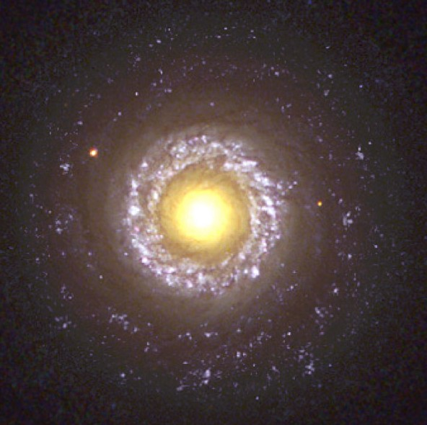
More Generally, Active Galactic Nuclei: AGNs
A small fraction of galaxies have extremely bright “unresolved” star-like cores (active nuclei)
Shown here is an HST image of NGC 7742, a so-called “Seyfert galaxy” after Carl Seyfert who did pioneering work in the 1940s (you might look up his original papers).

Slide 26
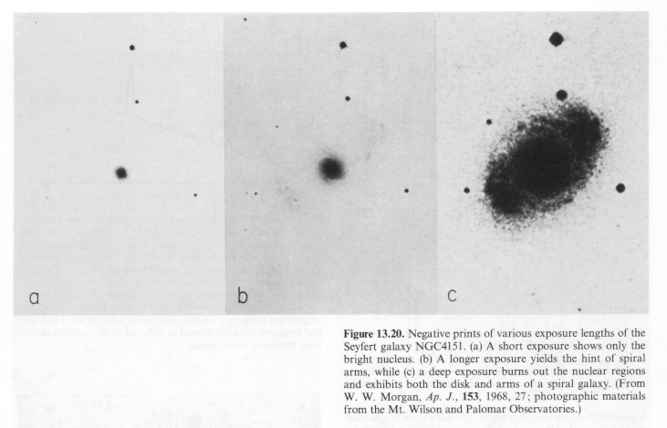
NGC4151 with a range of exposures

Slide 27
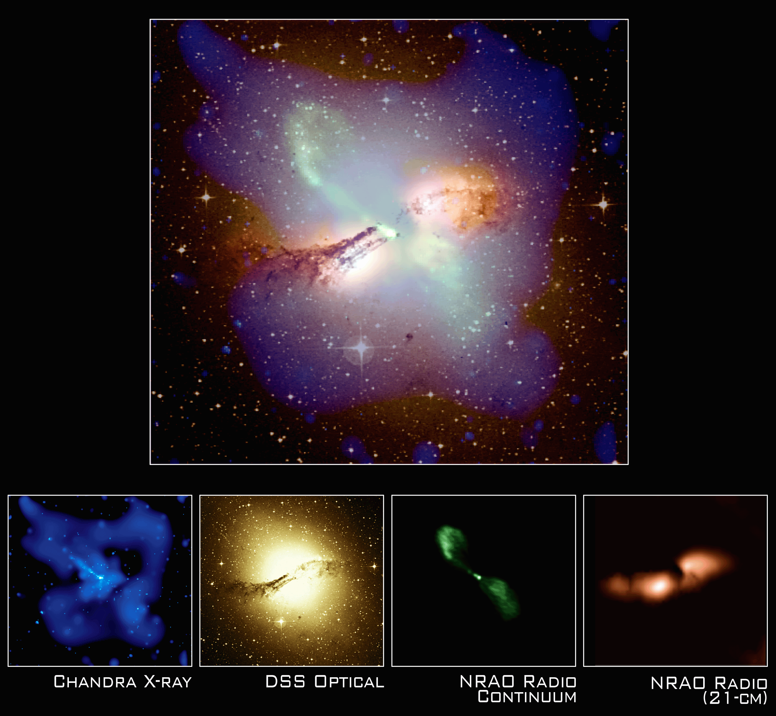
Many Views of Radio Galaxy Centaurus A

Slide 28
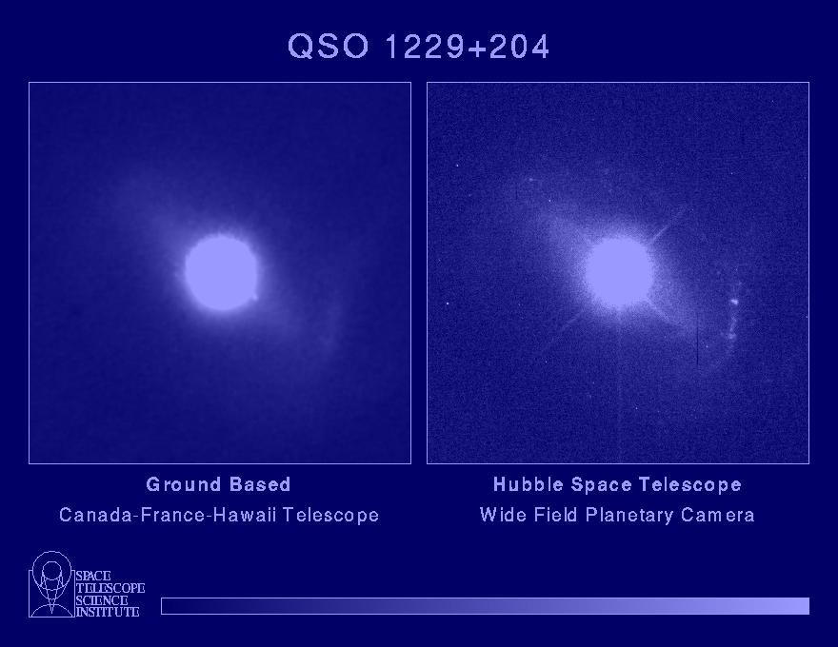
Quasars: like blue stars, hint of host galaxies

Slide 29
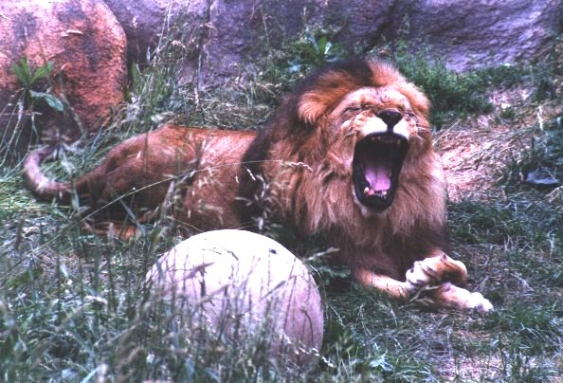
The AGN “Zoo”
Quasars (M < -23)
  Radio-Loud
    FR II Radio Galaxies (type 2 quasars)
    Radio-loud Quasars or just Quasars (type 1 quasars)
      Optically violent variables (OVVs)
  Radio-Quiet
    QSOs – type 1 (broad lines) and type 2 (only narrow lines)
  Infrared-Loud – IRAS quasars, Far-IR Galaxies, ULIRGs
Low Luminosity AGNs (M > -23)
  Radio-Loud
    FR I Radio Galaxies
    Bl Lac objects, AKA Blazars
  Radio-Quiet
    Seyfert Galaxies – type 1 through type 2 (see QSOs)
    LINERs (Low ionization nuclear emission-line regions)
Shields “A Brief History of AGN” astro-ph/9903401

Slide 30
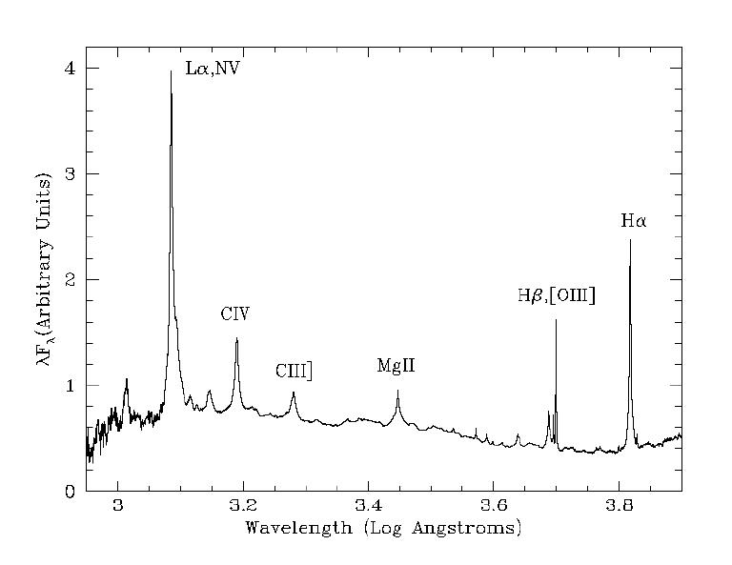
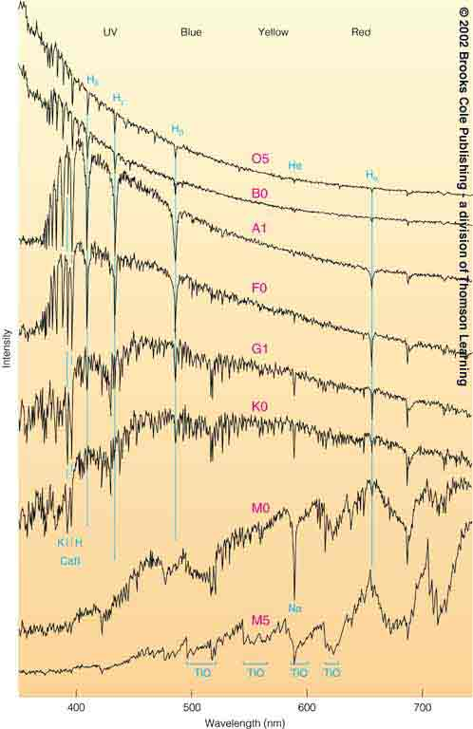
Spectra of Stars, Spectra of AGNs
Rest-frame Angstroms.
Type 1 Seyfert has broad and narrow lines.
Type II Seyfert only has narrow lines on top of a galaxy spectrum.
Composite quasar, Brotherton et al. (2001)
Stars from Horizons by Seeds

Slide 31
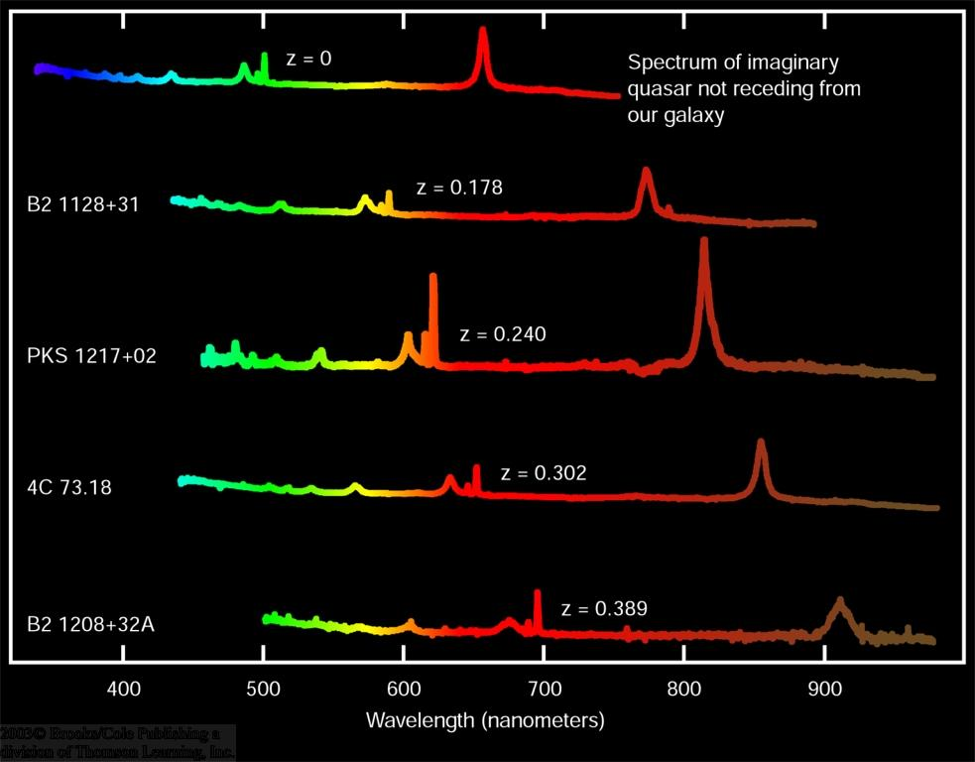
Quasar Redshifts
0
Quasars have been detected at the highest redshifts, up to
z ~ 7.6
z = 0
z = 0.178
z = Δλ/λ₀
z = 0.240
Our old formula
Δλ/λ₀ = v_{r}/c
is only valid in the limit of low speed, v_{r} << c
z = 0.302
z = 0.389

Slide 32
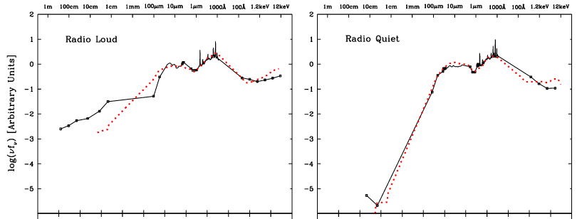
Quasar Spectral Energy Distributions (SEDs)
Shang, Brotherton, et al. (2011)

Slide 33
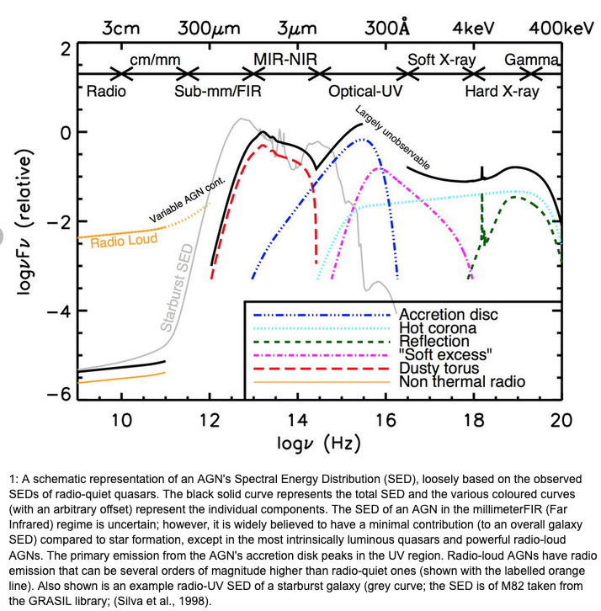
Quasar Spectral Energy Distribution
(AKA SED) along with physical components responsible for each regime. Note the axes and units. Note also the difference between radio-loud and radio quiet. There is a tab on NASA’s NED for the SED.
Why is the far UV “Largely unobservable?”
Baldini (2015)

Slide 34
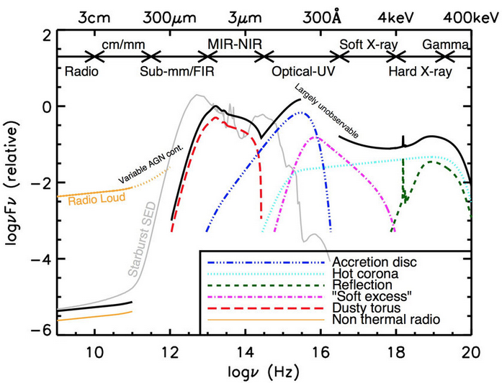
Unified Models (Physical Components, Orientation)

Slide 35
Luminosities and Energetics
Luminosities can be up to ~10¹⁴ solar luminosities, “hyperluminous”
Fusion processes not enough, which was why black holes invoked
Consider gravitational potential energy, dropping material into SMBH from infinity: 𝝙E=-(GMm/r)+(GMm/r_{Sch}) ~ 1/2mc²
An accretion disk (coming up) is a way to release the kinetic energy into radiation
Expected efficiency η is more like 10% rather than 50% -- still huge

Slide 36



Eddington Luminosity and Eddington Ratio
See Ryden & Peterson P. 498
Basic idea: Gravity pulls inward, radiation pressure drives outward
As luminosity goes up with accretion rate, a limit, the Eddington limit is reached when they balance, stopping accretion
Flux around accreting object:
Photon has momentum p = E/c, so momentum flux is:
Radiation force:

Slide 37


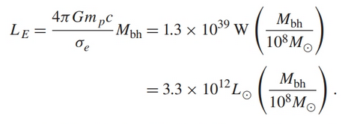
Eddington Luminosity and Eddington Ratio
Continuing…assume pure hydrogen for simplicity
Photons push out, Gravity pulls in:
When radiation pressure equals gravity, it is the Eddington luminosity/limit:
Solve for the luminosity when this is true:

Slide 38


Eddington Ratio
This implies a maximal accretion rate for black holes:
Expressing the accretion rate as a fraction of this is the Eddington Ratio:
This can also be expressed as the total bolometric luminosity divided by the Eddington luminosity: L_{bol} /L_{Edd}

Slide 39
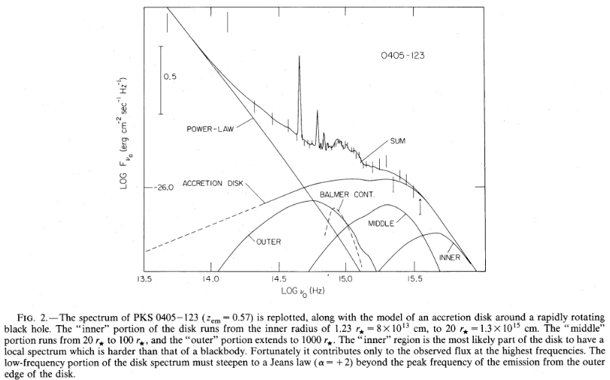
Accretion Disk and the Big Blue Bump
Ryden and Peterson (P. 499) has some basics of disk theory, far from a completely solved problem, and a bit advanced for ASTR 2320
Assumptions of geometrically thin and optically thick not verified
Steady-state axisymmetric disk theoretically has T(r) ∝ r ^{-3/4}
Assuming local black body emission gives
For issues of disk luminosity and dependence on mass, accretion rate, and viewing angle, see Nemmen & Brotherton (2010). Right, figure 2 from Malkan (1983).

Slide 40
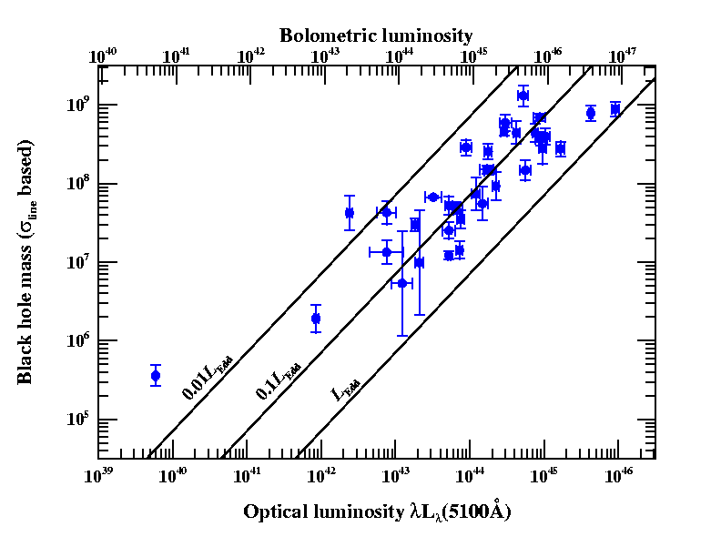
Quasar/Seyfert Galaxies in LBol, Eddington fraction, mass space (after Peterson)
Luminosities in ergs/s
How do we get the
quasar masses?
(In solar units here.)

Slide 41
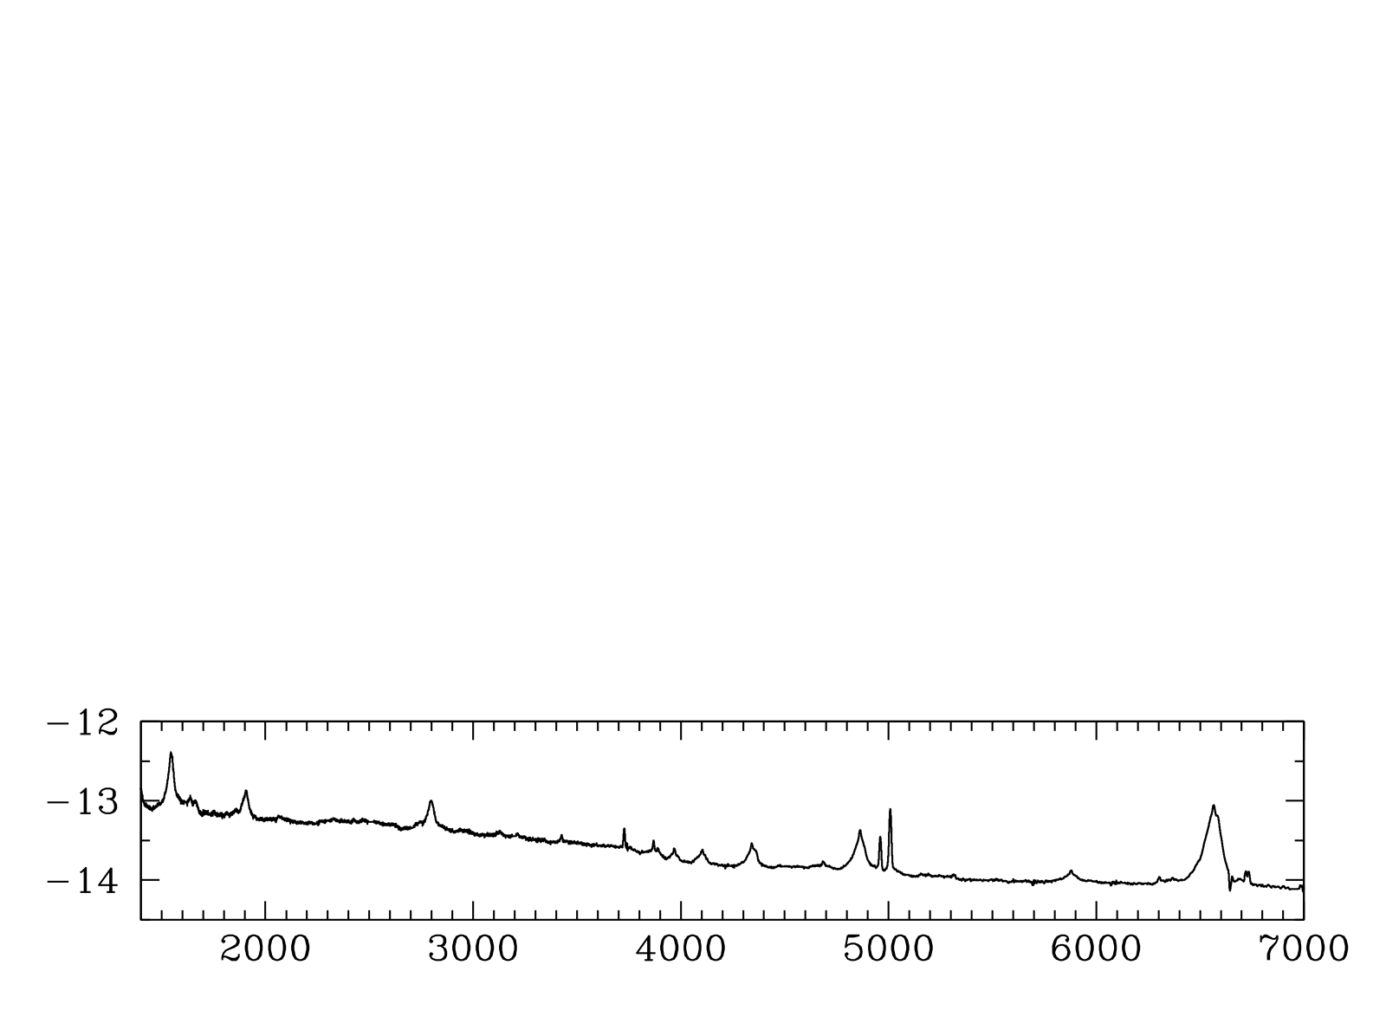
Black Hole Masses in Quasars from their Spectral Broad Emission Lines
e.g., Vestergaard et al. (2006, 2009)
Hα
Hβ
log(F_{λ})
C IV
Mg II
Rest λ (Angstroms)
Notes:
Another important parameter in AGN is the black hole mass, which isn’t necessarily a typical SED project but I can really get at this with my quasi-simultaneous spectra.
How do you measure M in AGN?
Spectrum, CIV at high redshift and Hβ at low.
Ideally measurements using these lines in the same object would agree, but there’s scatter of a factor of a few between them.
I’m interested in understanding this scatter so that I can reduce it.

Slide 42
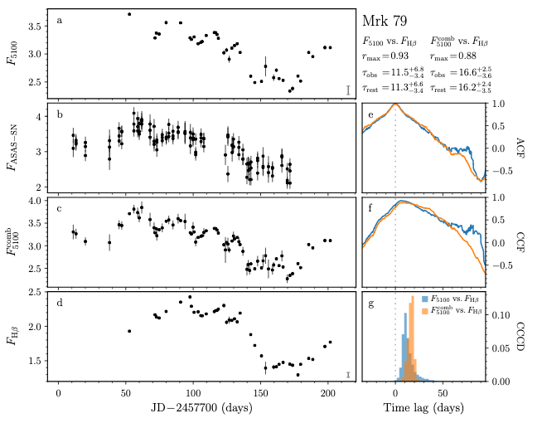
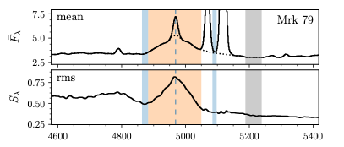
WIRO Reverberation Mapping
Brotherton et al. (2020)
Broad lines are photoionized by the central continuum, which varies. The line flux follows the continuum with a time lag t which is set by the size of the broad-line emitting region and the speed of light. Recombination timescales are very short, BLR stable, and continuum source small and central. Mrk 79 ~ 80 million solar masses!

Slide 43
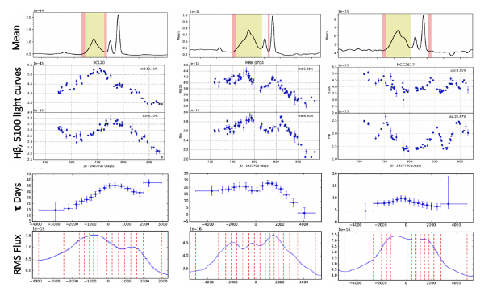
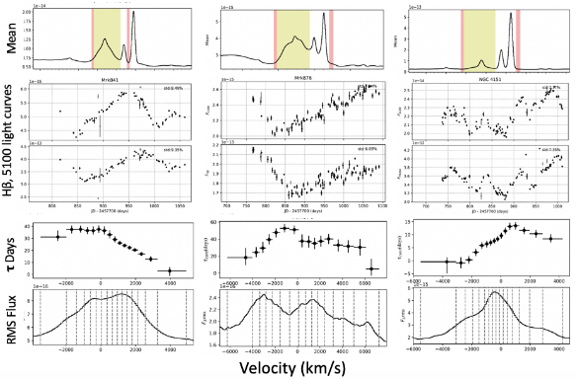
More WIRO Reverberation Mapping

Slide 44
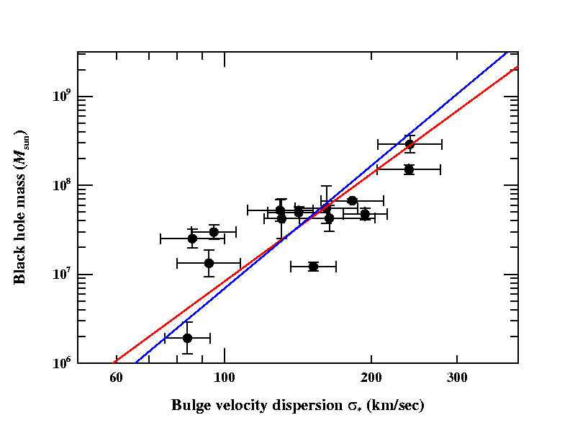
Calibration of the Reverberation Mass Scale (Onken et al. 2004)
Determine scale factor f that matches AGNs to the quiescent-galaxy M_{BH}-σ*. Relationship
σ in the equation is the emission line dispersion
Current best estimates: f = 5.5 for σ_{line}
f = 1.1 for FWHM
Scaling factor is empirically determined
This removes bias from the ensemble
  Equal numbers of masses are overestimated and underestimated
M = f (cτ_{cent}σ _{line}² /G)
M = f (cτ_{cent}FWHM² /G)
Ferrarese slope
Tremaine slope
based on Onken et al. (2004)

Slide 45
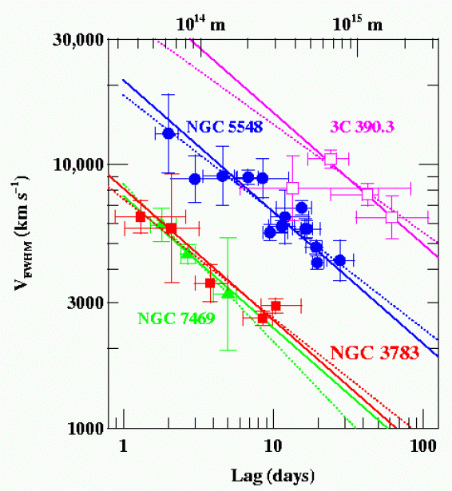
Are Different Lines Consistent? Does Kepler’s 3rd Law Apply?
Four well studied AGNs, RM of multiple emission lines shows the expected relationship (slope = -2) between time lags and velocities (note each of the three will have different central black hole masses).
NGC7469: 8.4x10⁶ M☼
NGC3783: 8.7x10⁶ M☼
NGC5548: 5.9x10⁷ M☼
3C 390.3: 3.2x10⁸ M☼
Peterson (2011)

Slide 46
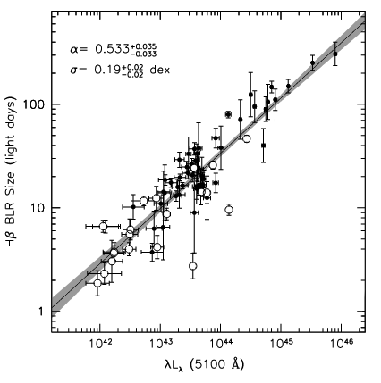
Updated Radius-Luminosity Relationship
(Bentz et al. 2013)
Mentioned previously the Kaspi et al. (2000) result how R ~ L^{0.7} (above). Misty Bentz et al. (2006) showed that proper correction for host galaxy leads to a slope of 0.5! This permits the possibility of using single-epoch measurements to estimate black hole masses – much easier!

Slide 47
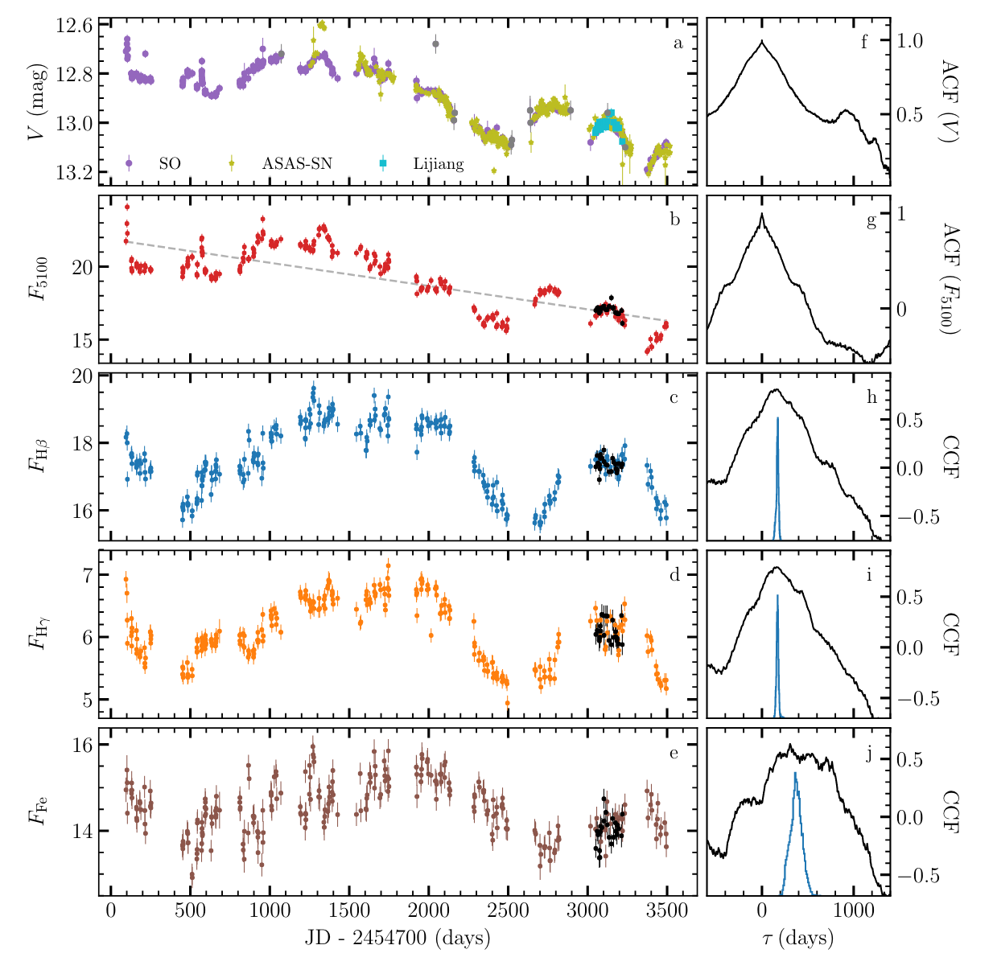
A Decade of Reverberation Mapping of 3C 273
Zhang et al. (2019)
Hydrogen broad line region size about 147 light-days, plus or minus 10%

