Slide 1
ASTR 2320 General Astronomy II
Professor Mike Brotherton
Binary Stars

Slide 2
Binary Stars
Why do we care?
Yes, a lot of stars are in multiple star systems, but these binary systems are key to determining stellar masses!

Slide 3
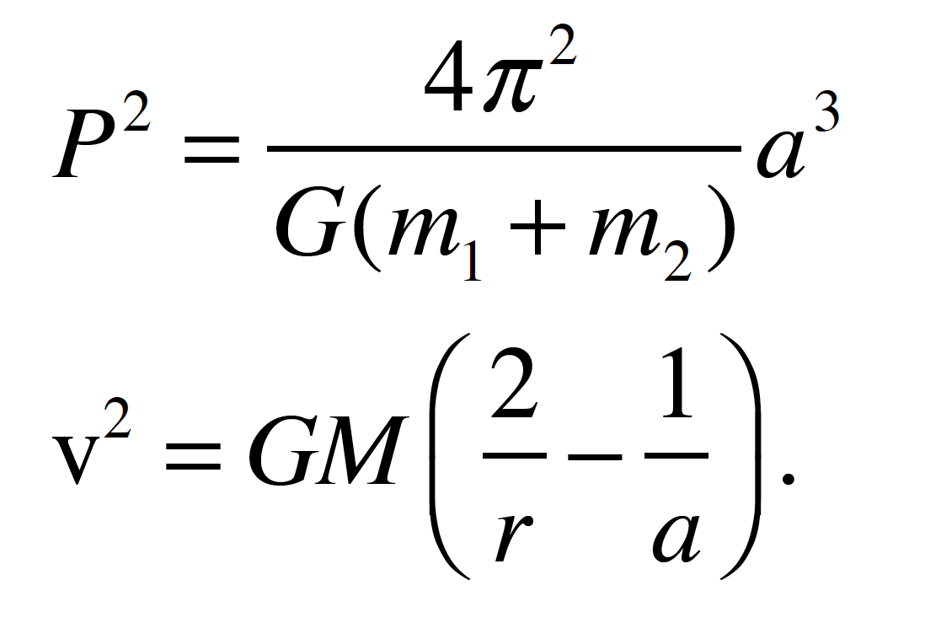
Binary Stars
From Kepler’s 3rd law and vis-viva equation (M=m₁+m₂):

Slide 4
Detection Methods
Visual Binaries (not just optical doubles)
Need to monitor to be sure!
Note also the astrometric binary
Spectroscopic (and Spectrum) Binaries
Spectrum will be sum of two stars
Spectroscopic binaries show double lines
Also need to monitor to be sure not chance alignment
Eclipsing Binaries
Can do with time-series photometry
Links: http://www.astro.keele.ac.uk/jkt/links/binaries.html (unfortunately many links here are currently broken)

Slide 5
Visual Binaries: Reduced Orbit
Left: Two stars orbiting center of mass AKA barycenter. m₁r₁=m₂r₂. The distances r₁ and r₂ are the distance from each mass to the center of mass, like see saw.
Right: Equivalent single “reduced orbit” with reduced mass μ = m₁m₂/(m₁+m₂) in orbit around mass M = m₁+m₂, with semi-major axis a = r₁ + r₂.
Barycenter likely moving, too.
Link: http://hyperphysics.phy-astr.gsu.edu/hbase/orbv.html

Slide 6
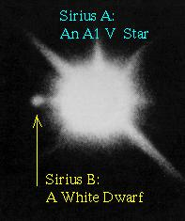
Visual Binaries: Sirius
Daviddarling.info
Combination of orbital motion, proper motion, and parallax. Must correct for the last two in order to study the first. Inclination effects.

Slide 7
Visual Binaries: Relative Orbit
``Relative’’ Orbit holding the primary virtually fixed. If distance is known, angular separation can be converted to a projected distance (arcseconds times parsecs yields distance in AUs).
But keep in mind with stars of not extremely dissimilar mass, the two stars are actually orbiting around a common center of mass.

Slide 8
Visual Binaries: Sirius Again
Daviddarling.info
Relative Orbit holding the primary virtually fixed. Can obtain period and stellar separation to use Kepler’s 3rd law to get mass(es). See example on page 4 of Dobson’s chapter 12.

Slide 9
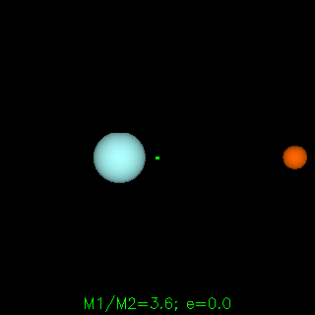
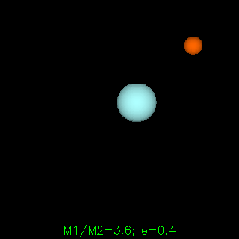
Visual Binaries: Animation
Binary Orbit animated gifs from Rick Pogge @Ohio State University

Slide 10
Spectroscopic Binaries
The wavelengths of the double absorption lines will change with time and have a period the same as the orbit period.
There are redshifts and blueshifts due to the Doppler effect.

Slide 11
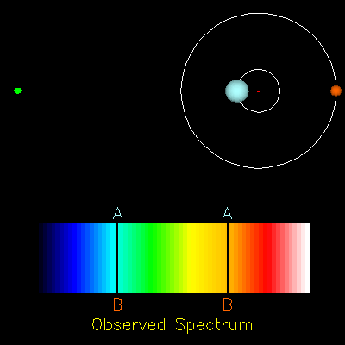
Spectroscopic Binaries: Animation
Spectroscopic Binary animated gif from Rick Pogge @Ohio State

Slide 12
Spectroscopic Binaries: Dependence on Orbital Parameters
Radial velocity curve for spectroscopic binary with circular orbits, 90 degree inclination, and 3:1 mass ratio. What does “phase” mean? Why is the velocity ratio the inverse of the mass ratio? (Hint: Use center of mass equation and velocity equation for circular orbit.)

Slide 13
Spectroscopic Binaries: Dependence on Inclination
Projected velocity is not full velocity, but only v sin i.
Inferred separation will be a sin i.
Inferred mass will be M sin i.

Slide 14
Spectroscopic Binaries: Dependence on Eccentricity
Eccentricity here is 0.714 (that’s a ratio of a : b = 4 : 2.8)
Consider Kepler’s 2nd law. Equal area in equal time.

Slide 15
Spectroscopic Binaries: Dependence on Eccentricity 2
Eccentricity here is 0.714 (that’s a ratio of a : b = 4 : 2.8)
Consider Kepler’s 2nd law.
Left: orbit seen end on. Right: Orbit seen sideways.

Slide 16
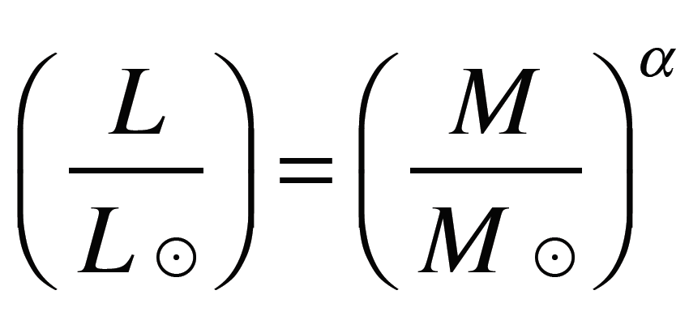
Mass-Luminosity Relation for Main-Sequence Stars
Power-law relationship, nearly linear in log-log space:
Slope is about 3, but varies with mass range

Slide 17
Mass-Luminosity Relation for Main-Sequence Stars
So this is important! Empirical for now, but hints at underlying energy production and variation, as we shall see!

Slide 18
Eclipsing Binaries: Useful!
Inclination is (probably) large, close to 90 degrees
Usually also spectroscopic binaries
Can lead to direct measurement of stellar sizes

Slide 19
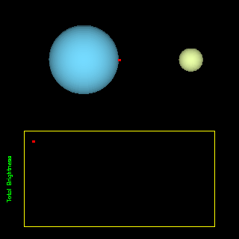
Eclipsing Binaries: Animation
Eclipsing Binary animated gif from Rick Pogge @Ohio State

Slide 20
Eclipsing Binaries: Area eclipsed and stellar temperatures
Blackbody emission depends on surface area and T⁴, right?
Eclipsed area same, but temperature of eclipsed area differs, so depth differs

Slide 21
Eclipsing Binaries: Timing + Velocity gives sizes
1 to 2 – moves diameter of secondary
1 to 3 – moves diameter of primary
How to know velocity? Spectroscopy helps!
Diameters range from 1/10 solar to > 1000 times solar. More to come later.

Slide 22
Eclipsing Binaries: Other configurations
Non-central eclipse geometries

Slide 23
Stranger Binary Systems
Concept of Roche lobes and contact binaries…
Stars can also have sunspots!

Slide 24
More direct stellar diameters: Imaging (hard!)
Direct imaging of Betelgeuse with Hubble Space telescope – it’s sort of close and very large! (How close and how large?)

Slide 25
More direct stellar diameters:
Occultations (like passing behind the Moon) and high-speed photometry
Optical Interferometry (we’ll discuss more later in the course)
And also looking ahead, there are some good but less direct ways to measure stellar sizes…

Slide 26
Binary and Multiple Star System Statistics:
Binary and multiple star systems not at all uncommon
Exact statistics not simply stated – depends on mass among other things
Dobson: “…approximately 50-60% of solar type stars are in multiple star systems…decreases for lower-mass stars to perhaps as low as 15 - 25% for stars less than half the Sun’s mass…for stars more massive than ~5 M⦿, likely higher than 70%...”
And many stars systems are triples or even more extreme (e.g., Alpha Centauri, Castor, Alcor and Mizar, etc.)

