Slide 1
ASTR 2310 General Astronomy I
Professor Mike Brotherton
Ch. 9 from Ryden & Peterson, Earth and Moon
Earth’s Atmosphere, Origin of Moon, Radioactive Dating

Slide 2
Overview
Earth’s interior, seismic waves, etc.
Earth’s atmosphere, origins, structure
Earth’s magnetosphere
Moon’s Interior and Surface, Origin
Radioactive Dating
Nice video about formation of Earth & Moon: https://youtu.be/rQVzNynZ9vM (11min)

Slide 3
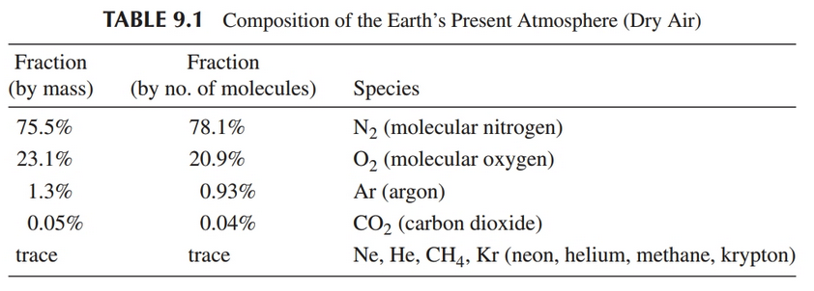
Earth’s Atmosphere
Evolved over time
Primeval (H, He, lost early, methane, ammonia)
Outgassing of Carbon dioxide (lost in oceans), water, nitrogen
Life brings/replenishes Oxygen

Slide 4
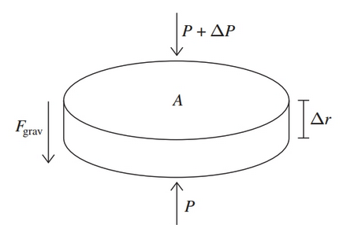





Hydrostatic Equilibrium

Slide 5

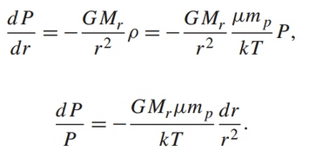


Atmospheric Pressure
Ideal gas law:

Slide 6



Atmospheric Pressure
For an ideal gas:
Take g, r, T, mean molecular mass ~constant, so integrating:
Use sea level as boundary condition:

Slide 7
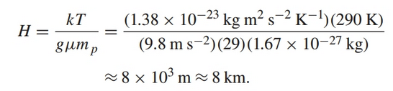
Atmospheric Pressure
Scale Height:
For Earth, use T=290K, g = 9.8 m s⁻², but what is mean molecular mass?

Slide 8
Atmospheric Pressure
Scale Height:
So what does this mean?
Every 8km of altitude, pressure decreases by 1/e or about 0.37. Note that at sea level P=1.01e5 N m⁻² = 1 atmosphere.
What is the pressure in Laramie?

Slide 9
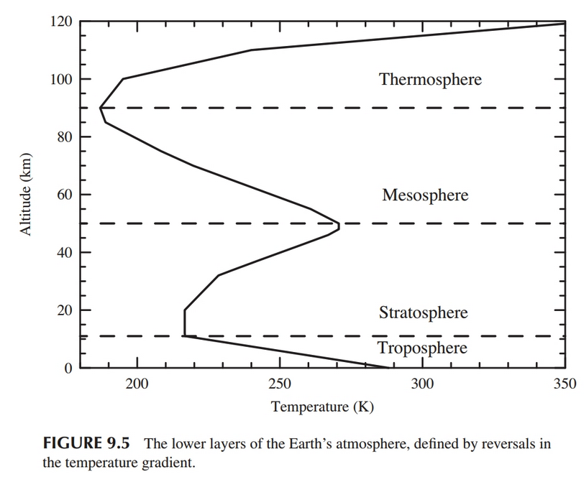
Atmospheric structure

Slide 10
Atmospheric Scattering
Particle size L << λ, Rayleigh scattering, which gives us the blue sky. Oxygen and Nitrogen about 3Å. Blue light mostly scattered.
L ~ λ, like dust, scatters red and NIR light
L>> λ, like big water droplets, λ-independent, fog and clouds and similar.

Slide 11
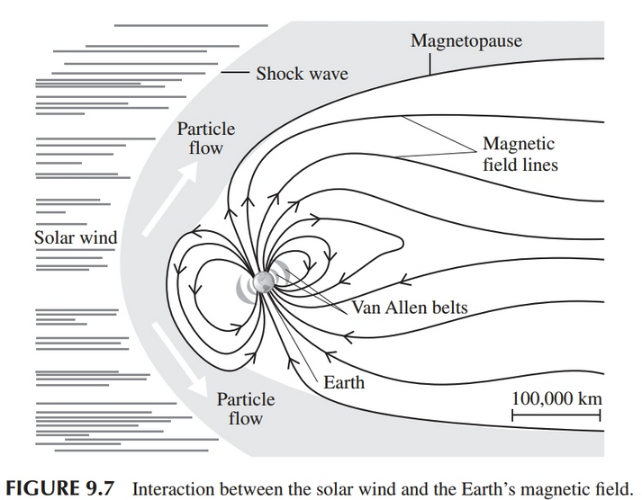
Earth’s Magnetosphere

Slide 12
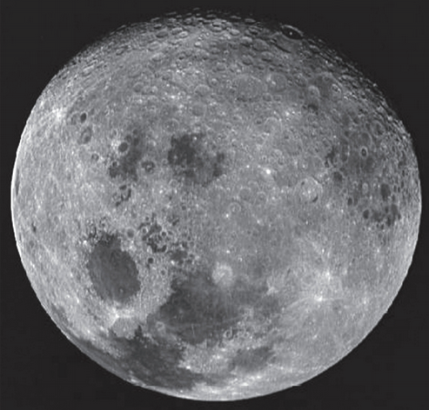
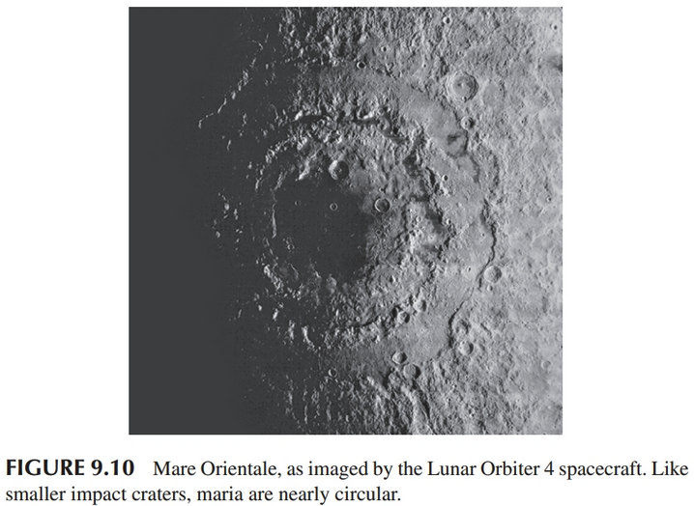
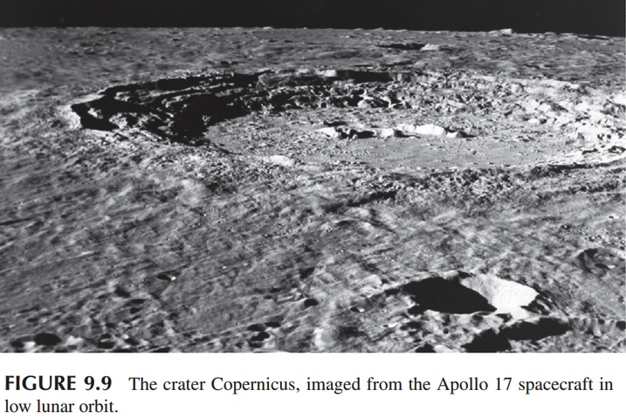
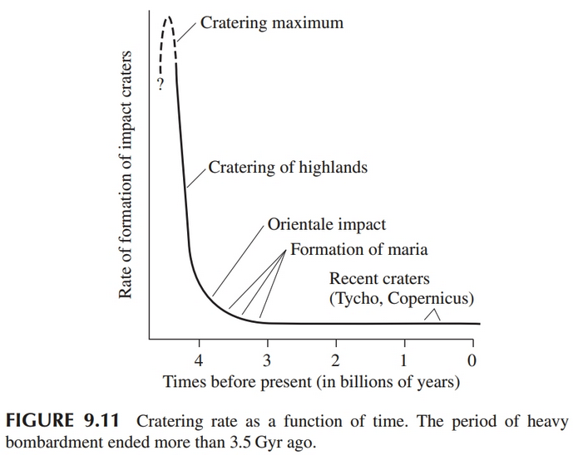
The Moon
Highlands and Maria
Cratering
Covered these a bit in lab

Slide 13
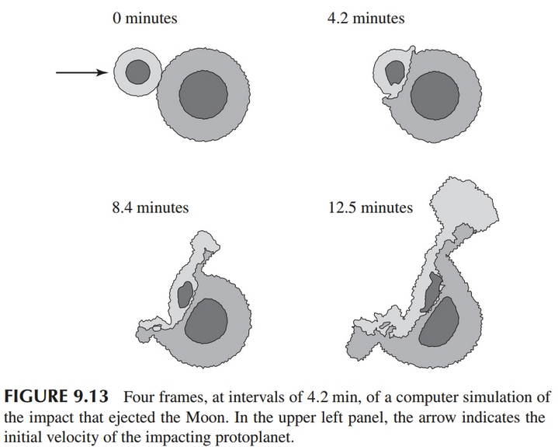
Origin of Moon
https://youtu.be/S3ArL94ZJWw ( 8 minutes)

Slide 14






Age: Radioactive Decay
For example:
Random process with a probability per unit time for a decay
Relate half life and decay constant:
Nice video: https://youtu.be/rQVzNynZ9vM (10m)

