Slide 1
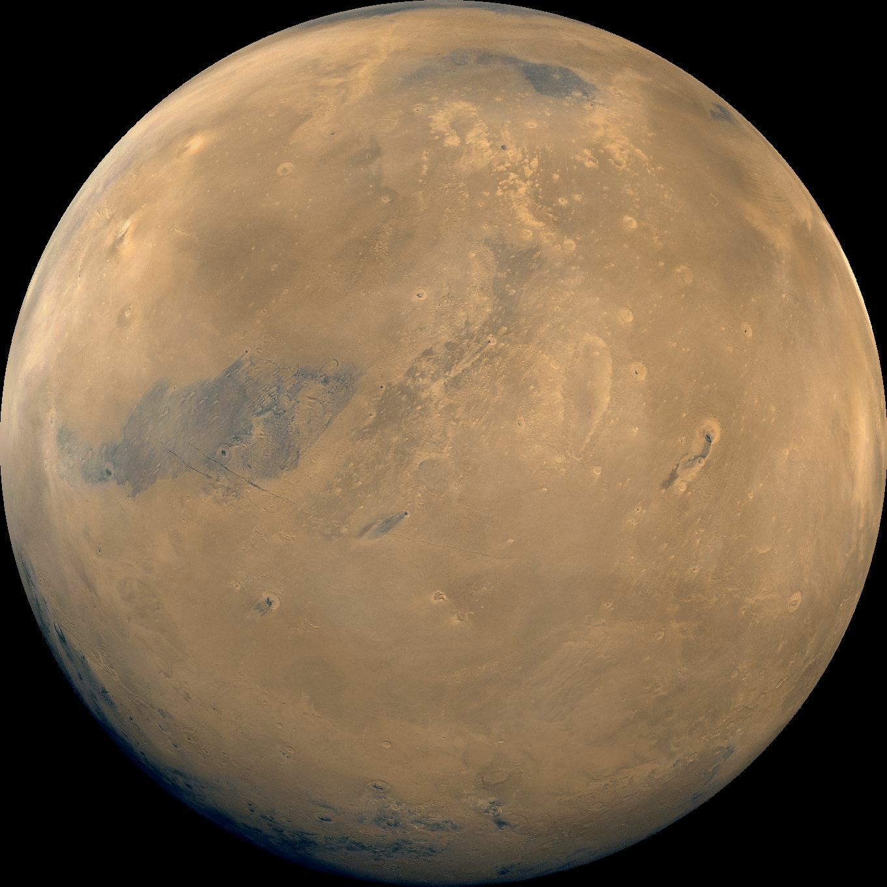
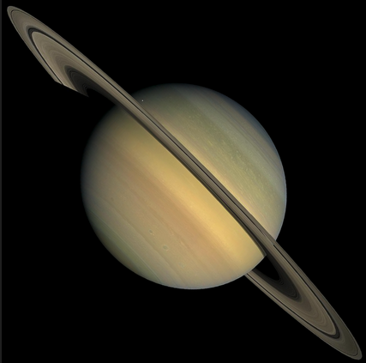
ASTR 2310 General Astronomy I
Professor Mike Brotherton
Ch. 8 from Ryden & Peterson, Solar System Overview
“Two” types of planets, Physical properties, Retention of atmosphere, Solar System Formation

Slide 2
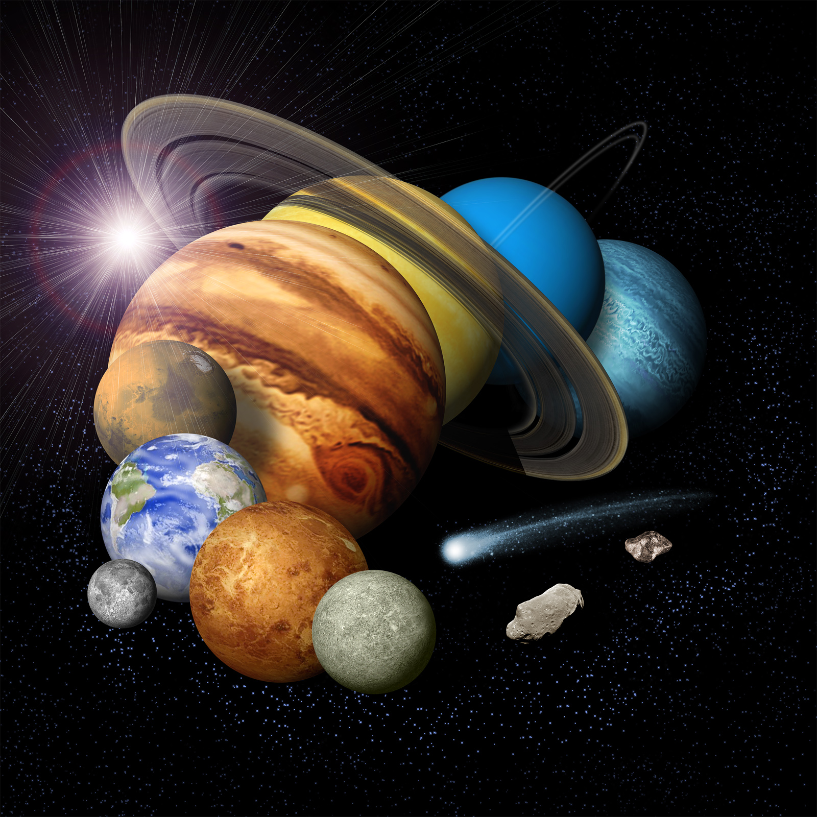
Here’s one overview:
What is wrong with this picture? It's from NASA...

Slide 3
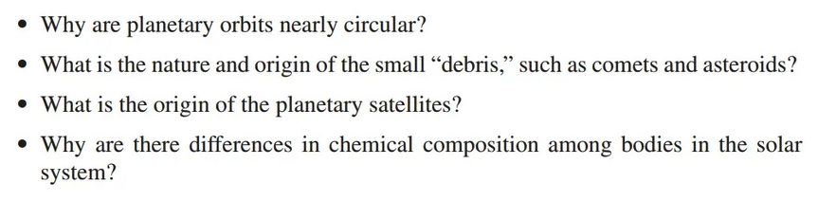
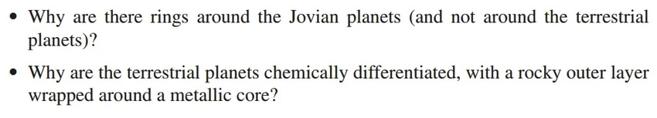
Questions about Solar System
Why Terrestrial, Jovian, and Dwarf planets, and smaller "Debris”?

Slide 4
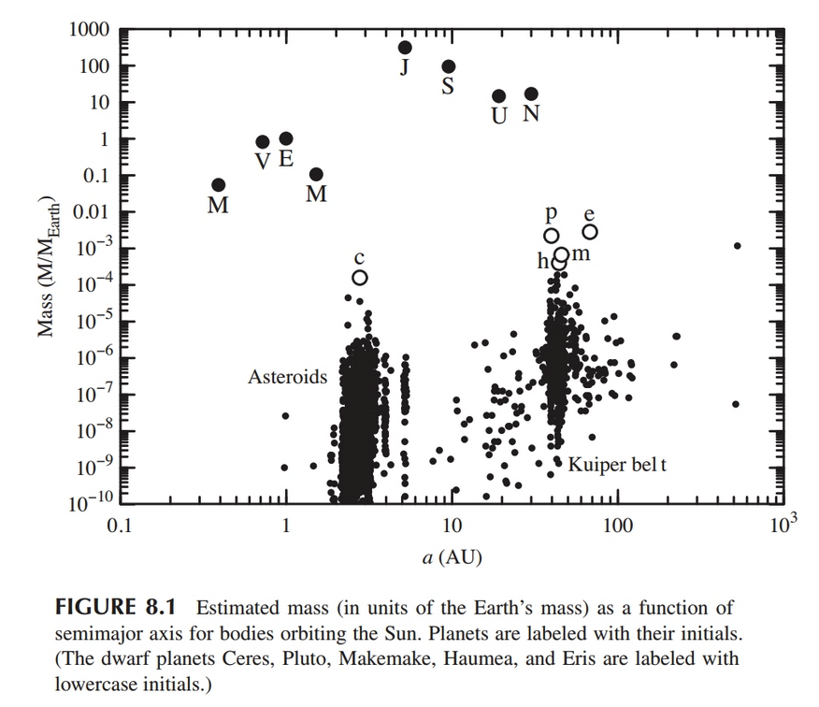
Mass distribution for bodies orbiting the Sun (99.8% of total)

Slide 5
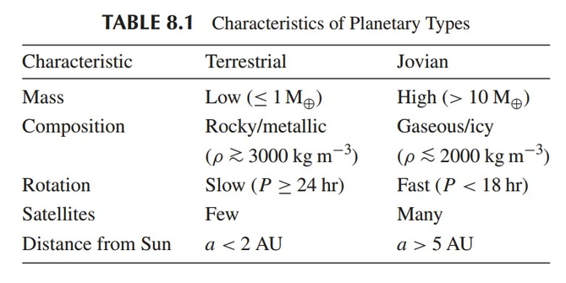
Characteristics of Planetary Types

Slide 6
Planet Properties
Planet Masses – How?
Planet Sizes – How?
Planet Densities – How?
Planet Temperature more involved...

Slide 7

Planet Properties
Planet Masses –
Planet Sizes – How?
Planet Densities – How?
Planet Temperature more involved...

Slide 8
Planet Properties
Planet Masses –
Planet Sizes –
Angular size and distance (e.g. radar)
Planet Densities – How?
Planet Temperature more involved...

Slide 9

Planet Properties
Planet Masses –
Planet Sizes –
Angular size and distance (e.g. radar)
Planet Densities –
710-5500 km/m⁻³
Planet Temperature more involved...

Slide 10
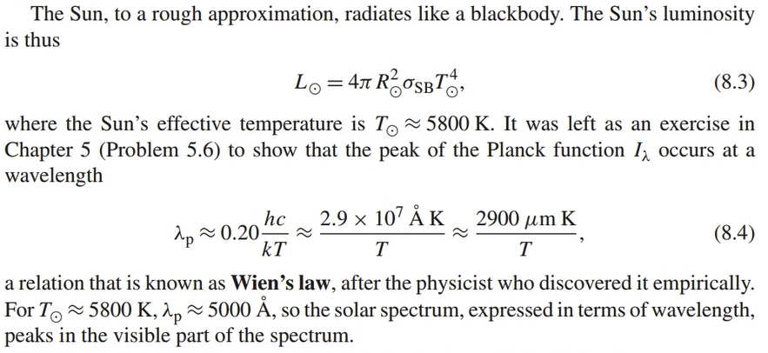
Planet Temperatures (Theory)
A number of factors…heating from the Sun

Slide 11


Planet Temperatures (Theory)
Heating from the Sun—flux at planet
But what’s important is the energy/s absorbed:

Slide 12
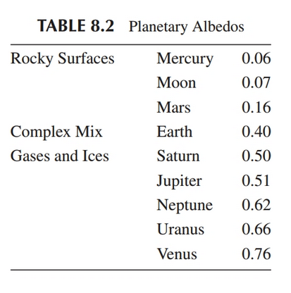
Planet Temperatures (Theory)
A is for “Albedo”

Slide 13


Planet Temperatures (Theory)
To find equilibrium temperature, need cooling:
Planet radiates like a blackbody. Now:
Cooling = Heating

Slide 14


Planet Temperatures (Theory)
Solving for equilibrium temperature,
Expressing in AUs and plugging in for solar R, T

Slide 15

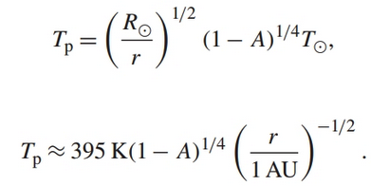
Planet Temperatures (Theory)
Complication: slow rotator, poor heat conduction, and energy absorbed in area Σ where sun is overhead must be locally reradiated:
This is subsolar temperature

Slide 16
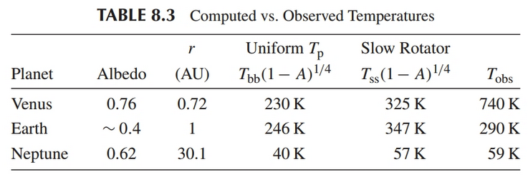
Temperature: Theory vs. Observation
…What gives?

Slide 17
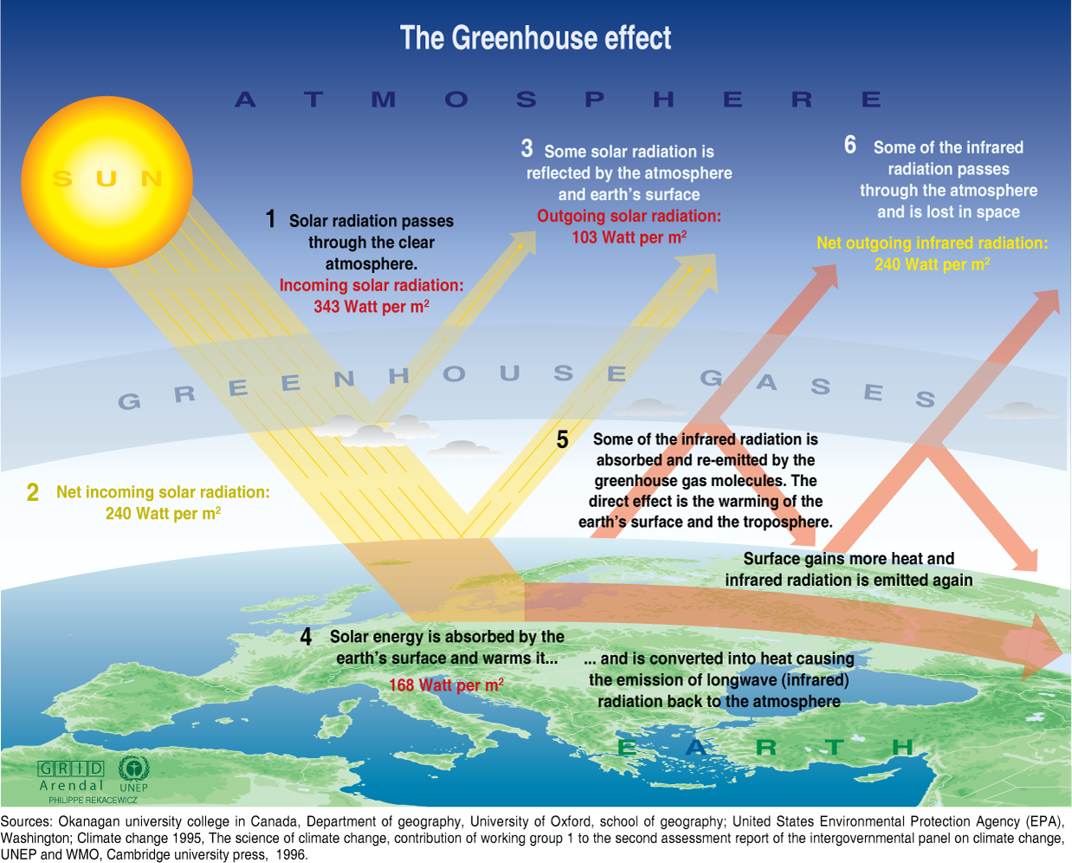
Greenhouse Effect

Slide 18
Greenhouse Effect

Slide 19
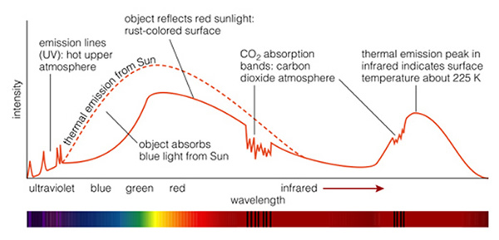
Example planetary spectrum
Spectrum of Mars:

Slide 20

Planetary Atmospheres
Hotter means higher thermal gas speeds
Mean free path distance where a particle scatters, depends on density
Exobase, z_{ex}, is height were a gas particle faster than escape velocity can leave without scattering:

Slide 21




Planetary Atmospheres
At exobase:
Because of the long tail of the Maxwell-Boltzmann distribution cannot just equate speeds to find limits of retention. Need

Slide 22

Planetary Atmospheres
Planetary escape velocity, gas temperature, and gasses

Slide 23
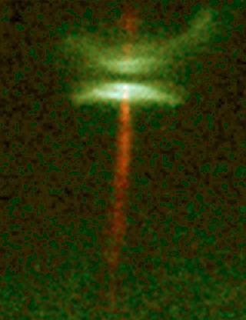
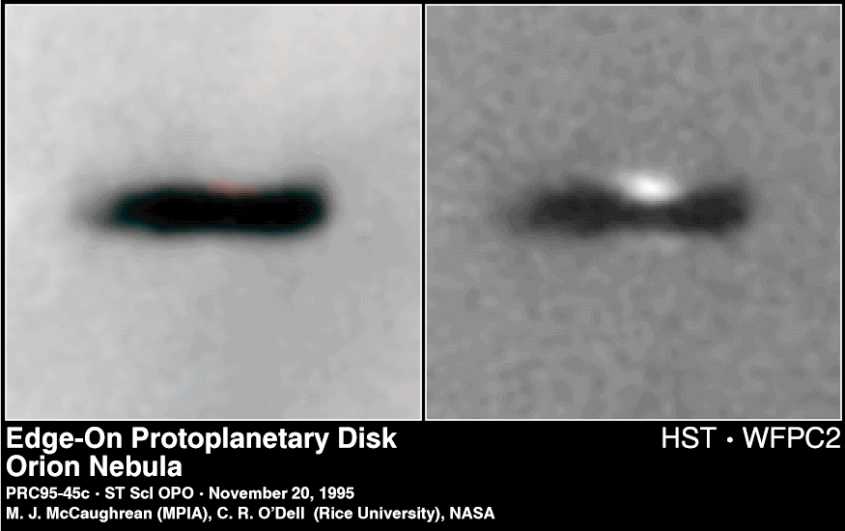
Solar System Formation
Protoplanetary Disks:

Slide 24
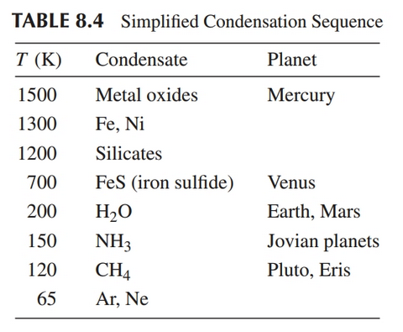
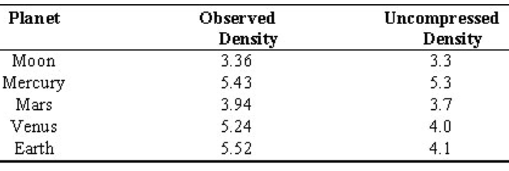
Solar System Formation
Units of g/cm³

Slide 25
Some early surface features
Cratering and Volcanic Flooding
Mercury is very much like the moon
Venus has active volcanoes, surface hidden by clouds but not radar
Nice website from Guy Worthey* at WSU:
http://astro.wsu.edu/worthey/astro/html/lec-mercvenus.html
*A Wyoming graduate now an astro professor
More in coming chapters on each of the planets…

