Slide 1
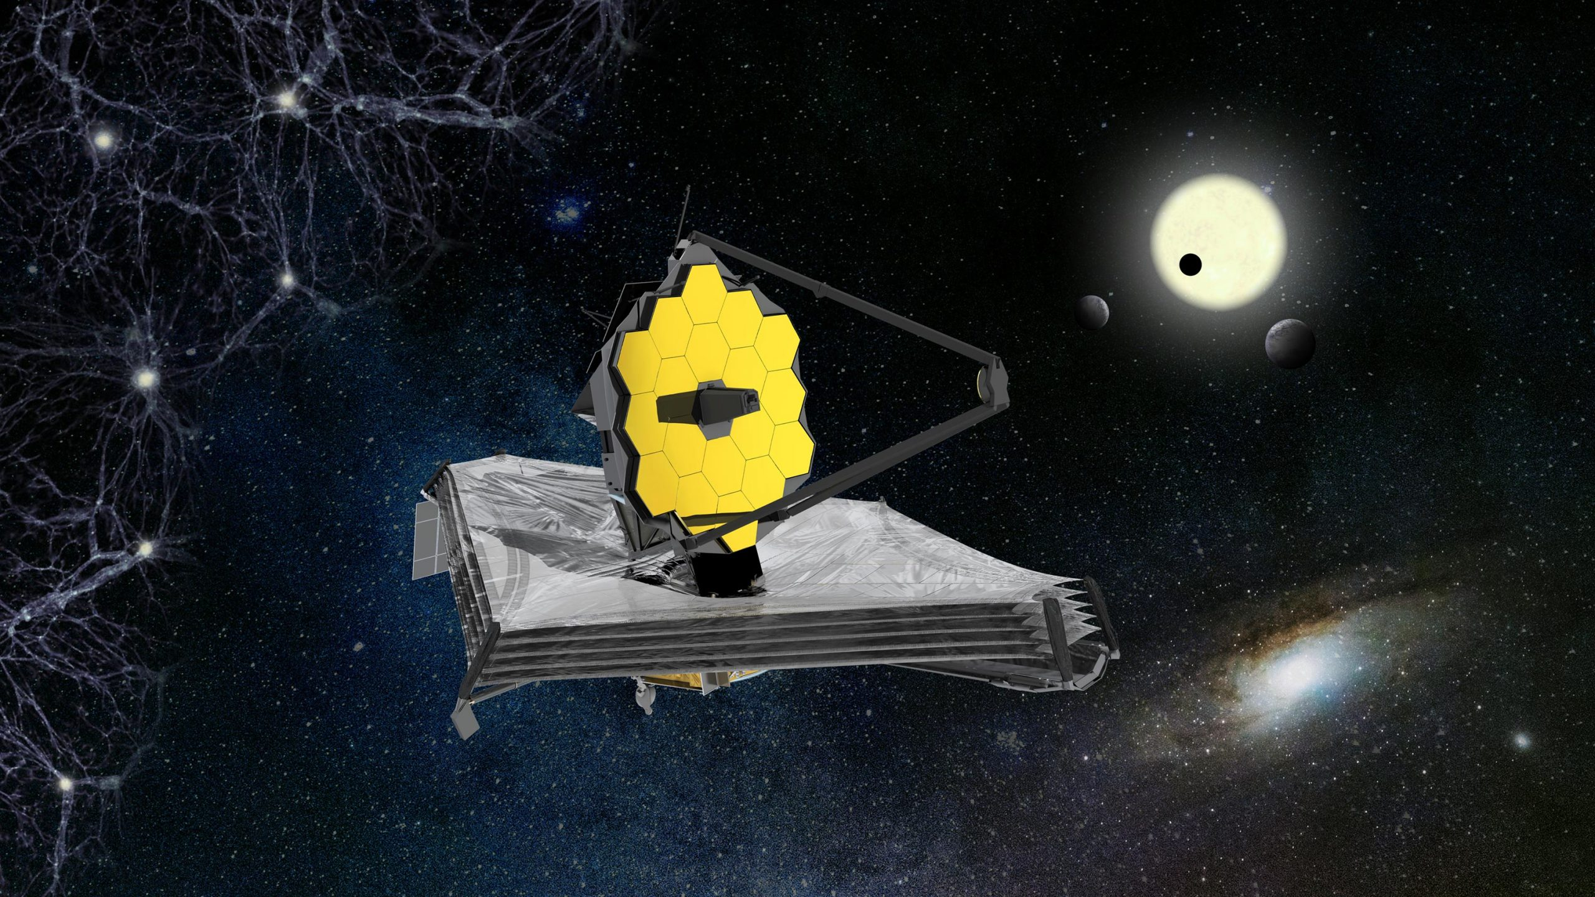
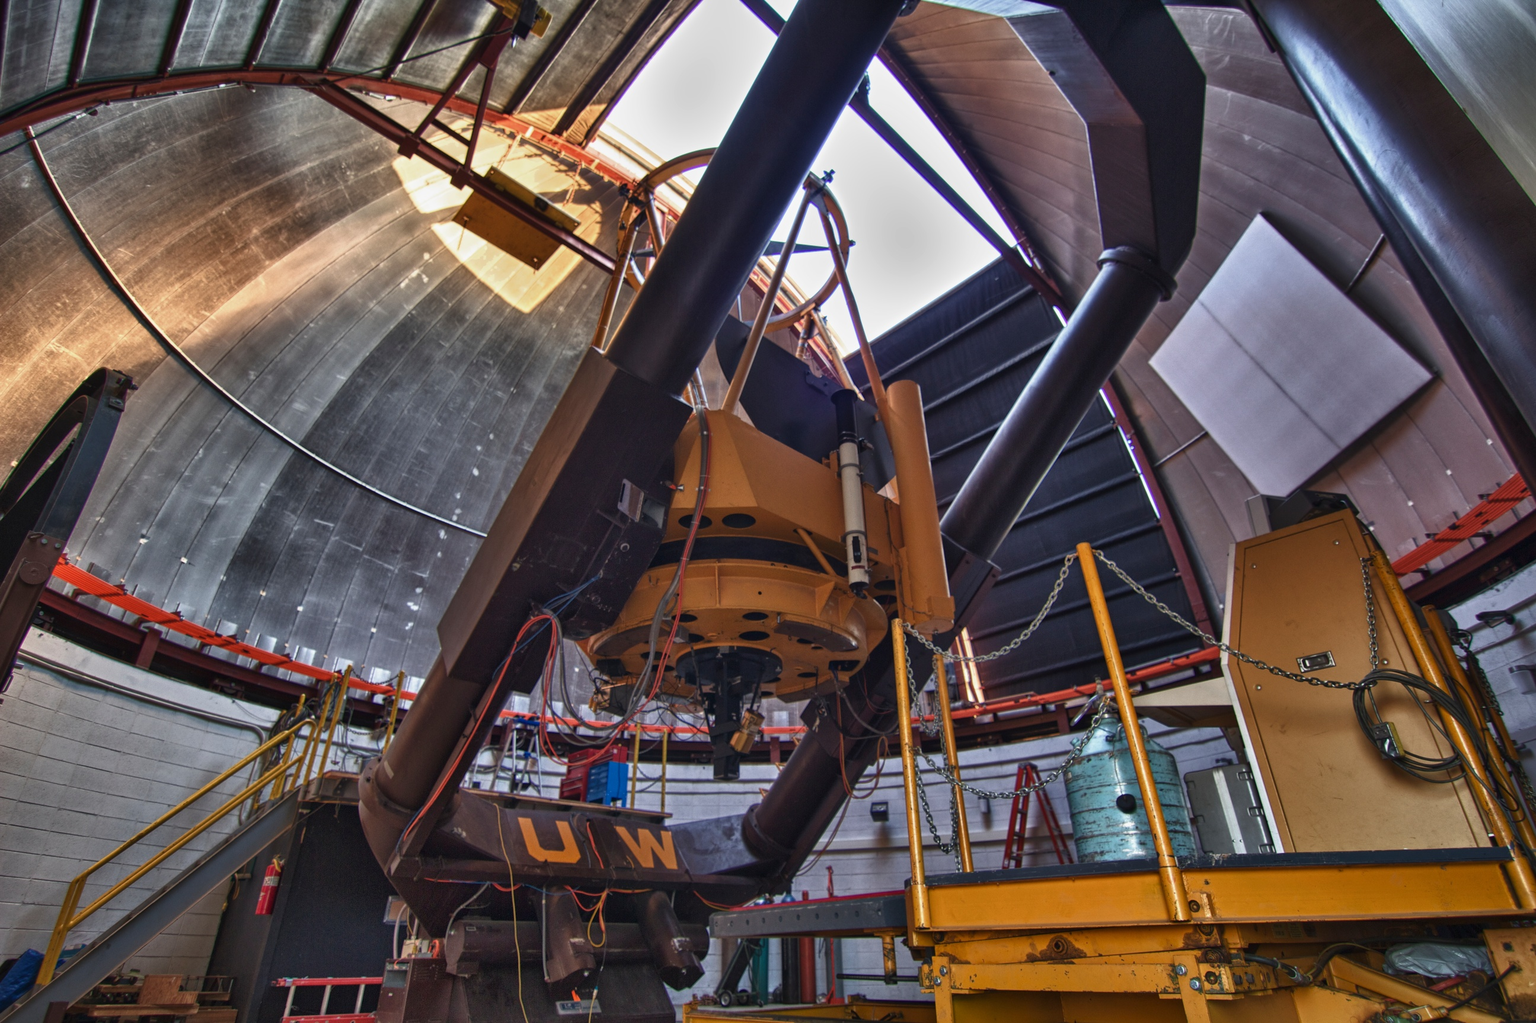
ASTR 2310
General Astronomy I
Professor Mike Brotherton
Ryden & Peterson Chapter 6: Astronomical Detection of Light
The Telescope as a Camera, Refracting and Reflecting, Quality of Images
Instruments and Detectors, Observations and Photon Counting
Observations at Other Wavelengths, Modern Telescopes

Slide 2
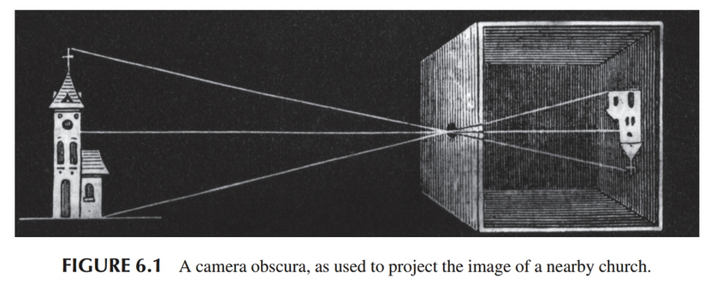
Camera Obscura

Slide 3
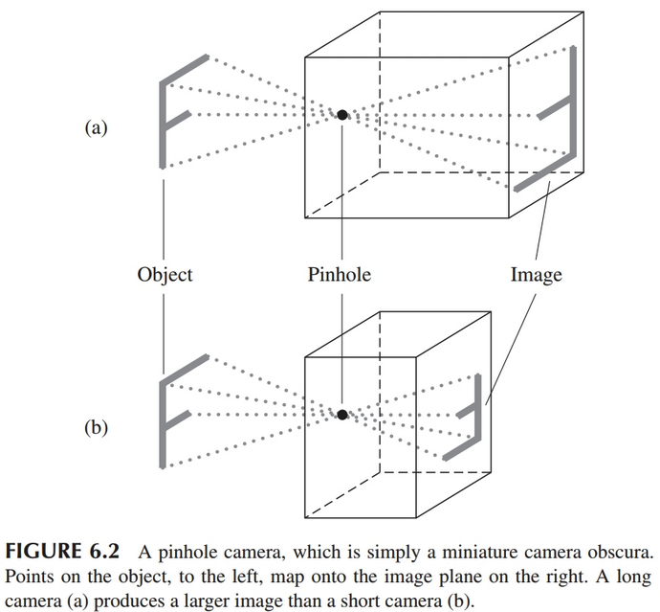
Pinhole Camera
Image is inverted.
Focal length F is length of box
Exposure time can be long since pinhole is small
Exposure time proportional to area of image, or F squared.
Terminology: a short focal length is therefore “fast” and a long one “slow”

Slide 4
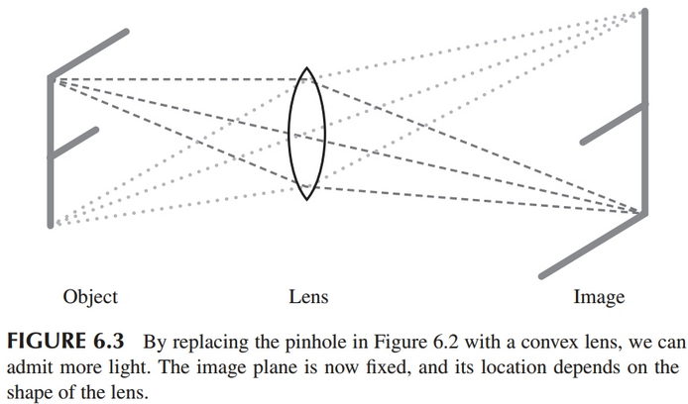
Lenses

Slide 5
Lenses
Lens is transparent with a refractive index different from air (or surrounding medium).
Refractive index n=c/v_{m}, where v_{m} is the speed of light in the material and c is in a vacuum.
Glass is usually around n=1.5.
Air, n=1.0003

Slide 6
Snell’s Law

Slide 7
f-number
Focal length F depends on shape of lens and its refractive index.
Focal ratio f=F/D, where D is diameter of the lens
An f/8 lens has F/D=8.
This basically tells you how “fast” light rays converge.
Can also use f-numbers when discussing mirrors, which we will get to.

Slide 8
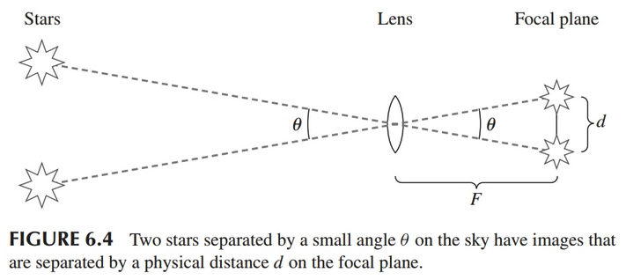
Plate Scale: relating image size to angle

Slide 9




Plate Scale: relating image size to angle

Slide 10
Example: The Human Eye
The human eye:
Focal ratio f=F/D, where D is the diameter of the lens
Bright surroundings, f/8
In the dark, f/2

Slide 11
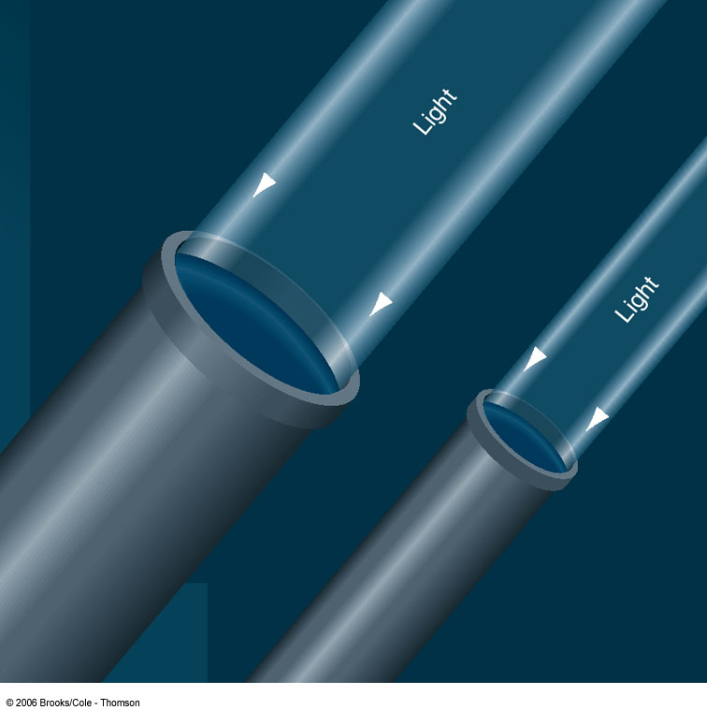
The Powers of a Telescope (I):
Size does matter!
1. Light-gathering power: Depends on the surface area A of the primary lens / mirror, proportional to diameter squared:
D
A = π (D/2)²

Slide 12
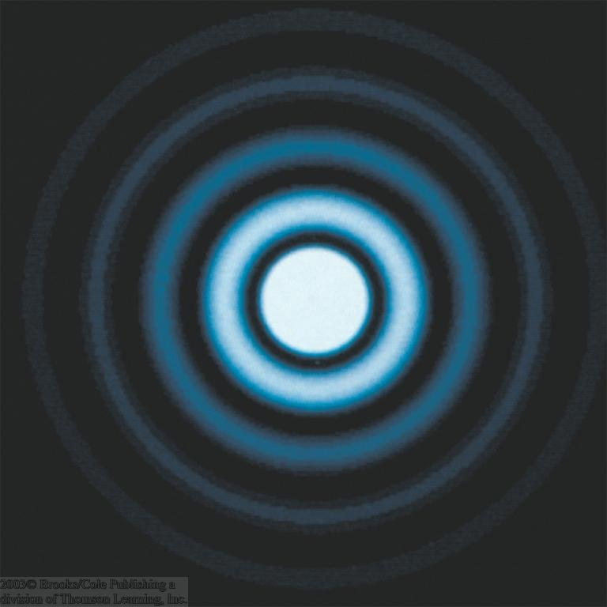
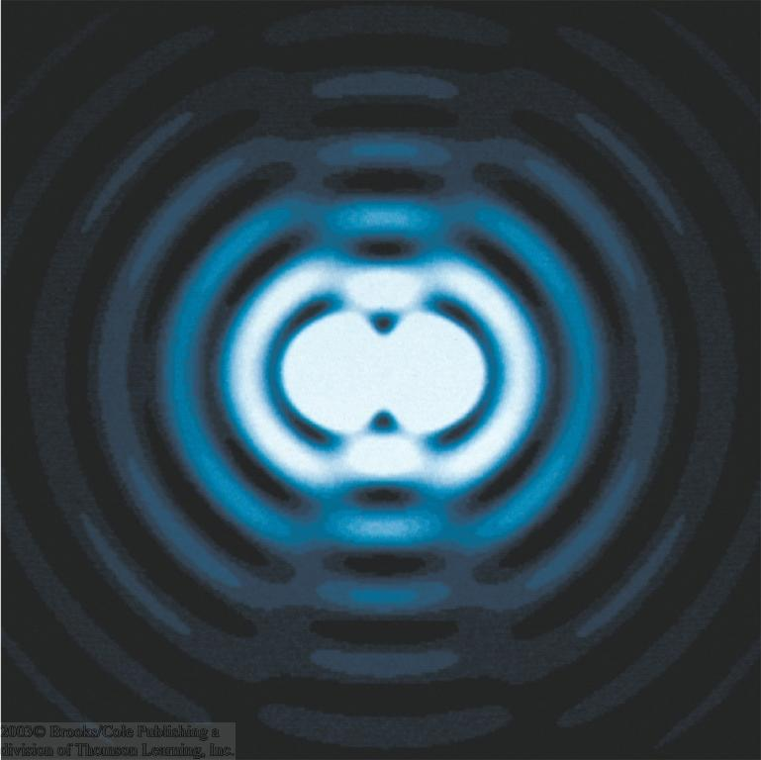
The Powers of a Telescope (II)
2. Resolving power: Wave nature of light => The telescope aperture produces fringe rings that set a limit to the resolution of the telescope.
Astronomers can’t eliminate these diffraction fringes, but the larger a telescope is in diameter, the smaller the diffraction fringes are. Thus the larger the telescope, the better its resolving power.
α_{min} = 1.22 (λ/D)
α_{min}
For optical wavelengths, this gives
α_{min} = 11.6 arcsec / D[cm]

Slide 13
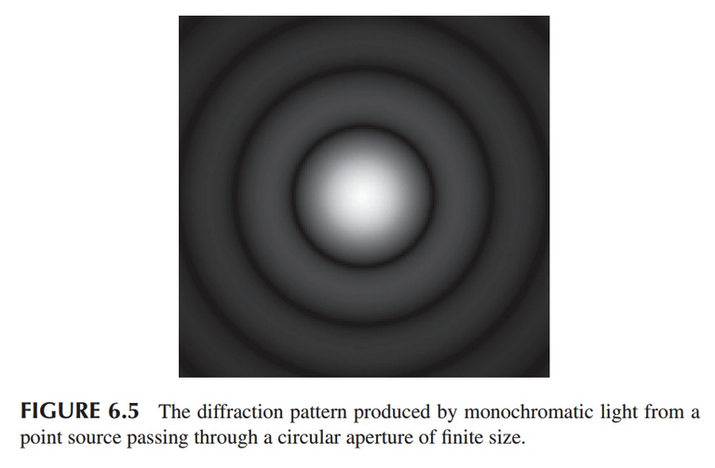

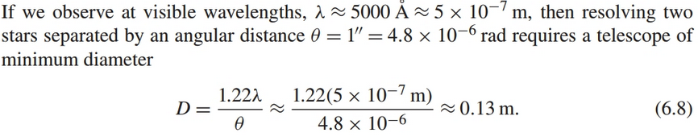
Diffraction Limited Image Resolution
The “Airy disk” is the bright central region of the ringed pattern from a point source through a circular aperture.

Slide 14
Astronomical Seeing

Slide 15
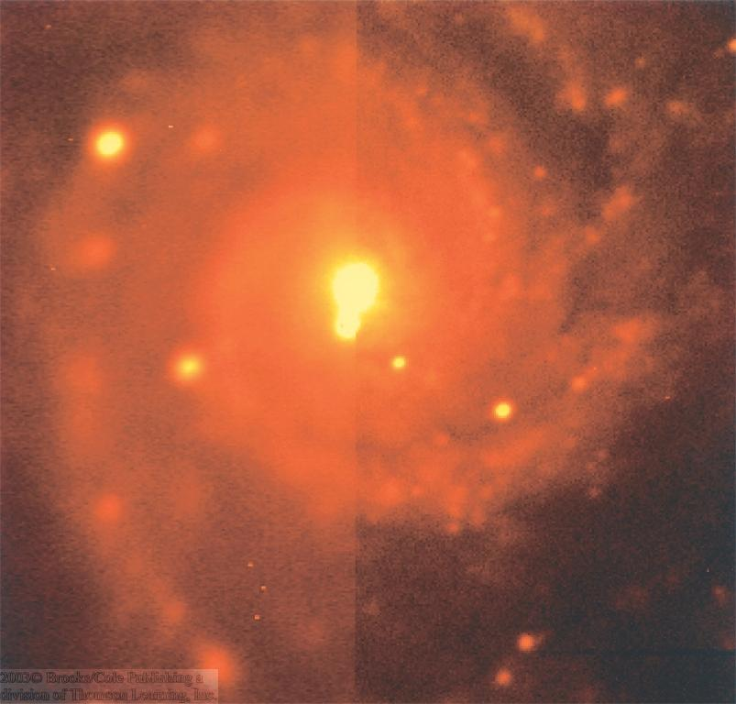
Seeing
Weather conditions and turbulence in the atmosphere set further limits to the quality of astronomical images
Bad seeing
Good seeing

Slide 16
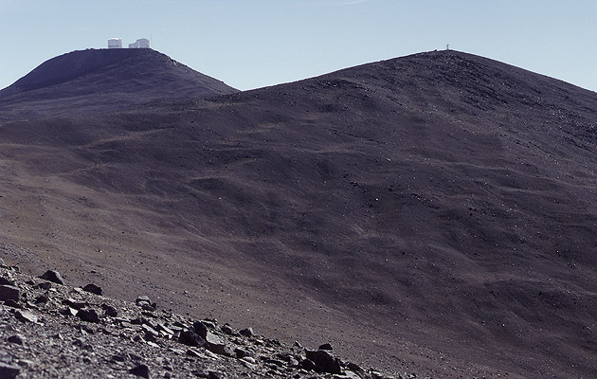
The Best Location for a Telescope (I)
Paranal Observatory (ESO), Chile
http://en.wikipedia.org/wiki/Paranal_Observatory
On high mountain-tops – to avoid atmospheric turbulence (→ seeing) and other weather effects

Slide 17
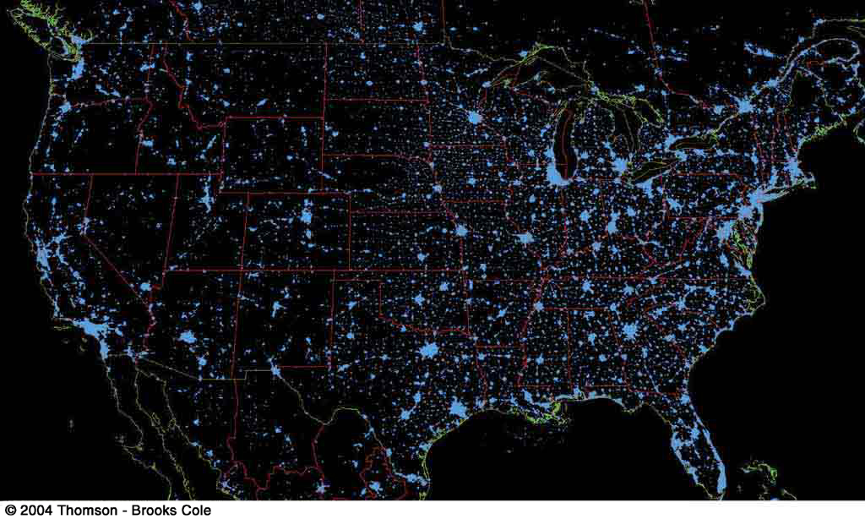
The Best Location for a Telescope (II)
Far away from civilization – to avoid light pollution

Slide 18
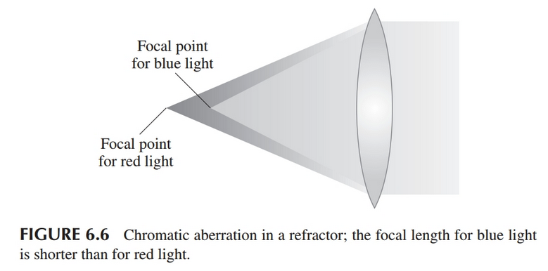
Refracting Telescopes (lenses)

Slide 19
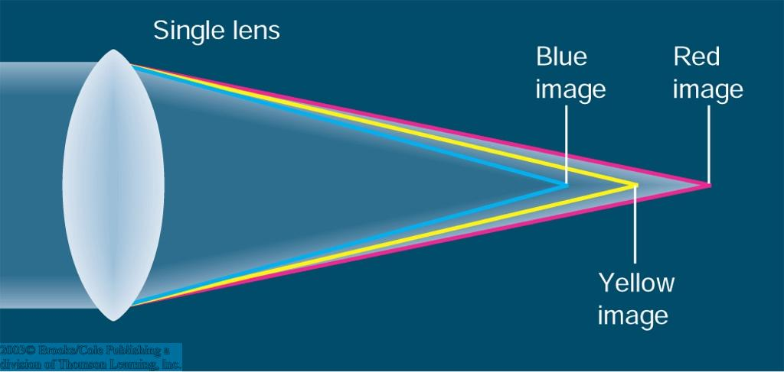
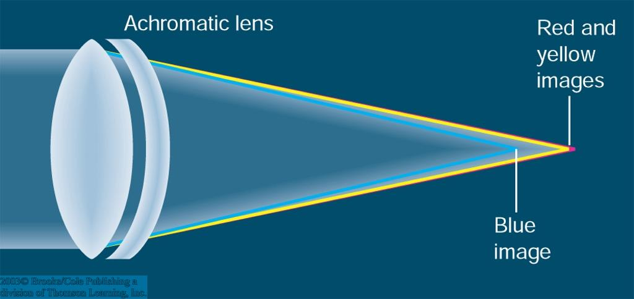
Refracting Telescopes (lenses)
Chromatic aberration: Different wavelengths are focused at different focal lengths (prism effect).
Can be corrected, but not eliminated by second lens out of different material.
Difficult and expensive to produce: All surfaces must be perfectly shaped; glass must be flawless; lens can only be supported at the edges.

Slide 20
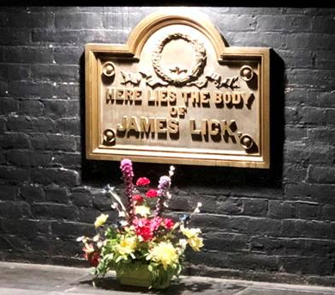
Lick 36” Refractor (1888)
Hard to build lenses (f/19) much bigger!
First Mountaintop Telescope
Nice to look through for your guests at a wedding reception.
"Here lies the body of James Lick".

Slide 21
Amazing History of the Telescope
Nice video (12 minutes) about historical telescope development through the nineteenth century. Pretty cool stuff! Watch outside of class, please.

Slide 22
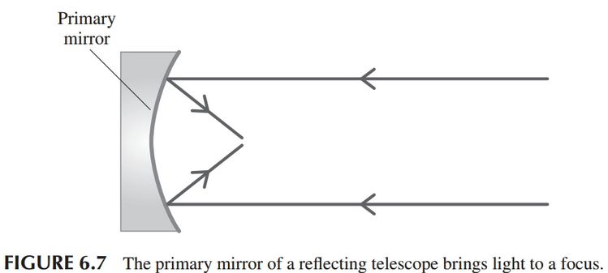
Reflecting Telescopes (mirrors, now standard)

Slide 23
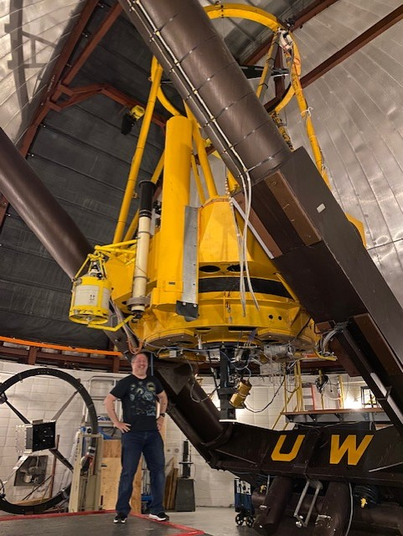
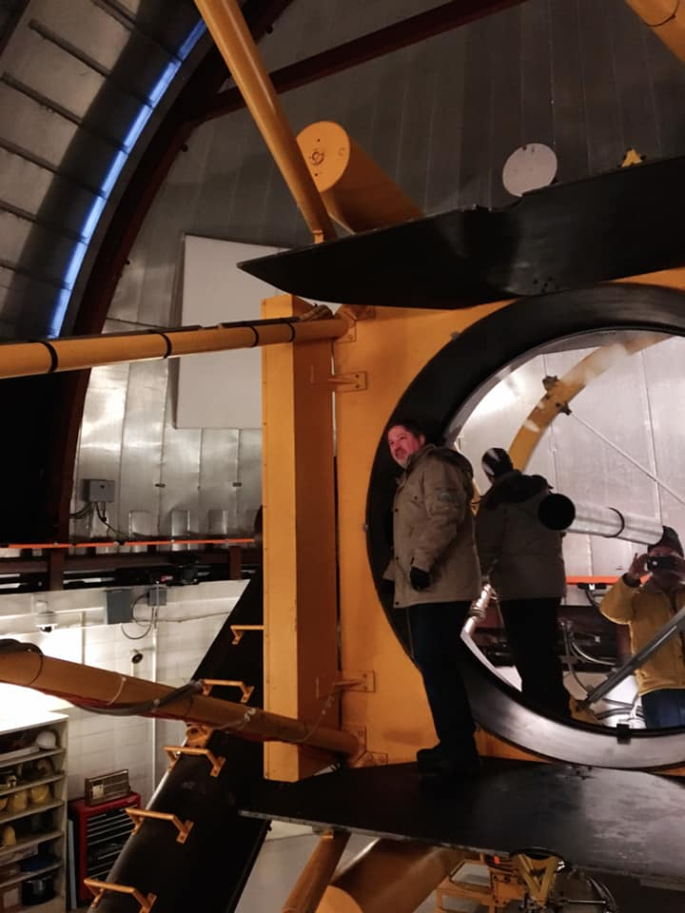
WIRO 2.3-m
(1977)

Slide 24
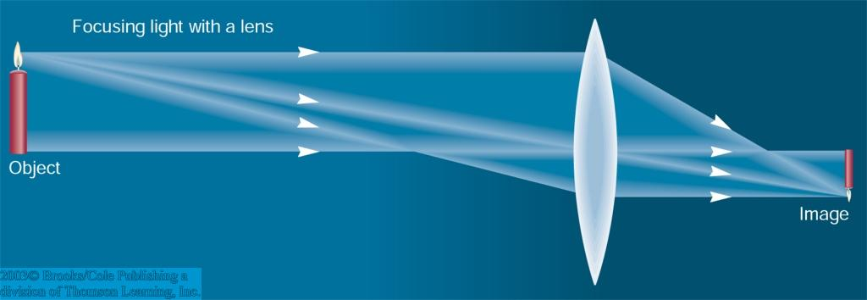
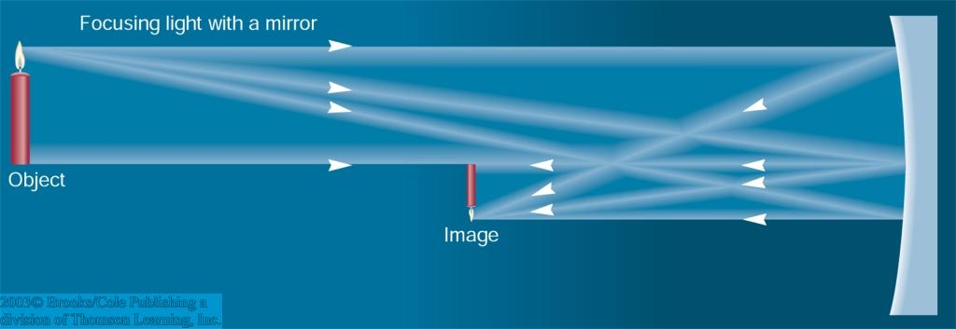
Refracting / Reflecting Telescopes
Refracting Telescope: Lens focuses light onto the focal plane
Focal length
Reflecting Telescope: Concave Mirror focuses light onto the focal plane
Focal length
Almost all modern telescopes are reflecting telescopes.

Slide 25
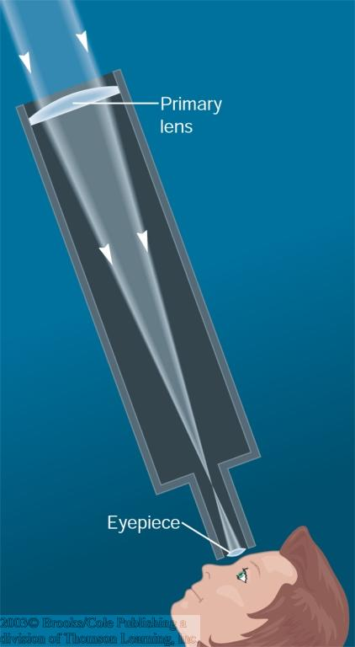
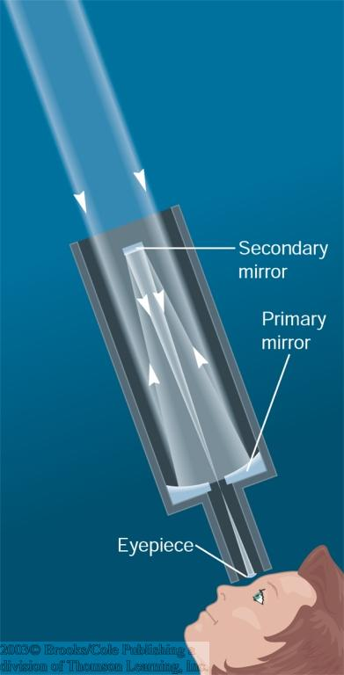
Secondary Optics
In reflecting telescopes: Secondary mirror, to re-direct light path towards back or side of incoming light path.
Eyepiece: To view and enlarge the small image produced in the focal plane of the primary optics.

Slide 26
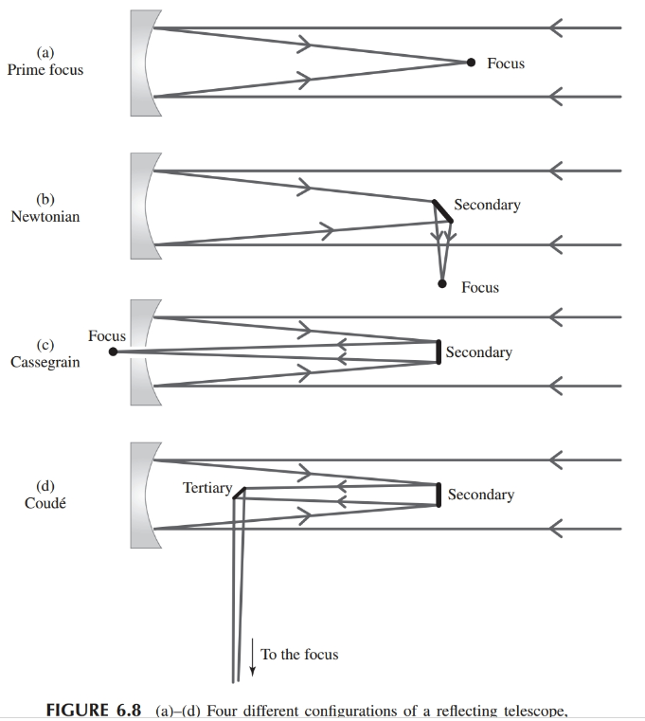
Reflectors: some optical configurations

Slide 27
Image Quality Issues with Optical Systems
Spherical aberration: different annuli of lens or mirror have different focal lengths, therefore not one clean focal plane.
Coma: Light rays near edge of lens/mirror come to a focus at a larger distance than those near the center (seen in off-axis images from parabolic mirrors).
Astigmatism: Happens when radius of curvature differs along different axes.
Curvature of field: Detectors usually flat, but real focal surface is not a plane, but curved, in practice.
Distortion: pincushion (positive), barrel (negative).

Slide 28
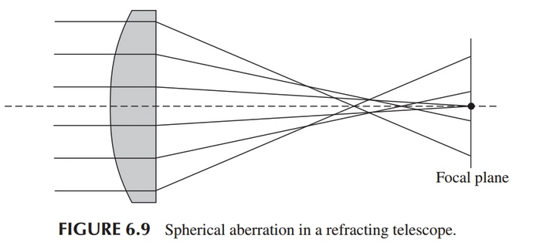
Image Quality Issues with Optical Systems

Slide 29
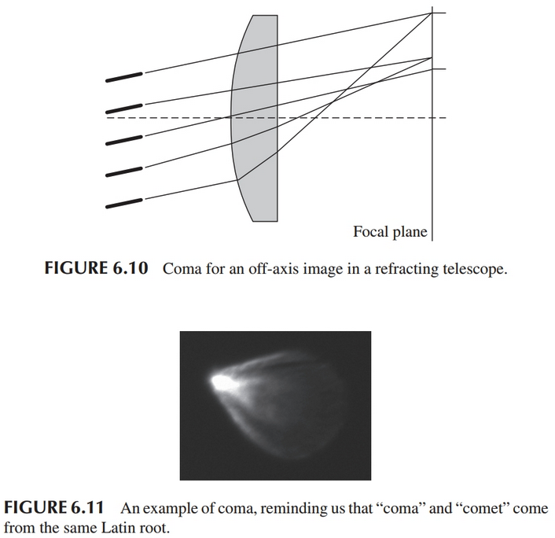
Image Quality Issues with Optical Systems

Slide 30
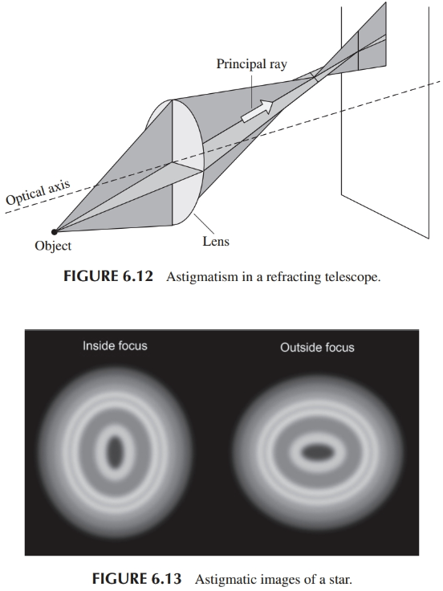
Image Quality Issues with Optical Systems

Slide 31
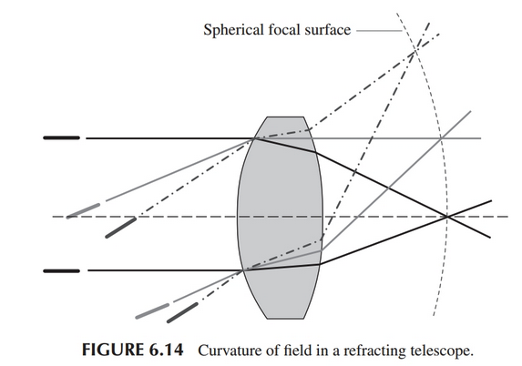
Image Quality Issues with Optical Systems

Slide 32
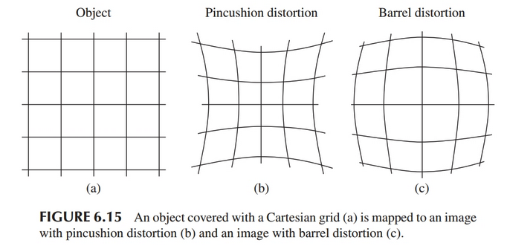
Image Quality Issues with Optical Systems

Slide 33
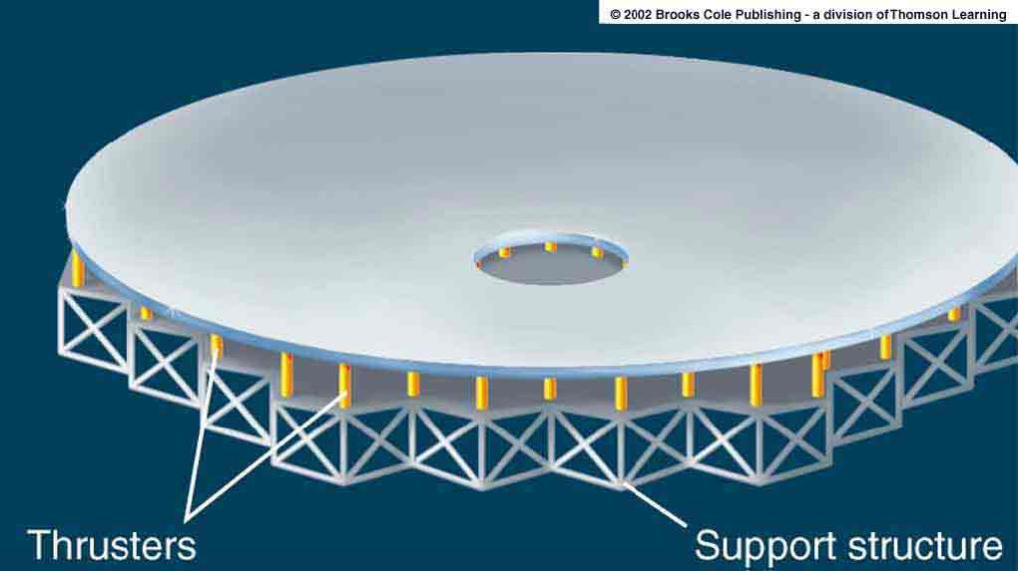
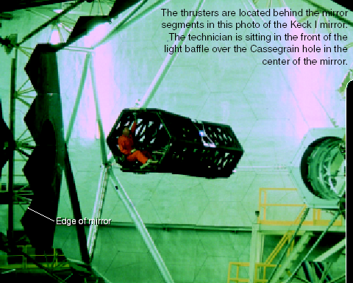
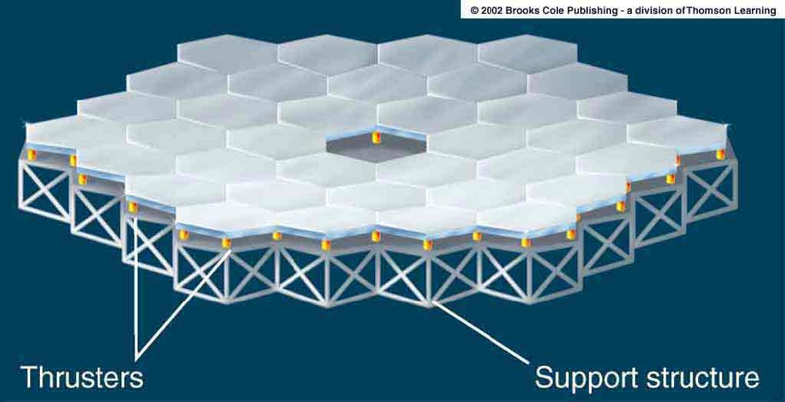
Advances in Modern Telescope Design
Lighter mirrors with lighter support structures, to be controlled dynamically by computers
Floppy mirror
Segmented mirror

Slide 34
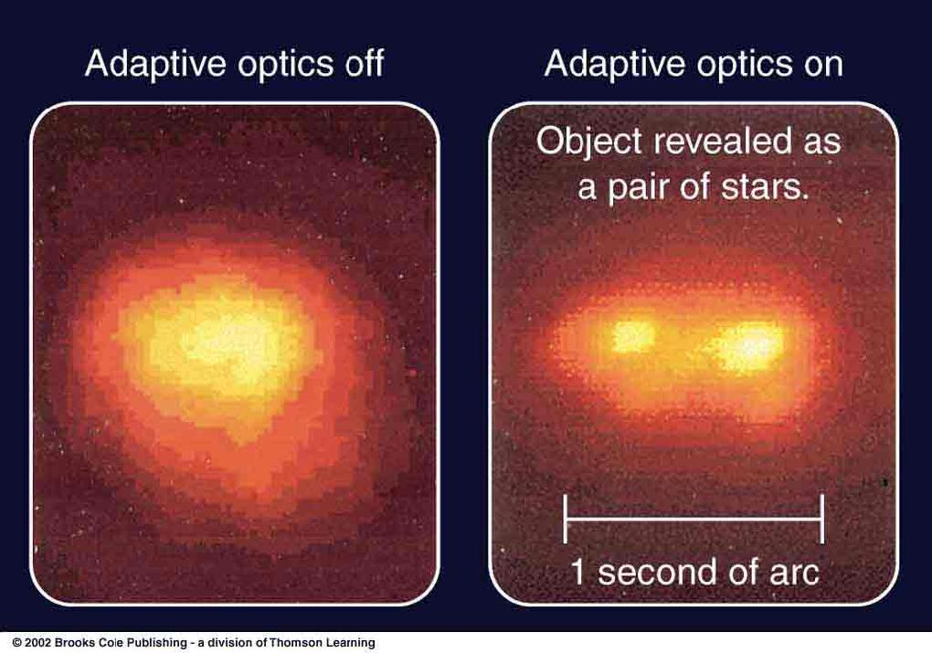
Adaptive Optics – Ground-based telescopes
Computer-controlled mirror support adjusts the mirror surface (many times per second) to compensate for distortions by atmospheric turbulence

Slide 35
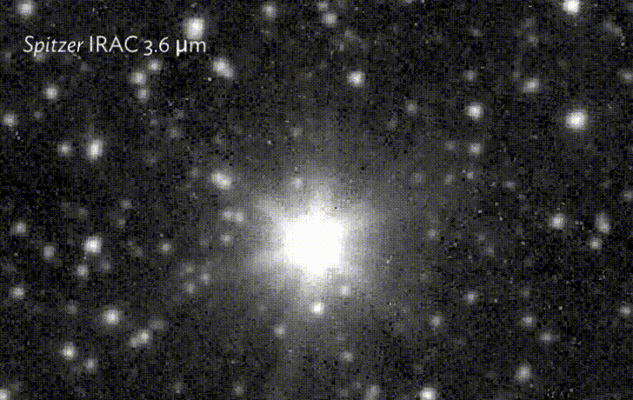
Point Spread Function or PSF

