Slide 1
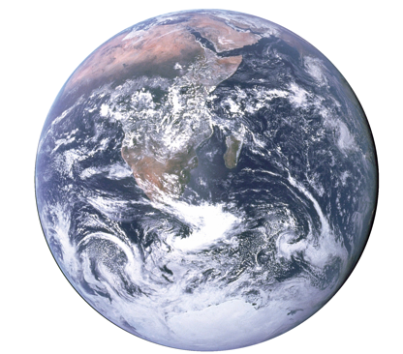
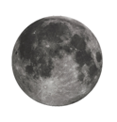
ASTR 2310 General Astronomy I
Professor Mike Brotherton
Ryden & Peterson Chapter 4: Earth-Moon System

Slide 2
Voyager, 1977 (NASA/JPL)

Slide 4
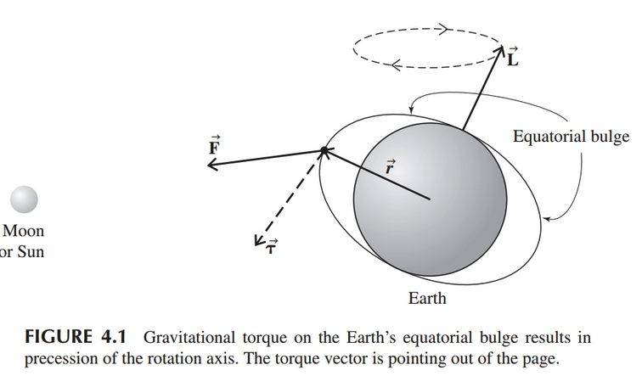


Oblate Spheroids and Precession
Exaggerated!

Slide 5
Tides (from moon and sun)
Launch Pad Astronomy video (8 minutes)
Not just the water going up and down!
Gravity is an inverse square law. Things pull on the near side harder than on the far side – and this is a stretching, differential force in addition to the average pull.

Slide 6



Tides (from moon and sun)
Differential tidal force:
Taylor series expansion:

Slide 7

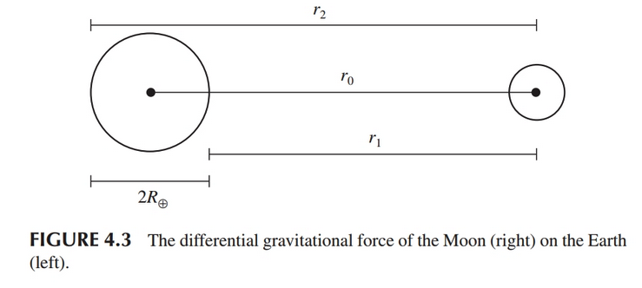
Tides (from Moon)
Differential Gravitation Force near center of Earth:
Now can evaluate at Earth’s surfaces

Slide 8


Tides (Moon, stretching)
Near point (r₁=r₀-R_{E}):
Far point (r₂=r₀+R_{E}):
Note the signs!

Slide 9


Tides (Sun vs. Moon)
Differential force from sun:
Ratio of tidal forces of sun/moon:

Slide 10
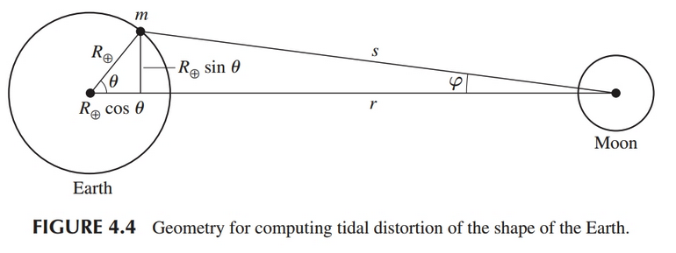


Tides (more general, 2D)
Force on mass m:
Vs. central force:

Slide 11
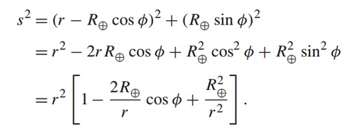
Tides (more general, 2D)
s:

Slide 12
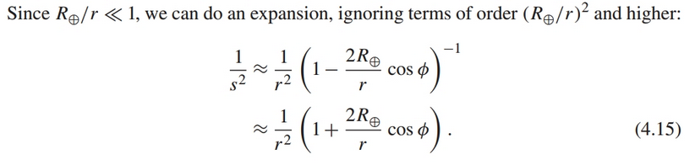

Tides (more general, 2D)
Series expansion.

Slide 13
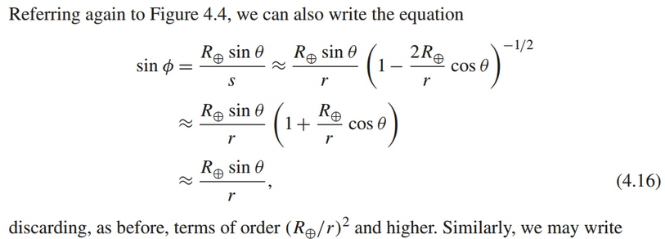
Tides (more general, 2D)

Slide 14
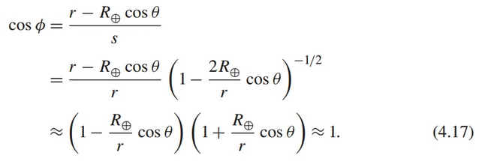
Tides (more general, 2D)

Slide 15

Tides (more general, 2D)

Slide 16
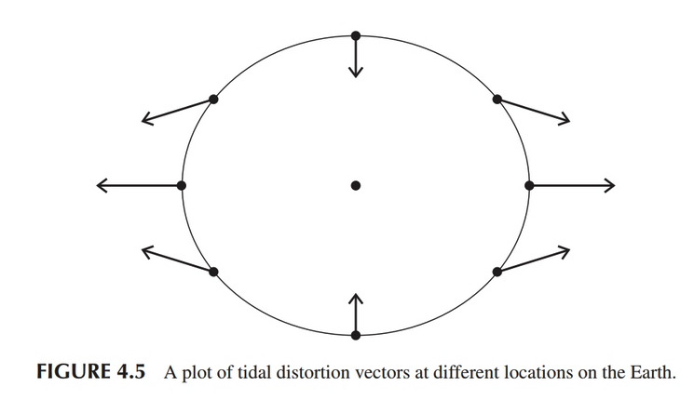
Tides (more general, 2D)

Slide 17
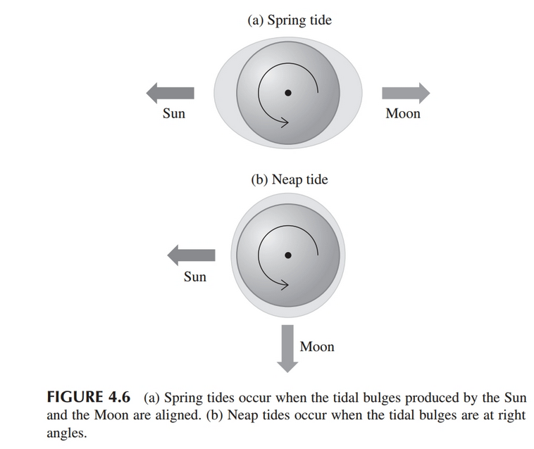
Spring Tides and Neap Tides

Slide 18
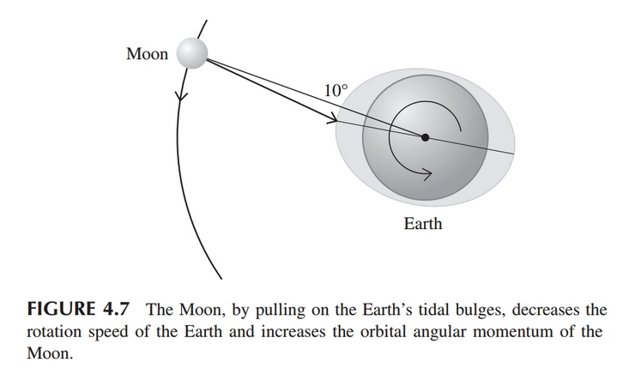
Tidal Braking
Lunar tidal bulge moves around monthly, and Earth’s rotation drags it forward about 10 degrees. Pulls on moon, slows Earth rotation.

Slide 19



Tidal Braking
Changes in angular momentum result in changes in orbital radius.
Changes in moon’s orbital momentum come out of Earth’s rotational angular momentum.

Slide 20



Tidal Braking
Approximating Earth as a constant density sphere.

Slide 21





Tidal Braking

Slide 22
Limits to sizes of orbits
Quasi-minimum orbital size: Roche Limit
Maximum: Hill radius

Slide 23
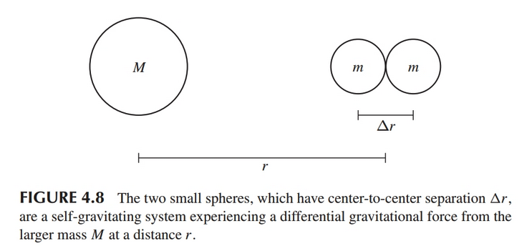
Roche Limit
Quasi-minimum orbital size: Roche Limit

Slide 24
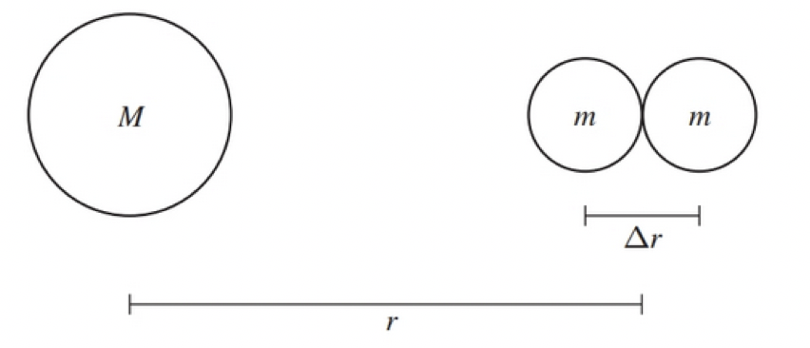


Roche Limit
Differential tidal force from M on the two masses:
Gravitational force between two masses:

Slide 25


Roche Limit
Equate attractive and tidal forces:
Solve for the Roche limit r_{R}:

Slide 26




Roche Limit in terms of density
Assume uniform material, spheres.
Fluid approximation better:
Discuss!

Slide 27
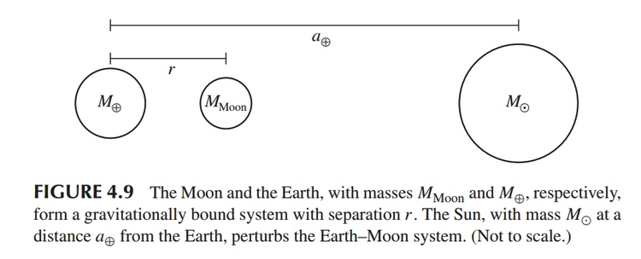

Hill Radius: Maximum orbit (for a moon)
Compare sun’s Acceleration of moon and Earth:

Slide 28
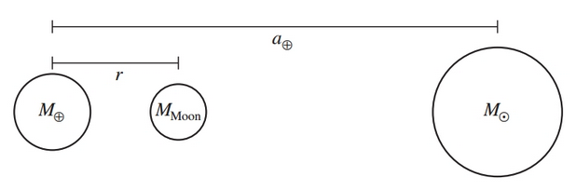
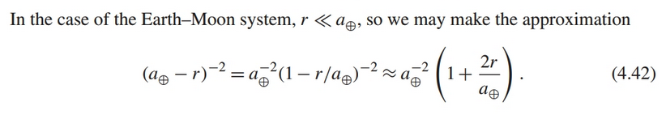

Hill Radius:
Differential acceleration of Earth and Moon by Sun:

Slide 29


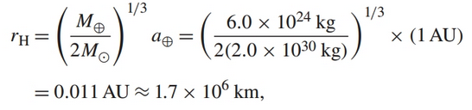
Hill Radius:
Increase r until differential acceleration of Earth and Moon by Sun equals the acceleration of the Moon by Earth:

Slide 30
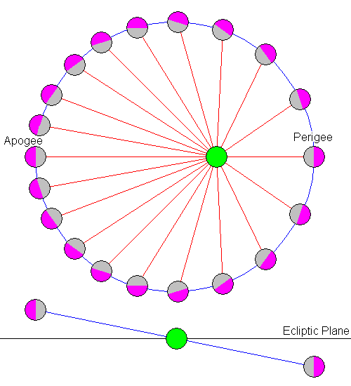
Lunar Orbit, etc.
Titled by 5.1 degrees compared to the ecliptic
Librations (in longitude due to eccentricity of lunar orbit, and in latitude due to orbital tilt):

Slide 31
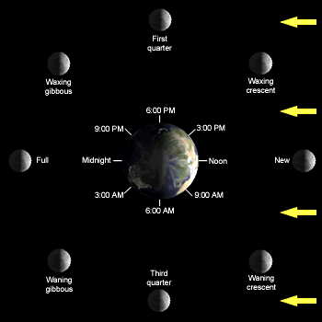
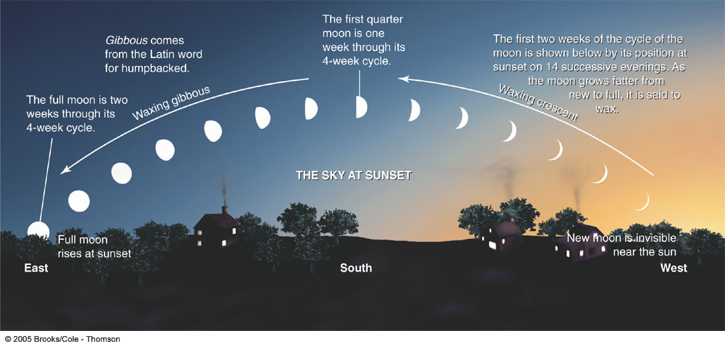
Phases of the Moon
Video
Quiz and check

Slide 32
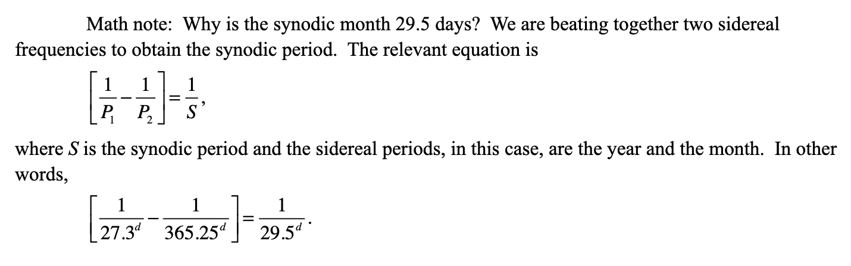
Lunar Periods
Sidereal vs. Synodic months
P_syn = 29.531 days (e.g. new moon to new moon)‏
P_sid = 27.322 days

Slide 33
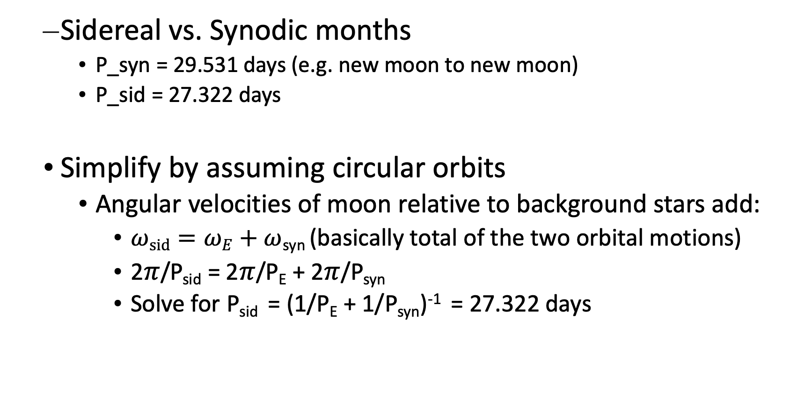
Lunar Periods
Sidereal vs. Synodic months
P_syn = 29.531 days (e.g. new moon to new moon)‏
P_sid = 27.322 days
Simplify by assuming circular orbits
Angular velocities of moon relative to background stars add:
$ωsid=ωE+ω$_{syn} (basically total of the two orbital motions)
2$π$/P_{sid} = 2$π$/P_{E} + 2$π$/P_{syn}
Solve for P_{sid} = (1/P_{E} + 1/P_{syn})⁻¹ = 27.322 days

Slide 34
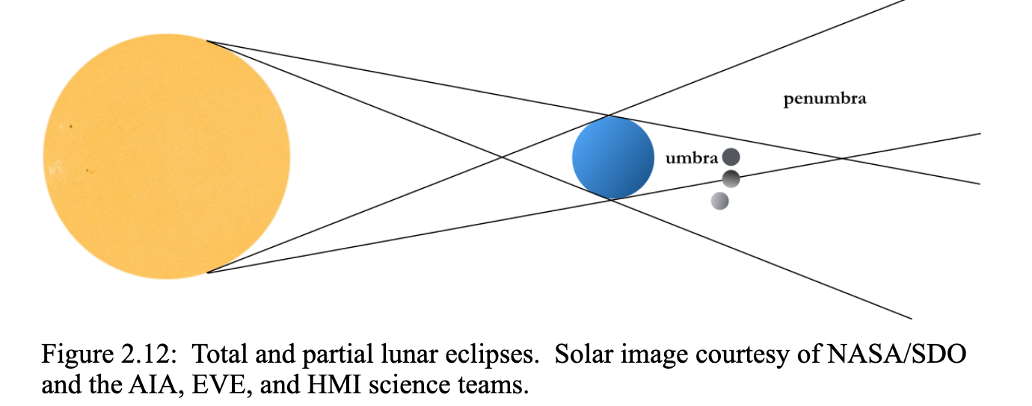
Eclipses and umbra/penumbra

Slide 35
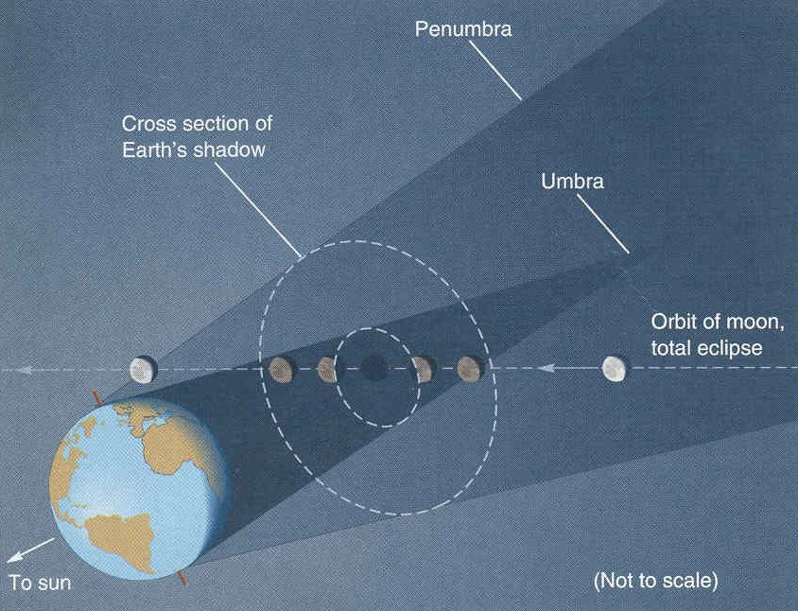
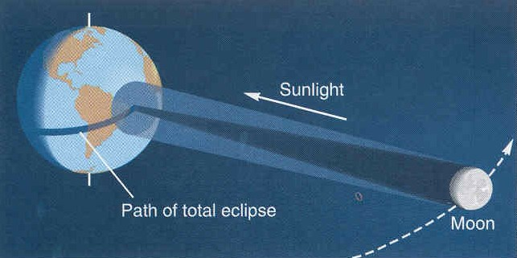
Types of eclipses
Lunar Eclipse
Solar Eclipse
From our text: Horizons, by Seeds
We view the illuminating object (the Sun) and see it blocked out.
Only a few people are in the right place to be in the shadow.
It is “coincidence” that the umbra just barely reaches earth.
We view the illuminated object and watch it go dark.
Everyone on one side of the Earth can see the Moon – so a given lunar eclipse is visible to many people.

Slide 36
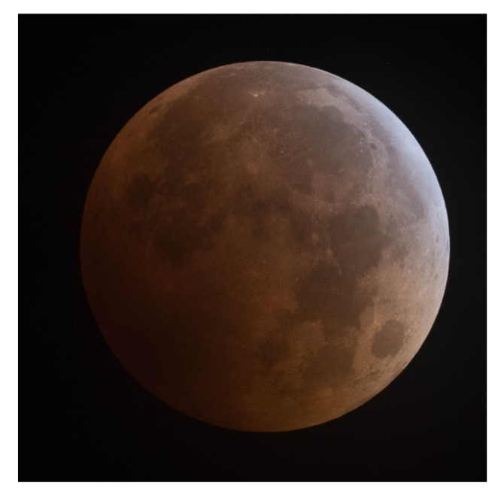
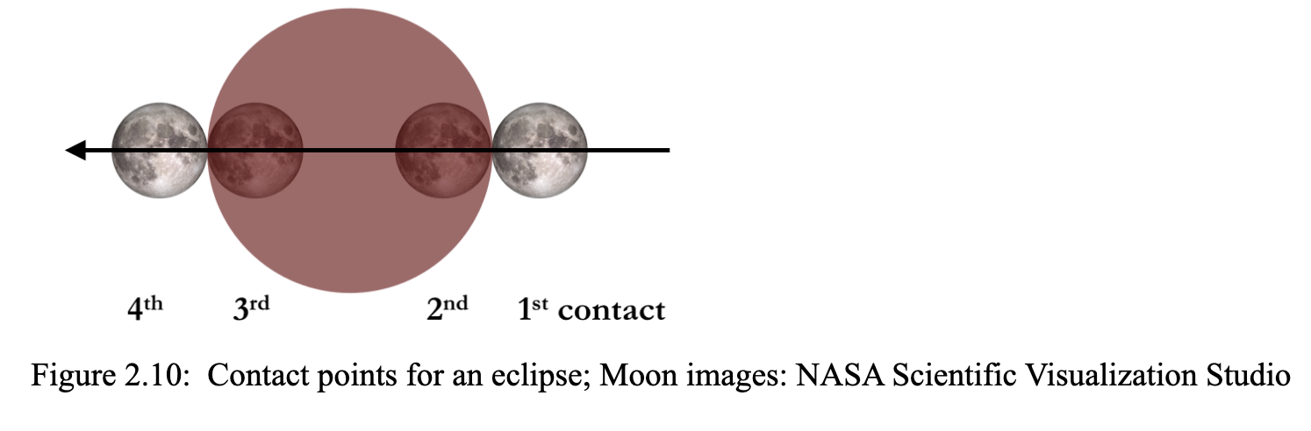
Lunar Eclipses

Slide 37
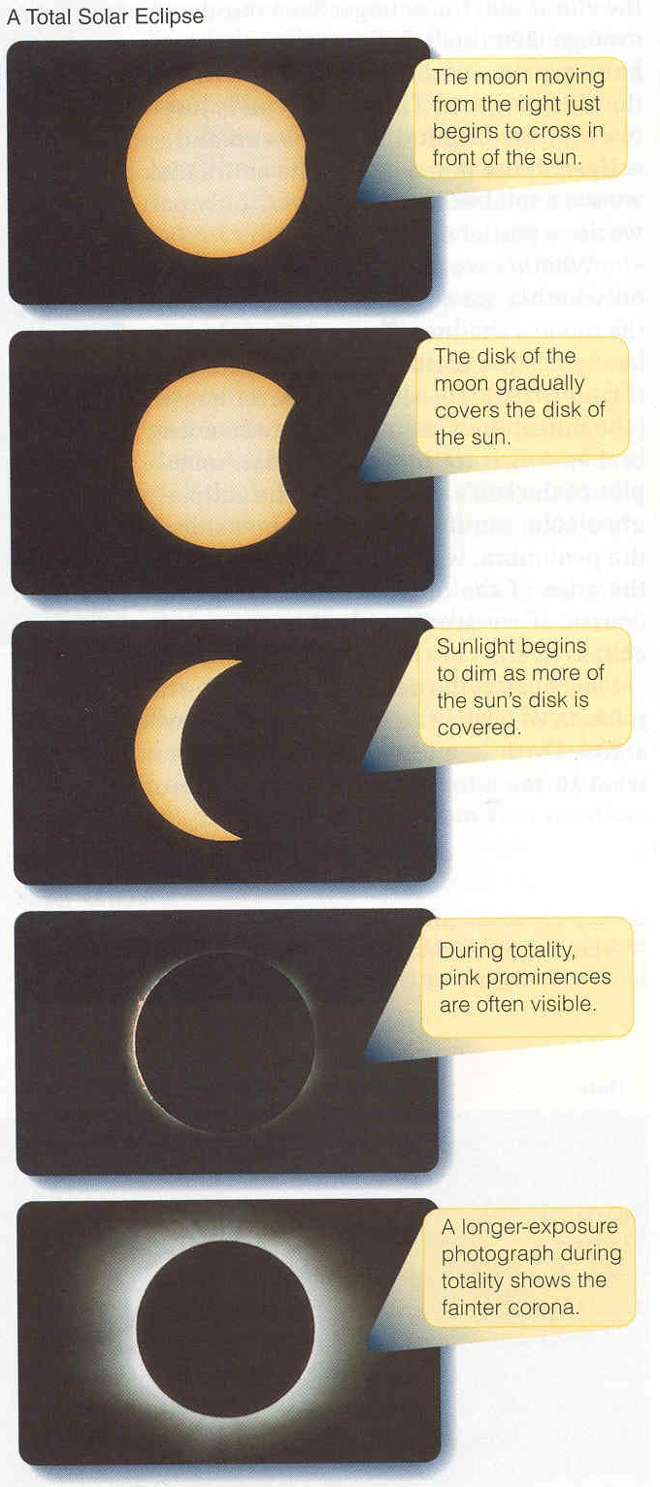
Solar eclipses
If you are outside the penumbra you see the whole sun.
If you are in the penumbra you see only part of the sun.
If you are in the umbra you cannot see any of the sun.
The fact that the moon is just barely big enough to block out the sun results from a coincidence:
The sun is 390 times bigger than the moon, but also almost exactly 390 times further away.
The orbit of the moon is elliptical.
At perigee it can block out the full sun
At apogee it isn’t quite big enough, giving an annular eclipse.
What is the relationship between size, distance, and angle?
From our text: Horizons, by Seeds

Slide 38
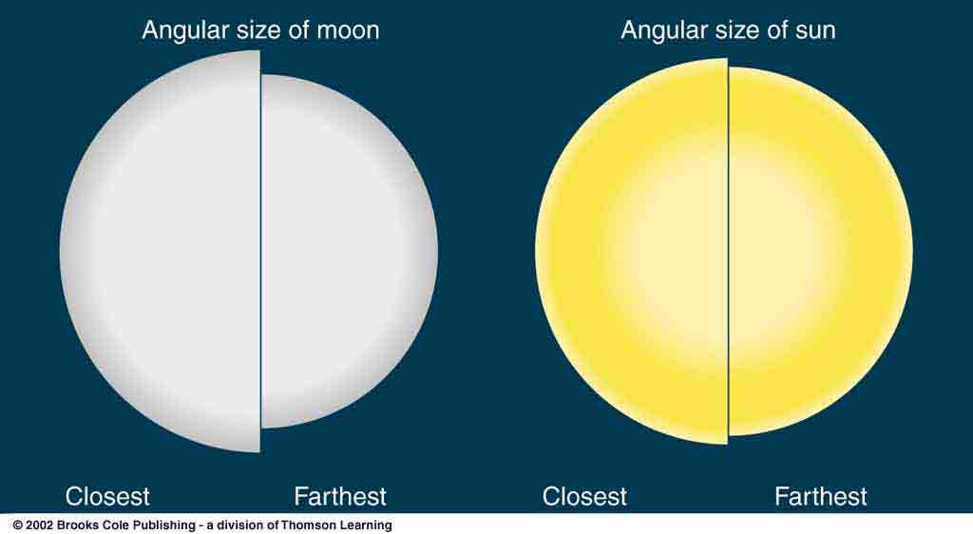
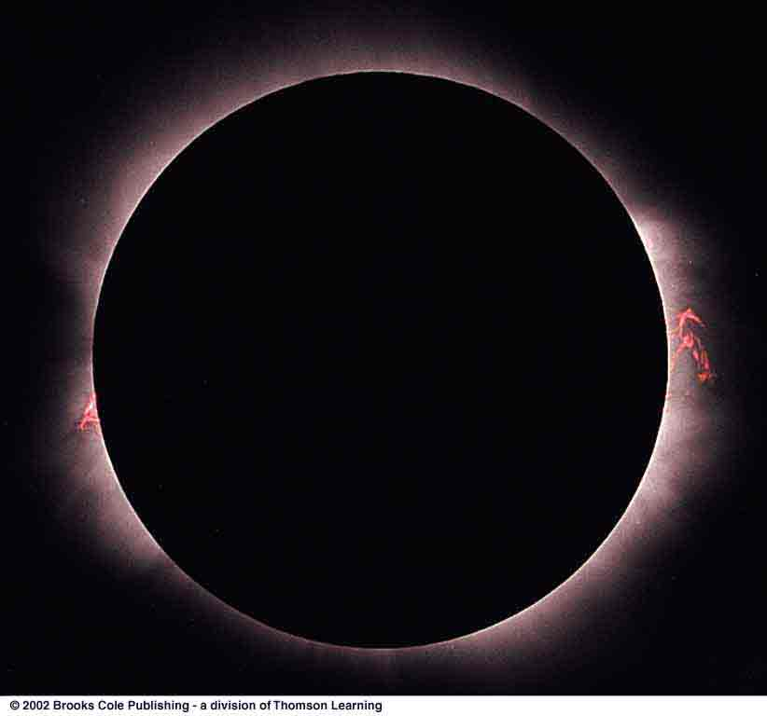
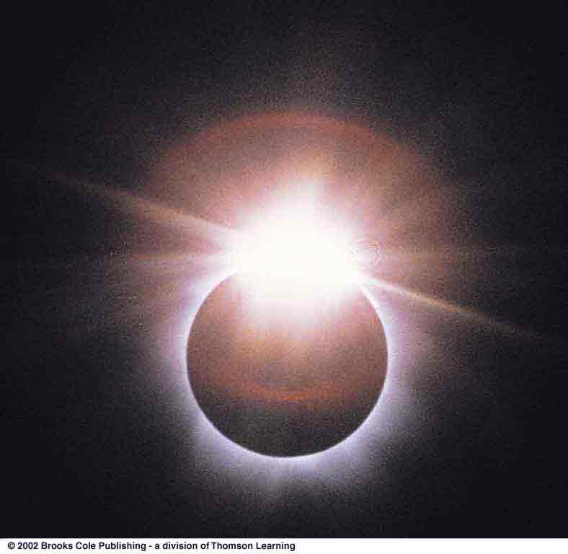
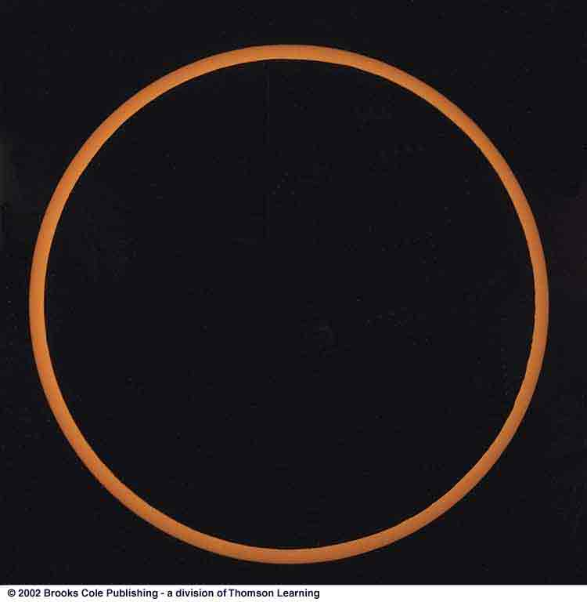
Variations in Solar Eclipses
Elliptical orbits mean angular size variation.
Total Solar Eclipse
Diamond-Ring Effect
Annular Eclipse

Slide 39
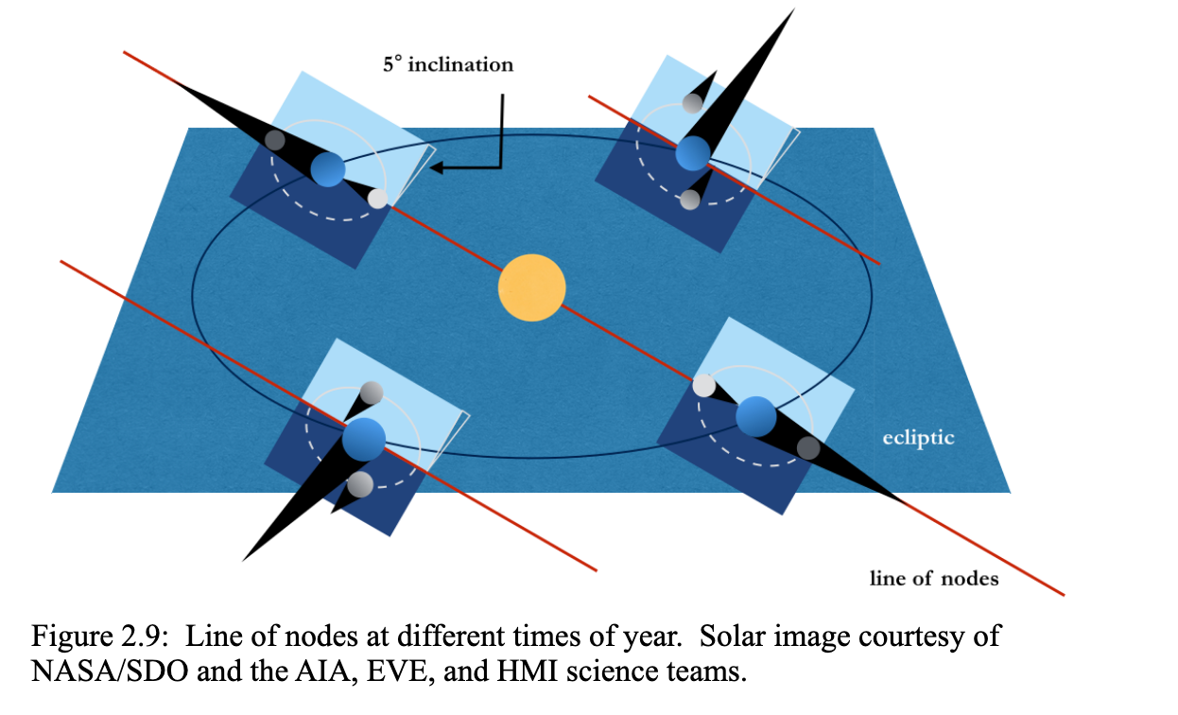
Eclipses and nodes

Slide 40
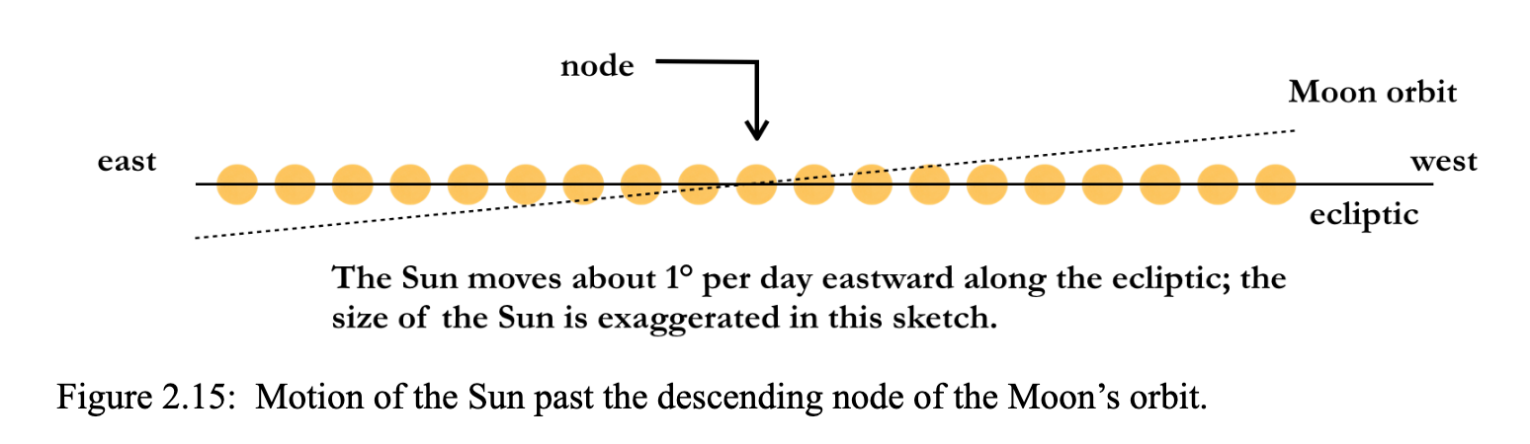
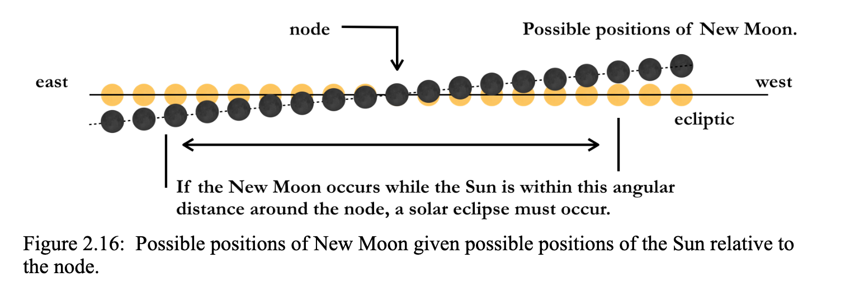
Eclipses and nodes

Slide 41
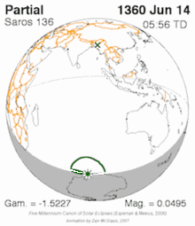
Saros cycle
Nice Universe Today article explaining this:
A period of 223 synodic months syncs up three key lunar cycles which are crucial to predicting eclipses:
Synodic month- The time it takes for the Moon to return to like phase (29.5 days).
Anomalistic month- The time it takes for the Moon to return to perigee (27.6 days).
Draconic month- the time it takes for the Moon to return to a similar intersecting node (ascending or descending) along the ecliptic (27.2 days).
And thus, the saros was born. A saros period is just eight hours shy of 18 years and 11 days, which in turn is equal to 223 synodic, 242 anomalistic or 239 draconic months. 8 hours is 1/3 of a day, so there is a shift westward of about 120 degrees each cycle.
Image credit: A.T. Sinclair/NASA/GSFC/Wikimedia Commons

Slide 42
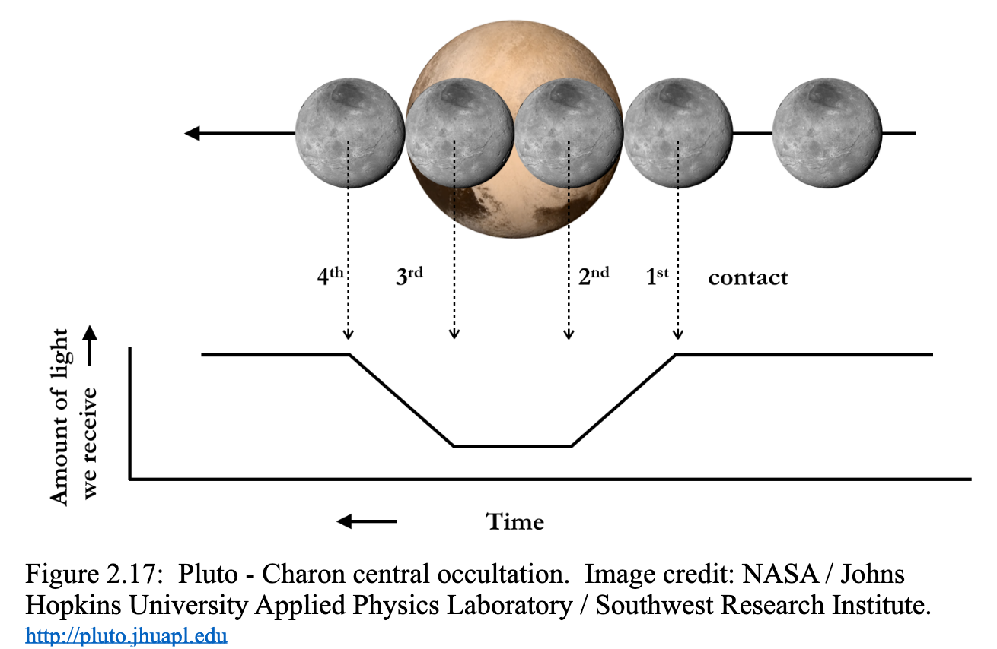
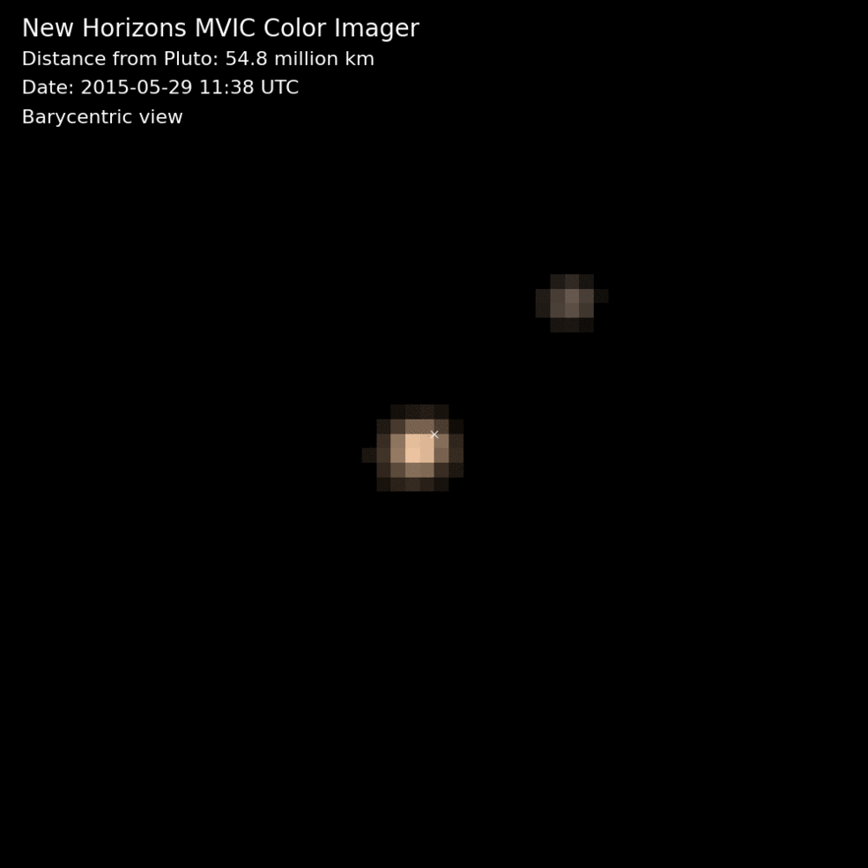
Transits in general useful

Slide 43
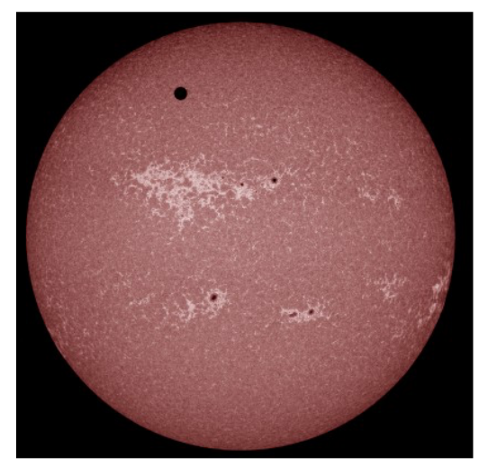
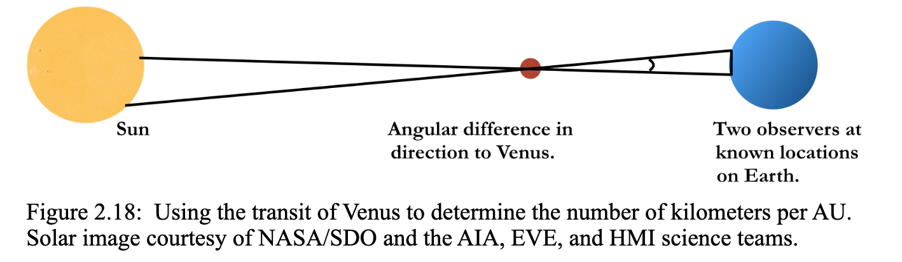
Venus Transits

