Slide 1
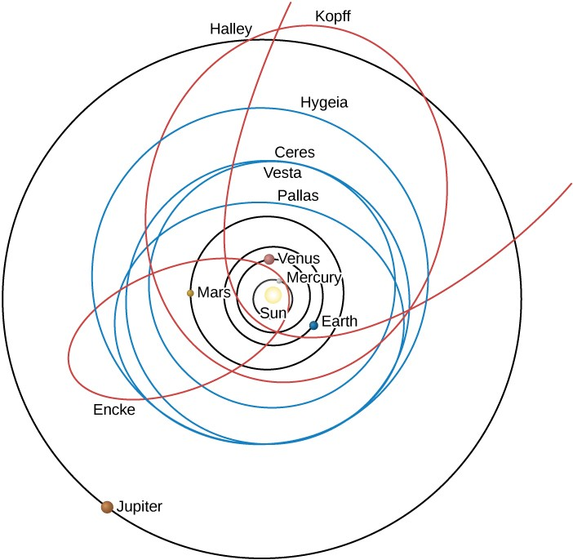
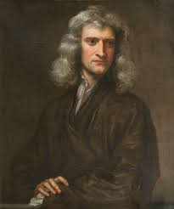
ASTR 2310
General Astronomy I
Professor Mike Brotherton
Ryden & Peterson Chapter 3: Orbital Mechanics
Newton's Laws of Motion & Gravitation; (Derivation of Kepler's Laws)‏; Conic Sections and other details; General Form of Kepler's 3rd Law; Orbital Energy & Speed; Virial Theorem

Slide 2
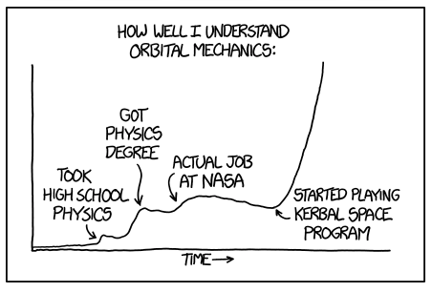
https://xkcd.com/1356/

Slide 3
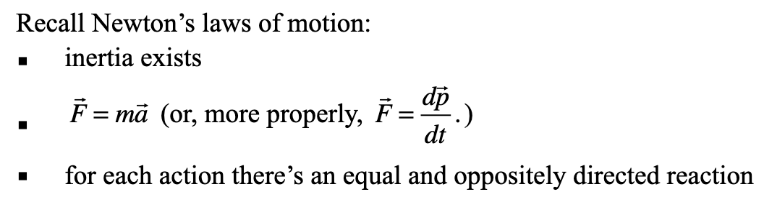


Orbital Dynamics
Newton – theory to explain Kepler’s laws and to go beyond
Issue of sign on Law of Gravitation
Circular orbits not too hard with this information, I hope? Let’s write that down and discuss.

Slide 4
Orbital Dynamics
Deriving Kepler’s Laws from Newton’s law of Gravitation and Laws of Motion requires vector calculus and mathematics beyond the prerequisites of the class.
If you have the math, please do take the opportunity to read carefully section 3.1 in Ryden and Peterson. There’s a bunch of useful stuff in there about ellipses, too, for instance (e.g., e=(1-b²/a²)^{1/2}).
Alternative calculus-based derivations of Kepler’s laws and related equations can be found here: https://faculty.fiu.edu/~vanhamme/ast3213/orbits.pdf

Slide 5


Orbital Dynamics
Some applications of Kepler’s third law: mass
What about mass of the sun?

Slide 6
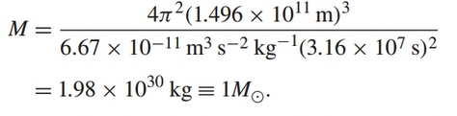
Orbital Dynamics
Some applications of Kepler’s third law: mass
What about mass of the sun?

Slide 7
Angular momentum L
Concept of Angular Momentum, L
  Linear version: L = rmv
  Vector version: L is the cross product of r and p
  Angular momentum is a conserved quantity

Slide 8





Orbital Energetics
Energy determines if an orbit is closed (circle or ellipse) or open (parabola or hyperbola). As in harmonic motion, energy is conserved and shifts between kinetic and potential:
More vector math we’ll skip in class, but you can read in text.

Slide 9
Orbital Energetics
Energy determines if an orbit is closed (circle or ellipse) or open (parabola or hyperbola). As in harmonic motion, energy is conserved and shifts between kinetic and potential:
More vector math we’ll skip in class, but you can read in text.
!

Slide 10
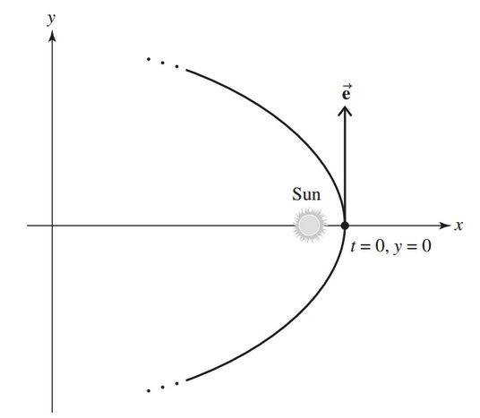


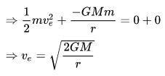
Orbital Energetics
Hyperbolic orbits: e > 1, E > 0, and K > |U|
Parabolic orbits: e=1, E = 0, K = |U|
Elliptical orbits: e < 1, E < 0, K < |U|

Slide 11
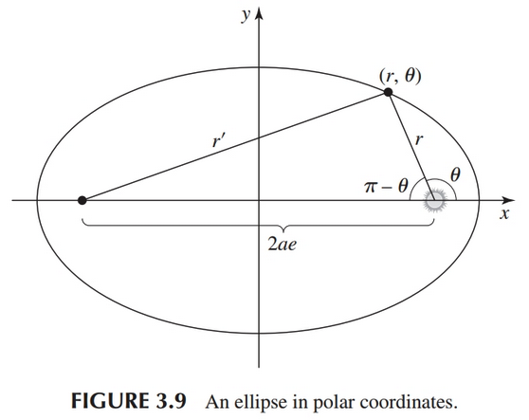

Orbital Speed
No simple equations for r( t ) or v( t ), but there is for v( r ), called the vis viva equation:
This is derived in the text for those interested, based on tracking kinetic energy with radius. We will mostly worry about its application in this course.

Slide 12
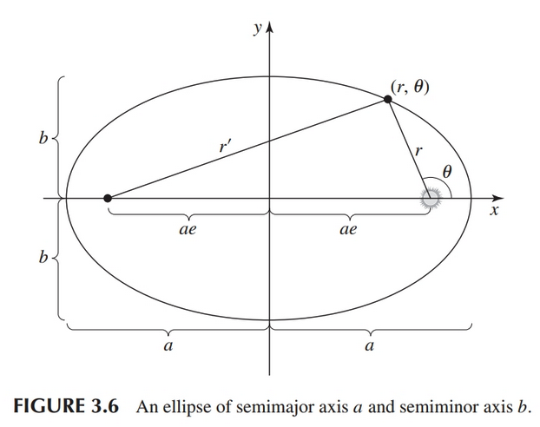



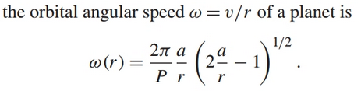
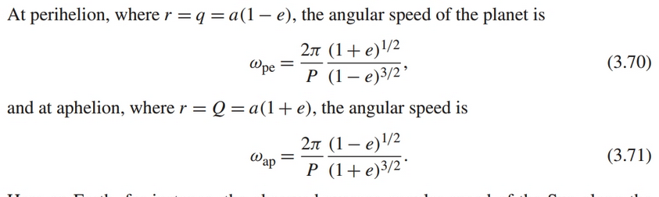
Orbital Speed
Other versions of the vis viva equation from substitutions and change of variables:

Slide 13
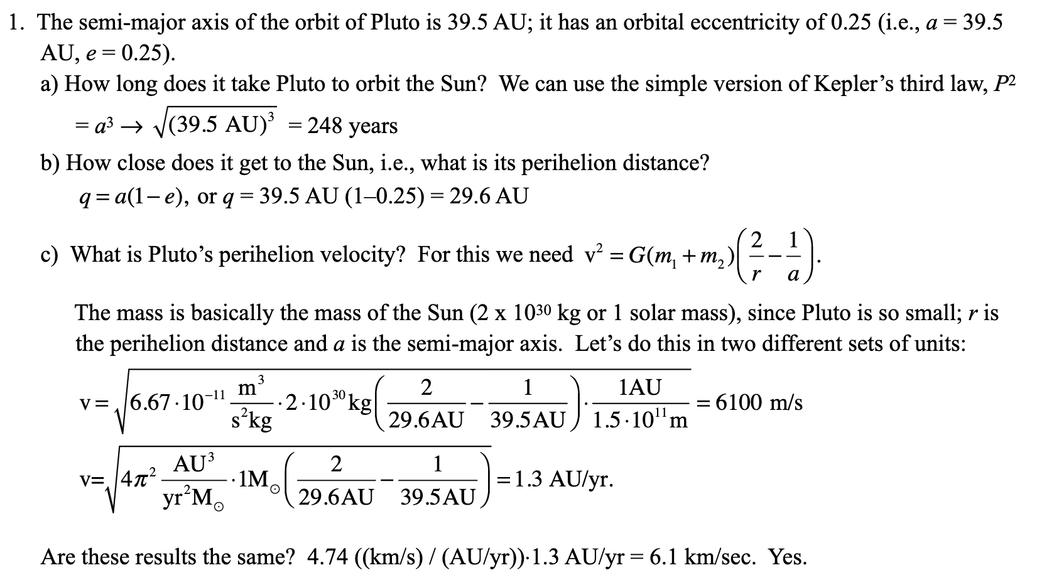
Orbital Dynamics
Example problem in Dobson:

Slide 14
Orbital Dynamics
Example problem in textbook:

Slide 15
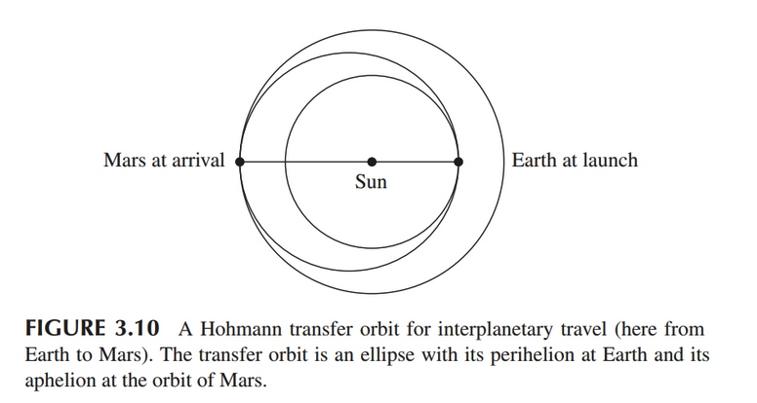
Hohmann transfer orbits

Slide 16
Hohmann transfer orbit (to)
Ryden & Peterson shows case for Earth to Mars.
Need semi-major axis of to
Then what is orbital period of to?
Time to Mars?
Speed of Earth?
Speed of Mars?
Use vis viva equation at both ends to calculate the delta vees.
Use care to determine launch windows.

Slide 17

Hohmann transfer orbit (to)
Ryden & Peterson shows case for Earth to Mars.
Need semi-major axis of to

Slide 18

Hohmann transfer orbit (to)
Ryden & Peterson shows case for Earth to Mars.
Need semi-major axis of to
Then what is orbital period of to?

Slide 19
Hohmann transfer orbit (to)
Ryden & Peterson shows case for Earth to Mars.
Need semi-major axis of to
Then what is orbital period of to?
Time to Mars? HALF the to orbital period, right?

Slide 20

Hohmann transfer orbit (to)
Ryden & Peterson shows case for Earth to Mars.
Need semi-major axis of to
Then what is orbital period of to?
Time to Mars?
Speed of Earth?

Slide 21

Hohmann transfer orbit (to)
Ryden & Peterson shows case for Earth to Mars.
Need semi-major axis of to
Then what is orbital period of to?
Time to Mars?
Speed of Earth?
Speed of Mars?

Slide 22
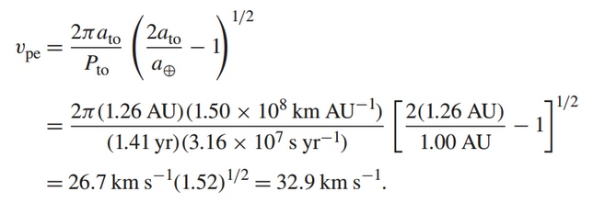
Hohmann transfer orbit (to)
Ryden & Peterson shows case for Earth to Mars.
Need semi-major axis of to
Then what is orbital period of to?
Time to Mars?
Speed of Earth?
Speed of Mars?
Use vis viva equation at both ends to calculate the delta vees.

Slide 23

Hohmann transfer orbit (to)
Ryden & Peterson shows case for Earth to Mars.
Need semi-major axis of to
Then what is orbital period of to?
Time to Mars?
Speed of Earth?
Speed of Mars?
Use vis viva equation at both ends to calculate the delta vees.

Slide 24
Got it? 60 second check…
https://ifunny.co/video/0wRlnem09

Slide 25
Orbital Dynamics
Virial Theorem (needs vector calculus to derive, in previous link of derivations)
For gravitational systems in equilibrium:
Will be handy in many astronomical situations, not just orbits in the solar system. Very general, works for systems of objects (e.g., star clusters, galaxy clusters).
K= -½ U

Slide 26
Orbital Mechanics Resource
Old style but nice webpage: http://www.braeunig.us/space/orbmech.htm

