Slide 1
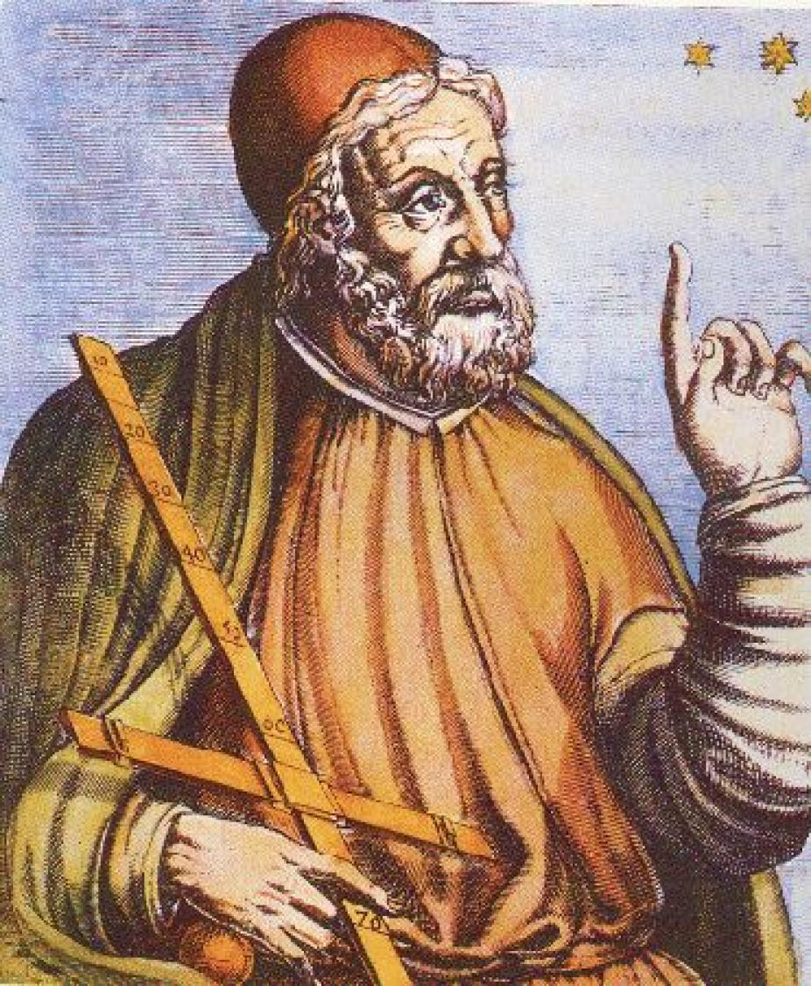
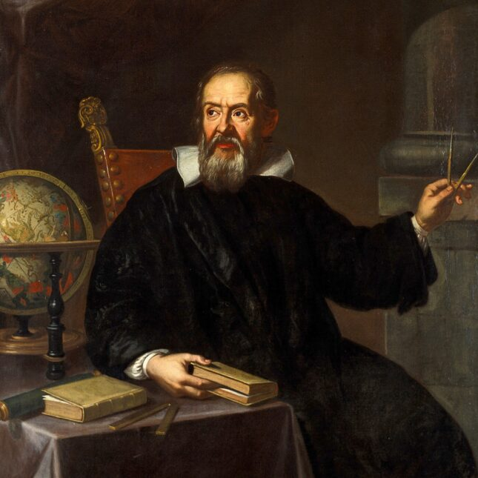
ASTR 2310 General Astronomy I
Professor Mike Brotherton
Ryden & Peterson Chapter 2
Early Greek astronomy; Ptolemaic vs. Copernican Astronomy; Galileo; Kepler’s Laws; Earth’s Motion

Slide 2
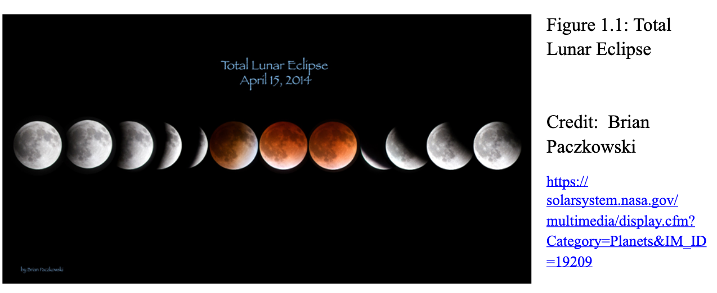
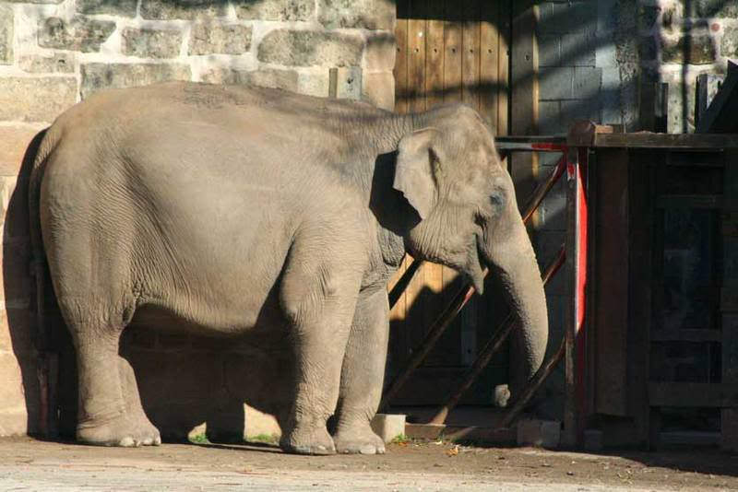
Early Greek successes (Aristotle 384-322 BC)
Spherical Earth
Different stars visible moving south, shadow of Earth during lunar eclipse
But wait, there’s more! Consider the elephant…
https://www.astronomy.ohio-state.edu/thompson.1847/161/measearth.html

Slide 3
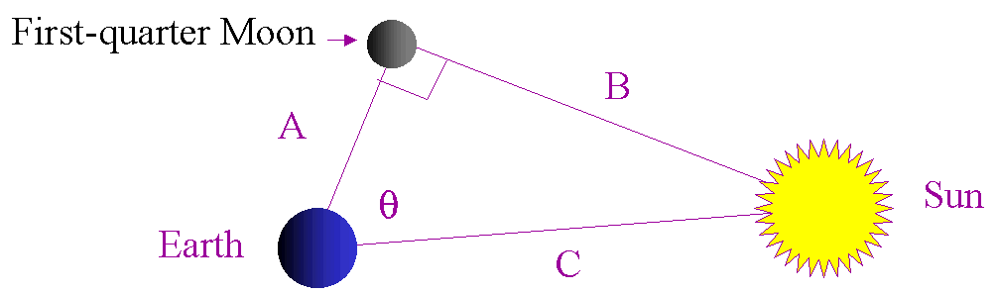
Some early Greek successes
Aristarchus (310-230 BC):
Relative Distances and Sizes of Moon, Earth, Sun
A/C=cosine theta. Theta=87degrees means C=19A
If theta =89.853 degrees (modern value) then C=390A
For relative sizes, add geometry involving eclipses
Wiki: http://en.wikipedia.org/wiki/Aristarchus_On_the_Sizes_and_Distances#Lunar_eclipse
Came up with 1:3:19 (modern values 1:4:390) for ratios of diameters.

Slide 4
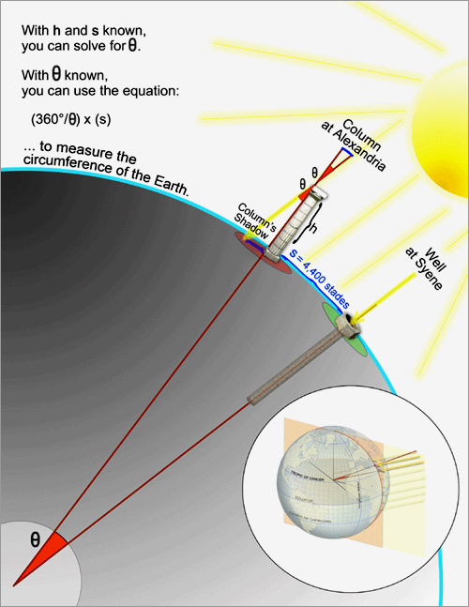
Some early Greek successes
Eratosthenes (276-195 BC):
Size of the Earth
Geometry involving the sun
Wiki: http://en.wikipedia.org/wiki/Eratosthenes
Figured out what fraction (1/50) of the Earth's circumference corresponded to the distance between Alexandria and Syene
Stade not uniform, but Athenian stade = 185 meters
Figure from Wired Magazine, a bit different in text
Theta is about 7 degrees
Answer is the circumference is 46,000 km
Modern value closer to 40,000 km

Slide 5
Hipparchus (190-120 BC)
Catalog of star positions
Astrometric satellite Hipparcos named after him.
Magnitude system
Six point system originally, based on visual estimation
Quantified today as one magnitude difference is a factor of 2.512 in brightness (fifth root of 100)
Will use extensively in ASTR 2320, less so in ASTR 2310

Slide 6
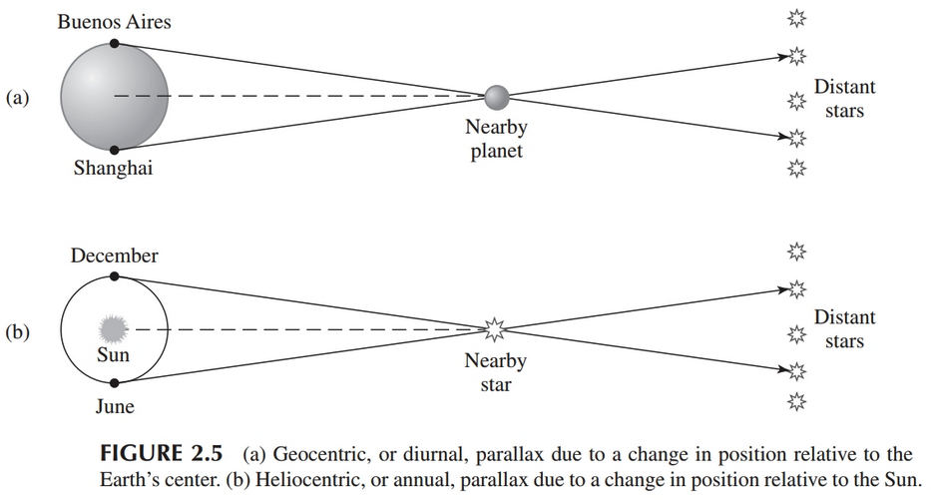
Some early Greek failures
Aristotle
No parallax, so Earth must be stationary (technology matters!)

Slide 7
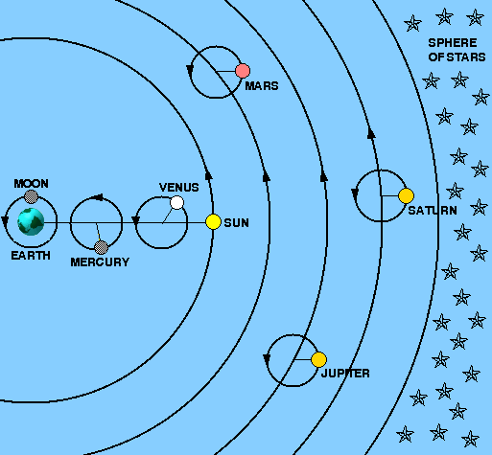
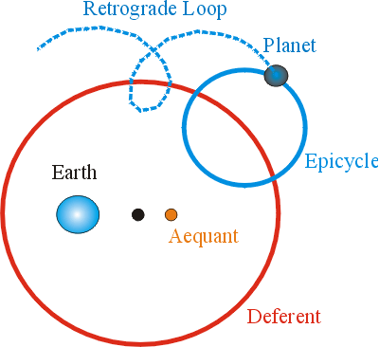
Some early Greek “failures”
Ptolemy
Conceptually flawed based on a stationary Earth, but quantitatively predictive

Slide 8
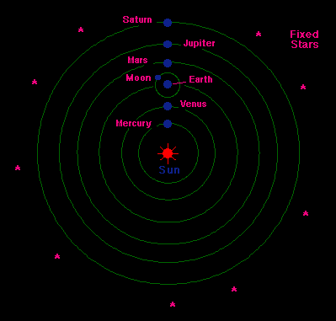
Copernican Revolution
Copernicus – Heliocentric with circular orbits

Slide 9
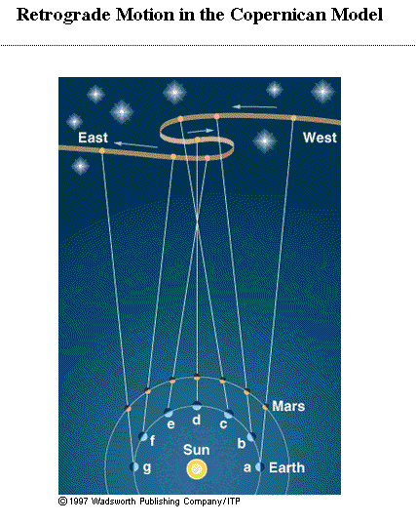
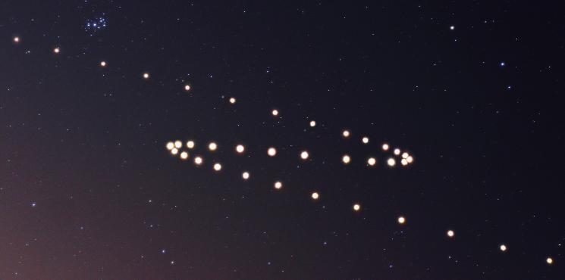
Retrograde Motion
Over the course of subsequent nights, the general motion of Mars in the sky eastward reverses itself for a time relative to the background stars.

Slide 10
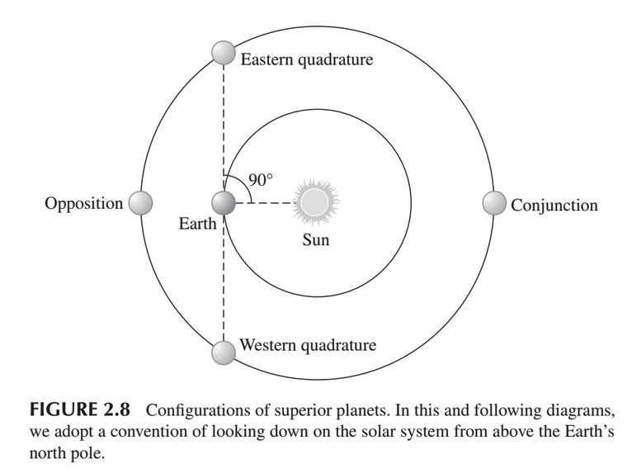
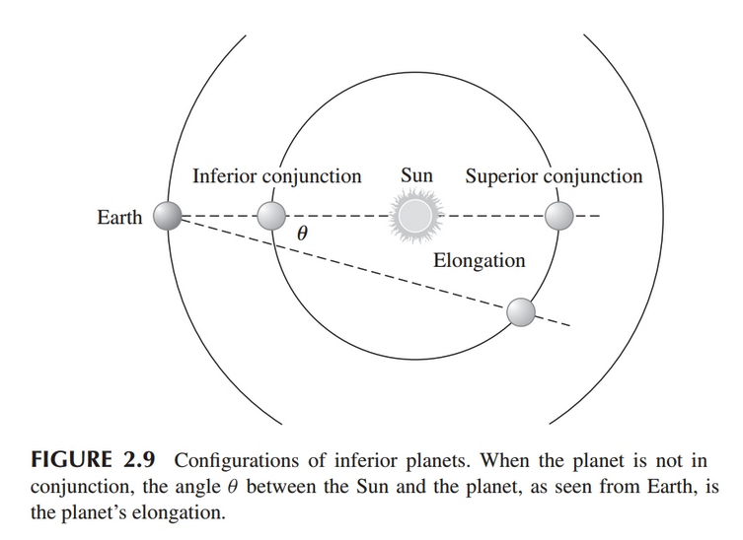
Some vocabulary…

Slide 11
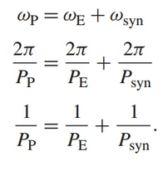
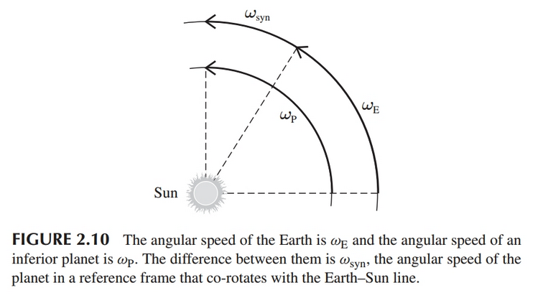
Synodic (time between conjunctions) vs. sidereal periods

Slide 12
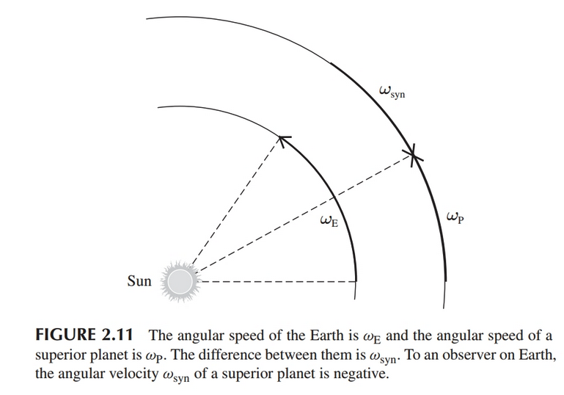
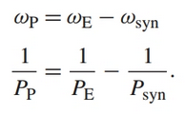
Synodic (time between conjunctions) vs. sidereal periods

Slide 13
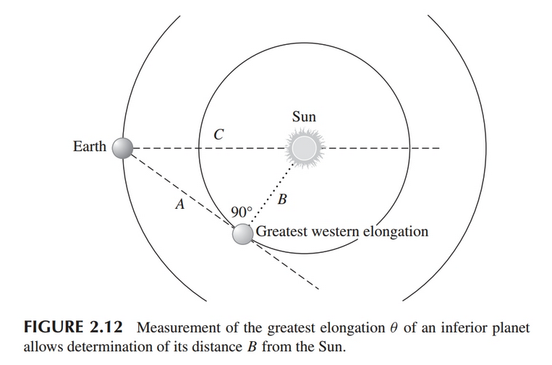
The AU and relative orbital sizes

Slide 14
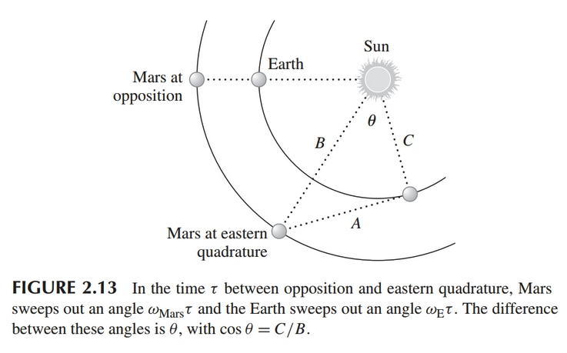
The AU and relative orbital sizes

Slide 15
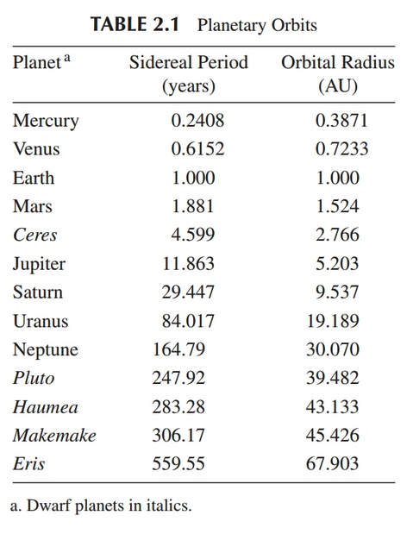

Slide 16
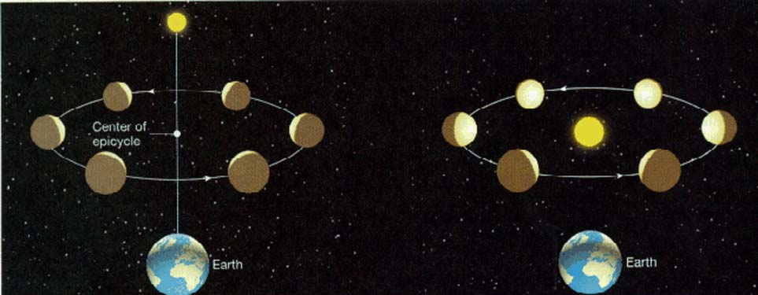
Copernican Revolution: Galileo
Both Ptolemaic model and Copernican model (with elliptical orbits!) make predictions of planetary positions. How to test? Phases, sizes!

Slide 17
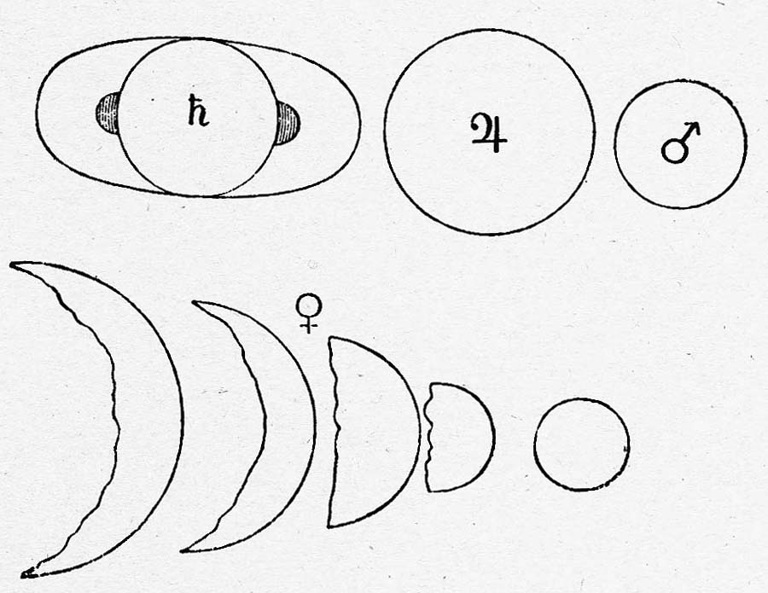
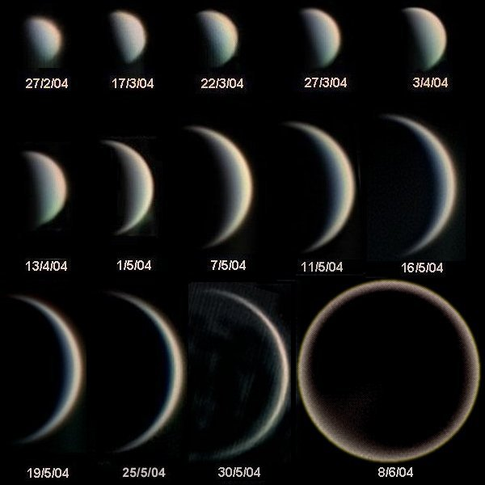
Copernican Revolution: Galileo
Venus too small to resolve without telescope, but the technology was on track for Galileo to do the experiment!
Galileo’s drawings of planet shapes, NASA.
Venus images, Statis Kalyvas

Slide 18
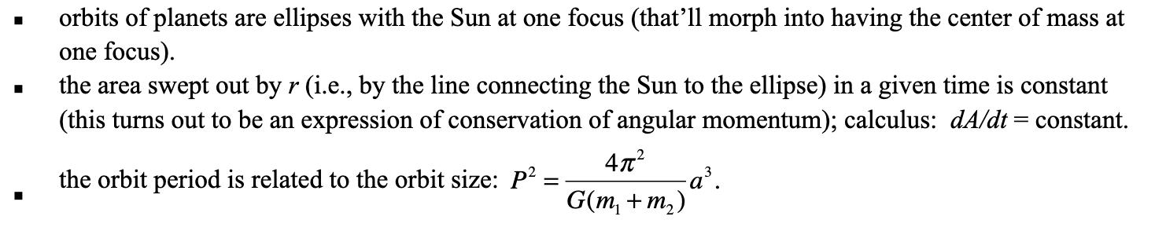
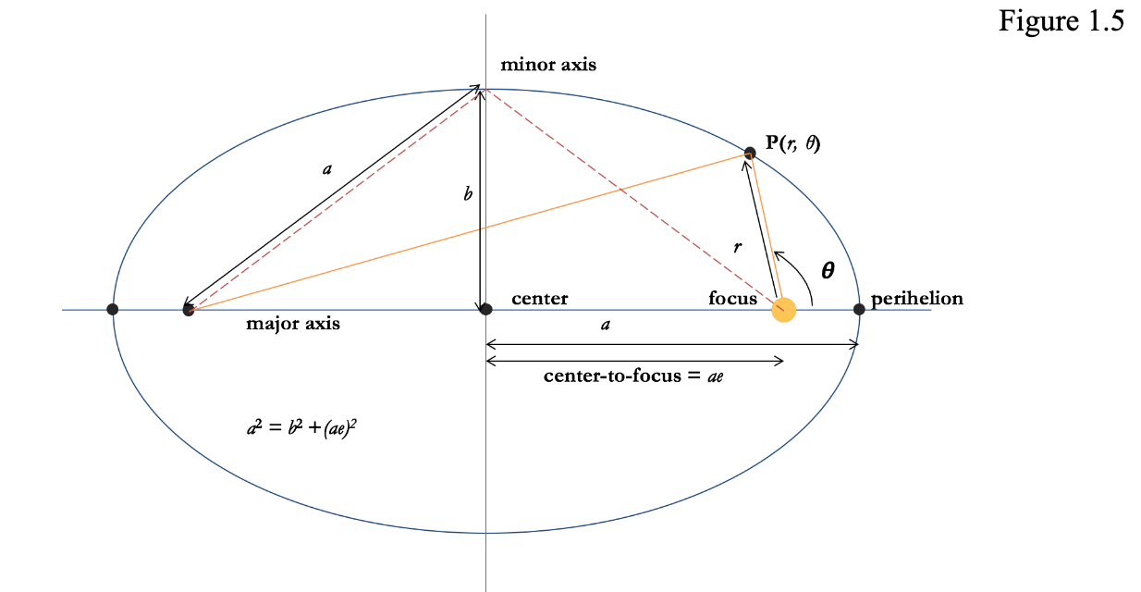

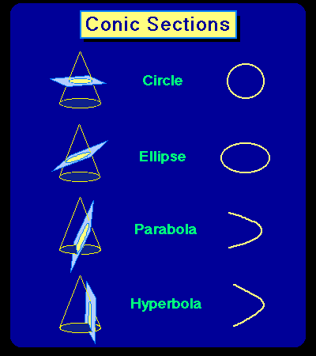

Copernican Revolution
Tycho Brahe – best pre-telescope dataset, planetary positions vs. time
Johannes Kepler – Tycho’s data set leads to Kepler’s three laws

Slide 19
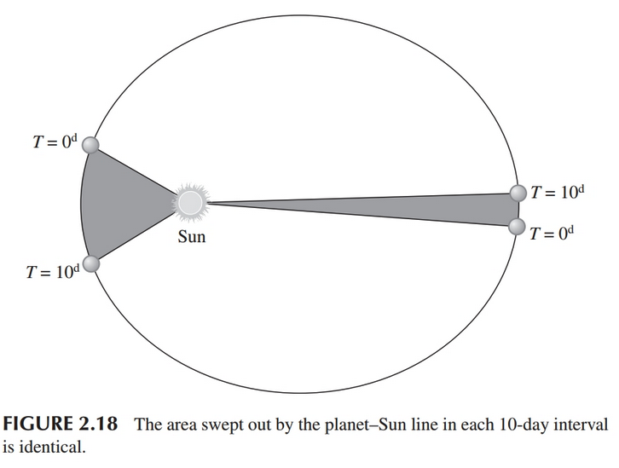
Copernican Revolution
Tycho Brahe – best pre-telescope dataset, planetary positions vs. time
Johannes Kepler – Tycho’s data set leads to Kepler’s three laws

Slide 20
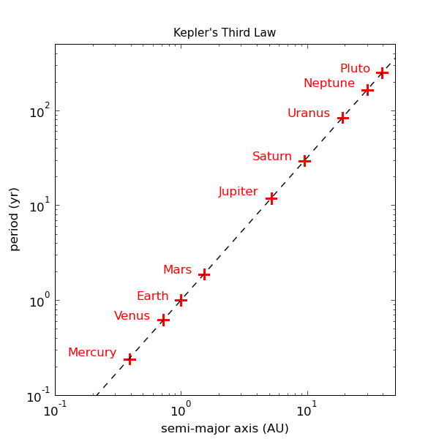

Copernican Revolution
Tycho Brahe – best pre-telescope dataset, planetary positions vs. time
Johannes Kepler – Tycho’s data set leads to Kepler’s three laws

Slide 21
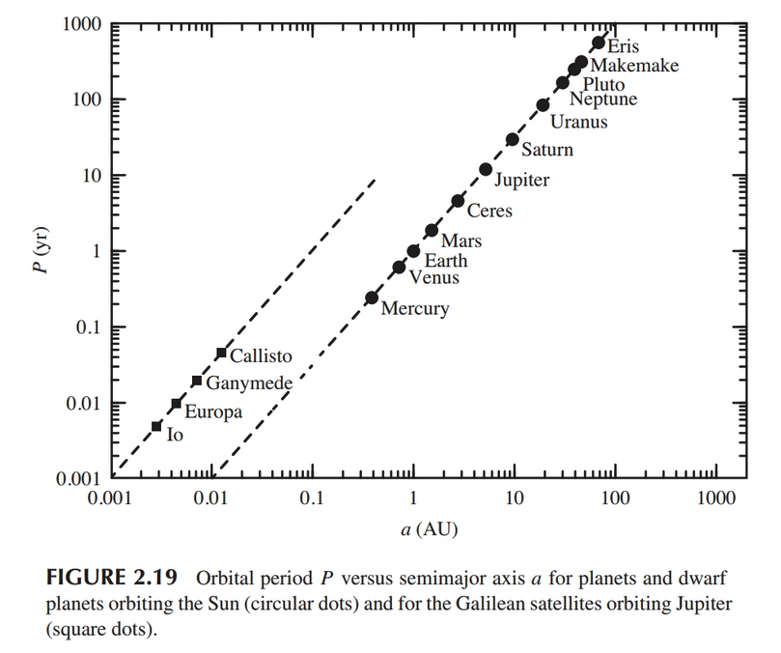
Application of Kepler’s 3rd Law
For objects in motion around the sun: (P/years)²=(a/AU)³
Asteroid has a semi-major axis of 4 AU (in asteroid belt), what is P?
Would this work for the Galilean Moons?

Slide 22
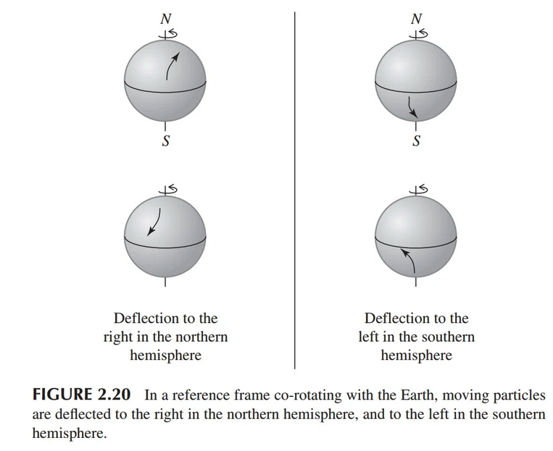
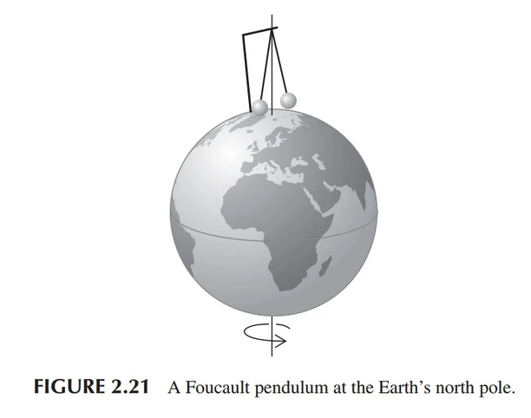
Rotation of the Earth
Text discusses effects of centrifugal force on weight.
Coriolis effect (save for intermediate mechanics)
Foucault pendulum

Slide 23
Revolution of Earth (around the Sun)
Aberration of Starlight
Running through the rain with an umbrella
Speed of light is high (300,000 km/s), but...
Speed of Earth around Sun is 30 km/s
What is angle?
Detectable (by Jean “Luc” Picard in 1680)

Slide 24
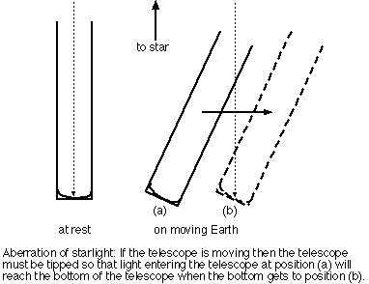
Revolution of Earth (around the Sun)
Proofs of Earth's motion, by the way…
Aberration of Starlight
Tan theta = theta= v/c
Or for 30 km/s and c
20.5 arcseconds, very detectable centuries ago and now, also. Another effect to go into telescope pointing models.

Slide 25
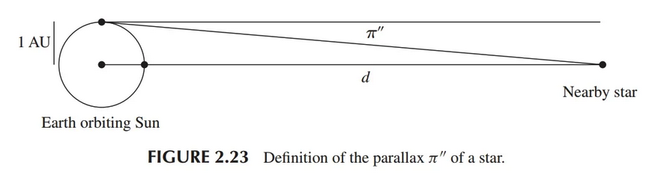


Revolution of the Earth (around the Sun)
Parallax is observable to modern instruments! Measure in parsecs.

