Slide 1
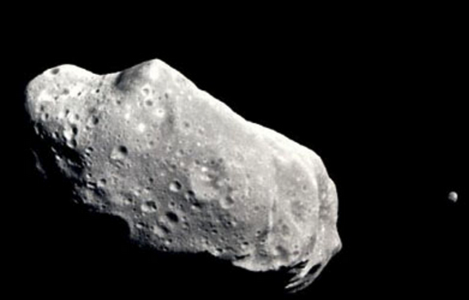
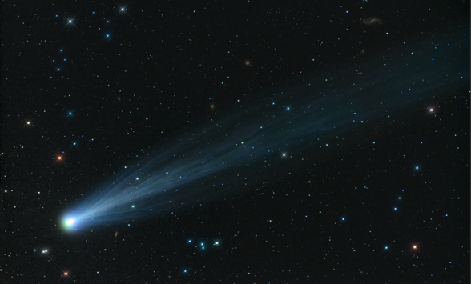
ASTR 2310
General Astronomy I
Professor Mike Brotherton
Ch. 11 from Ryden & Peterson, Smaller Bodies
Asteroids, TNOs, Comets, Dust

Slide 2
Asteroids
Much covered in the video (17 min):
https://www.youtube.com/watch?v=1Mcovvt-LBs
Nice size comparison (3 min):
https://www.youtube.com/watch?v=bSkPNMjRRio

Slide 3

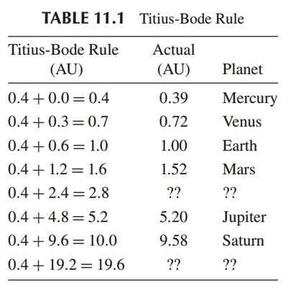
Asteroids—Titius-Bode Rule,
More commonly “Bode’s Law”
Kind of dumb numerology:

Slide 4
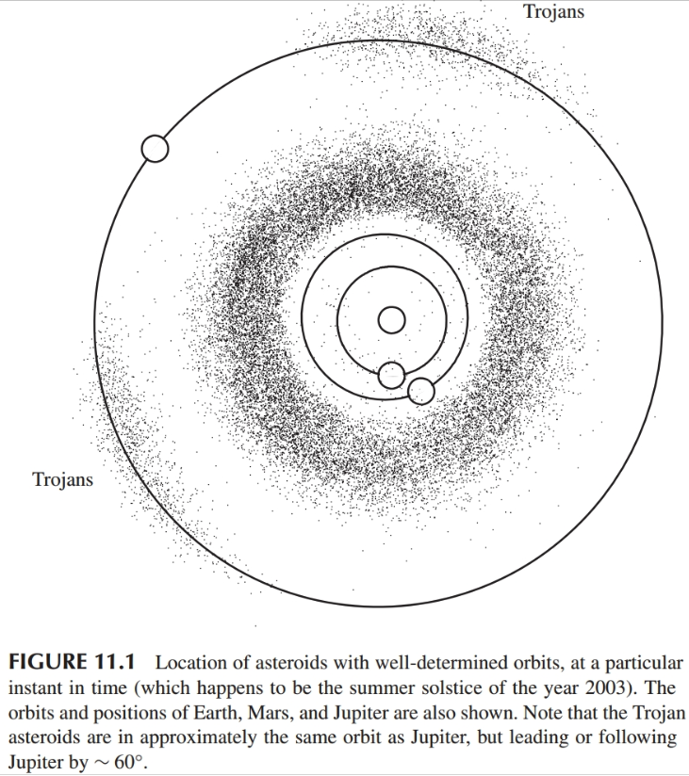
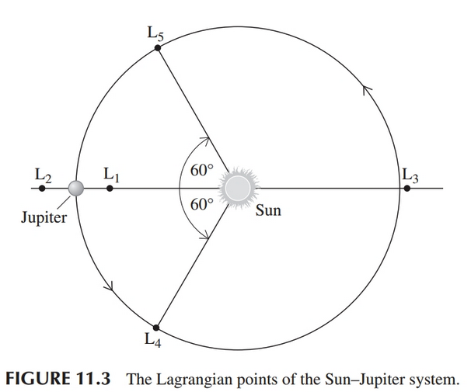
Asteroids plotted

Slide 5
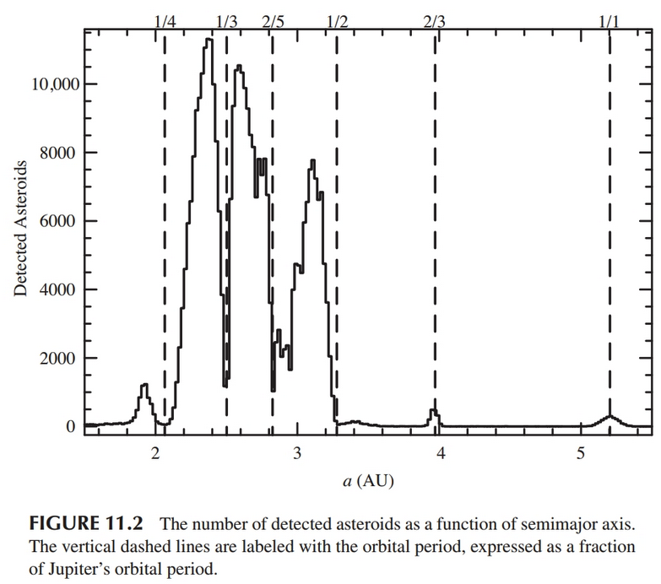
Asteroids – Kirkwood Gaps

Slide 6



Trans-Neptunian Objects (a > 30.1 AU)
How to find? Same as asteroids, but retrograde motion (at opposition) will be smaller.
Keplerian motion in SS:
Relative velocities:
Change to angular speed:

Slide 7
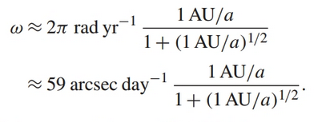
Trans-Neptunian Objects (a > 30.1 AU)
Angular speed
Angular speed:
Reduces to
Asteroids will be about 12 arcmin/day
TNOs will be smaller than about 1.6 arcmin/day

Slide 8
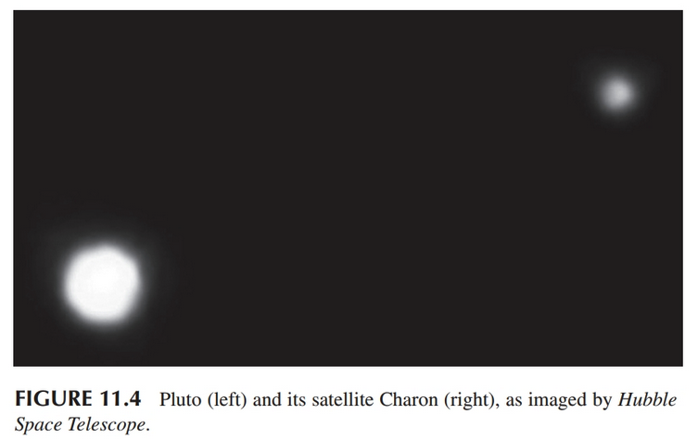
Pluto
Clyde Tombaugh, 1930
a=39.5 AU, e = 0.249, i=17degrees
Bigger x2 than Ceres
Has moons!

Slide 9
New Horizons visited Pluto
Flyby 2015, PI Alan Stern
One brief video (2 min):
https://www.youtube.com/watch?v=g1fPhhTT2Oo
Longer one (NASA, 20 min):
https://www.youtube.com/watch?v=JqmIo-tUd48

Slide 10
The Kuiper Belt
Introductory Video (< 5 min):
https://www.youtube.com/watch?v=XjW6k--6Oi0

Slide 11
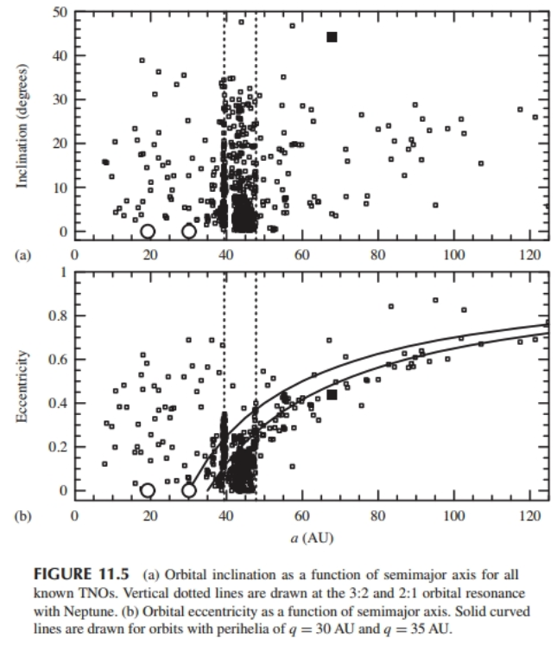
TNO orbital properties

Slide 12
Kuiper Belt Dwarf Planets

Slide 13
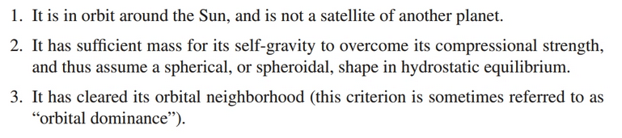
Planet Definition (IAU 2006)
Dwarf planets satisfy the first two criteria, not the third. Not everyone agrees with this definition. Read more about what happened:
https://www.sciencenewsforstudents.org/article/pluto-dwarf-planet-definition-iau-astronomy

Slide 14
Comets
Introductory Video (8 min.):
https://www.youtube.com/watch?v=-oA44WL6P6k
My photos of NEOWISE from July 2020:

Slide 15
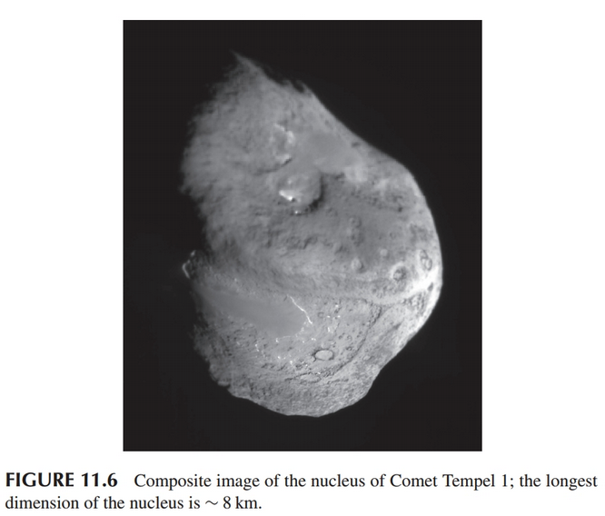
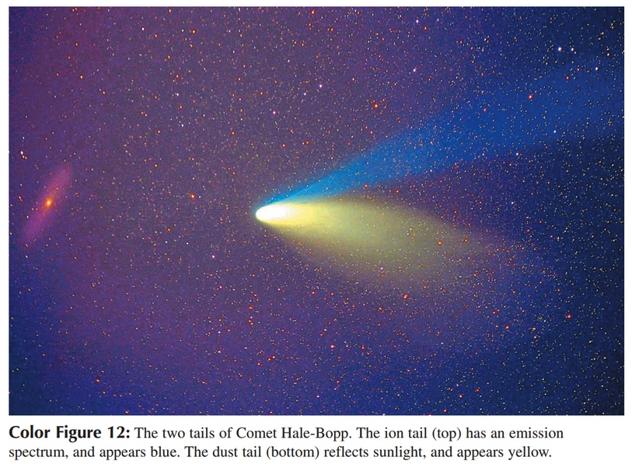
Comets

Slide 16
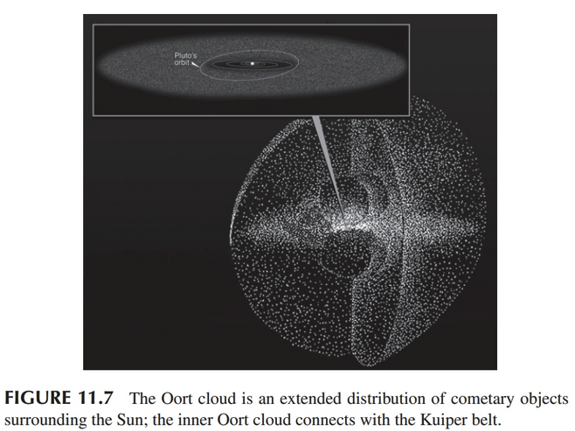
Oort Cloud (50,000 AU, long periods)

Slide 17
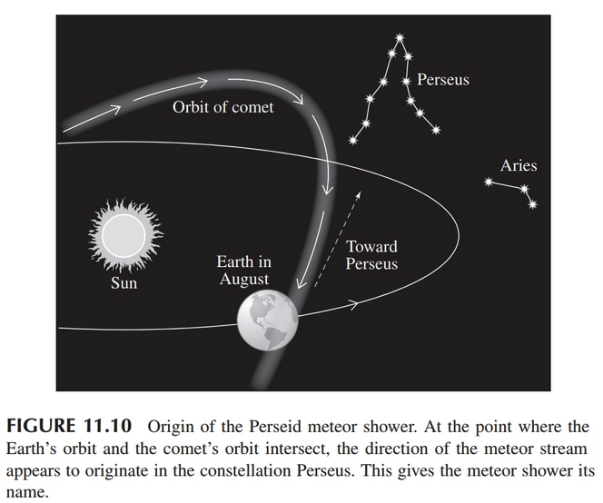
Meteoroids and Dust
Meteor Showers associated with Earth crossing cometary orbits:

Slide 18
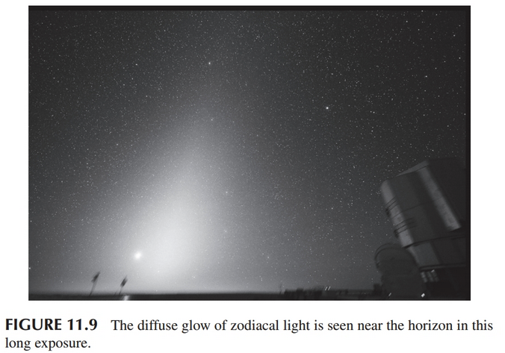
Meteoroids and Dust
Zodiacal Light

Slide 19
The Fates of Dust
Radiation Pressure
  Smallest particles blown out
Poynting-Robertson Drag
  Larger particles slowed and spiral in

Slide 20



Radiation Pressure
Radiation pressure as photons have momentum
Radiation force on spherical particles (radius R):
Countering Gravitational Force:

Slide 21
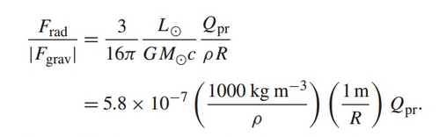


Radiation Pressure II
Ratio of force out/in:
Q_{pr} depends on the size R relative to the wavelength of impacting photons. See text for details. To be blow out, need
In practice grains blown out have

Slide 22
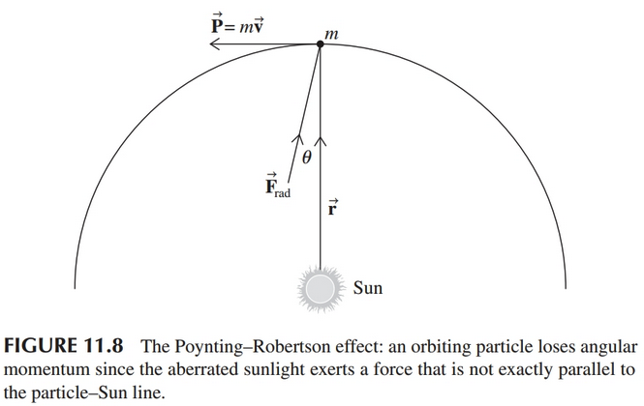

Poynting-Robertson Effect
Recall Stellar Aberration

Slide 23





Poynting-Robertson Effect
Particle in orbit is torqued by photons

Slide 24



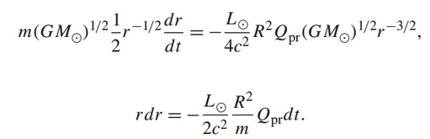
Poynting-Robertson Effect
The torque is equal to change in angular momentum:
For circular orbit:

Slide 25

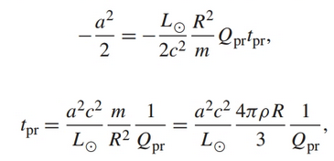

Poynting-Robertson Effect
Integrate to get timescale, t=0, r=a:
Assume R>>5000 Angstrom, so Q_{pr}=1

