Slide 1
ASTR 2310
General Astronomy I
Professor Mike Brotherton
Ryden & Peterson Chapter 6: Astronomical Detection of Light
The Telescope as a Camera, Refracting and Reflecting, Quality of Images
Instruments and Detectors, Observations and Photon Counting
Observations at Other Wavelengths, Modern Telescopes

Slide 2
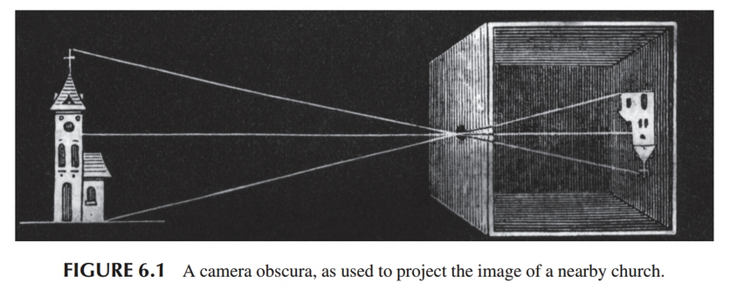
Camera Obscura

Slide 3
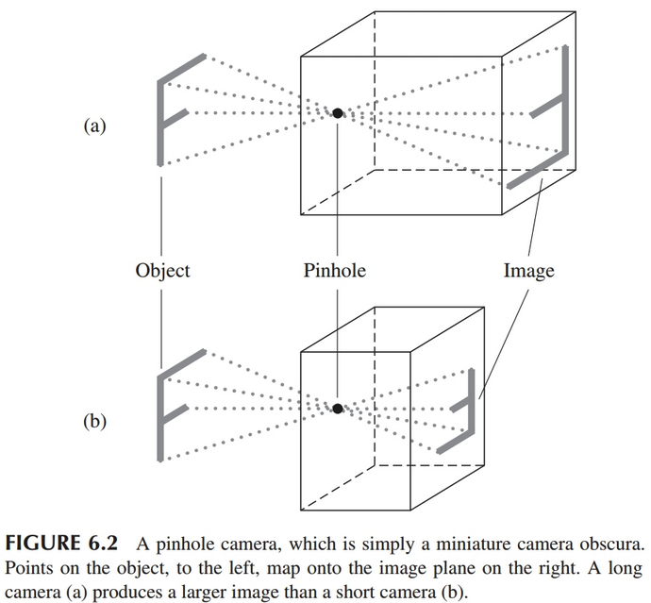
Pinhole Camera
Image is inverted.
Focal length F is length of box
Exposure time can be long since pinhole is small
Exposure time proportional to area of image, or F squared.
Terminology: a short focal length is therefore “fast” and a long one “slow”

Slide 4
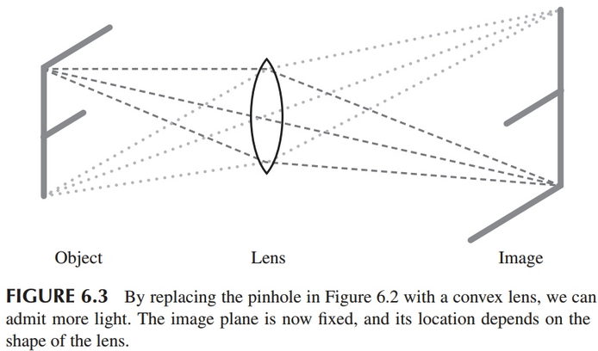
Lenses

Slide 5
Lenses
Lens is transparent with a refractive index different from air (or surrounding medium).
Refractive index n=c/v_{m}, where v_{m} is the speed of light in the material and c is in a vacuum.
Glass is usually around n=1.5.
Air, n=1.0003

Slide 6
Snell’s Law

Slide 7
f-number
Focal length F depends on shape of lens and its refractive index.
Focal ratio f=F/D, where D is diameter of the lens
An f/8 lens has F/D=8.
This basically tells you how “fast” light rays converge.
Can also use f-numbers when discussing mirrors, which we will get to.

Slide 8
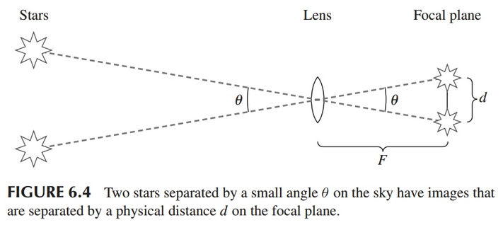
Plate Scale: relating image size to angle

Slide 9




Plate Scale: relating image size to angle

Slide 10
Example: The Human Eye
The human eye:
Focal ratio f=F/D, where D is the diameter of the lens
Bright surroundings, f/8
In the dark, f/2

Slide 11
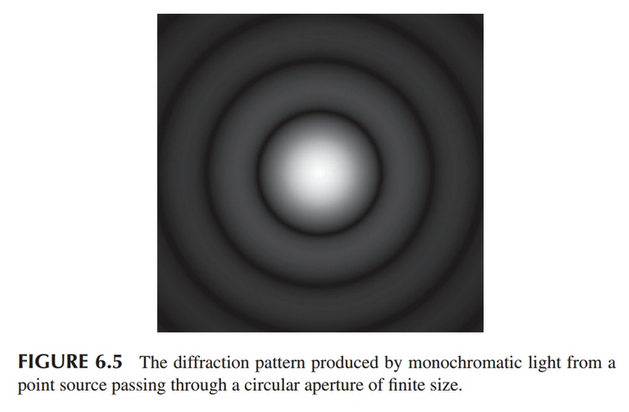

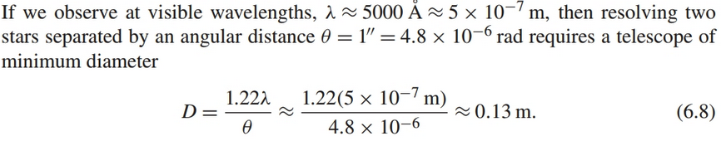
Diffraction Limited Image Resolution
The “Airy disk” is the bright central region of the ringed pattern from a point source through a circular aperture.

Slide 12
Astronomical Seeing

Slide 13
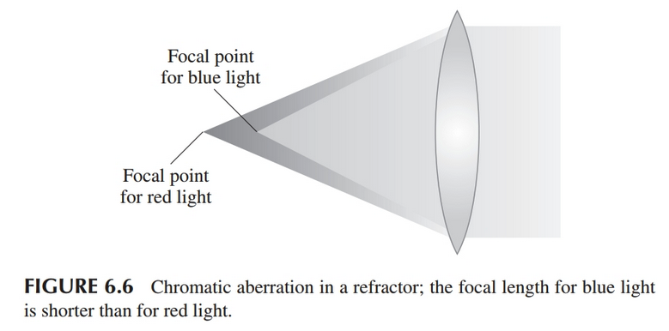
Refracting Telescopes (lenses)

Slide 14
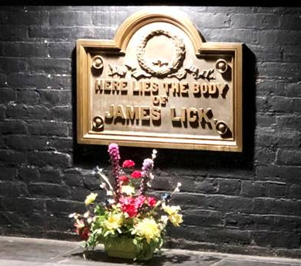
Lick 36” Refractor (1888)
Hard to build lenses (f/19) much bigger!
First Mountaintop Telescope
Nice to look through for your guests at a wedding reception.
"Here lies the body of James Lick".

Slide 15
Amazing History of the Telescope
Nice video (12 minutes) about historical telescope development through the nineteenth century. Pretty cool stuff! Watch outside of class, please.

Slide 16
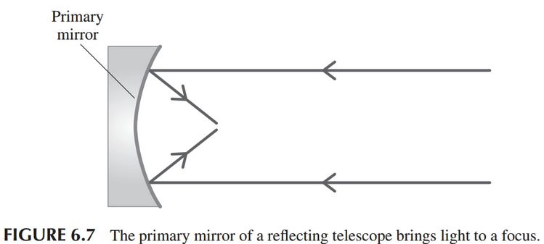
Reflecting Telescopes (mirrors, now standard)

Slide 17
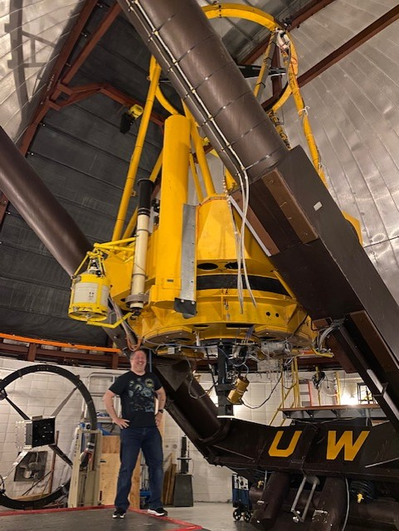
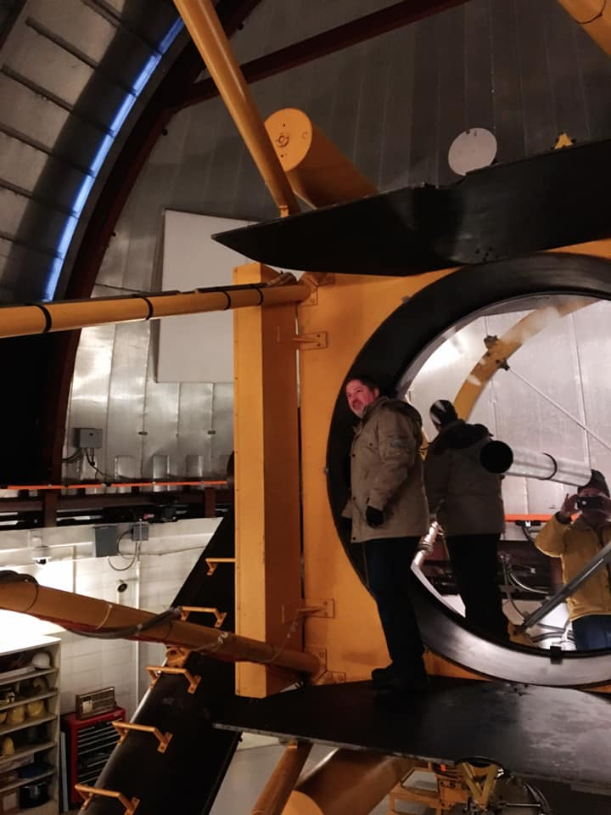
WIRO 2.3-m
(1977)

Slide 18
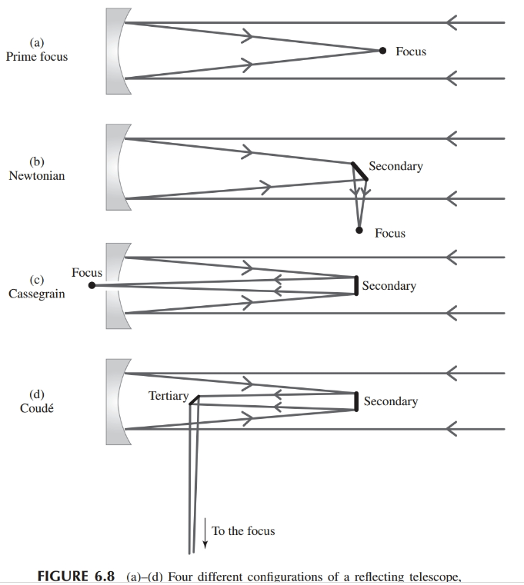
Reflectors: some optical configurations

Slide 19
Image Quality Issues with Optical Systems
Spherical aberration: different annuli of lens or mirror have different focal lengths, therefore not one clean focal plane.
Coma: Light rays near edge of lens/mirror come to a focus at a larger distance than those near the center (seen in off-axis images from parabolic mirrors).
Astigmatism: Happens when radius of curvature differs along different axes.
Curvature of field: Detectors usually flat, but real focal surface is not a plane, but curved, in practice.
Distortion: pincushion (positive), barrel (negative).

Slide 20
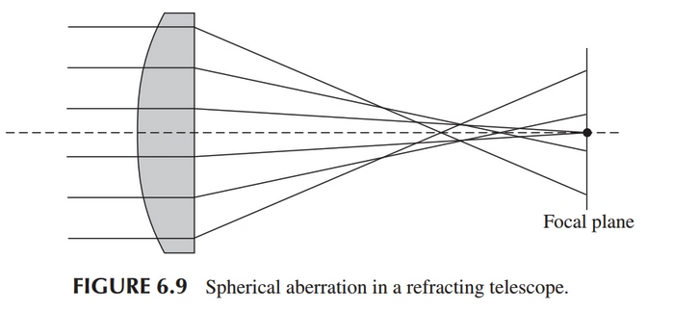
Image Quality Issues with Optical Systems

Slide 21
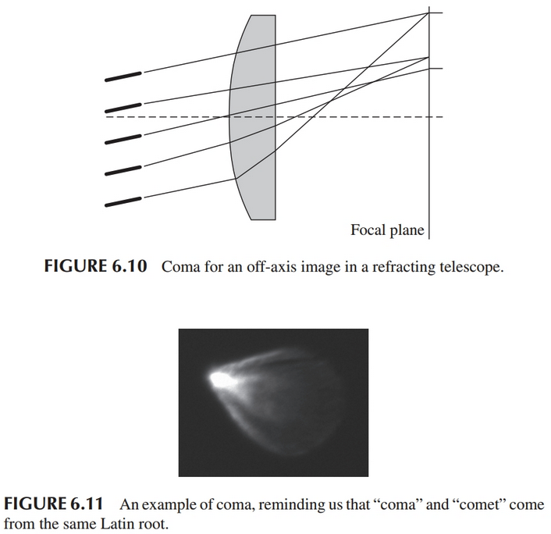
Image Quality Issues with Optical Systems

Slide 22
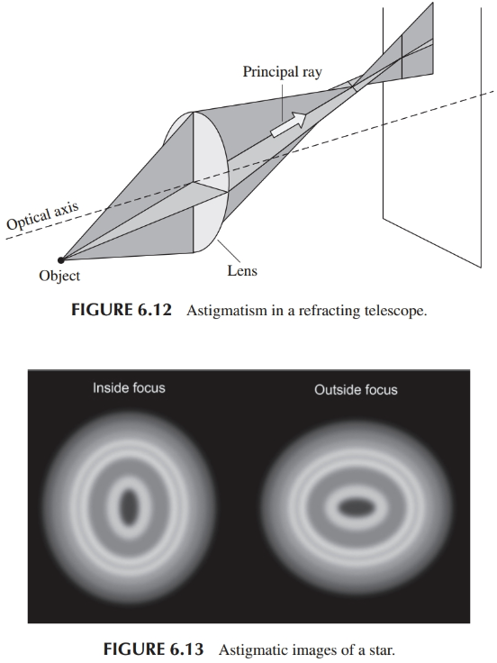
Image Quality Issues with Optical Systems

Slide 23
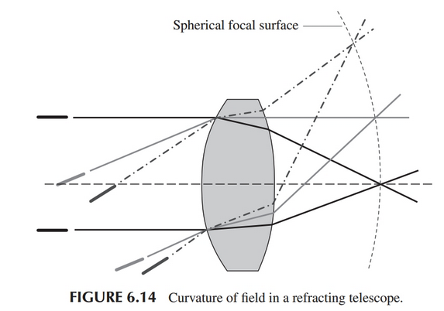
Image Quality Issues with Optical Systems

Slide 24
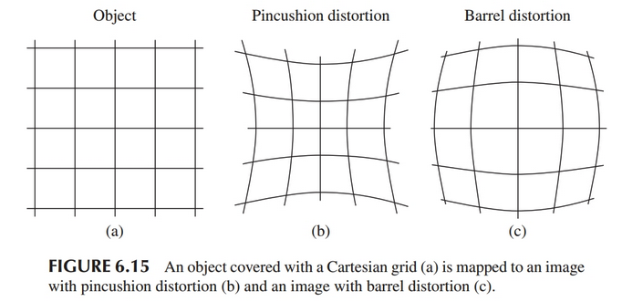
Image Quality Issues with Optical Systems

Slide 25
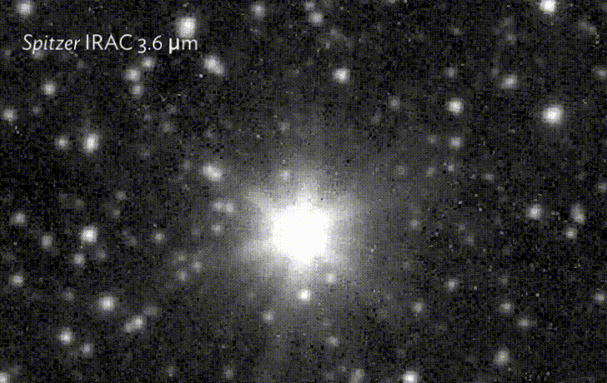
Point Spread Function or PSF

