Slide 1
ASTR 2310
General Astronomy I
Professor Mike Brotherton
Ryden & Peterson Chapter 6: Astronomical Detection of Light
The Telescope as a Camera, Refracting and Reflecting, Quality of Images
Instruments and Detectors, Observations and Photon Counting
Observations at Other Wavelengths, Modern Telescopes

Slide 2
Astronomical Instruments and Detectors
Imaging camera (detector at focal plane)
Spectrographs
But also…
  Polarimetry
  Hybrids like integral field units (IFUs)
  Bolometers and photon-counting/amplifying devices
  Interferometry
Also issue of detector tech, quantum efficiency as f(wavelength)

Slide 3
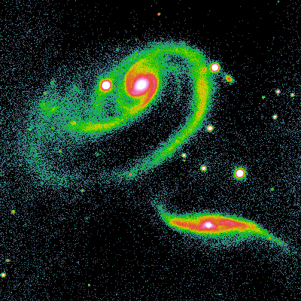
CCD Imaging
CCD = Charge-coupled device
More sensitive than photographic plates. CCD quantum efficiency is about 80%. The human eye <10%.
Pixilated data can be read directly into computer memory, allowing easy electronic manipulations. Typically want to have at least two pixels across your point spread function for optimal sampling.
False-color image to visualize brightness contours

Slide 4
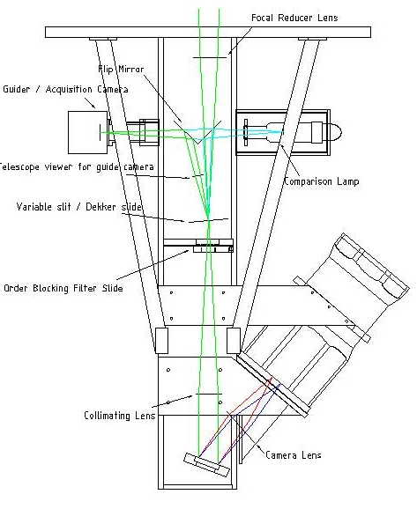
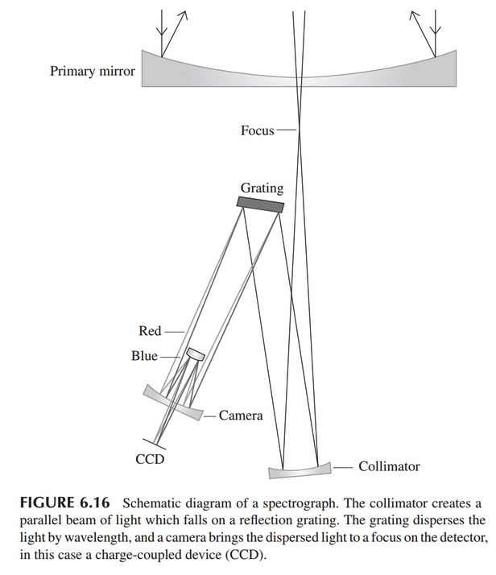
Simple Grating Spectrograph
WIRO spectrograph

Slide 5

Observations and Photon Counting
How long do my exposure times have to be? This is determined by the signal-to-noise ratio (S/N) needed and how many photons are required to obtain a given S/N.
For a given photon arrival rate, there is not an exact number per unit time, just a predictable average. There are random statistical fluctuations.
The number of photons follows a Poisson probability distribution:
Mu is the expected number of photons, and x is the actual number.

Slide 6

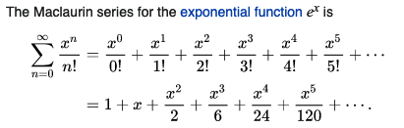

Poisson Probability Distribution (Wiki link)
The number of photons follows a Poisson probability distribution:
Normalized:
Since:

Slide 7
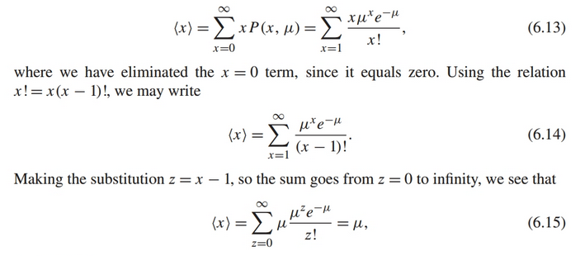
Mean Number of Photons Observed
Just sum the probabilities for each number:
As expected, right?

Slide 8
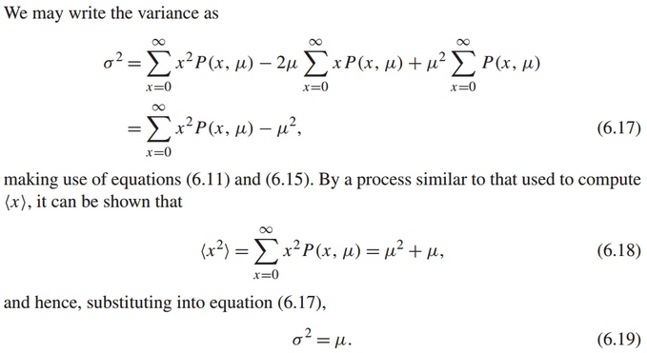
Variance in Number of Photons Observed
How from from mu is x likely to be for one observation:

Slide 9


Standard Deviation and S/N for Photons Observed
Standard deviation is square root of variance:
The uncertainty or spread in measurement is often taken to be 1σ, and about 68% of the data points will be within that value of the mean. It can also be taken as the “noise.”

Slide 10



Background noise and adding noise
Standard deviations of Poisson distributions add in quadrature:
Therefore:
Often conditions are such that background is very low or high compared to the brightness of your source and you can make an approximation. If you’re background limited (bright background)
More details in the text.

Slide 11
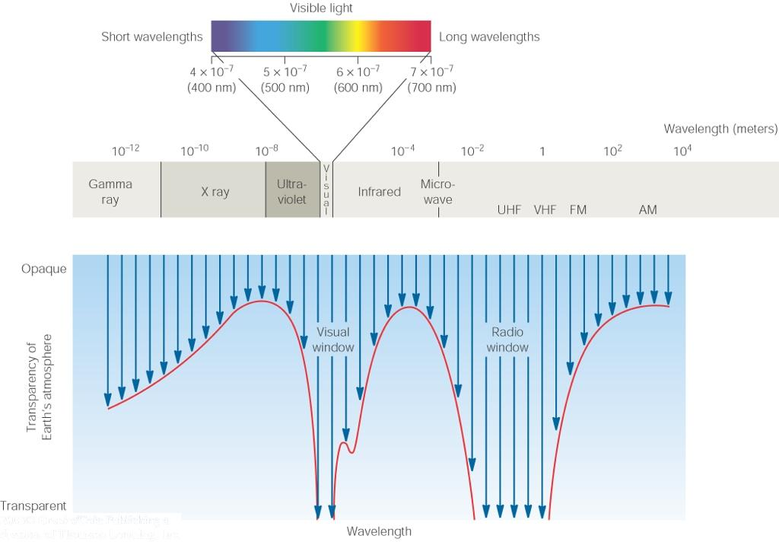
Radio Astronomy
Recall: Radio waves of λ ~ 1 cm – 1 m also penetrate the Earth’s atmosphere and can be observed from the ground.

Slide 12
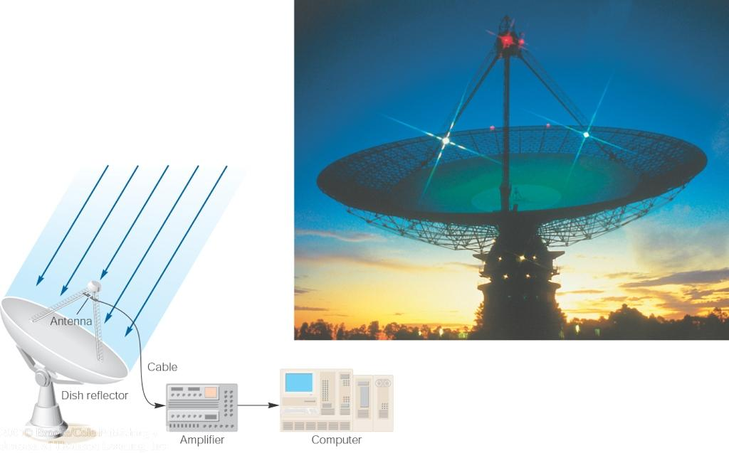
Radio Telescopes
Large dish focuses the energy of radio waves onto a small receiver (antenna)
Amplified signals are stored in computers and converted into images, spectra, etc.

Slide 13
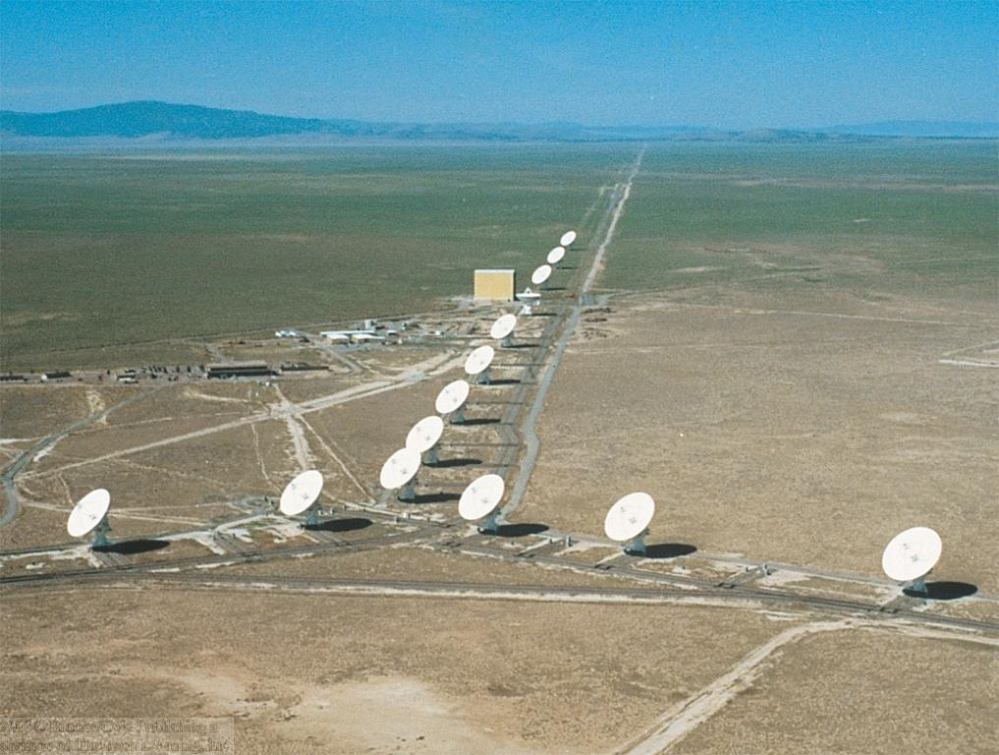
Radio Interferometry
Just as for optical telescopes, the resolving power of a radio telescope depends on the diameter of the objective lens or mirror α_{min} = 1.22 λ/D.
For radio telescopes, this is a big problem: Radio waves are much longer than visible light
The Very Large Array (VLA): 27 dishes are combined to simulate a large dish of 36 km in diameter.
→ Use interferometry to improve resolution!

Slide 14
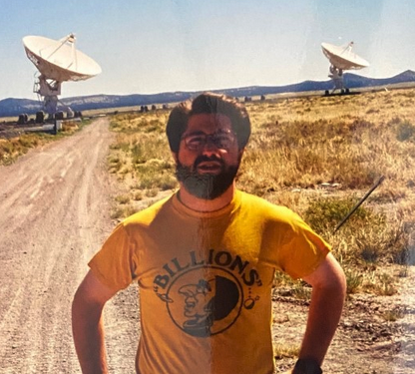
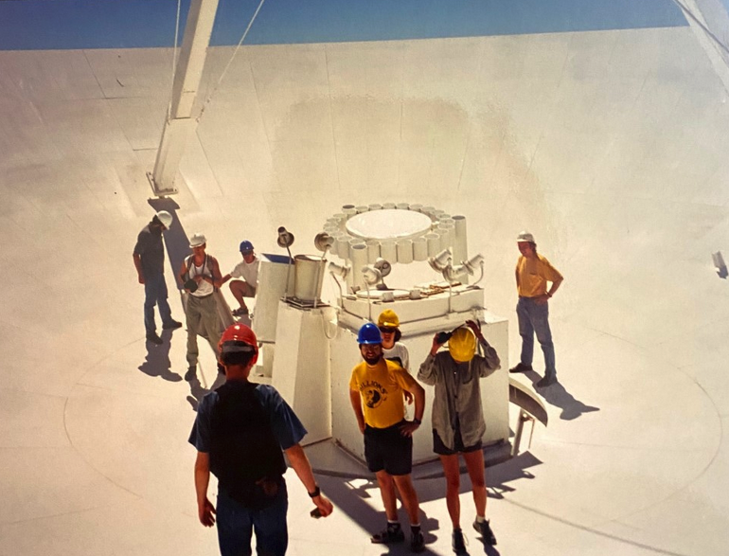
Me @ the VLA, circa 1998

Slide 15
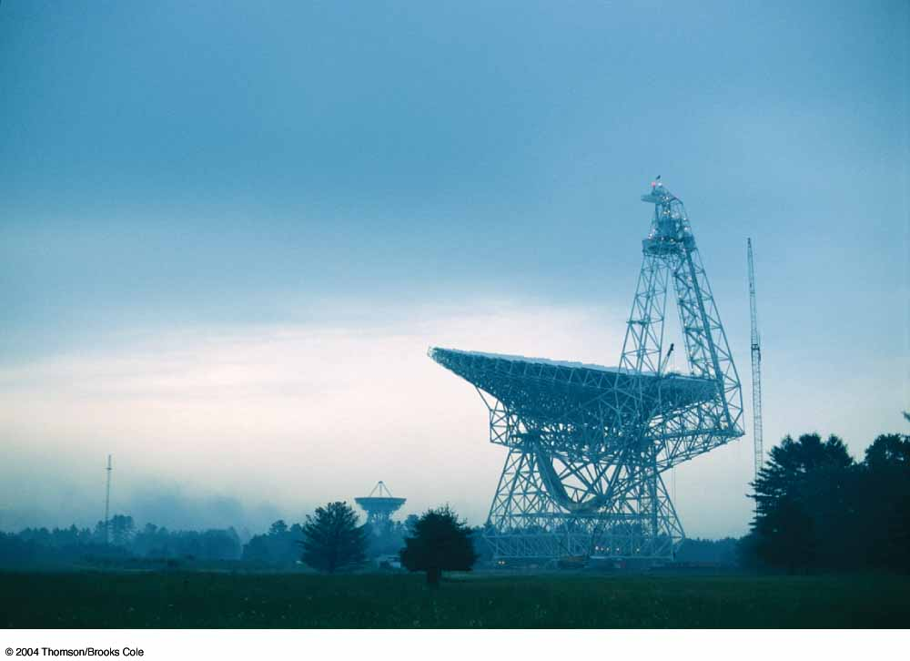
The Largest Single-Dish Radio Telescopes
The 100-m Green Bank Telescope in Green Bank, West Virginia.
The 500-m FAST telescope in southwestern China

Slide 16
Square Kilometer Array (SKA; under construction)
Australia and South Africa

Slide 17
Science of Radio Astronomy
Radio astronomy reveals several features, not visible at other wavelengths:
Neutral hydrogen clouds (which don’t emit any visible light), containing ~ 90 % of all the atoms in the universe.
Molecules (often located in dense clouds, where visible light is completely absorbed).
Radio waves penetrate gas and dust clouds, so we can observe regions from which visible light is heavily absorbed.

Slide 18
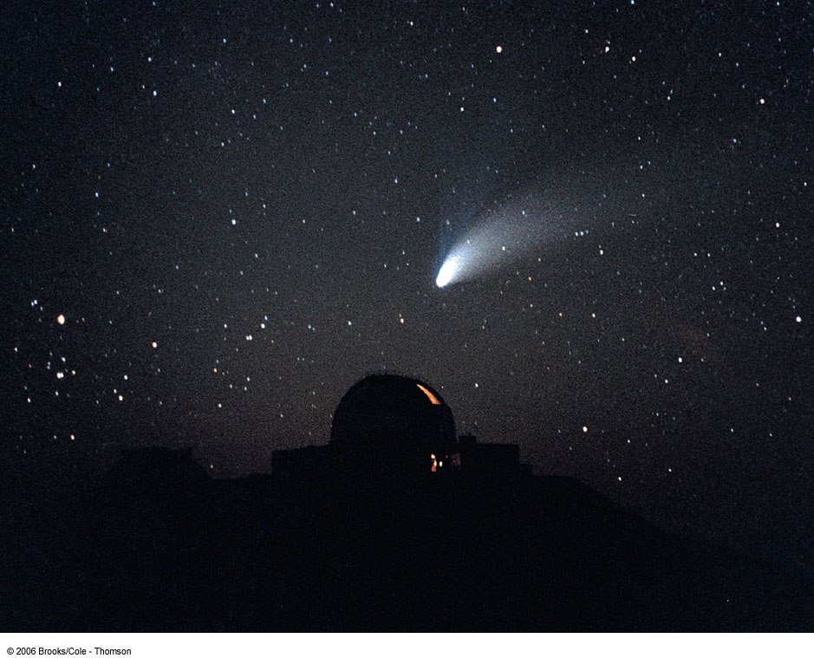
Infrared Astronomy
Most infrared radiation is absorbed in the lower atmosphere.
However, from high mountain tops or high-flying aircraft, some infrared radiation can still be observed.
NASA infrared telescope (IRTF) on Mauna Kea, Hawaii

Slide 19
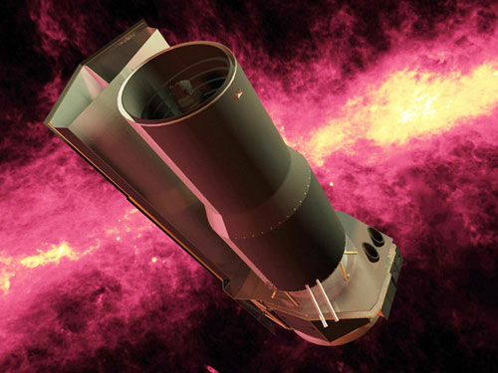
Infrared Telescopes
Spitzer Space Telescope
James Webb Space Telescope

Slide 20
Ultraviolet Astronomy
Ultraviolet radiation with λ < 290 nm is completely absorbed in the ozone layer of the atmosphere.
Ultraviolet astronomy has to be done from satellites.
Several successful ultraviolet astronomy satellites: IUE, EUVE, FUSE
Ultraviolet radiation traces hot (tens of thousands of degrees), moderately ionized gas in the universe.

Slide 21
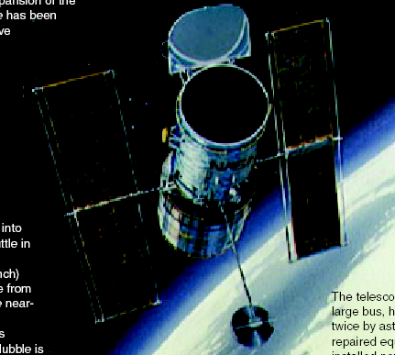
NASA’s Great Observatories in Space (I)
The Hubble Space Telescope
Launched in 1990; maintained and upgraded by several space shuttle service missions throughout the 1990s and early 2000’s
Avoids turbulence in Earth’s atmosphere
Extends imaging and spectroscopy to (invisible) infrared and ultraviolet

Slide 22
Hubble Space Telescope Images
Eagle Nebula, “Pillars of Creation”

Slide 23
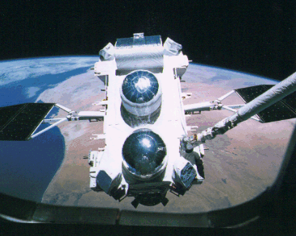
NASA’s Great Observatories in Space (II)
The Compton Gamma-Ray Observatory
Operated from 1991 to 2000
Observation of high-energy gamma-ray emission, tracing the most violent processes in the universe.

Slide 24
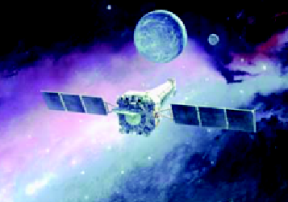
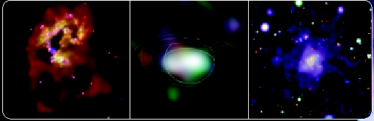
NASA’s Great Observatories in Space (III)
The Chandra X-ray Telescope
Launched in 1999 into a highly eccentric orbit that takes it 1/3 of the way to the moon!
X-rays trace hot (million degrees), highly ionized gas in the universe.
Two colliding galaxies, triggering a burst of star formation
Very hot gas in a cluster of galaxies
Saturn

Slide 25
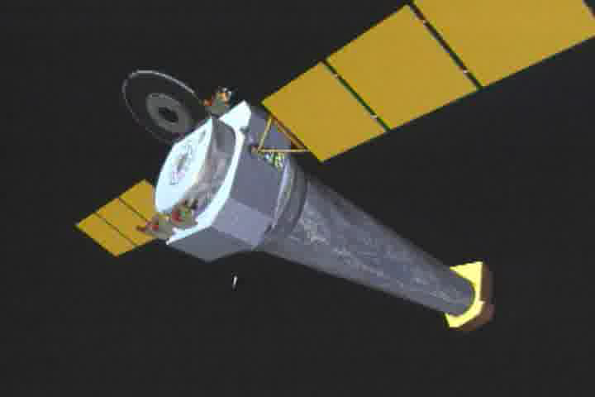
Chandra X-ray Observatory
Shuttle launched, highly eccentric orbit.
Grazing incidence mirrors – nested hyperboloids and paraboloids.

Slide 26
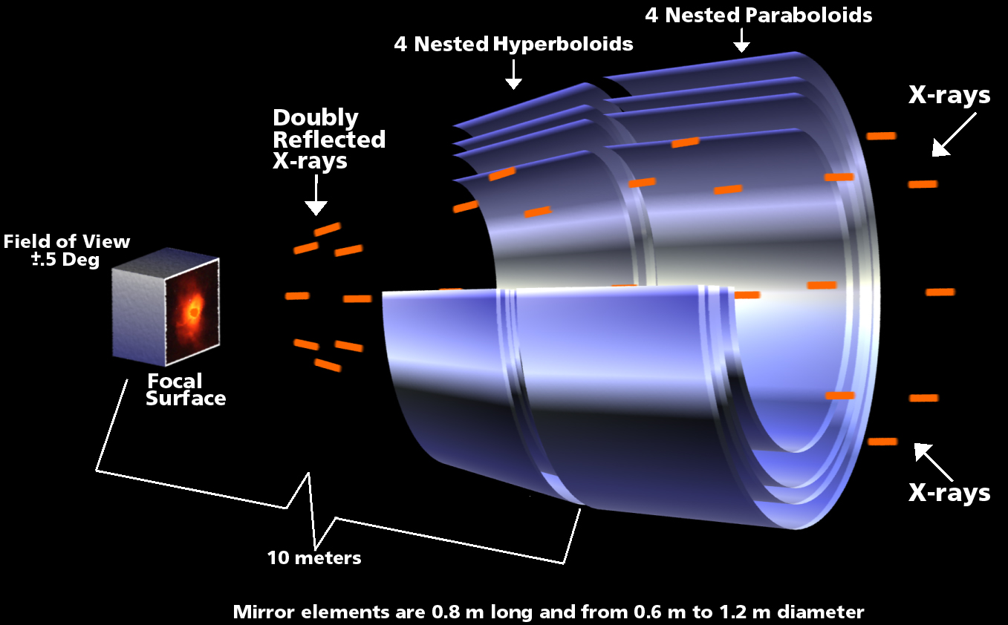
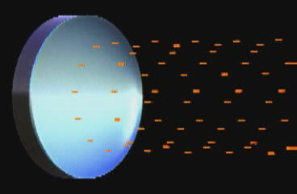
The Highest Tech Mirrors Ever!
Chandra is the first X-ray telescope to have an image as sharp as optical telescopes.

Slide 27
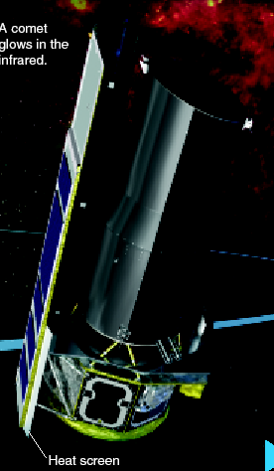
NASA’s Great Observatories in Space (IV)
The Spitzer Space Telescope
Launched in 2003
Infrared light traces warm dust in the universe.
The detector needs to be cooled to -273 ºC (-459 ºF).

Slide 28
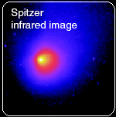
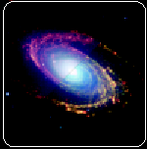
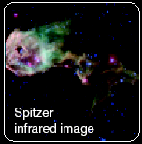
Spitzer Space Telescope Images
A Comet
Warm dust in a young spiral galaxy
Newborn stars that would be hidden from our view in visible light

Slide 29
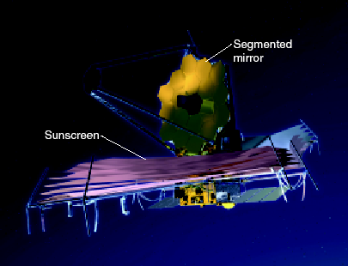
The Future of Space-Based Optical/Infrared Astronomy: James Webb Space Telescope
Launch Pad Astronomy video (18 minutes)

