Slide 1
ASTR 2310: Chapter 5
Interaction of Radiation and Matter
Atomic Structure
Atomic Processes
Emission and Absorption Spectra
Equation of Radiation Transfer
Curve of Growth
Local Thermodynamic Equilibrium
Blackbody Radiation (see other slides)

Slide 2
ASTR 2310: Chapter 5
Atomic Structure
  Some general properties of light, E&M spectrum
  Bohr Model for Hydrogen
  Lyman, Balmer, etc. series

Slide 3
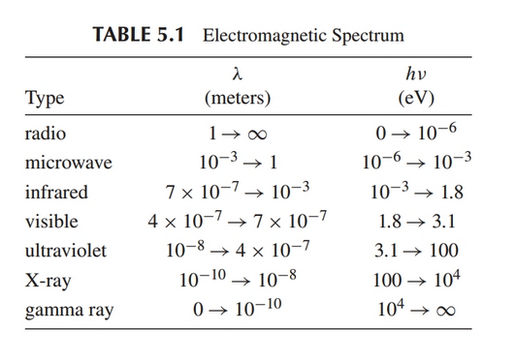
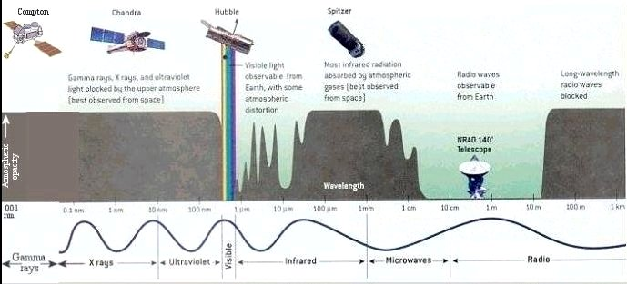
ASTR 2310: Chapter 5
E&M Spectrum:

Slide 4
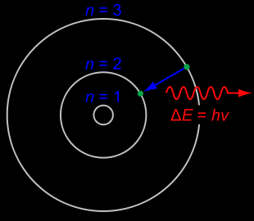
ASTR 2310: Chapter 5
Bohr Model: http://en.wikipedia.org/wiki/Bohr_model

Slide 5
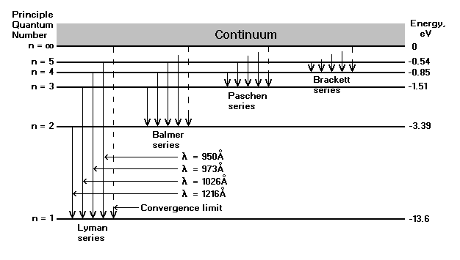
ASTR 2310: Chapter 5
Hydrogen energy levels:

Slide 6
ASTR 2310: Chapter 5
Helpful videos:
The Bohr Atom (6 minutes)
Bohr Model of Hydrogen Atom (5 minutes)
The Bohr model is imperfect, need full-blown quantum mechanics! But convenient and useful.

Slide 7
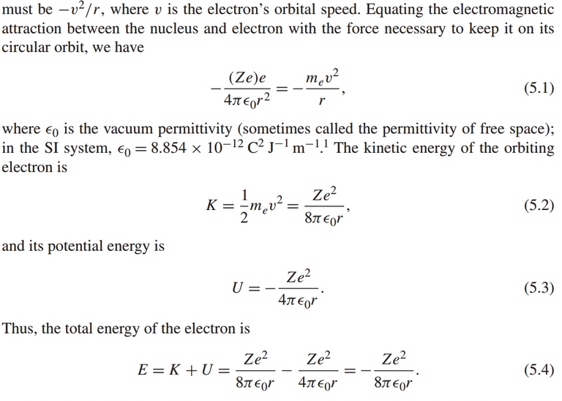
Relevant Bohr Model Equations
Central electrical force = ma of orbiting electrons

Slide 8
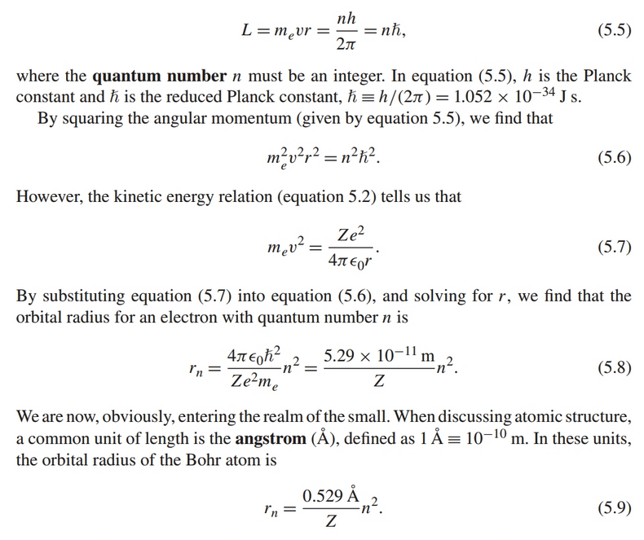
Bohr Model: Electron Orbits Quantized

Slide 9
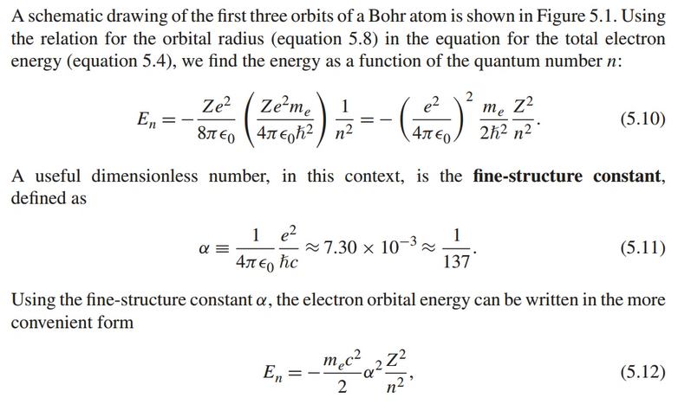
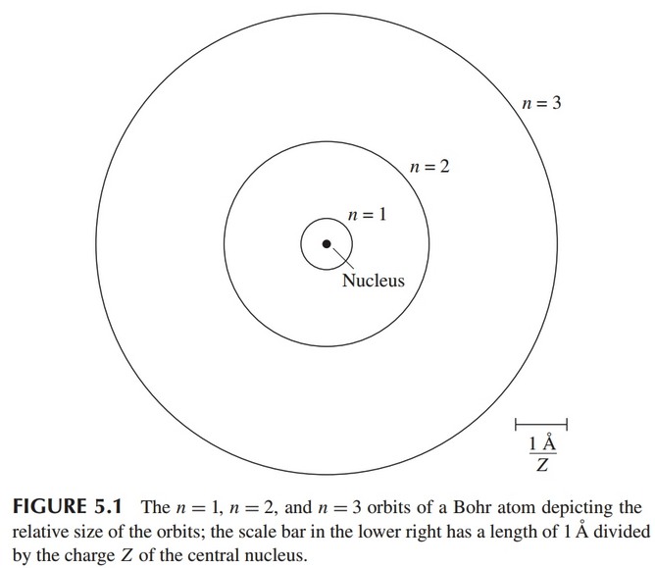
Bohr Orbital Energies

Slide 10
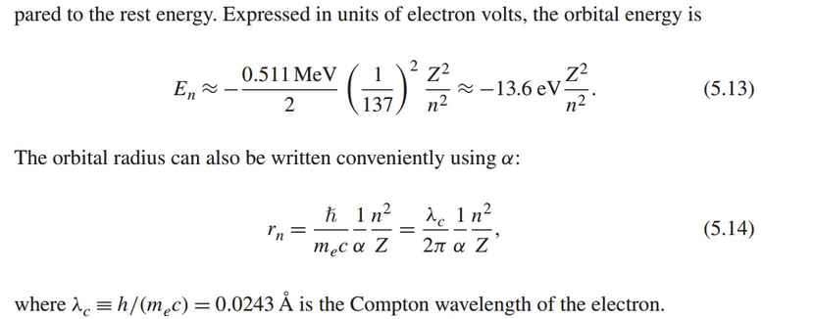
Useful alternative forms

Slide 11
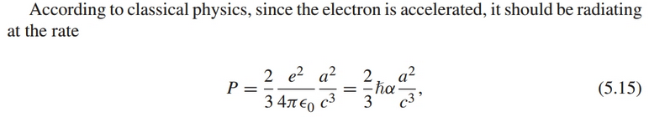
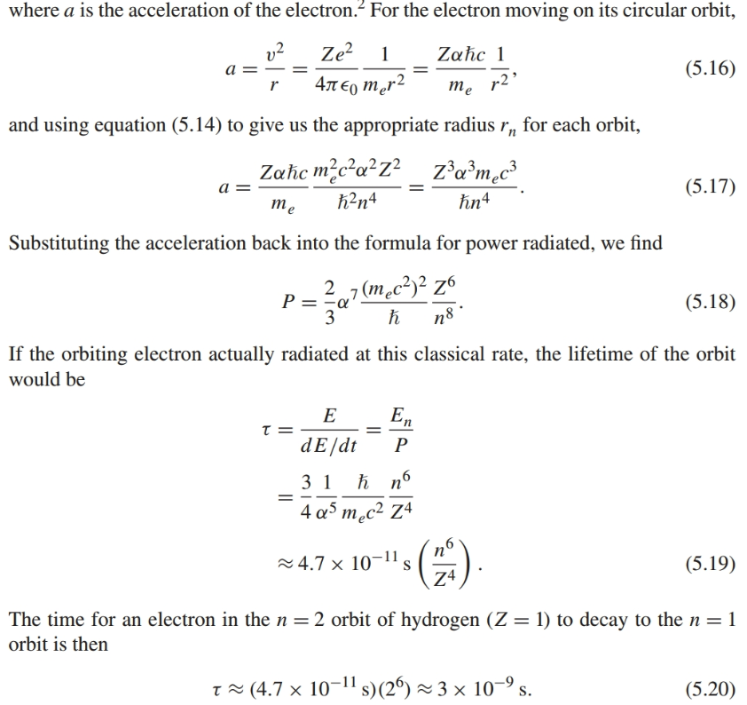
Decay rate, classical
About twice the actual value!

Slide 12
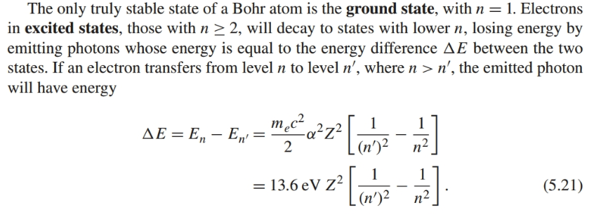
Ground state stable, other levels decay to ground with f Delta Esome time with release of photon

Slide 13
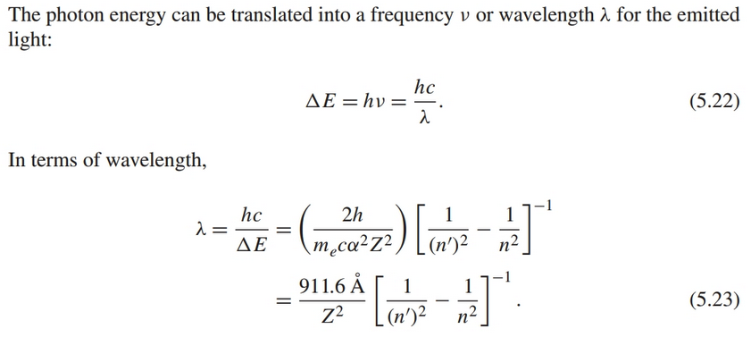
Wavelength of Bohr Model Transitions

Slide 14
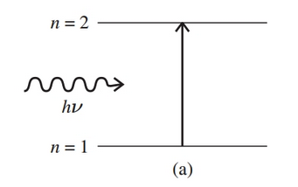

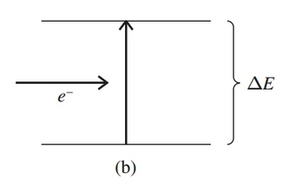


Atomic processes
Photoexcitation (absorption)
Collisional excitation

Slide 15



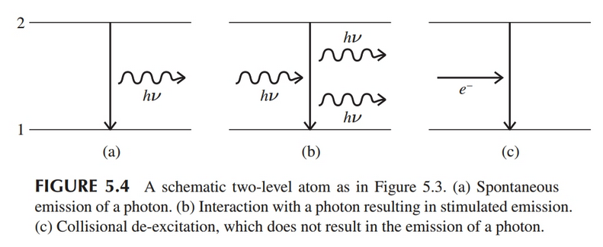
Atomic Processes
Spontaneous Emission, stimulated emission, and collisional de-excitation:

Slide 16



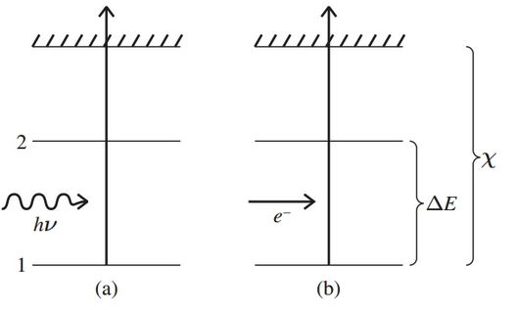
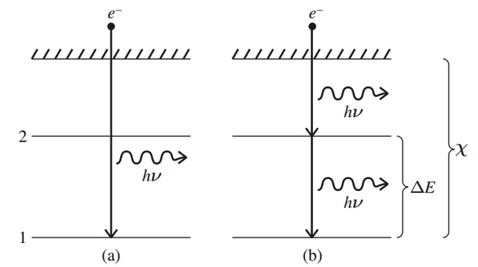
Atomic Processes
Photoionization, Collisional Ionization, Recombination

Slide 17


More on Spontaneous Emission
Probability per second given by Einstein A coefficient, computed using quantum mechanics

Slide 18
Other topics
Line broadening processes:
Natural broadening (arising from Heisenburg Uncertainty Principle)
Thermal Doppler broadening
Turbulent or Rotational Doppler broadening
Pressure (collisional) broadening
Zeeman broadening/splitting (magnetic)

Slide 19
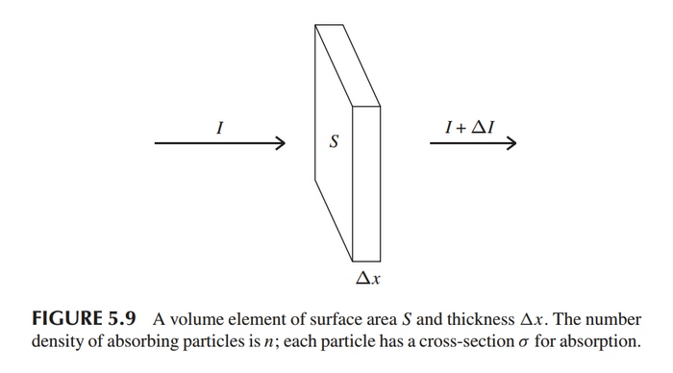






Other topics
Radiative Transfer
Basic equation
Column Density
Optical Depth
Revised Equations
Mean Free Path: distance for 𝛕 to go from 0 to 1

Slide 20
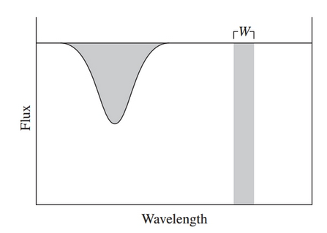
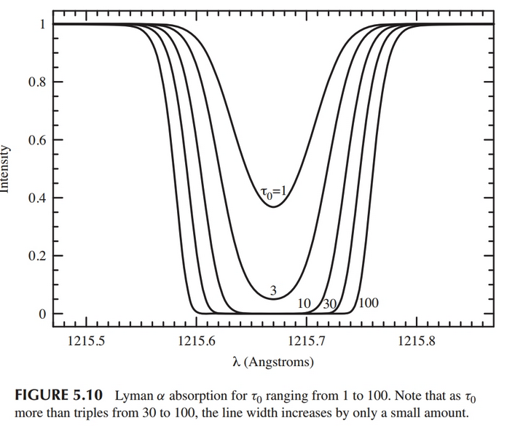
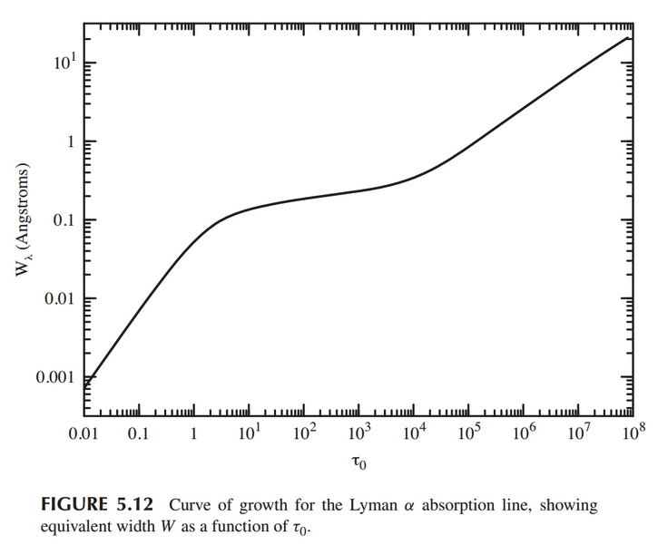
Other Topics
Curve of Growth:

Slide 21




Other topics
Local Thermodynamic Equilibrium (LTE): same temperature everywhere, same v distribution

