Slide 1
ASTR 2310 General Astronomy I
Professor Mike Brotherton
Ryden & Peterson Chapter 5
Blackbody Radiation (likely will be revised)

Slide 2
Light and Other Forms of Radiation
The Electromagnetic Spectrum
In astronomy, we cannot perform experiments with our objects (stars, galaxies, …).
The only way to investigate them is by analyzing the light (and other radiation) which we observe from them.

Slide 3
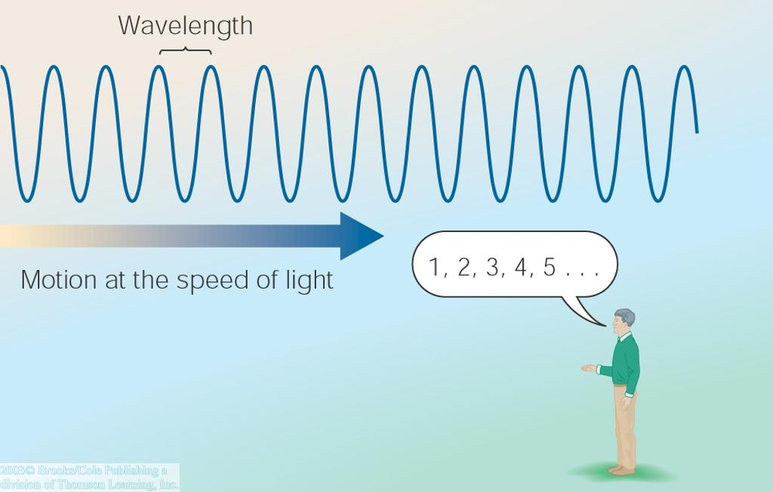
Light as a Wave
λ
c = 300,000 km/s = 3*10⁸ m/s
Light waves are characterized by a wavelength λ and a frequency f.
f and λ are related through
f = c/λ

Slide 4
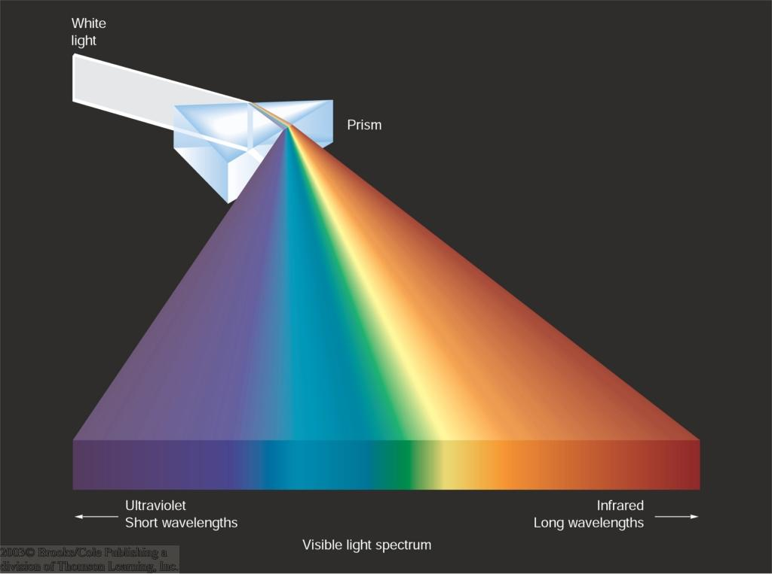
Wavelengths and Colors
Different colors of visible light correspond to different wavelengths.

Slide 5
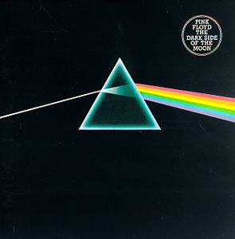
Dark Side of the Moon
“There is no dark side really. It’s all dark.” -- Pink Floyd

Slide 6
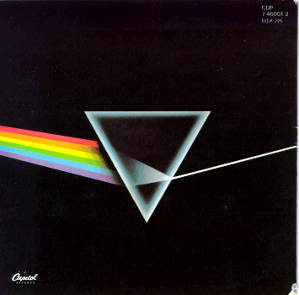
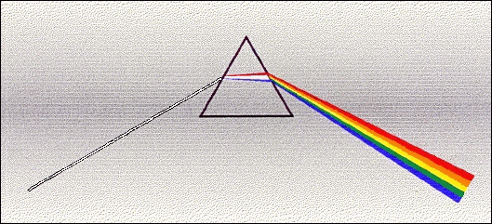
Dark Side of the Moon
What is wrong with this picture?
Front: Not all primary colors (e.g., pink, magenta), also refraction angles inconsistent
Back: Spectrum is Convergent –for art’s sake
Front cover Back cover
More accurate, from Richard Berg

Slide 7
Light as a Wave
Wavelengths of light are measured in units of nanometers (nm) or angstrom (Å):
1 nm = 10⁻⁹ m
1 Å = 10⁻¹⁰ m = 0.1 nm
Visible light has wavelengths between 4000 Å and 7000 Å (= 400 – 700 nm).

Slide 8
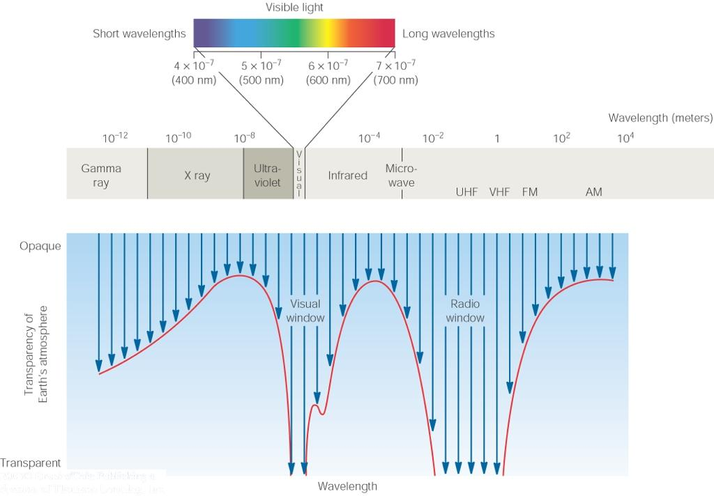
The Electromagnetic Spectrum
Wavelength
Frequency
High flying air planes or satellites
Need satellites to observe

Slide 9
Light as Particles
Light can also appear as particles, called photons (explains, e.g., photoelectric effect).
A photon has a specific energy E, proportional to the frequency f:
E = h*f
h = 6.626x10⁻³⁴ J*s
is the Planck constant.
The energy of a photon does not depend on the intensity of the light!!!

Slide 10
Why is energy per photon so important?
Real life example: Ultra-Violet light hitting your skin (important in Laramie!)
Threshold for chemical damage set by energy (wavelength) of photons
Below threshold (long wavelengths) energy too weak to cause chemical changes
Above threshold (short wavelength) energy photons can break apart DNA molecules
Number of molecules damaged = number of photons above threshold
Very unlikely two photons can hit exactly together to cause damage

Slide 11
Temperature and Heat
Thermal energy is “kinetic energy” of moving atoms and molecules
Hot material energy has more energy available which can be used for
Chemical reactions
Nuclear reactions (at very high temperature)
Escape of gasses from planetary atmospheres
Creation of light
Collision bumps electron up to higher energy orbit
It emits extra energy as light when it drops back down to lower energy orbit
(Reverse can happen in absorption of light)

Slide 12
Temperature Scales
Want temperature scale with energy proportional to T
Celsius scale is “arbitrary” (Fahrenheit even more so)
0º C = freezing point of water
100º C = boiling point of water
By experiment, available energy = 0 at “Absolute Zero” = –273ºC (-459.7ºF)
Define “Kelvin” scale with same step size as Celsius, but 0K = -273ºC = Absolute Zero
Use Kelvin Scale for most astronomy work
Available energy is proportional to T, making equations simple (really! OK, simpler)
273K = freezing point of water
373K = boiling point of water
300K approximately room temperature

Slide 13
Planck “Black Body Radiation”
Hot objects glow (emit light) as seen in PREDATOR, etc.
Heat (and collisions) in material causes electrons to jump to high energy orbits, and as electrons drop back down, some of energy is emitted as light.
Reason for name “Black Body Radiation”
In a “solid” body the close packing of the atoms means than the electron orbits are complicated, and virtually all energy orbits are allowed. So all wavelengths of light can be emitted or absorbed. A black material is one which readily absorbs all wavelengths of light. These turn out to be the same materials which also readily emit all wavelengths when hot.
The hotter the material the more energy it emits as light
As you heat up a filament or branding iron, it glows brighter and brighter
The hotter the material the more readily it emits high energy (blue) photons
As you heat up a filament or branding iron, it first glows dull red, then bright red, then orange, then if you continue, yellow, and eventually blue

Slide 14
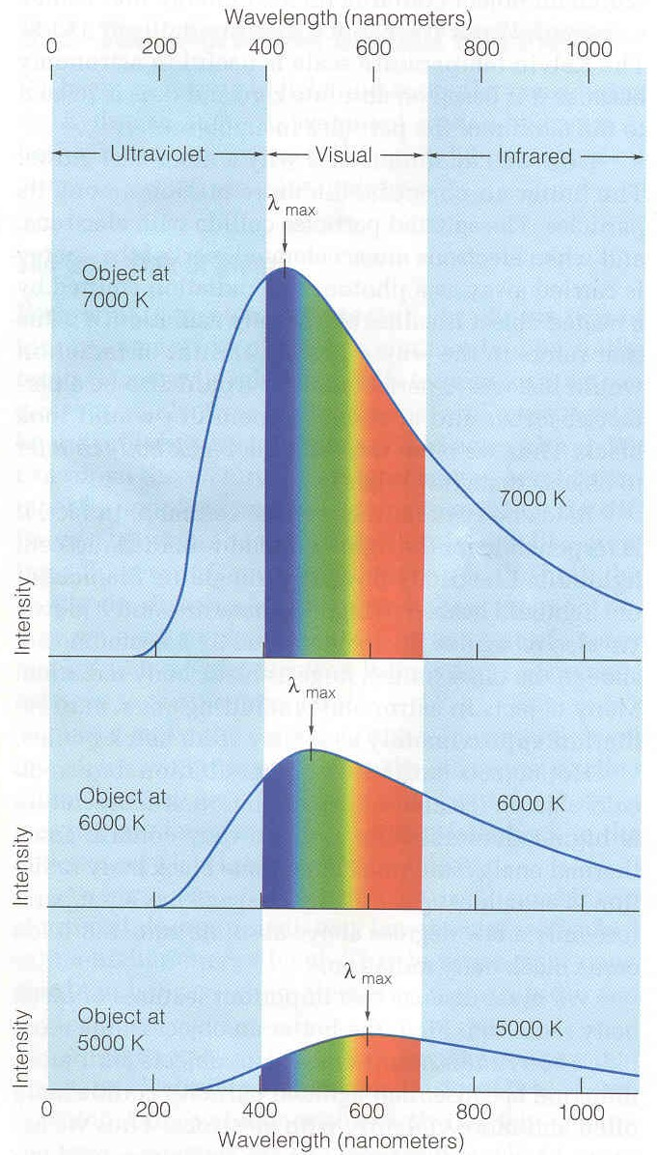
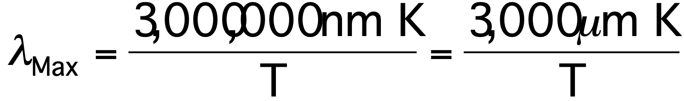
Planck and other Formulae
Planck formula gives intensity of light at each wavelength
It is complicated. We’ll more often use two simpler formulae which can be derived from it.
Wien’s law tells us what wavelength has maximum intensity
Stefan-Boltzmann law tells us total radiated energy per unit area
From our text: Horizons, by Seeds

Slide 15
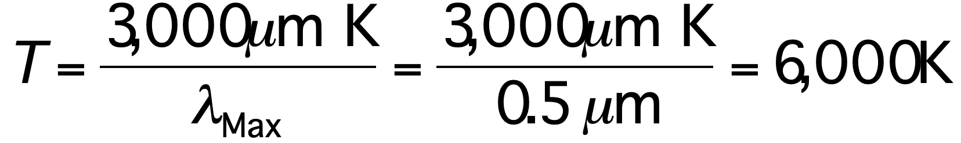
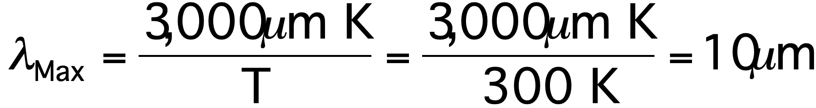
Example of Wien’s law
What is wavelength at which you glow?
Room T = 300 K so
This wavelength is about 20 times longer than what your eye can see. Thermal cameras operates at 7-14 μm.
What is temperature of the sun – which has maximum intensity at roughly 0.5 μm?
From our text: Horizons, by Seeds

Slide 16
Kirchoff’s laws
Hot solids emit continuous spectra
Hot gasses try to do this, but can only emit discrete wavelengths
Cold gasses try to absorb these same discrete wavelengths

Slide 17
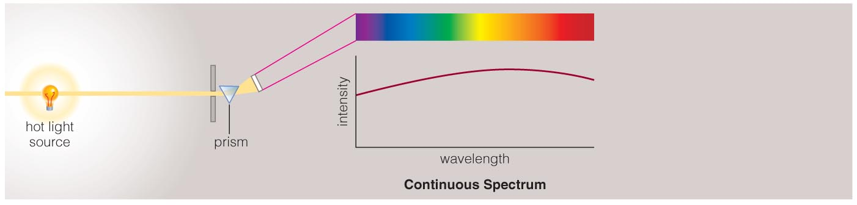
Continuous Spectrum
The spectrum of a common (incandescent) light bulb spans all visible wavelengths, without interruption.

Slide 18
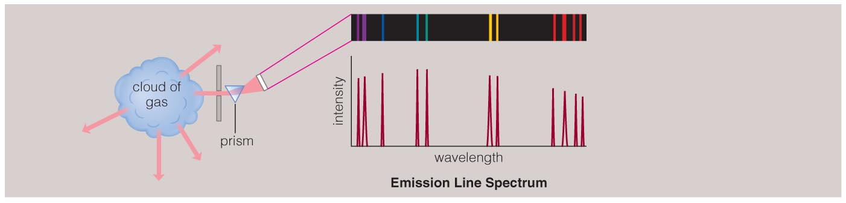
Emission Line Spectrum
A thin or low-density cloud of gas emits light only at specific wavelengths that depend on its composition and temperature, producing a spectrum with bright emission lines.

Slide 19
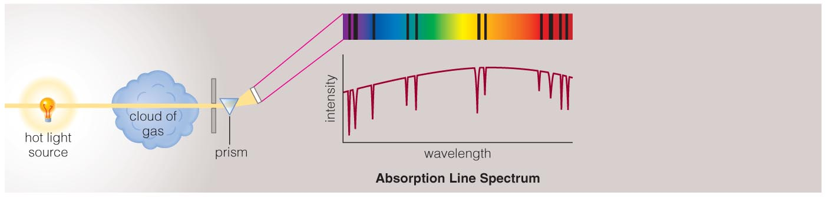
Absorption Line Spectrum
A cloud of gas between us and a light bulb can absorb light of specific wavelengths, leaving dark absorption lines in the spectrum.

Slide 20
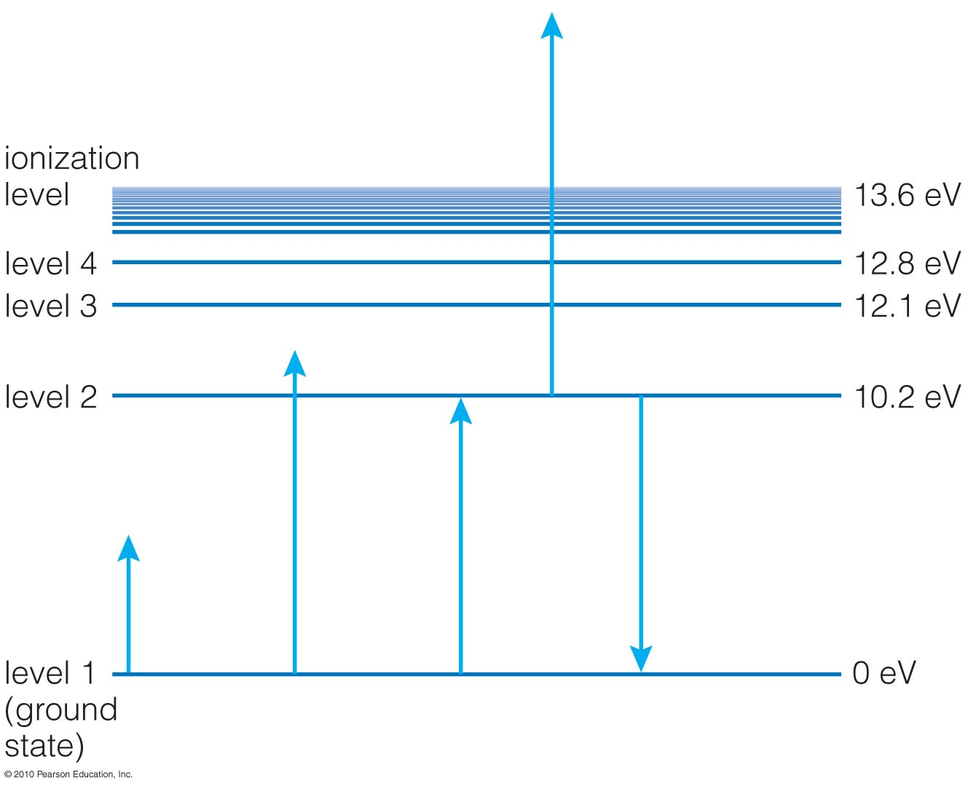
How is energy stored in atoms?
Excited states
Ground state
Electrons in atoms are restricted to particular energy levels.

Slide 21
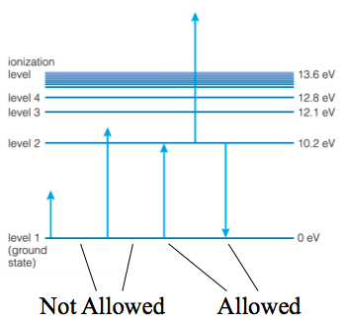
Energy Level Transitions
The only allowed changes in energy are those corresponding to a transition between energy levels.

Slide 22
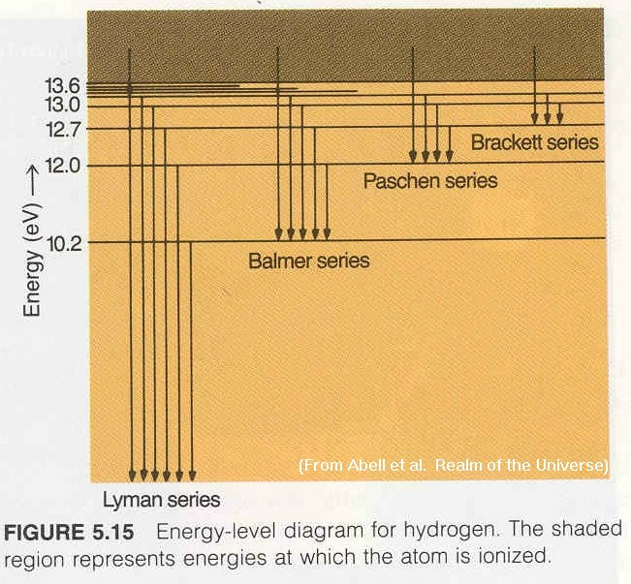
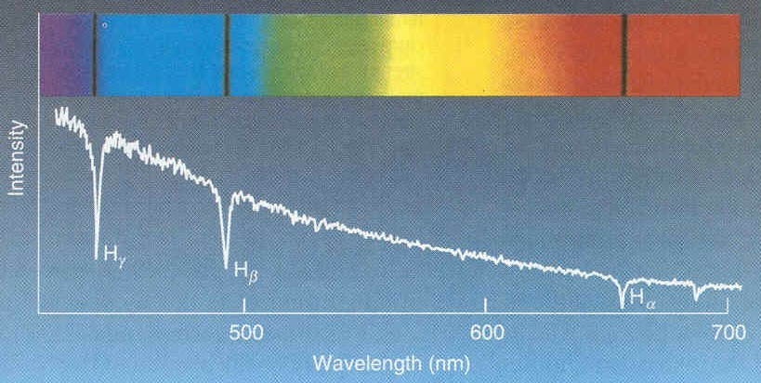
Atomic (Hydrogen) Lines
Energy absorbed/emitted depends on upper and lower levels
Higher energy levels are close together
Above a certain energy, electron can escape (ionization)
Series of lines named for bottom level
To get absorption, lower level must be occupied
Depends upon temperature of atoms
To get emission, upper level must be occupied
Can get down-ward cascade through many levels
n=3
n=2
n=1
From our text: Horizons, by Seeds

