Slide 1
ASTR 2310
General Astronomy I
Professor Mike Brotherton
Ch. 12 from Ryden & Peterson, Solar System in Perspective
Comparative planetology, origins, exoplanets

Slide 2
Comparative Planetology “Lessons”
Lesson 1: Surfaces of planets are shaped by competing internal mechanisms
and external mechanisms.
Lesson 2: More massive, colder planets are better able to retain atmospheres.
Lesson 3: Giant satellites of Jovian planets show patterns consistent with our
ideas about formation of the planets.
Lesson 4: Many unusual features of the solar system can be attributed to giant
impacts.
Discuss…

Slide 3
Origin of Solar System
Protoplanetary disks, as mentioned earlier in the course, explains:
Planetary orbits are all in nearly the same plane.
2. The Sun’s equator lies close to this plane.
3. Planetary orbits are nearly circular.
4. Planets all orbit in the same direction.
5. Most planets (and the Sun) rotate in the same direction as the planets’ orbital motion.

Slide 4
Exoplanets
Detection – how do we find them today? Directly and indirectly…
Properties – what are they like, individually and as their own solar systems?
Both like and unlike ours…

Slide 5


Brightness Difference
A Sun-like star is about a billion times brighter than the light reflected from its planets. Reflected light from Jupiter:
A challenge in contrast and S/N located close to a bright central star. Possible?

Slide 6
Yes, exoplanets imaged! See wiki.
Motion interpolation of 7 Keck images of HR 8799.

Slide 7
Another: 51 Eridani
Animated gif:
https://en.wikipedia.org/wiki/51_Eridani#/media/File:51_Eridani_b_orbit_animated_(2014-2018).gif
In general, see NASA Exoplanet Archive for up to date lists. Let’s visit…

Slide 8
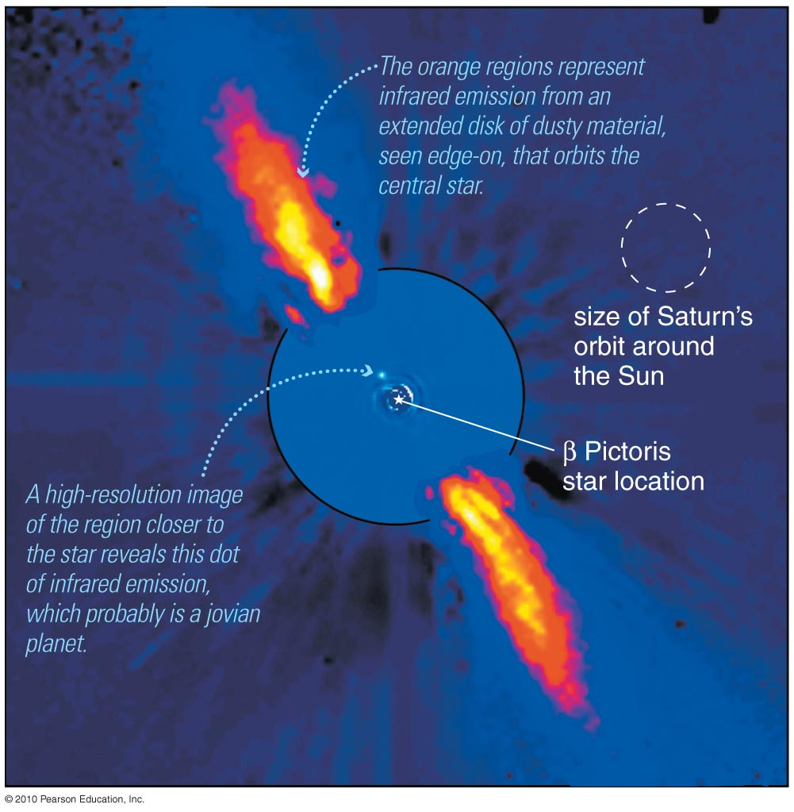
Direct Detection
Beta Pictoris. Techniques that help block the bright light from stars are helping us to find stuff/planets around them.

Slide 9
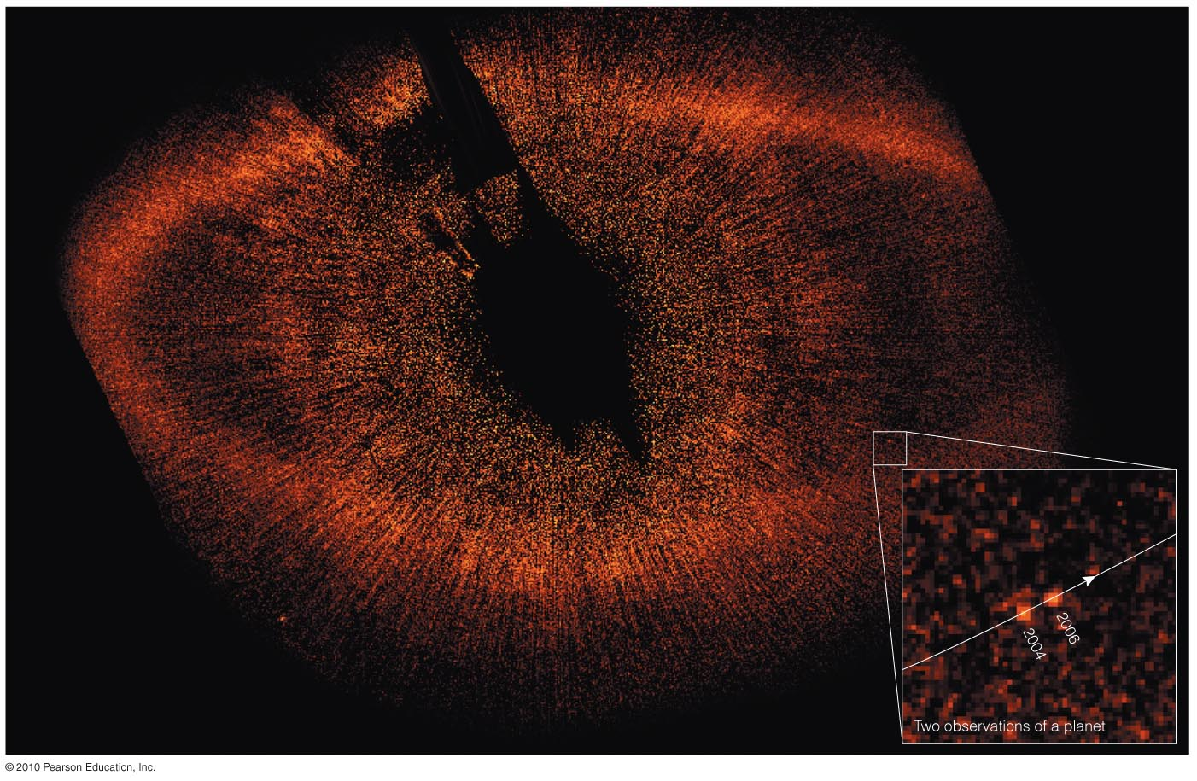
Be careful! The case of Fomalhaut b
Techniques that help block the bright light from stars are also helping us to find planets around them.

Slide 10
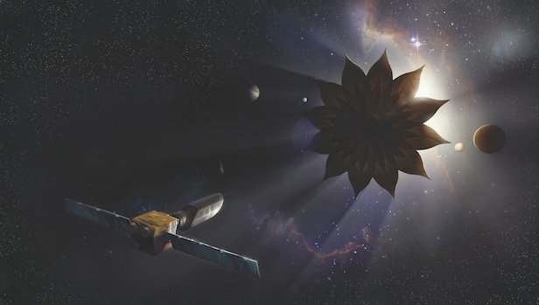
Direct Detection
Starshade, a specialized occulting mission possible.

Slide 11
Indirect Methods
Doppler Shifts of Stellar Lines from Gravity Tugs
Eclipses AKA Transits
Others:
  Gravitational Lensing
  Gaps in Dust Disks
  Pulsar Timing
  Astrometry

Slide 12
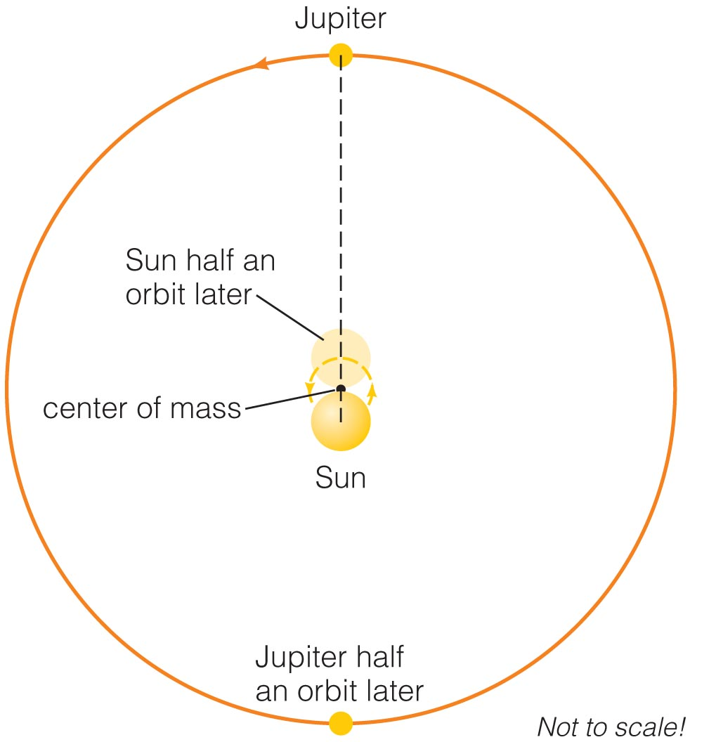
Gravitational Tugs
The Sun and Jupiter orbit around their common center of mass.
The Sun therefore wobbles around that center of mass with same period as Jupiter.

Slide 13
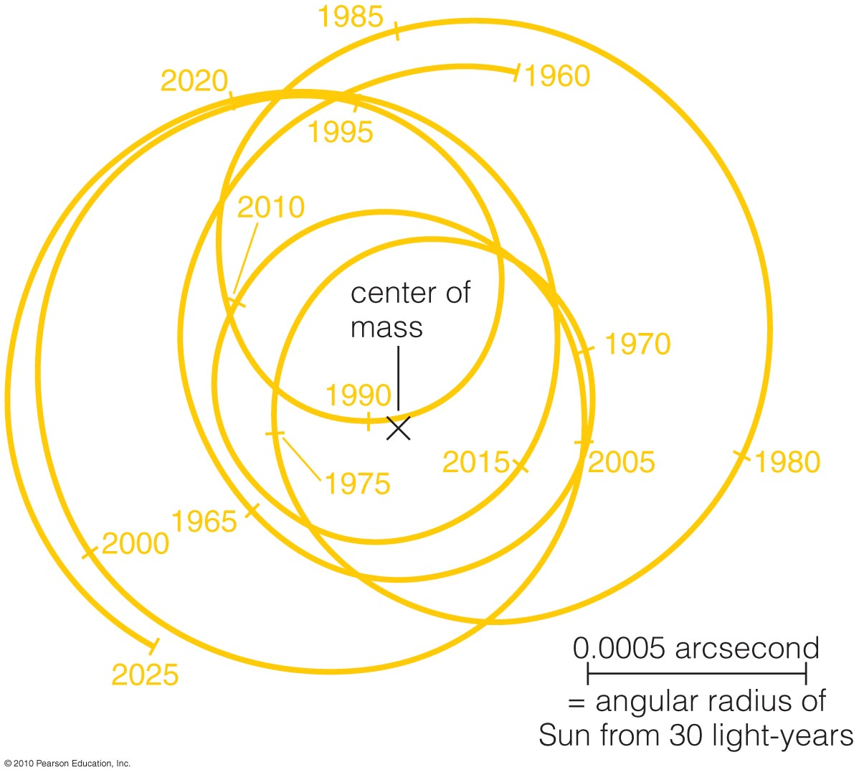
Gravitational Tugs
The Sun’s motion around the solar system’s center of mass depends on tugs from all the planets.
Astronomers around other stars that measured this motion could determine the masses and orbits of all the planets.

Slide 14
(Astrometric Technique)
We can detect planets by measuring the change in a star’s position on sky.
However, these tiny motions are VERY difficult to measure (~ 0.001 arcsecond).

Slide 15
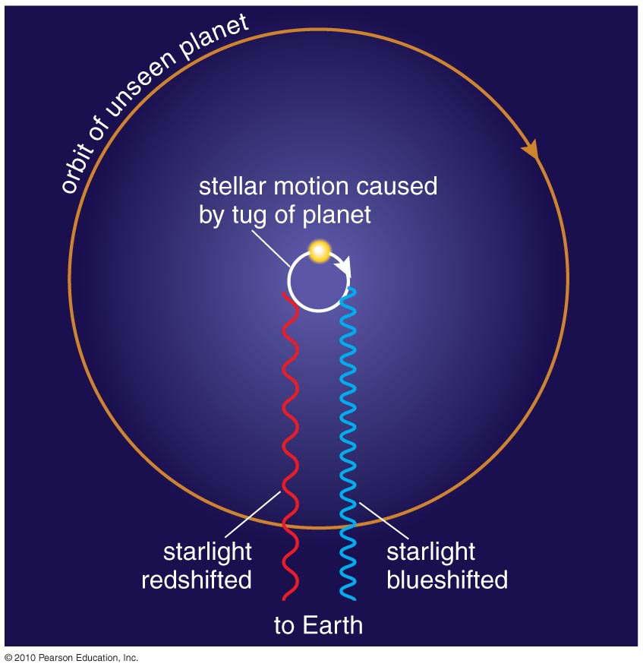
Doppler Technique
Measuring a star’s Doppler shift can tell us its motion toward and away from us.
Current techniques can measure motions as small as 1 m/s (walking speed!).

Slide 16
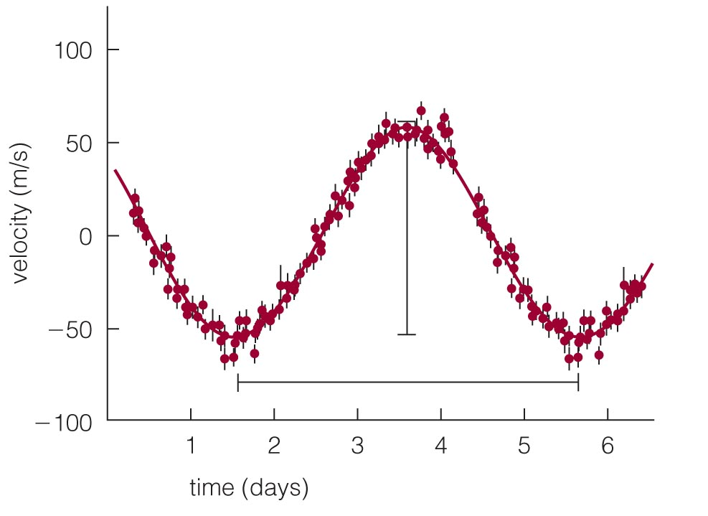
First Extrasolar Planet
Doppler shifts of the star 51 Pegasi indirectly revealed a planet with 4-day orbital period.
This short period means that the planet has a small orbital distance.
This was the first* extrasolar planet to be discovered (Mayor & Queloz 1995). Won them a Nobel Prize in 2019!
Insert TCP 6e Figure 13.4a unannotated

Slide 17
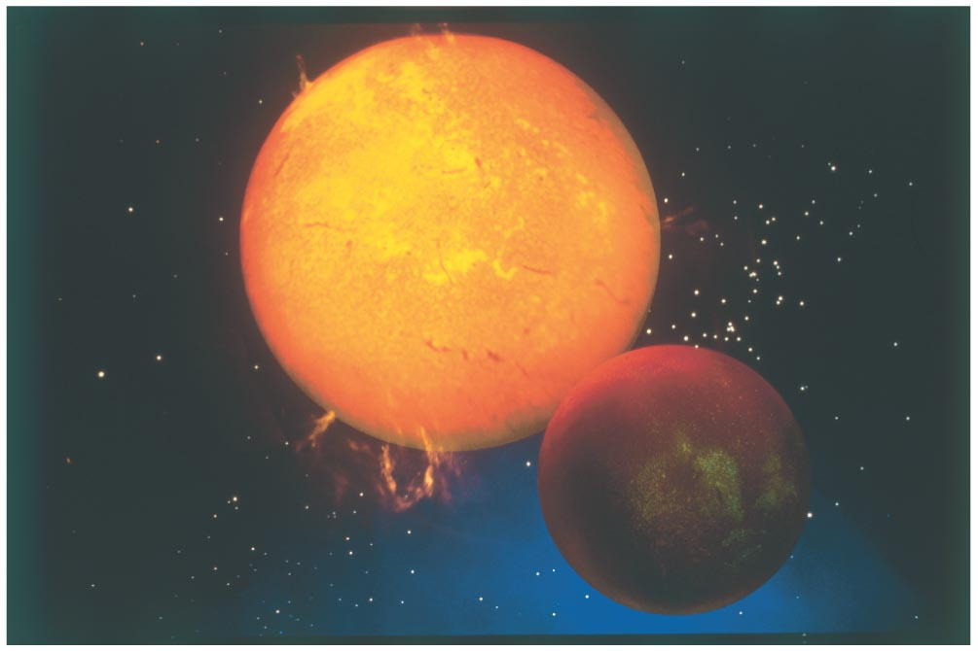
First* Extrasolar Planet
Insert TCP 6e Figure 13.4b
The planet around 51 Pegasi has a mass similar to Jupiter’s, despite its small orbital distance.

Slide 18
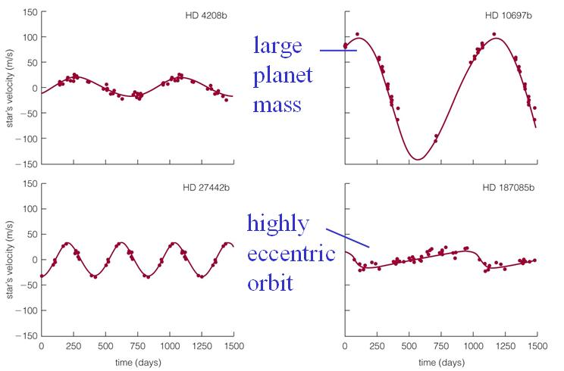
Other Extrasolar Planets
Doppler shift data tell us about a planet’s mass and the shape of its orbit.

Slide 19
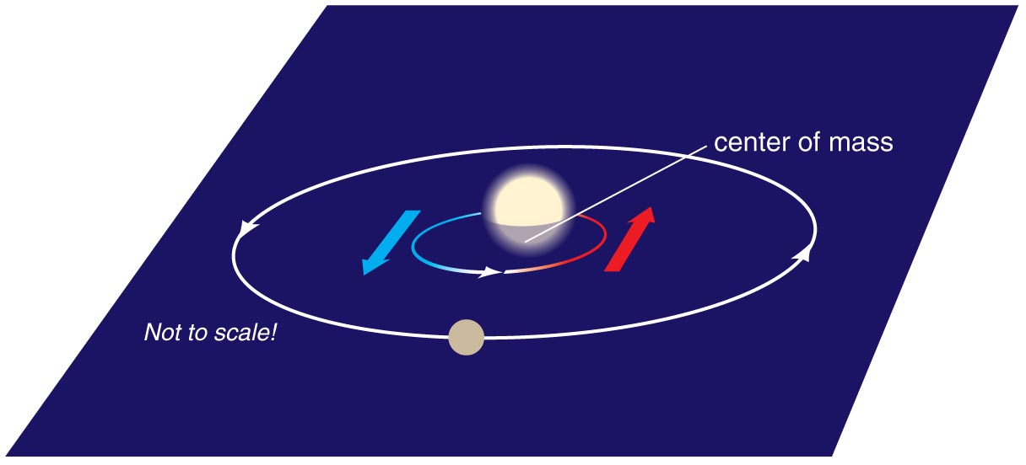
Planet Mass and Orbit Tilt
We cannot measure an exact mass for a planet without knowing the tilt of its orbit, because Doppler shift tells us only the velocity toward or away from us.
Doppler data give us lower limits on masses.

Slide 20
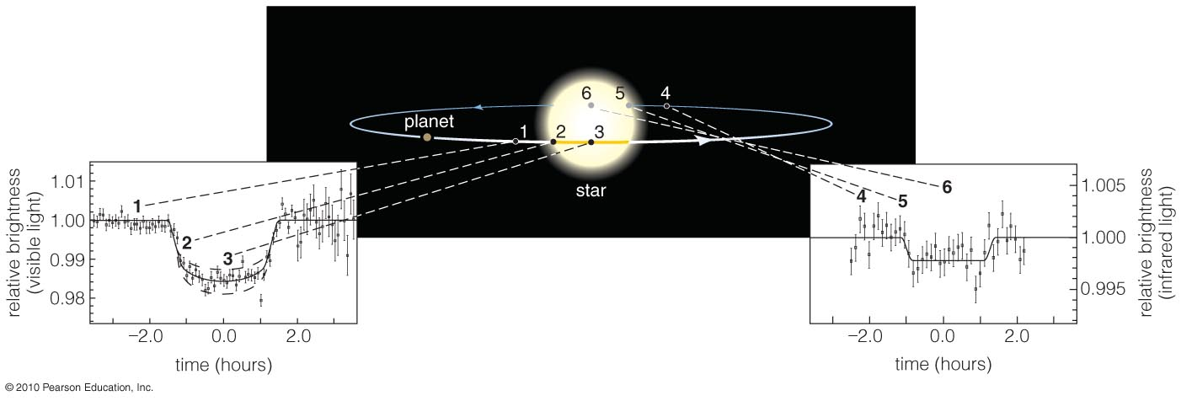
Transits and Eclipses
A transit is when a planet crosses in front of a star.
The resulting eclipse reduces the star’s apparent brightness and tells us planet’s radius.
No orbital tilt: accurate measurement of planet mass

Slide 21
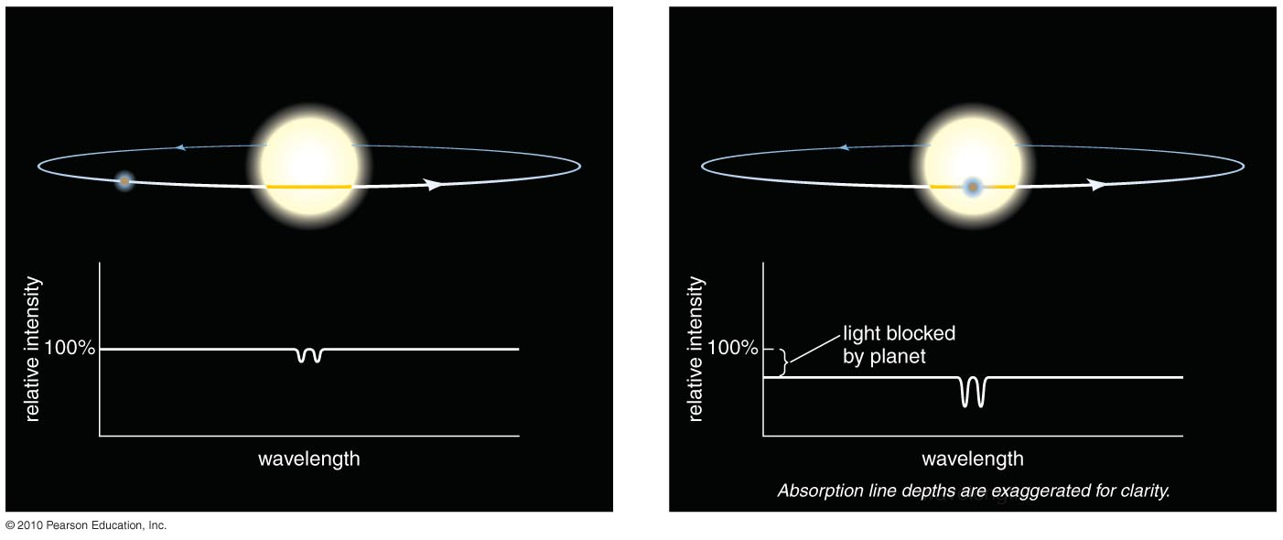
Spectrum During Transit
Change in spectrum during a transit tells us about the composition of planet’s atmosphere.

Slide 22
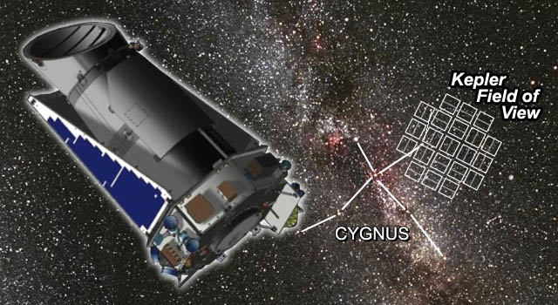
Transits from Kepler
Kepler Orrey video from 2011 or so:
https://www.youtube.com/watch?v=qRJ30fkyiU4

Slide 23
TESS-Transiting Exoplanet Survey Satellite (MIT/NASA)
Successor to Kepler
NASA Website
MIT Website
WIKI
TESS initial video
Completed mission video

Slide 24
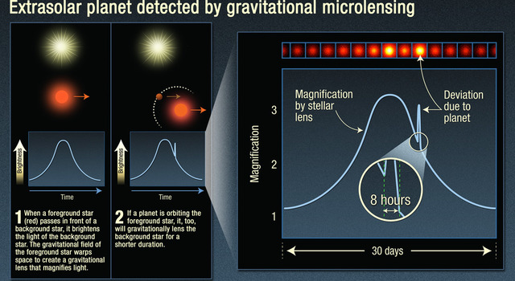
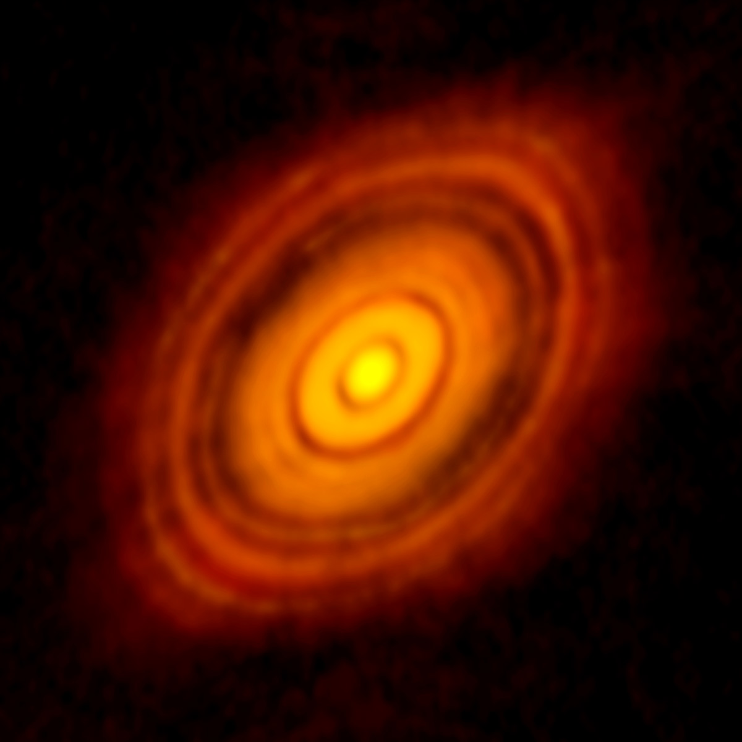
Other Planet-Hunting Strategies
Gravitational Lensing: Mass bends light in a special way when a star with planets passes in front of another star.
Features in Dust Disks: Gaps, waves, or ripples in disks of dusty gas around stars can indicate planets.

Slide 25
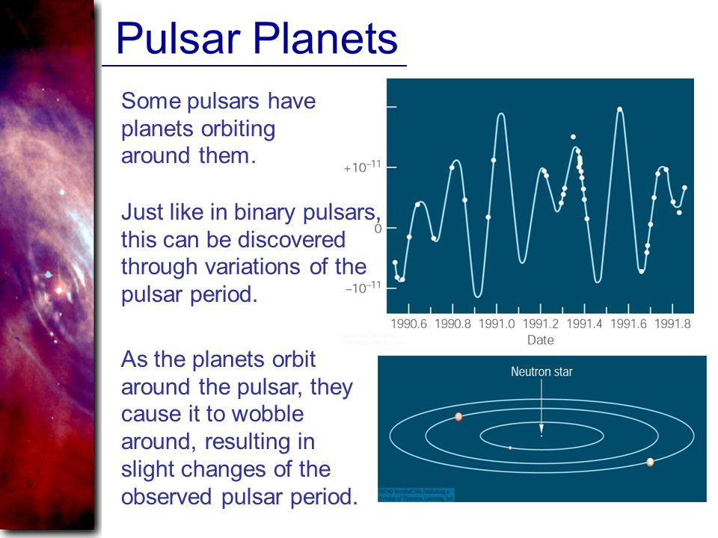
Pulsar Planets

Slide 26
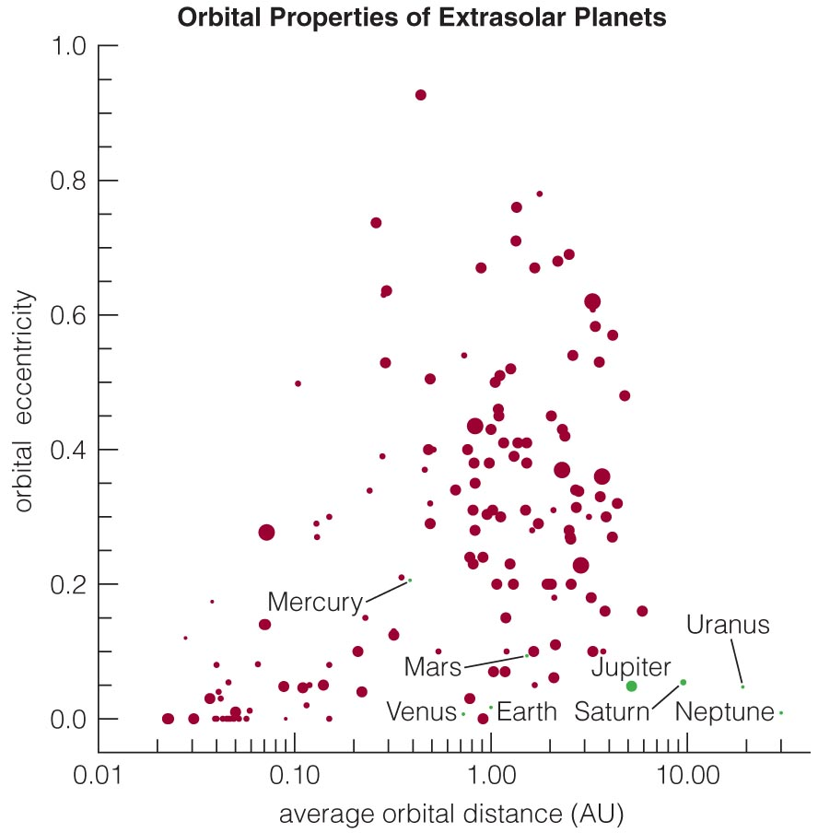
Orbits of Exoplanets
Orbits of some extrasolar planets are much more elongated (have a greater eccentricity) than those in our solar system. Circular orbits not required.

Slide 27
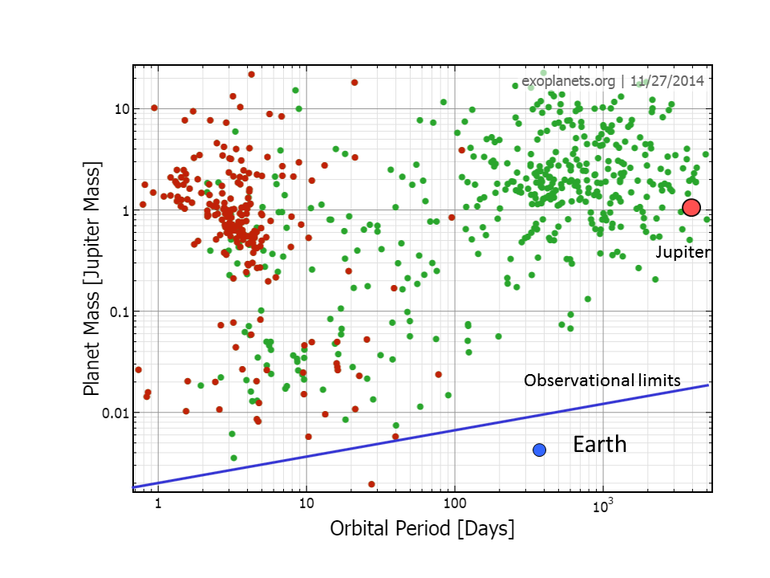
Mass and Period of Exoplanets
Red = Transit
Green=Doppler
(Note: a few years out of date already)

Slide 28
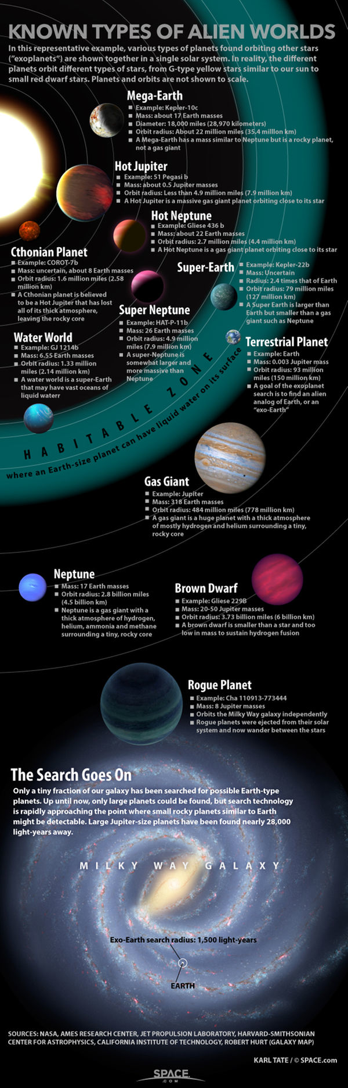

Slide 29
Hot Jupiters: Revisiting the Nebular Theory
The nebular theory predicts that massive Jupiter-like planets should not form inside the frost line (at << 5 AU).
The discovery of hot Jupiters has forced reexamination of nebular theory.
Planetary migration or gravitational encounters may explain hot Jupiters.

Slide 30
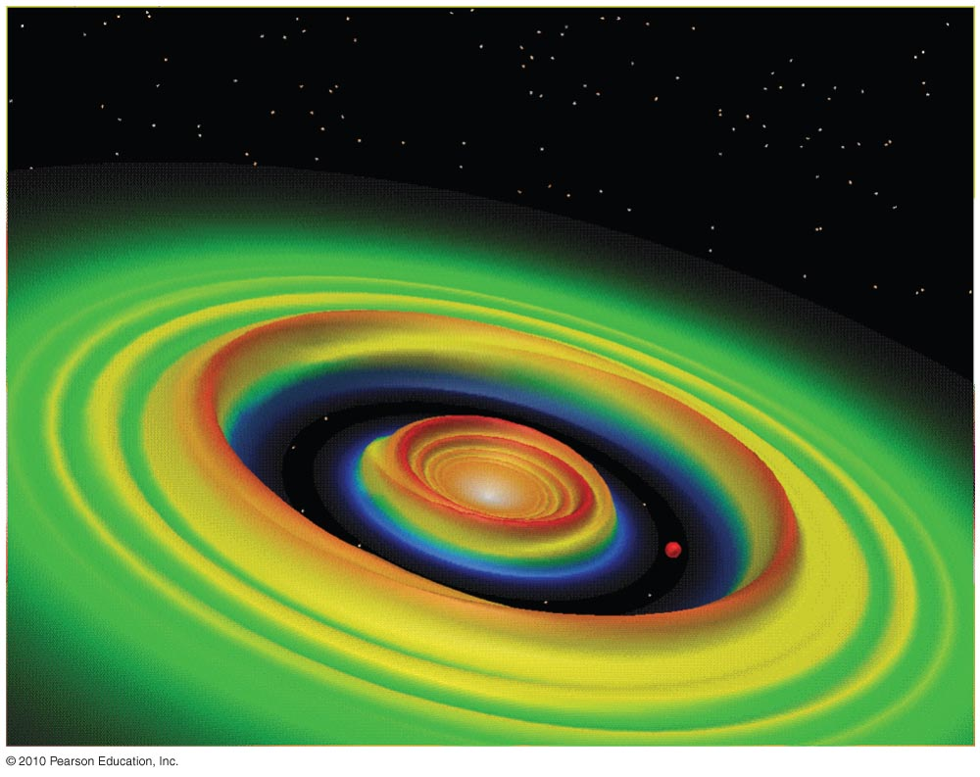
Planetary Migration
A young planet’s motion can create waves in a planet-forming disk.
Models show that matter in these waves can tug on a planet, causing its orbit to migrate inward.

Slide 31
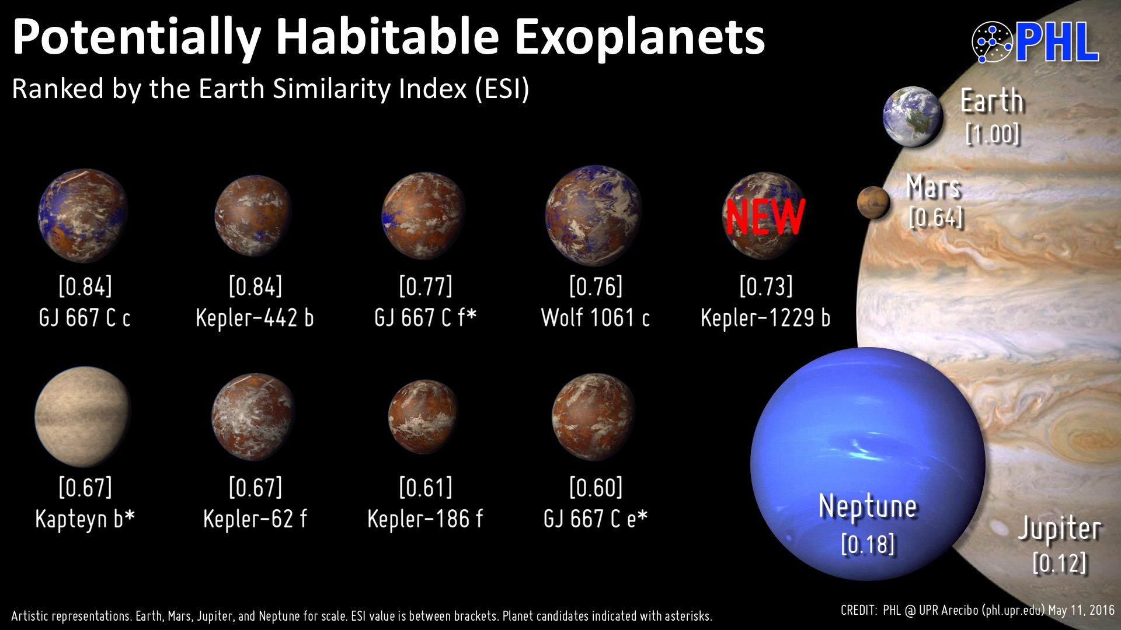
Potentially Habitable Exoplanets
http://phl.upr.edu/projects/habitable-exoplanets-catalog

Slide 32
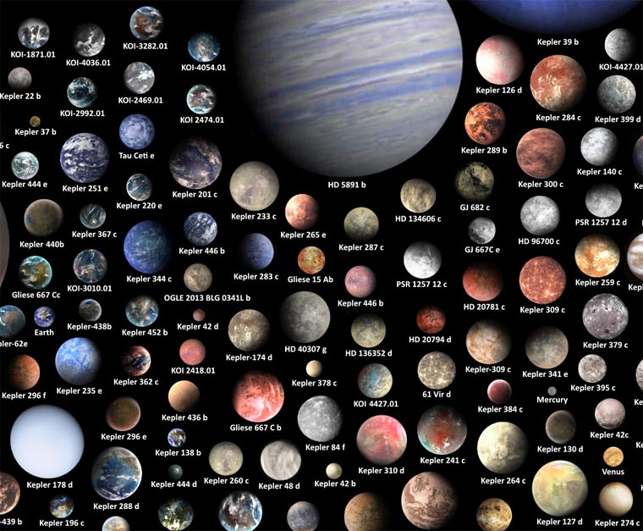
Take Aways
Planets are relatively common.
Planetary systems are quite varied!
Use online sources and apps to stay current (demo).

