Slide 1
ASTR 2310
General Astronomy I
Professor Mike Brotherton
Ch. 10 from Ryden & Peterson, The Planets
Terrestrial Planets, Jovian Planets, Moons, Rings

Slide 2
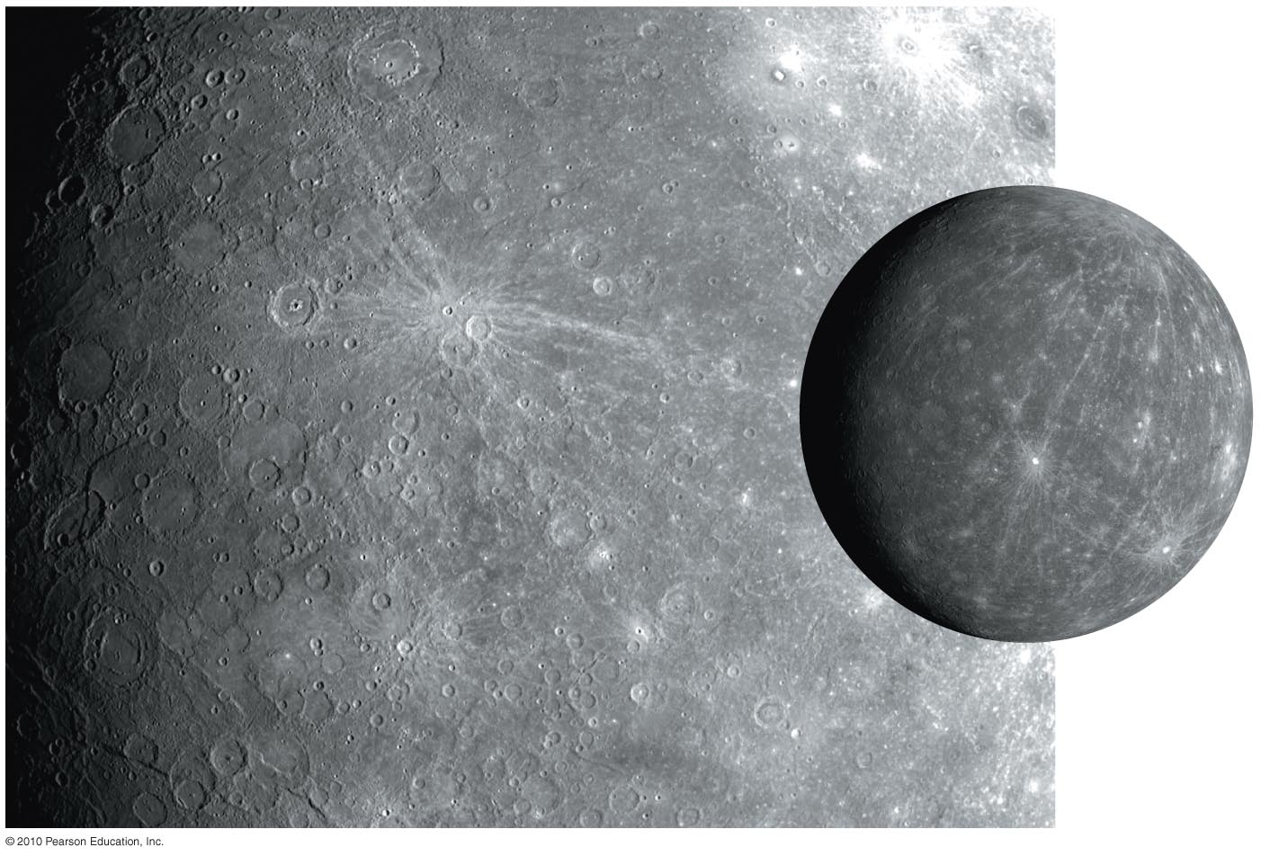
Mercury
Made of metal and rock; large iron core
Desolate, cratered; long, tall, steep cliffs
Very hot and very cold: 425°C (day) –170°C (night)

Slide 3
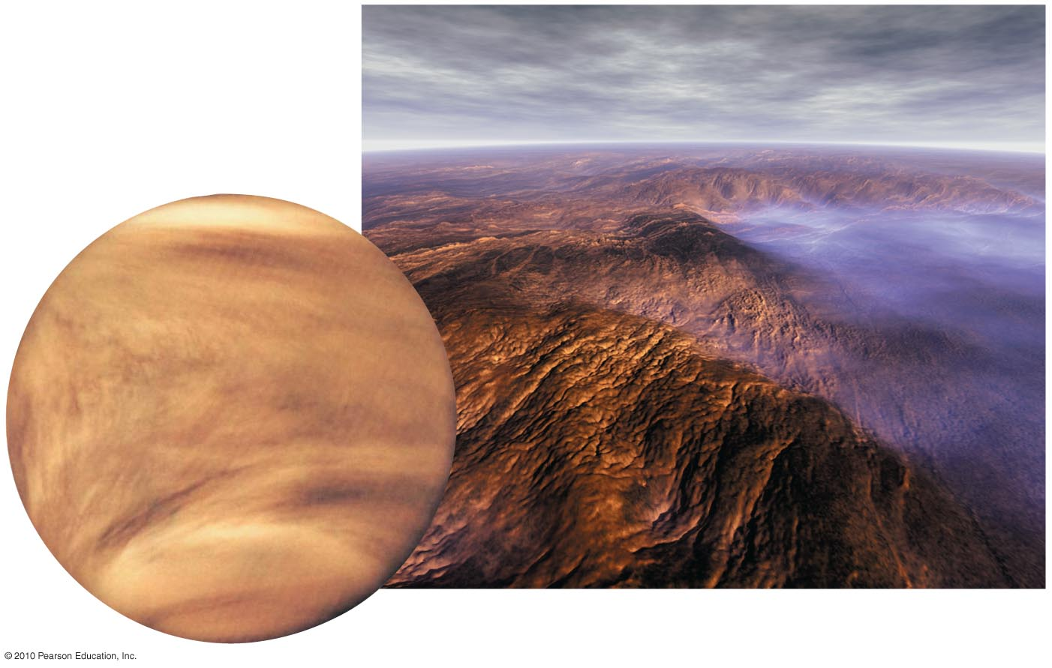
Venus
Nearly identical in size to Earth; surface hidden by clouds
Hellish conditions due to an extreme greenhouse effect
Even hotter than Mercury: 470°C, day and night

Slide 4
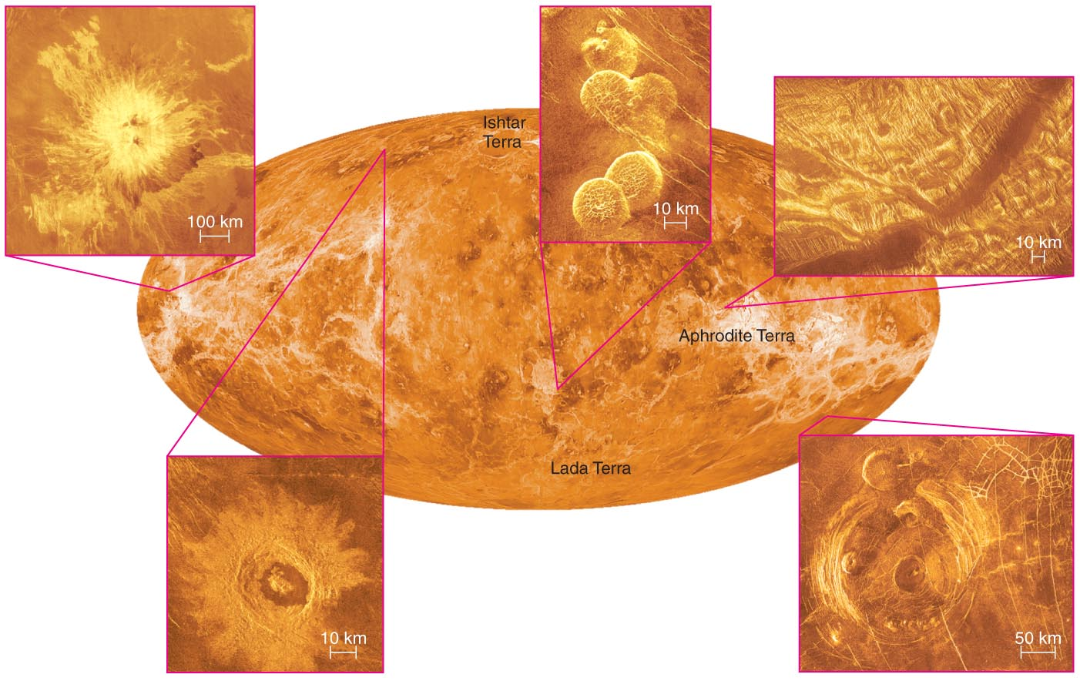
Radar Mapping
Its thick atmosphere forces us to explore Venus’s surface through radar mapping.

Slide 5
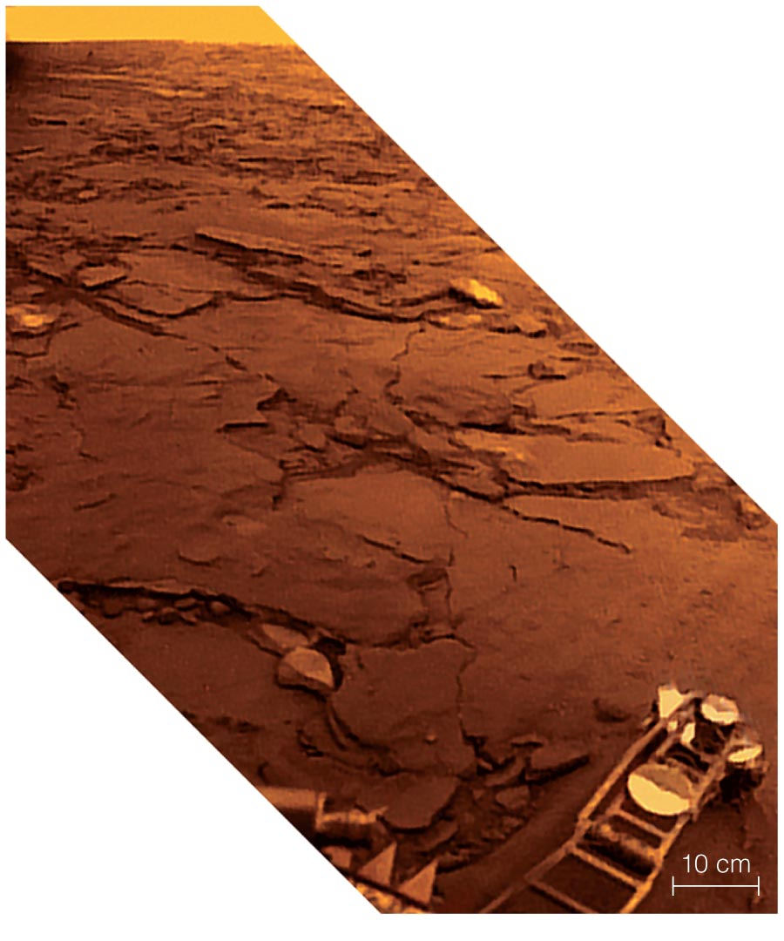
Erosion on Venus
Photos of rocks taken by Soviet Venera landers show little erosion.

Slide 6
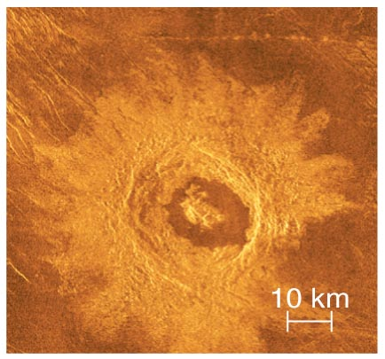
Cratering on Venus
Venus has impact craters, but fewer than the Moon, Mercury, or Mars.

Slide 7
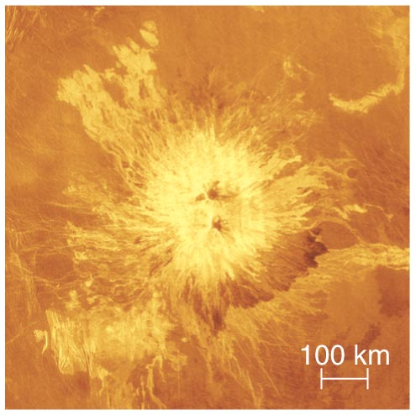
Volcanoes on Venus
It has many volcanoes, including both shield volcanoes and stratovolcanoes.

Slide 8
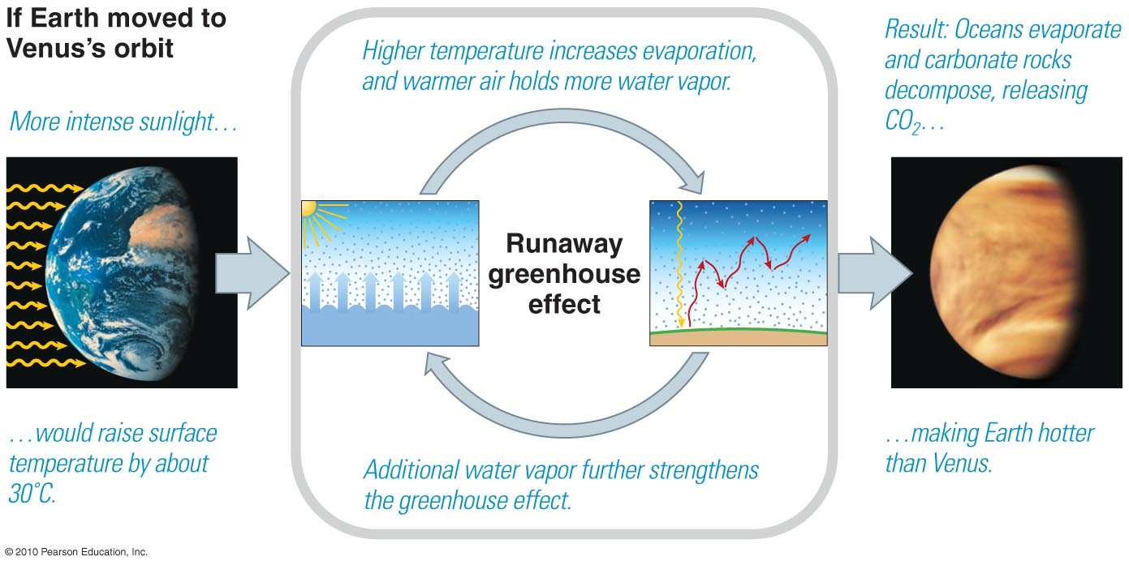
Runaway Greenhouse Effect
A runaway greenhouse effect would account for why Venus has so little water.

Slide 9
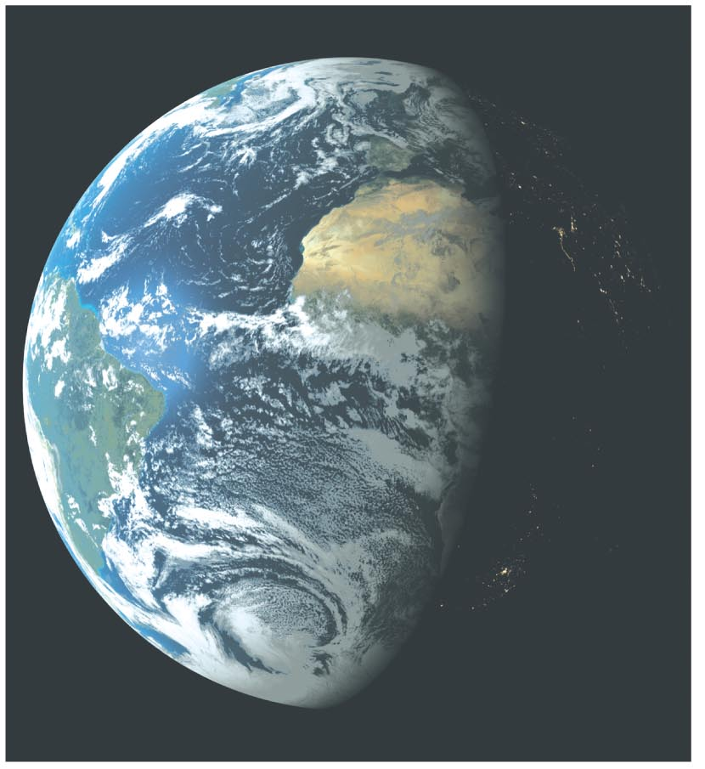
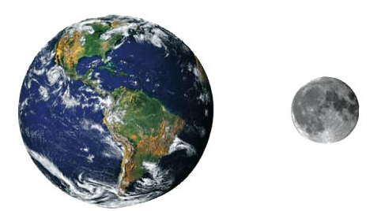
Earth
Earth and Moon with sizes shown to scale
An oasis of life
The only surface liquid water in the solar system
A surprisingly large moon

Slide 10
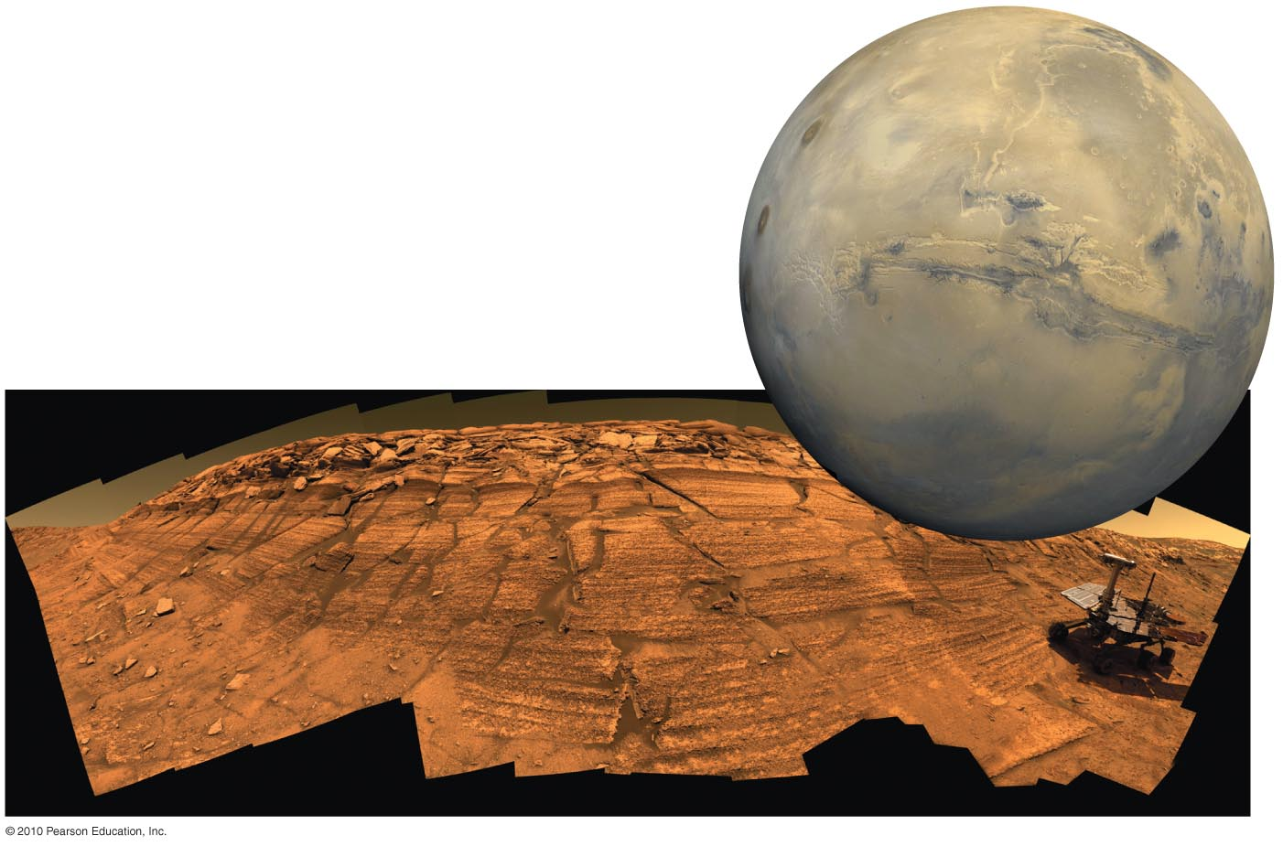
Mars
Giant volcanoes, a huge canyon, polar caps, more
Water flowed in distant past; could there have been life?

Slide 11
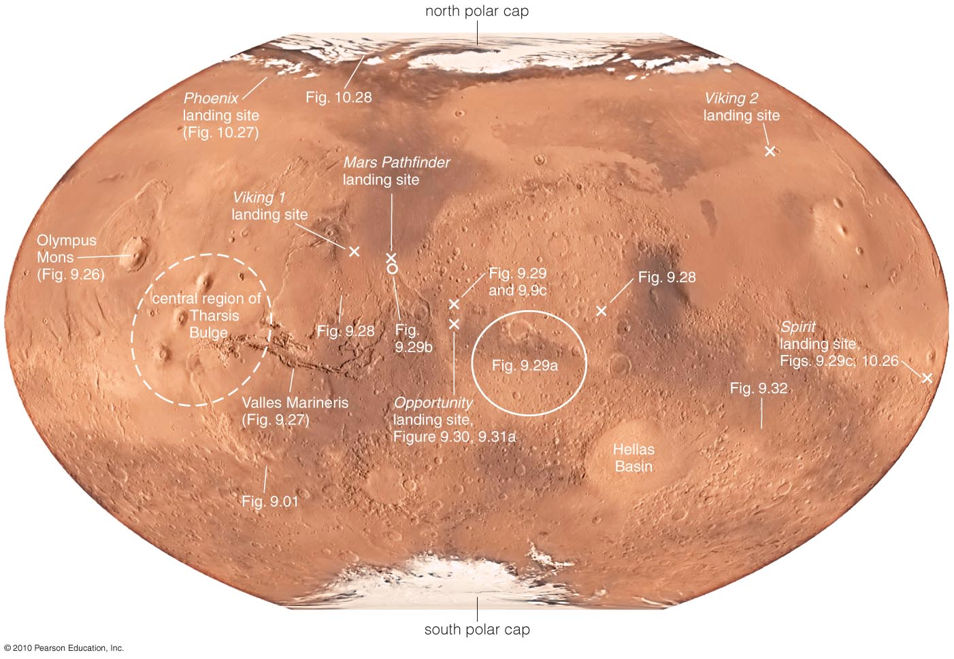
What are the major geological features of Mars?

Slide 12
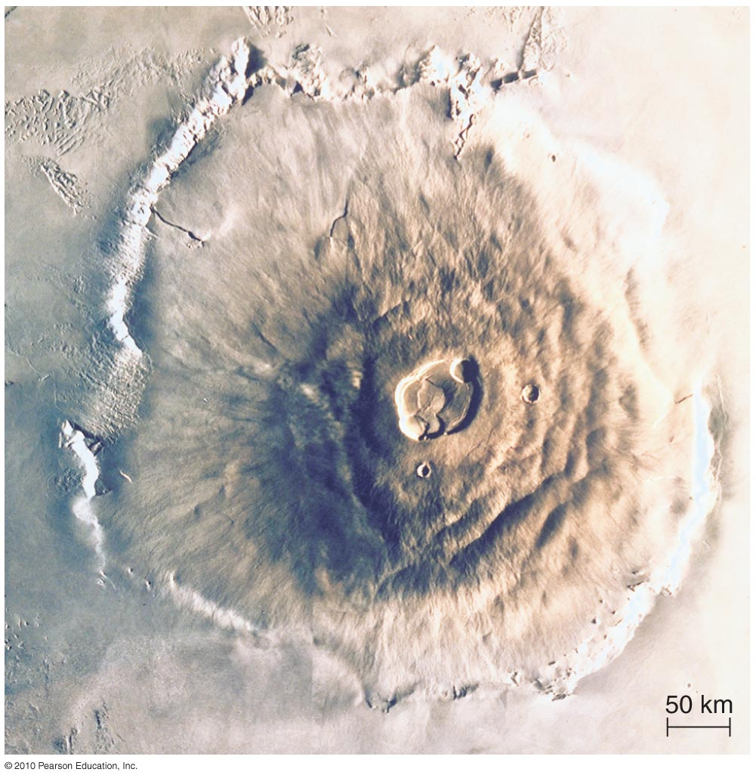
Volcanism on Mars
Mars has many large shield volcanoes.
Olympus Mons is largest volcano in solar system.

Slide 13
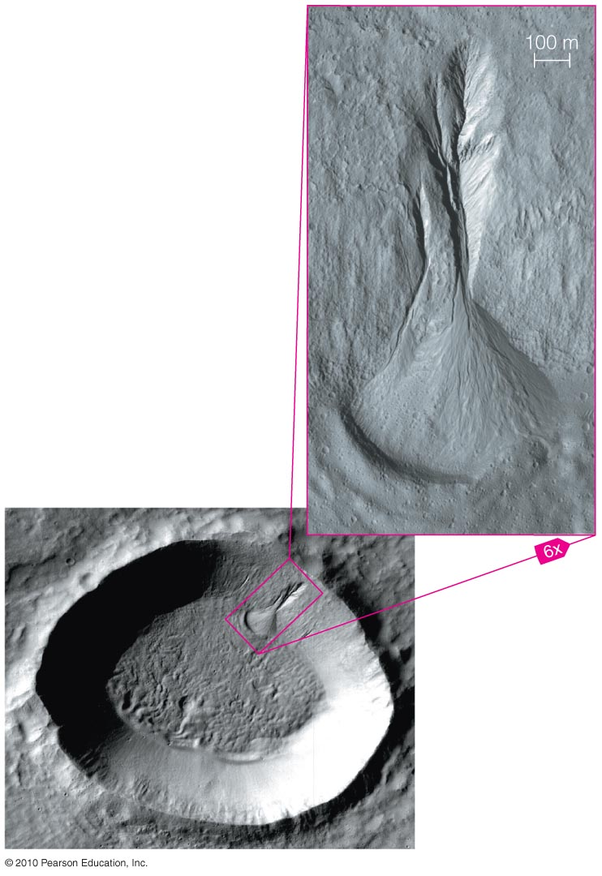
Geological evidence that water once flowed on Mars, for example:

Slide 14
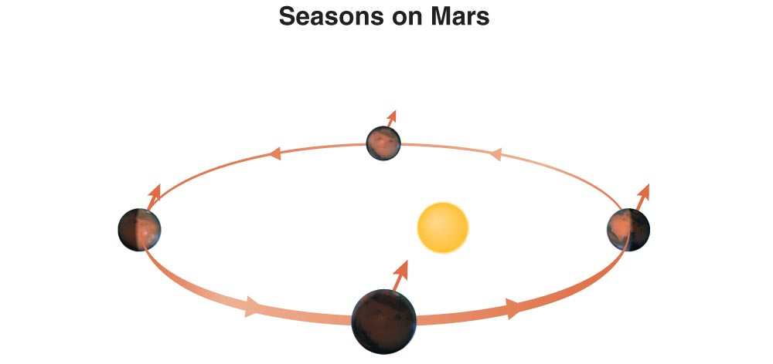
Seasons on Mars
The ellipticity of Mars’s orbit makes seasons more extreme in the southern hemisphere.

Slide 15
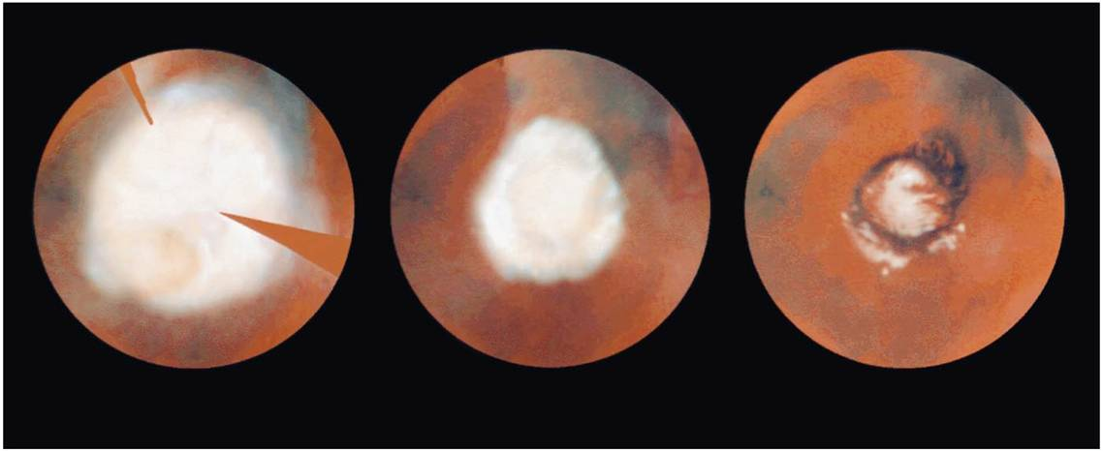
Polar Ice Caps of Mars
Late winter
Mid-spring
Early summer
Carbon dioxide ice of polar cap sublimates as summer approaches and condenses at opposite pole.

Slide 16
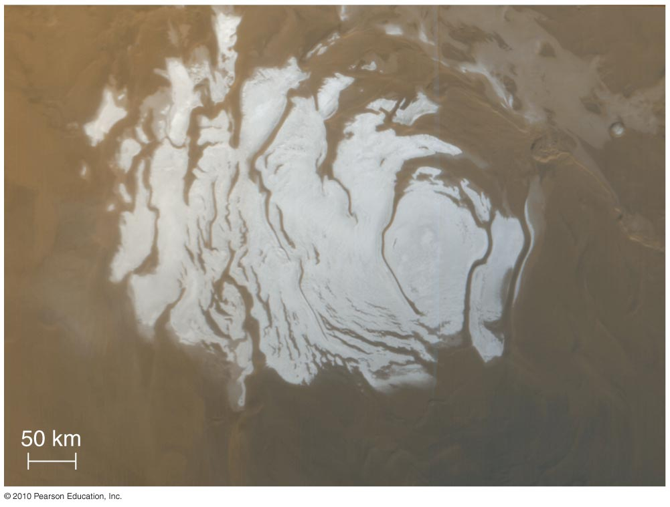
Polar Ice Caps of Mars
Residual ice of the polar cap remaining during summer is primarily water ice.

Slide 17
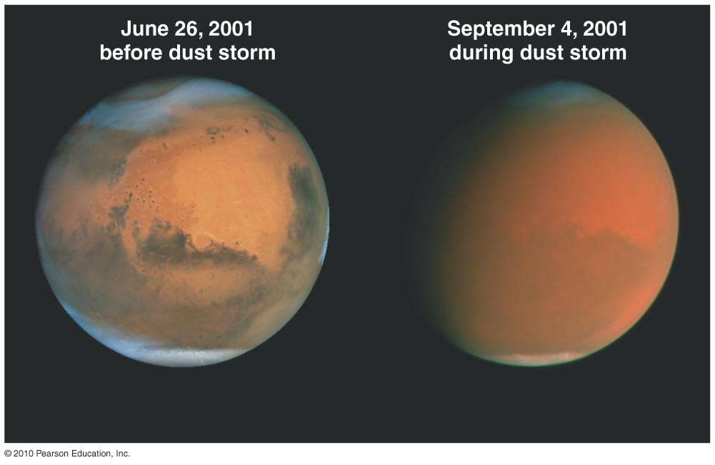
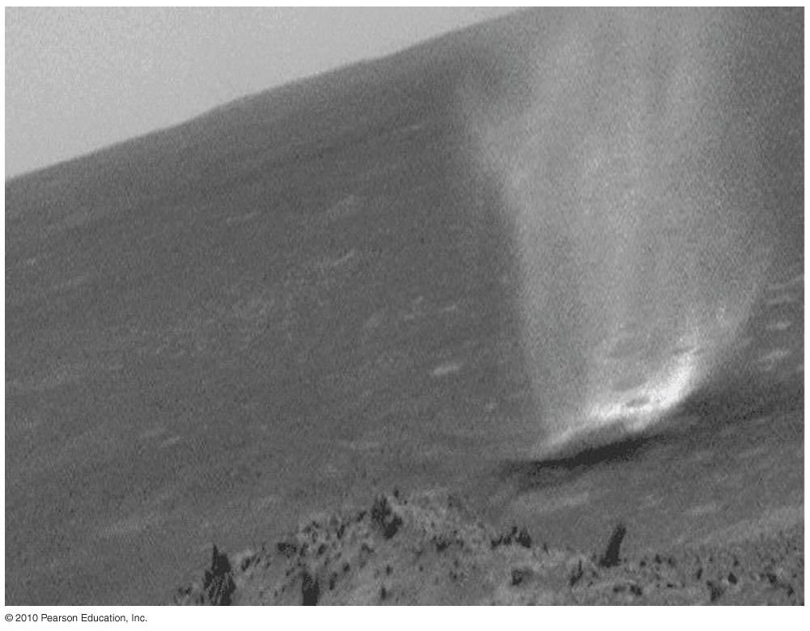
Dust Storms on Mars
Seasonal winds can drive dust storms on Mars.
Dust in the atmosphere absorbs blue light, sometimes making the sky look brownish-pink.

Slide 18
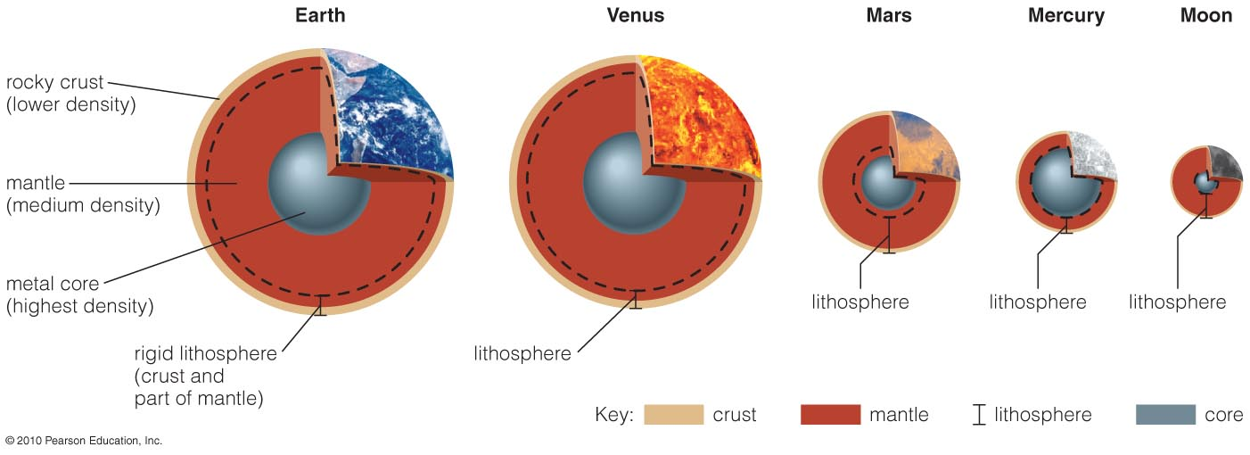
Terrestrial Interiors, Role of Size
Smaller worlds cool off faster and harden earlier. Heat content is volume, cooling is surface area.
The Moon and (maybe) Mercury are now geologically “dead.”

Slide 19
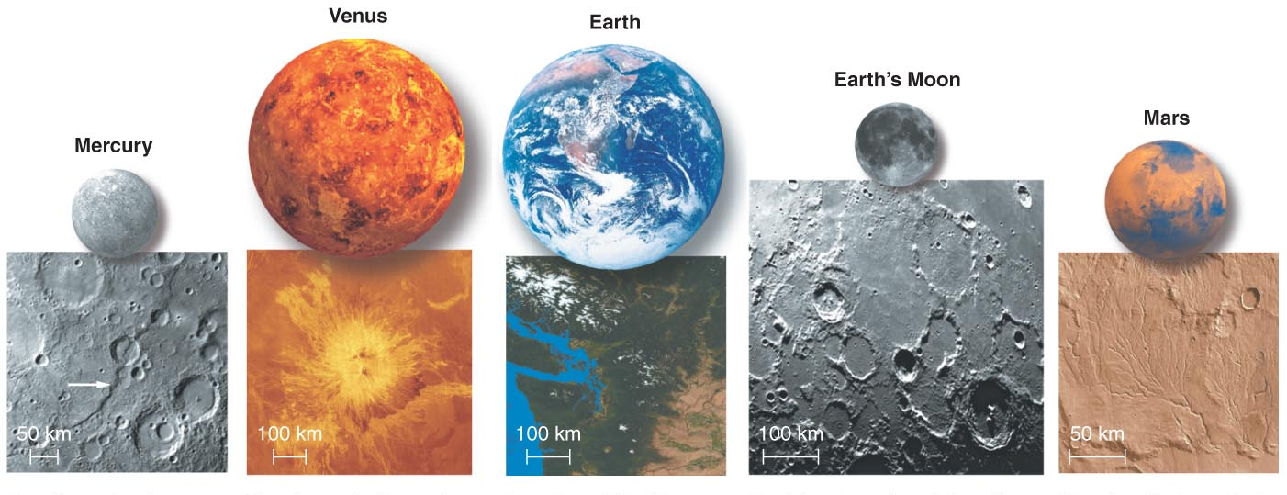
What processes shape planetary surfaces?
Impact cratering, Volcanism, Tectonics, Erosion

Slide 20
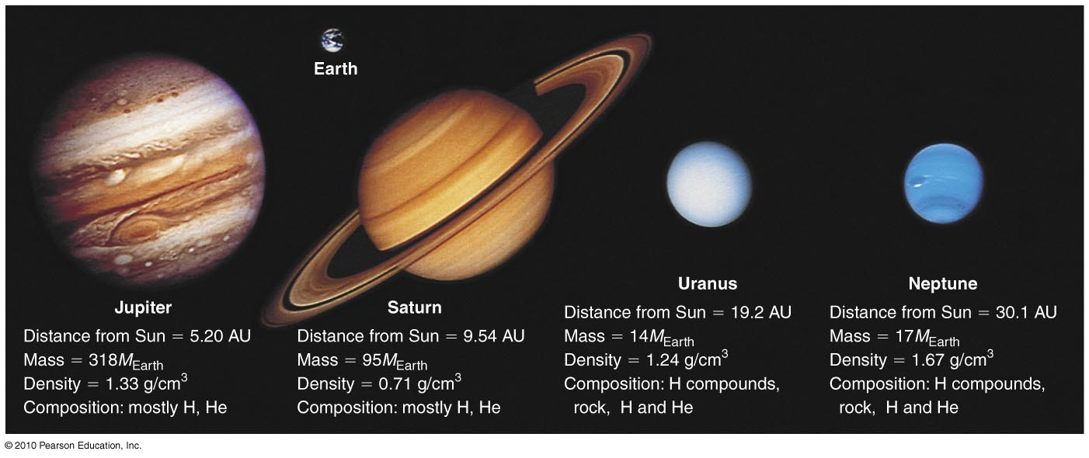
Jovian planets

Slide 21
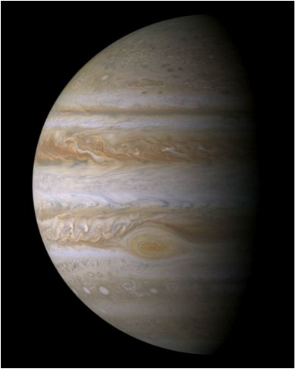
Jupiter
Much farther from Sun than inner planets
Mostly H/He; no solid surface
300 times more massive than Earth
Many moons, rings

Slide 22
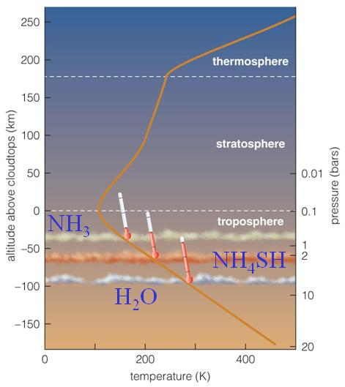
Jupiter’s Atmosphere
Hydrogen compounds in Jupiter form clouds.
Different cloud layers correspond to freezing points of different hydrogen compounds.

Slide 23
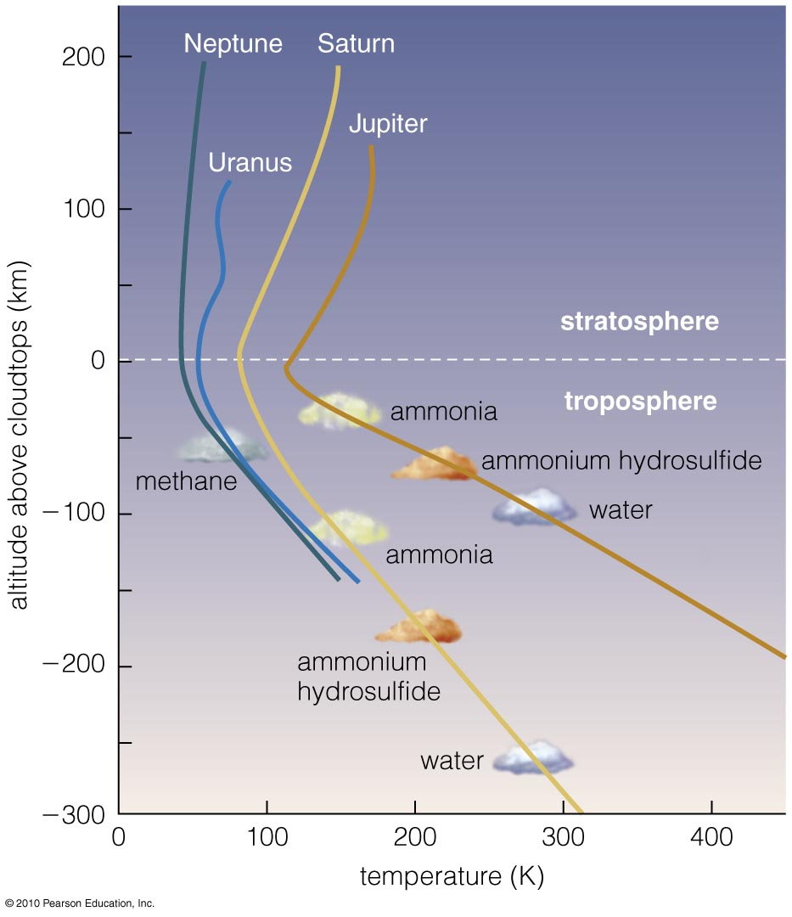
Jovian Planet Atmospheres
Other jovian planets have cloud layers similar to Jupiter’s.
Different compounds make clouds of different colors.

Slide 24
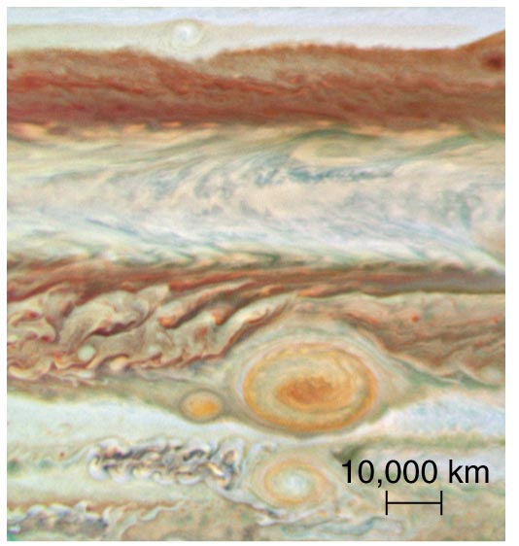
Jupiter’s Colors
Ammonium sulfide clouds (NH₄SH) reflect red/brown.
Ammonia, the highest, coldest layer, reflects white.

Slide 25
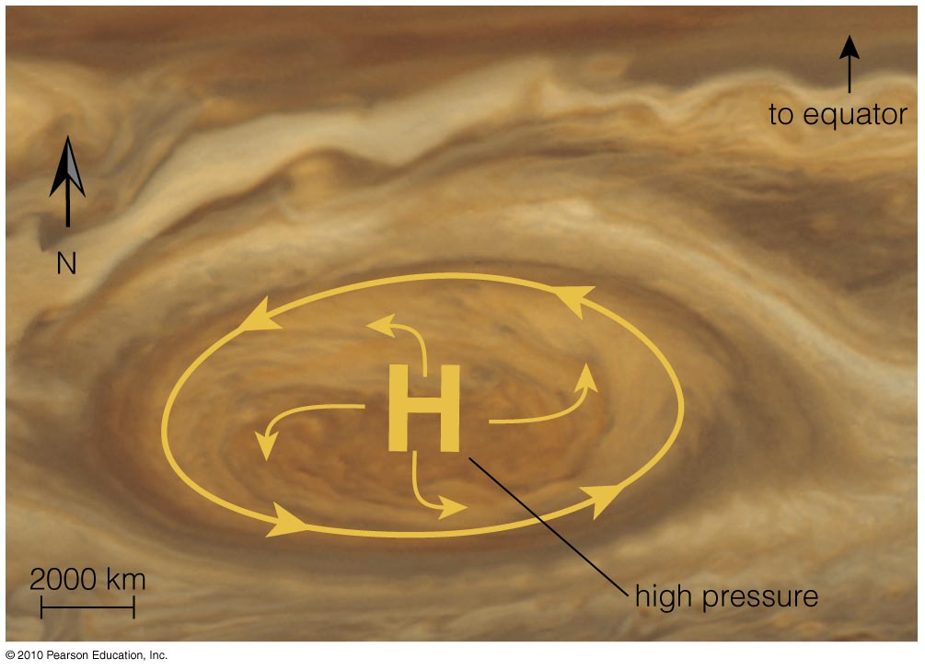
Jupiter’s Great Red Spot
Is a storm twice as wide as Earth
Has existed for at least three centuries

Slide 26
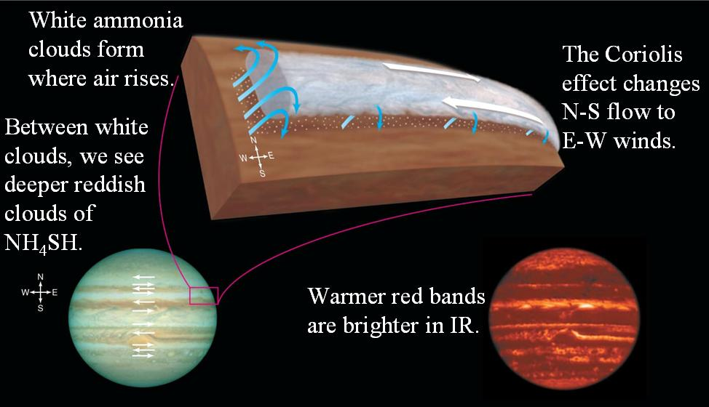

Jupiter’s Bands

Slide 27
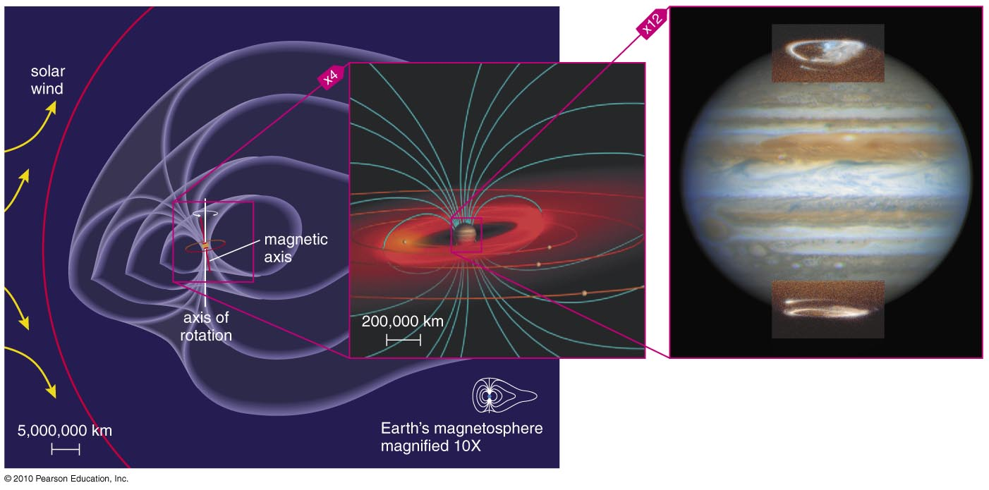
Jupiter’s Magnetosphere
Jupiter’s strong magnetic field gives it an enormous magnetosphere.
Gases escaping Io feed the donut-shaped Io torus.

Slide 28
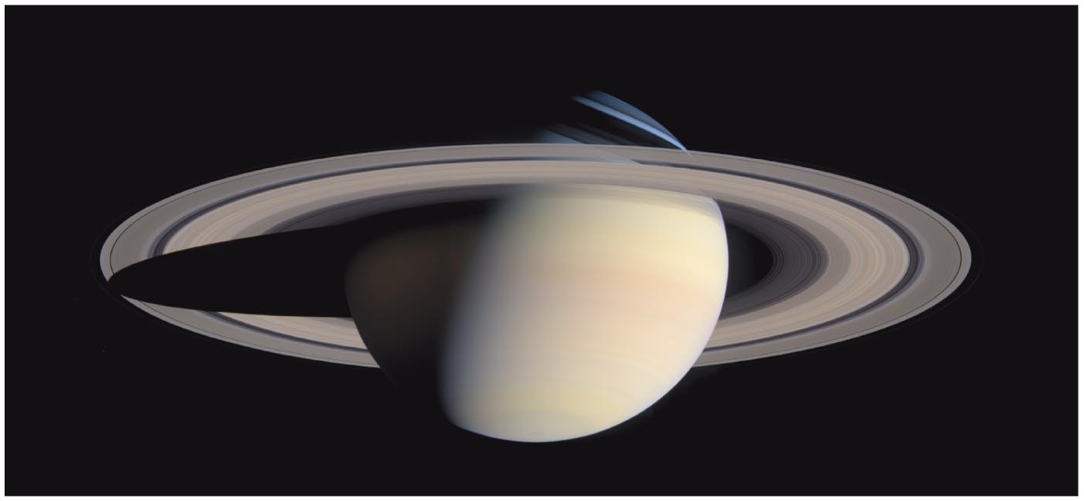
Saturn
Giant and gaseous like Jupiter
Spectacular rings
Many moons, including cloudy Titan

Slide 29
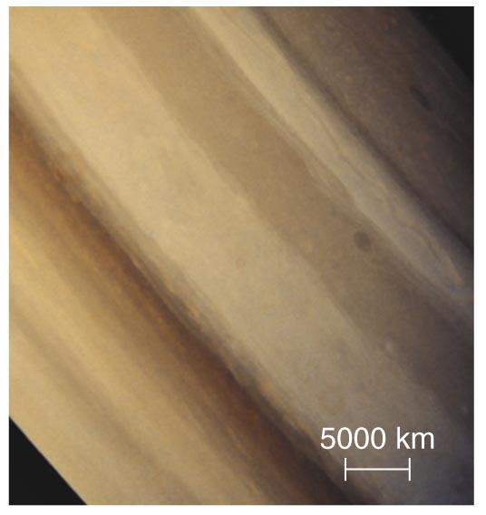
Saturn’s Colors
Saturn’s layers are similar to Jupiter’s, but deeper in and farther from the Sun (more subdued).

Slide 30
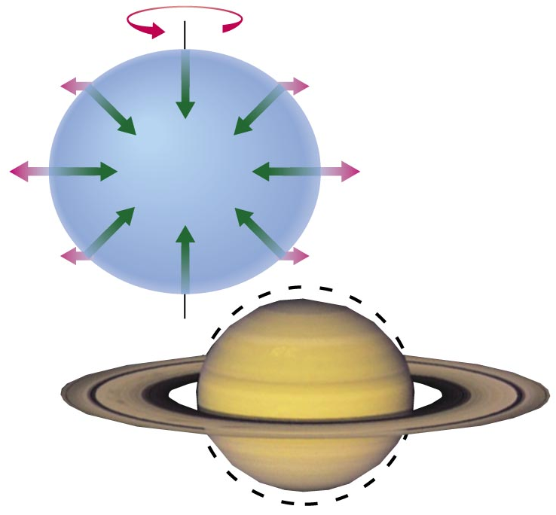
Rotation and Shape
Jovian planets are not quite spherical because of their rapid rotation.

Slide 31
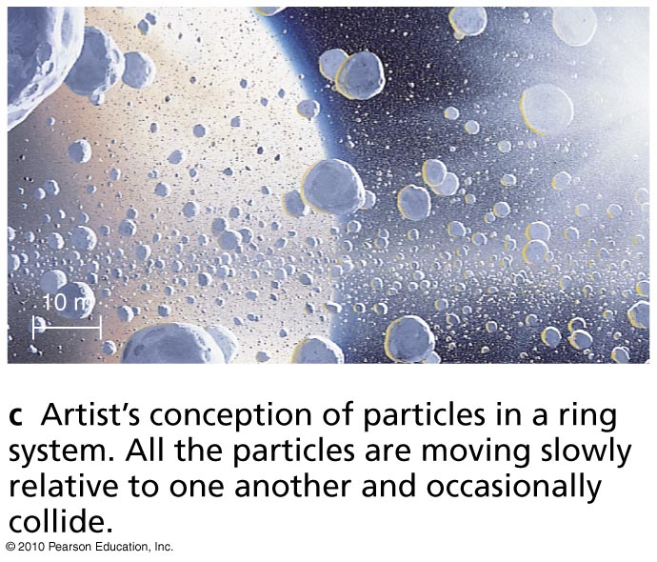
Rings are NOT solid; they are made of countless small chunks of ice and rock, each orbiting like a tiny moon.
Artist’s conception

Slide 32
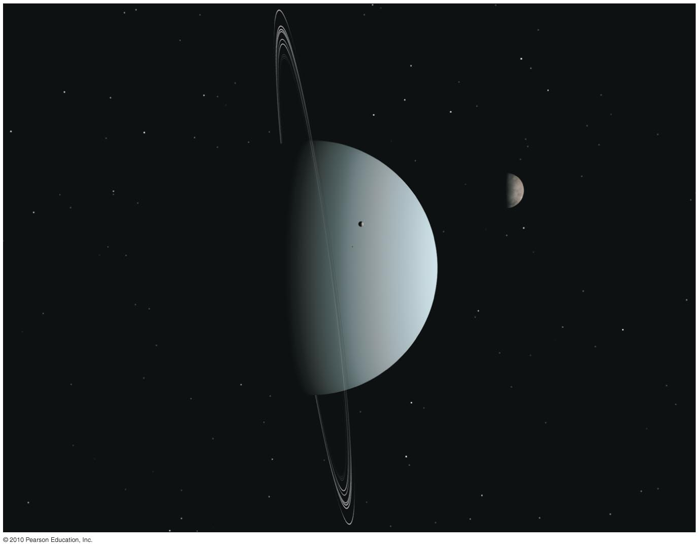
Uranus
Smaller than Jupiter/Saturn; much larger than Earth
Made of H/He gas and hydrogen compounds (H₂O, NH₃, CH₄)
Extreme axis tilt
Moons and rings

Slide 33
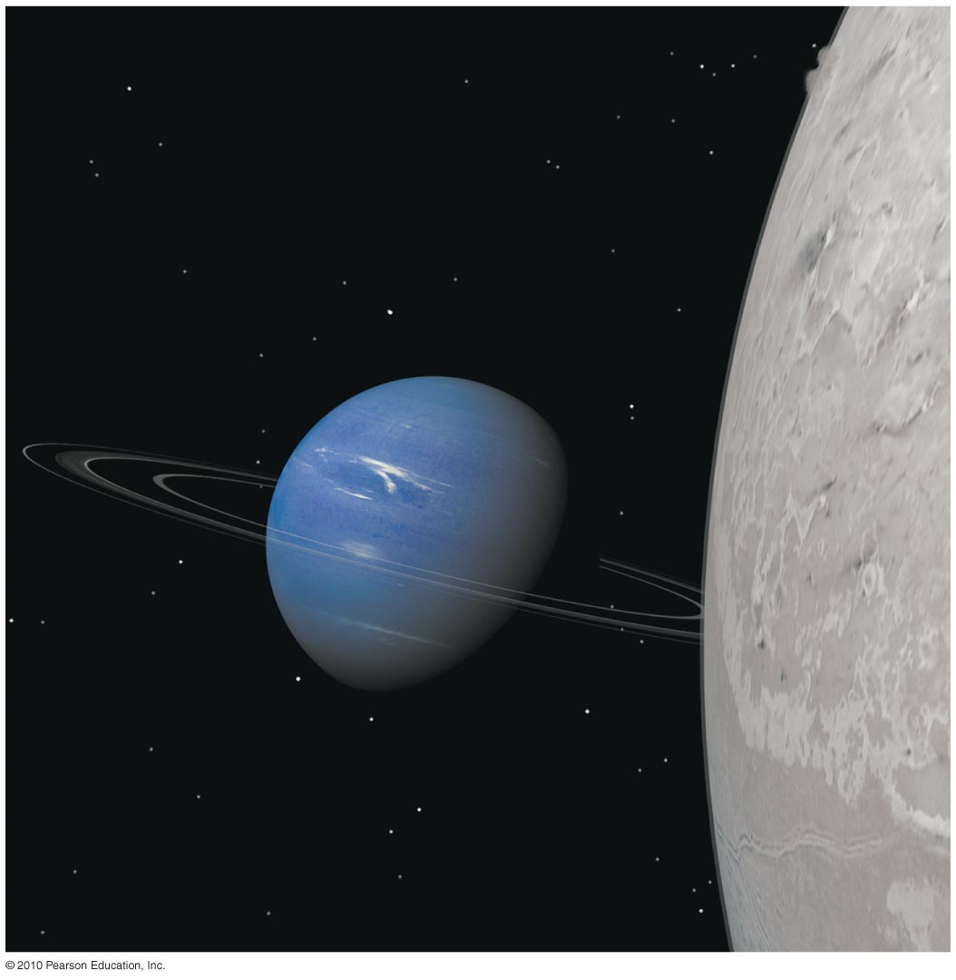
Neptune
Similar to Uranus (except for axis tilt)
Many moons (including Triton)
Notes:
Note: this is the same image as in the text but rotated 90° to show the axis tilt relative to the ecliptic plane as the horizontal on the page. (The orientation in the book chosen for its more dramatic effect.)

Slide 34
Methane on Uranus and Neptune
Methane gas of Neptune and Uranus absorbs red light but transmits blue light.
Blue light reflects off methane clouds, making those planets look blue.

Slide 35
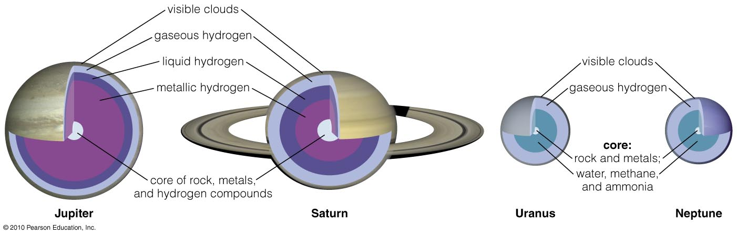
Comparing Jovian Interiors
Models suggest cores of jovian planets have similar composition.
Lower pressures inside Uranus and Neptune mean no metallic hydrogen.

Slide 36
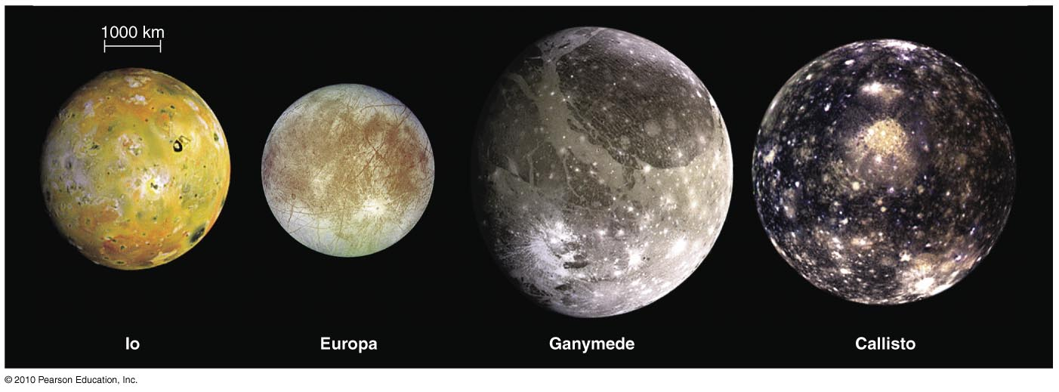
What kinds of moons orbit the jovian planets?

Slide 37
Sizes of Moons
Small moons (< 300 km)
  No geological activity
Medium-sized moons (300–1500 km)
  Geological activity in past
Large moons (> 1500 km)
  Ongoing geological activity

Slide 38
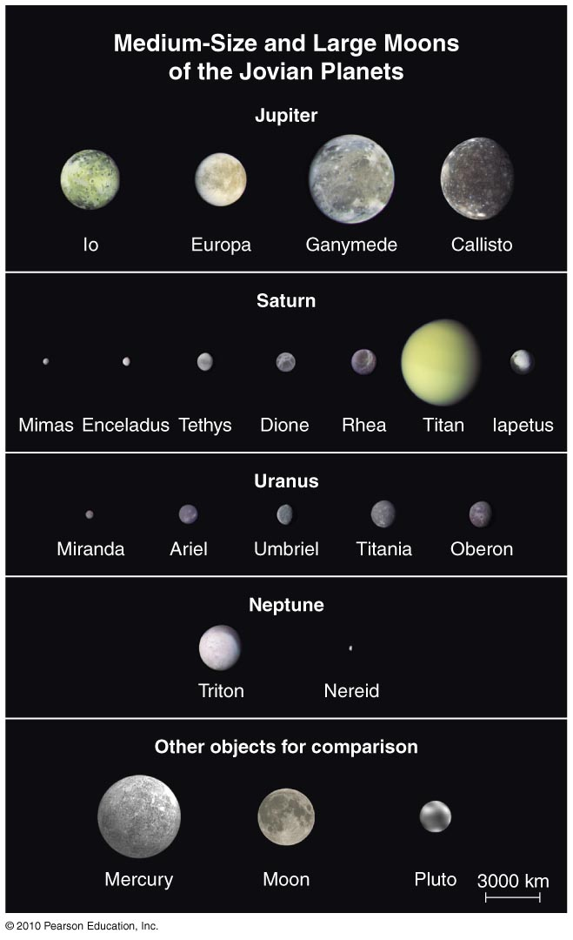
Medium and
Large Moons
Enough self-gravity to be spherical
Have substantial amounts of ice
Formed in orbit around jovian planets
Circular orbits in same direction as planet rotation

Slide 39
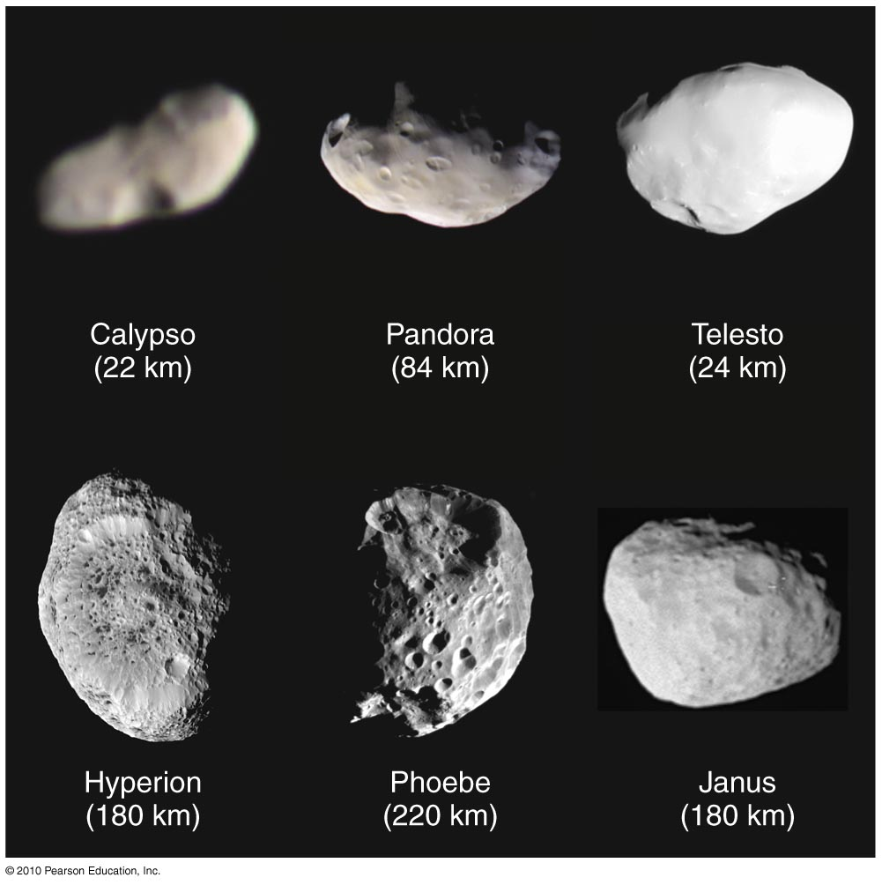
Small Moons
These are far more numerous than the medium and large moons. They do not have enough gravity to be spherical: Most are “potato-shaped.” They are captured asteroids or comets, so their orbits do not follow usual patterns.

Slide 40
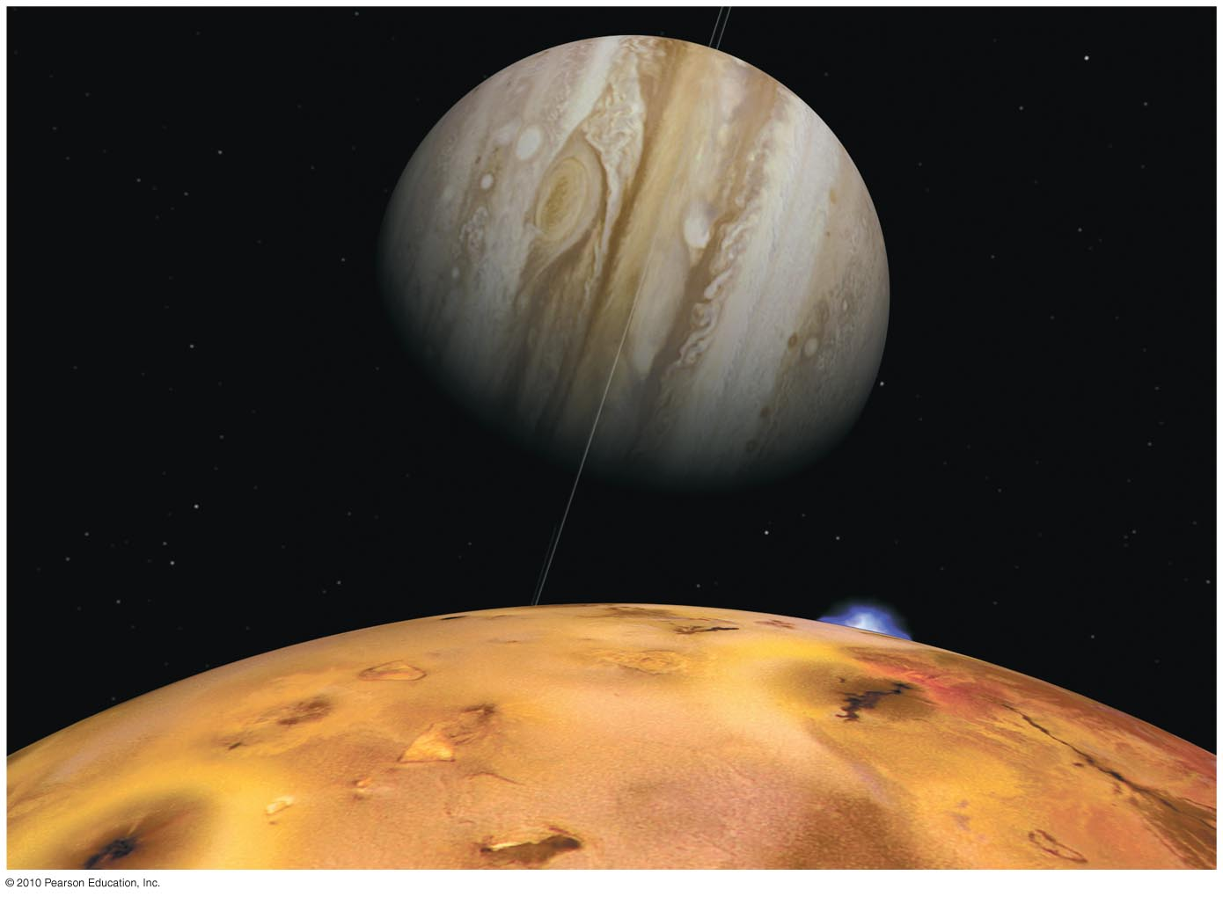
Jupiter’s moons can be as interesting as planets themselves, especially Jupiter’s four Galilean moons.
Io (shown here): active volcanoes all over
Europa: possible subsurface ocean
Ganymede: largest moon in solar system
Callisto: a large, cratered “ice ball”

Slide 41
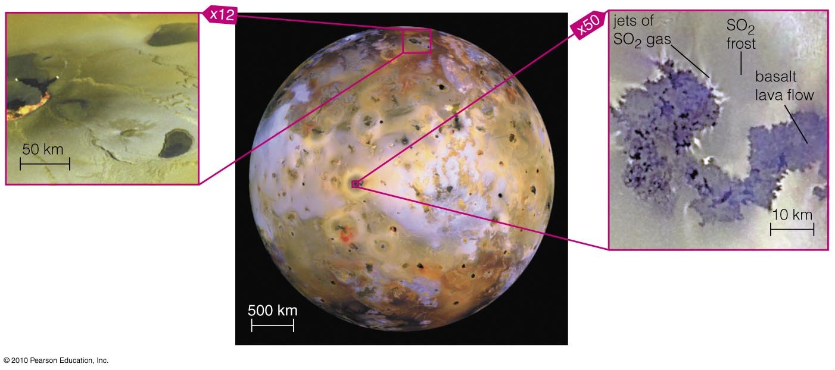
Io’s Volcanic Activity
Io is the most volcanically active body in the solar system, but why?

Slide 42
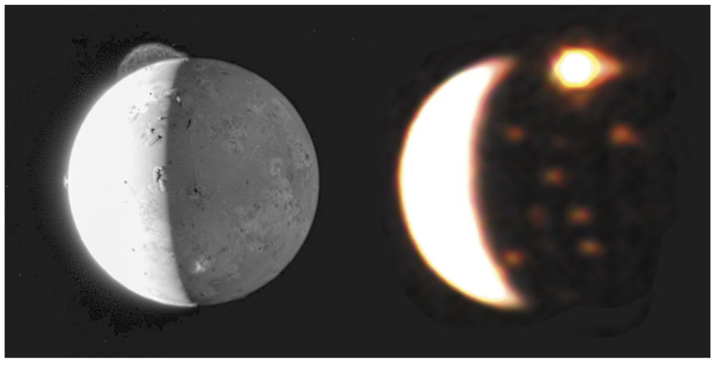
Io’s Volcanoes
Volcanic eruptions continue to change Io’s surface.

Slide 43
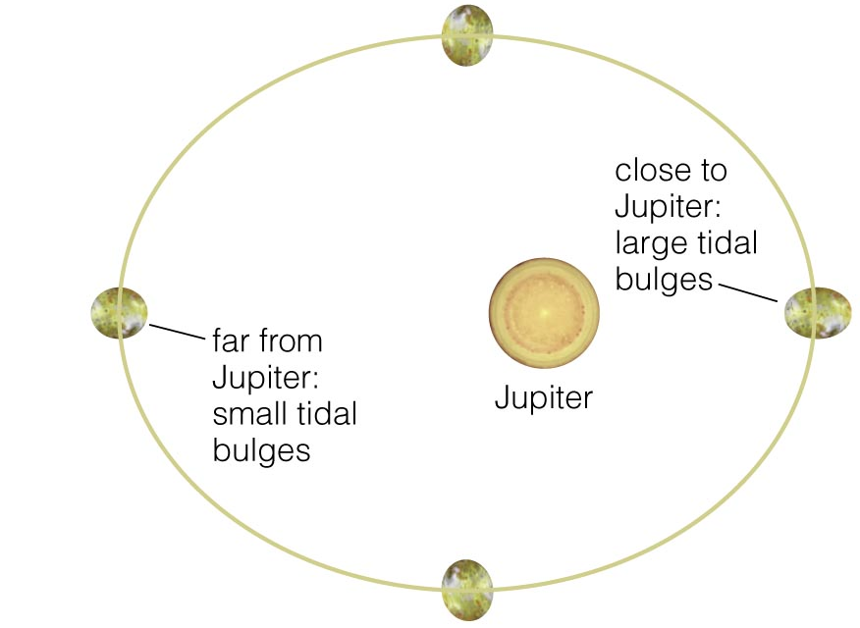
Tidal Heating
Io is squished and stretched as it orbits Jupiter.
Phase-locked with elliptical orbit.

Slide 44
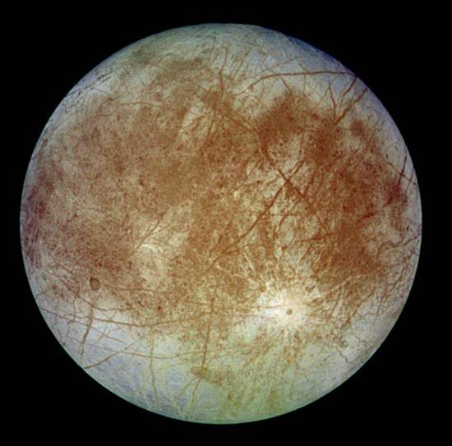
Europa’s Ocean: Waterworld?

Slide 45
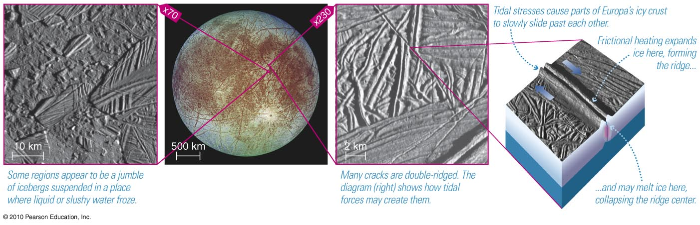
Tidal stresses crack Europa’s surface ice.

Slide 46
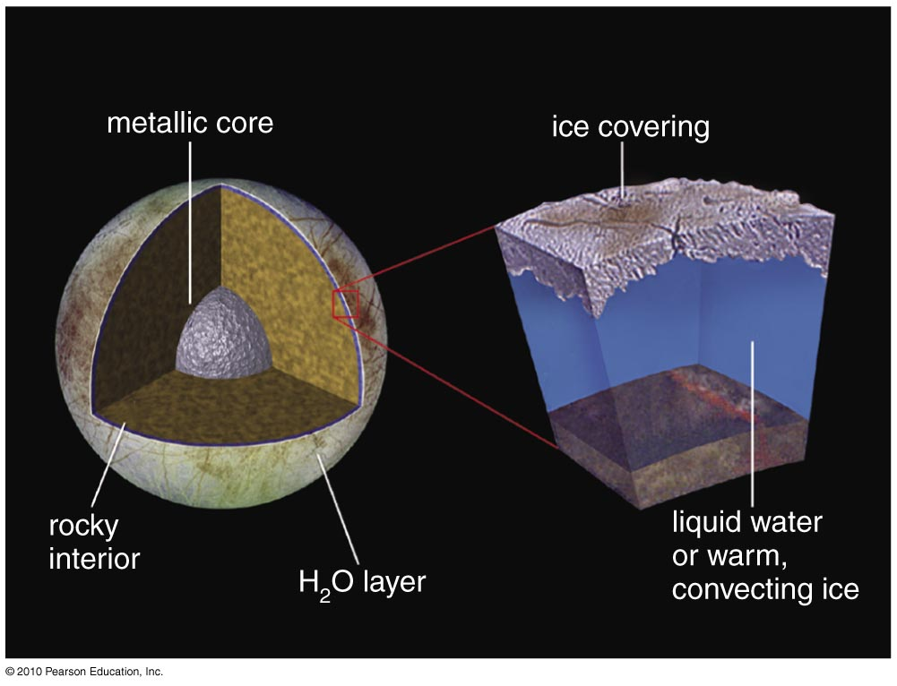
Europa’s interior also warmed by tidal heating.
Notes:
Based on Galileo spacecraft measurements of the strength of gravity over different positions of Europa and theoretical modeling of the interior.

Slide 47
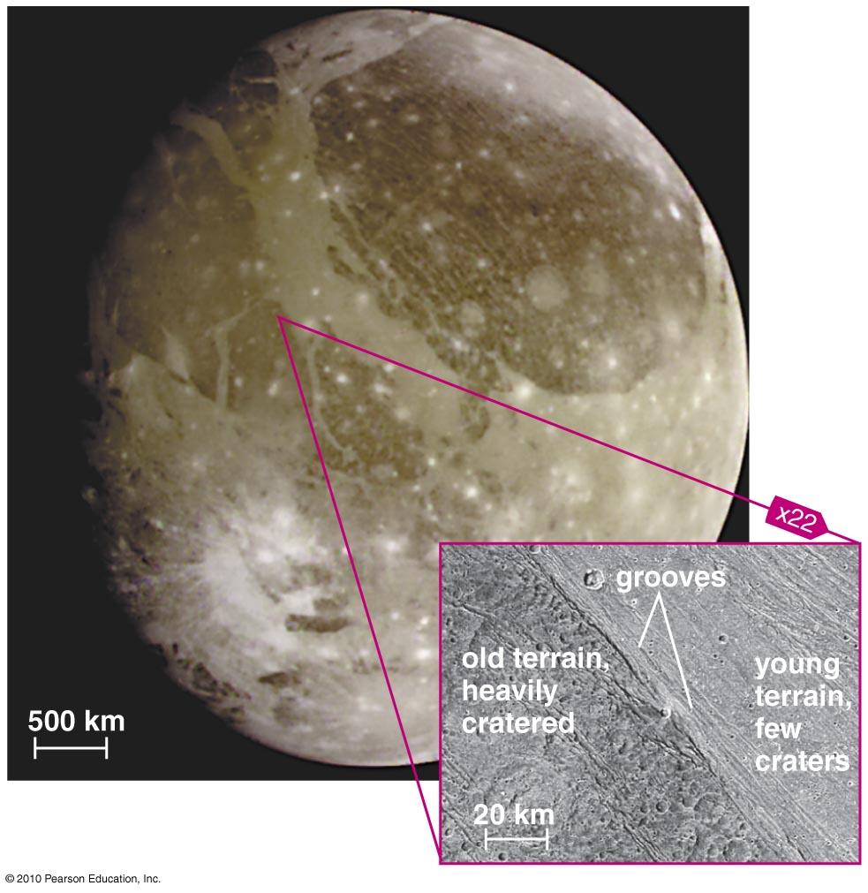
Ganymede
Largest moon in the solar system
Clear evidence of geological activity
Tidal heating plus heat from radio-active decay?
Notes:
Largest moon
Figure might work better if there were one with out the callouts.

Slide 48
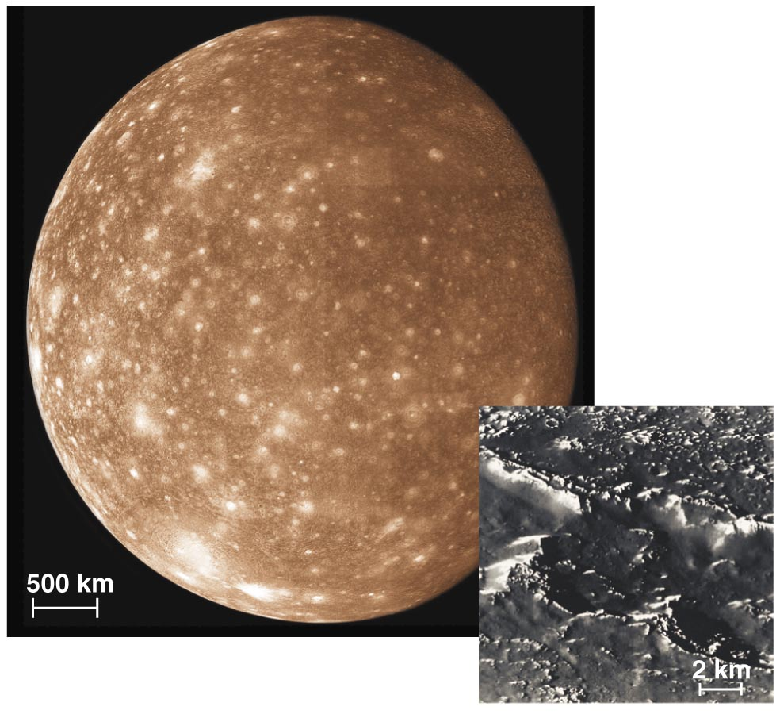
Callisto
“Classic” cratered iceball
No tidal heating, no orbital resonances
But it has a magnetic field!?

Slide 49
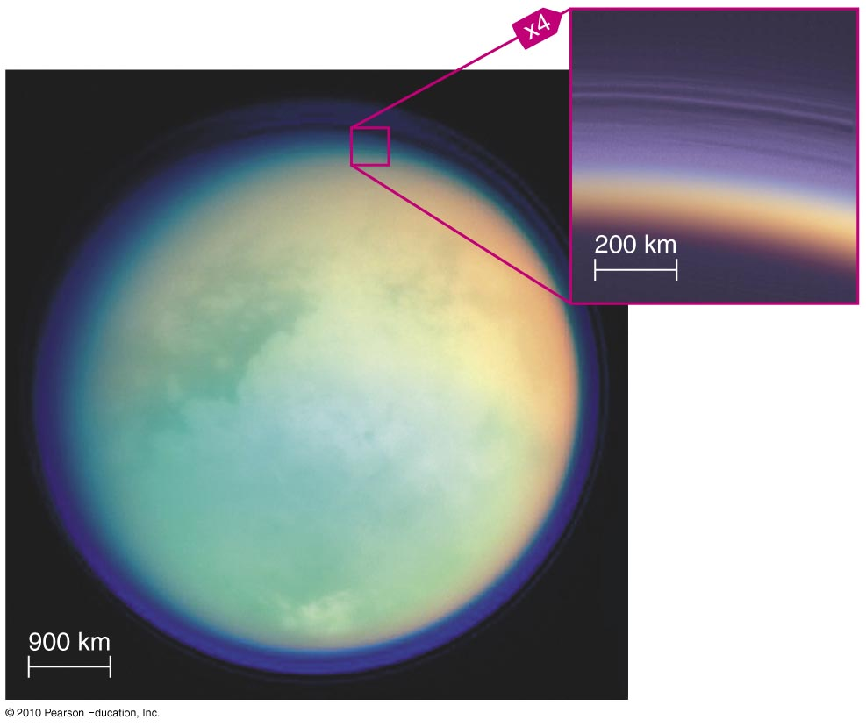
Titan’s Atmosphere
Titan is the only moon in the solar system to have a thick atmosphere.
It consists mostly of nitrogen with some argon, methane, and ethane.

Slide 50
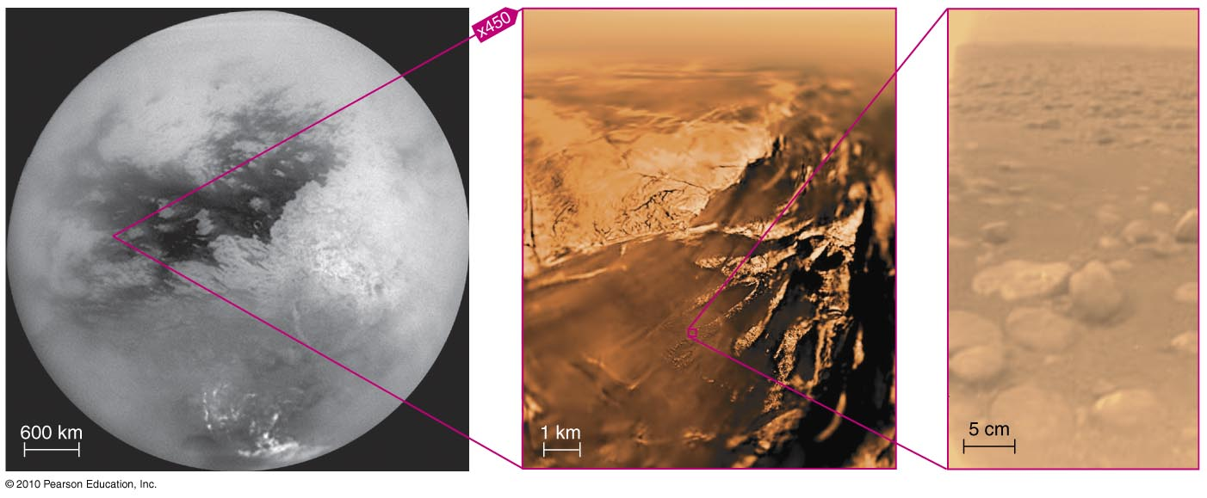
Titan’s Surface
Huygens probe provided first look at Titan’s surface in early 2005.
It found liquid methane and “rocks” made of ice.

Slide 51
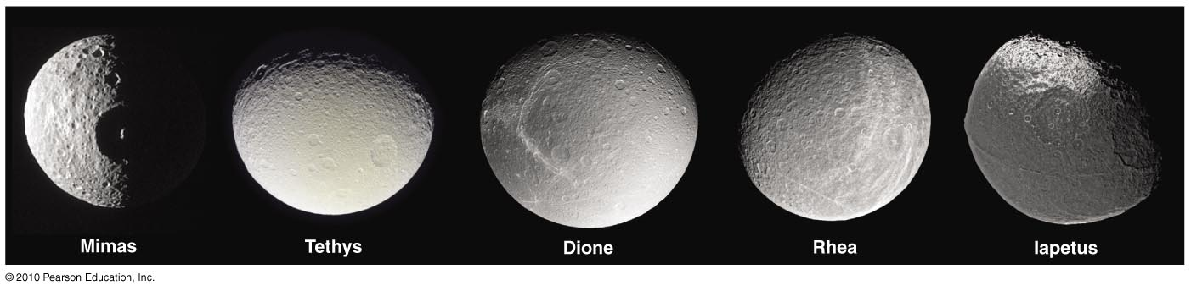
Medium Moons of Saturn
Almost all of them show evidence of past volcanism and/or tectonics.

Slide 52

Medium Moons of Saturn
Ice fountains of Enceladus suggest it may have a subsurface ocean.

Slide 53

Medium Moons of Uranus
They have varying amounts of geological activity.
Miranda has large tectonic features and few craters (possibly indicating an episode of tidal heating in past).

Slide 54

Neptune’s Moon Triton
Similar to Pluto, but larger
Evidence of past geological activity

Slide 55

What are Saturn’s rings like?

Slide 56
What are Saturn’s rings like?
They are made up of numerous, tiny individual particles.
They orbit around Saturn’s equator.
They are very thin.

Slide 57

Spacecraft View of Ring Gaps
Notes:
Voyager

Slide 58
Artist’s Conception of Rings Close-Up

Slide 59

How do other jovian ring systems compare to Saturn’s?

Slide 60

Jovian Ring Systems
All four jovian planets have ring systems.
Others have smaller, darker ring particles than Saturn.

Slide 61
Why do the jovian planets have rings?

Slide 62

Ring Formation
Jovian planets all have rings because they possess many small moons close in.
Impacts on these moons are random.
Saturn’s incredible rings may be an “accident” of our time.

