Slide 1

Reverberation Mapping of
Active Galactic Nuclei
Michael Brotherton

Slide 2
What Are active galactic nuclei?
How Can We Measure their Black Hole masses with reverberation mapping?
Where is the field now?
What is the future of the field? And what are we doing at wyoming?

Slide 3
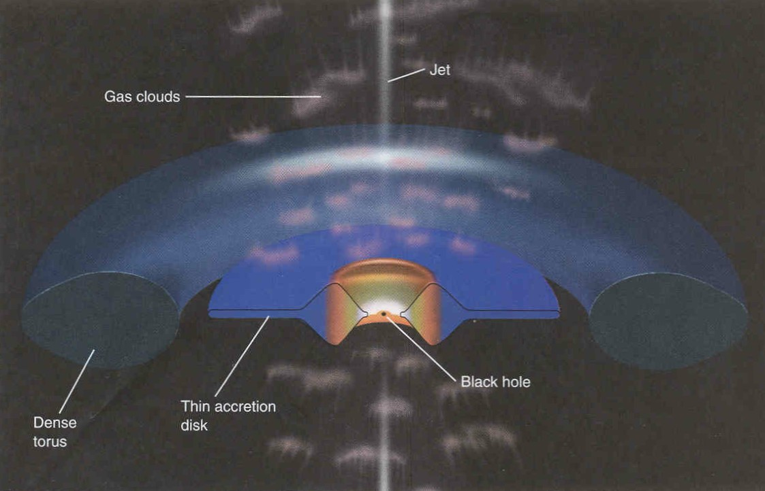
AGN Schematic (Horizons by Seeds)
Broad and narrow-line emitting regions

Slide 4
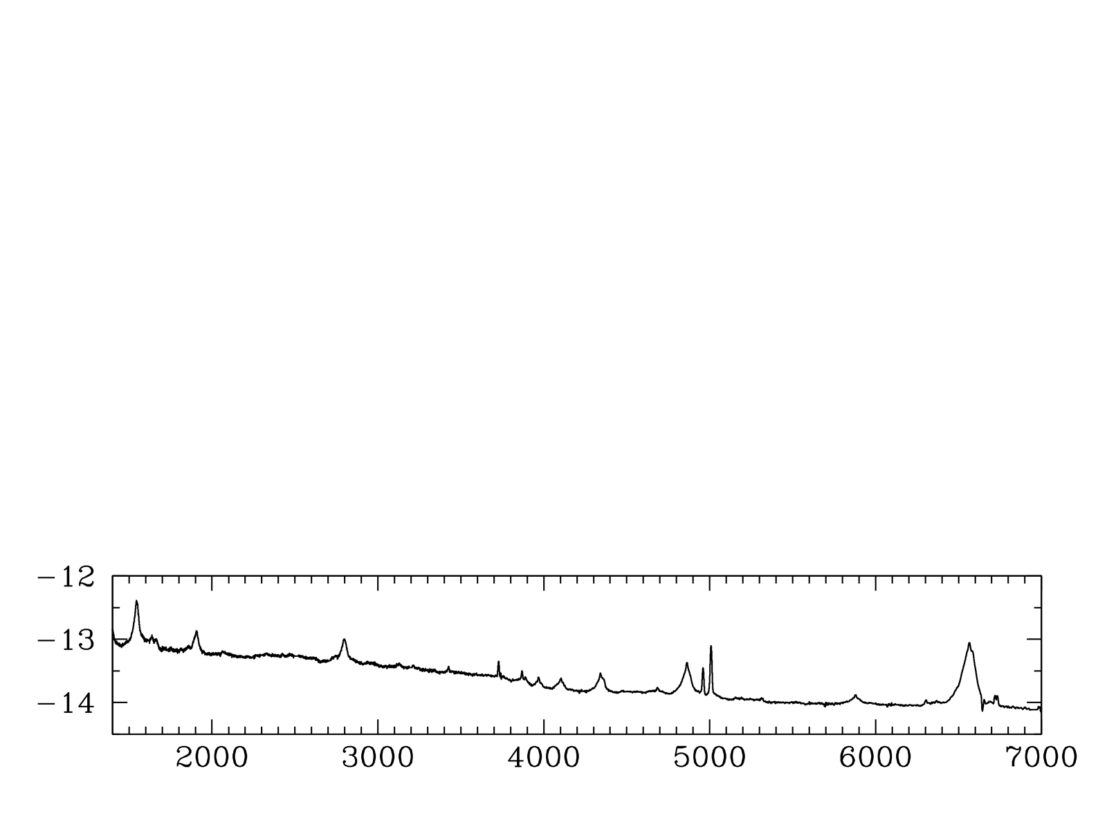
AGN Ultraviolet-Optical AGN Spectrum
Note especially the Hbeta Line
Hβ
Hα
log(F_{λ})
C IV
Mg II
Rest λ (Angstroms)
Notes:
Another important parameter in AGN is the black hole mass, which isn’t necessarily a typical SED project but I can really get at this with my quasi-simultaneous spectra.
How do you measure M in AGN?
Spectrum, CIV at high redshift and Hβ at low.
Ideally measurements using these lines in the same object would agree, but there’s scatter of a factor of a few between them.
I’m interested in understanding this scatter so that I can reduce it.

Slide 5
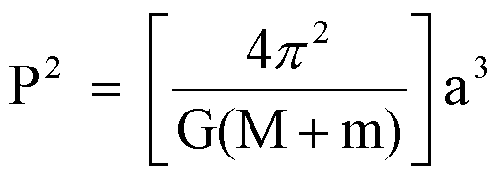
How Can We Measure Masses in space?

Slide 6
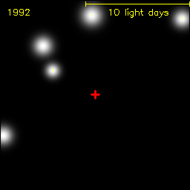
the galactic core
Groups at Max Planck and UCLA have been observing the center of the Milky Way for over two decades, tracing the orbits of stars. The mass of the central dark object lurking there is about 4 million solar masses.

Slide 7
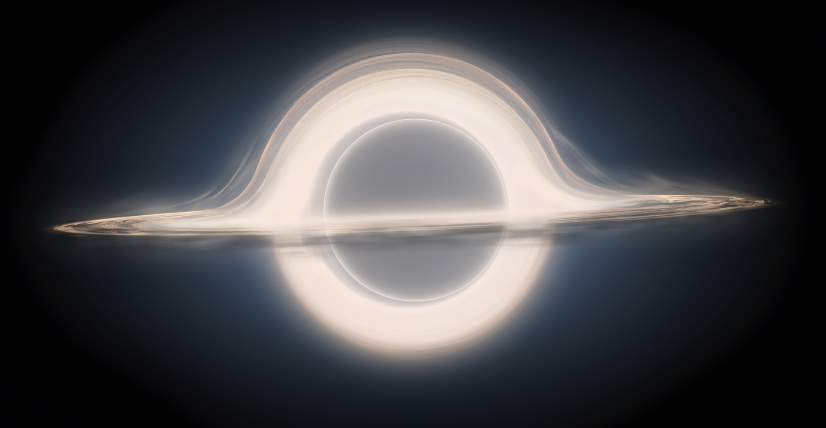
“Gargantua” from interstellar
100 Million Solar Masses

Slide 8
Virial Black Hole Masses in Quasars
e.g., Vestergaard et al. (2006, 2009)
Notes:
Another important parameter in AGN is the black hole mass, which isn’t necessarily a typical SED project but I can really get at this with my quasi-simultaneous spectra.
How do you measure M in AGN?
Spectrum, CIV at high redshift and Hβ at low.
Ideally measurements using these lines in the same object would agree, but there’s scatter of a factor of a few between them.
I’m interested in understanding this scatter so that I can reduce it.

Slide 9
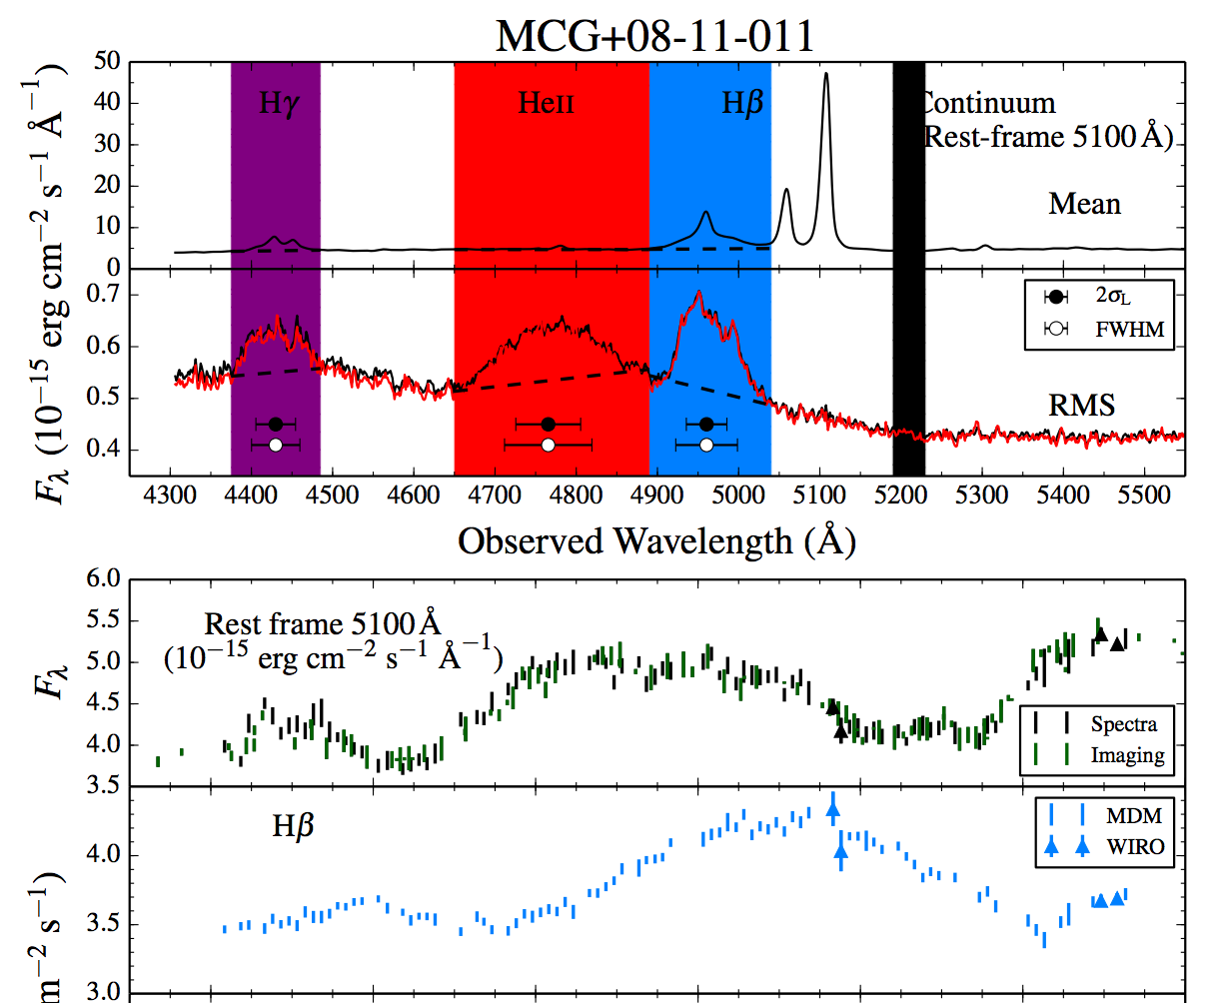
Reverberation Mapping (RM)
Fassnaugh et al. (2016)
Broad lines are photoionized by the central continuum, which varies. The line flux follows the continuum with a time lag t which is set by the size of the broad-line emitting region and the speed of light. Recombination timescales are very short, BLR stable, and continuum source small and central.

Slide 10
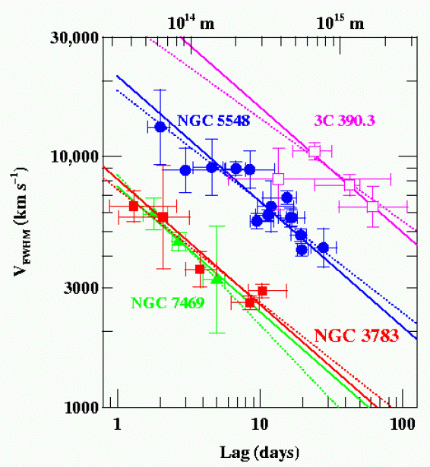
Does the BLR obey the Virial Theorem?
Four well studied AGNs, RM of multiple emission lines shows the expected relationship (slope = -2) between time lags and velocities (note each of the three will have different central black hole masses).
NGC7469: 8.4x10⁶ M☼
NGC3783: 8.7x10⁶ M☼
NGC5548: 5.9x10⁷ M☼
3C 390.3: 3.2x10⁸ M☼
Peterson (2011)

Slide 11
Expect that BLR Scales With Luminosity
Photoionization Models (Baldwin et al. 1996) suggest that strong selection effects make line emission come from gas with the same physical conditions (same U, n)
U = Q(H)/4πR²n_{H}c ~ L/n_{H}R²
  So, for same U, n_{H}, then expect that…
  R ~ L^{0.5}
If it works empirically, single epoch (SE) masses viable.

Slide 12
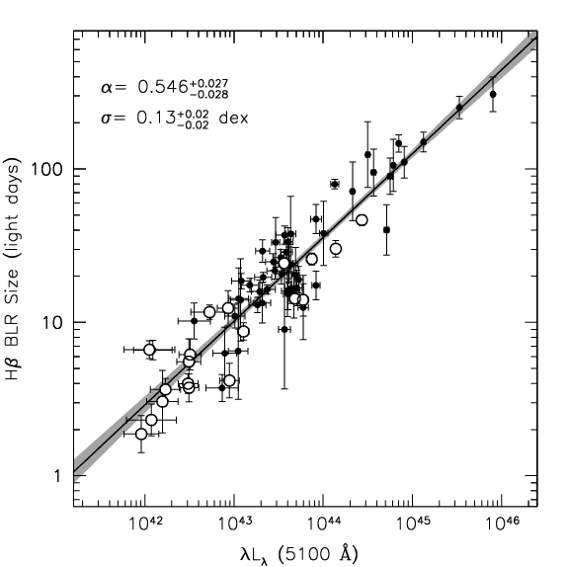
Empirically BLR Scales With Luminosity
Bentz et al. (2013): R ~ L^{0.5}

Slide 13
Black Hole Mass from Quasar Spectra
e.g., Vestergaard et al. (2006, 2009)
Hα
Hβ
log(F_{λ})
C IV
Mg II
Rest λ (Angstroms)
Notes:
Another important parameter in AGN is the black hole mass, which isn’t necessarily a typical SED project but I can really get at this with my quasi-simultaneous spectra.
How do you measure M in AGN?
Spectrum, CIV at high redshift and Hβ at low.
Ideally measurements using these lines in the same object would agree, but there’s scatter of a factor of a few between them.
I’m interested in understanding this scatter so that I can reduce it.

Slide 14
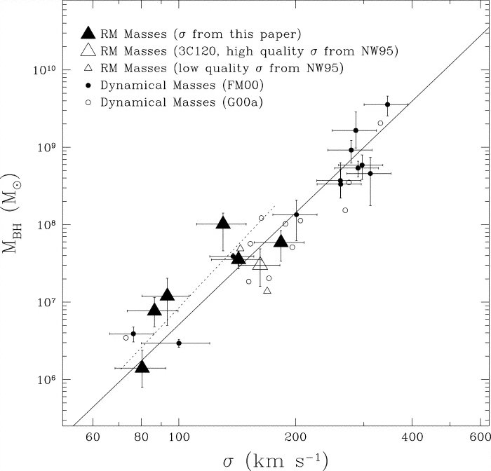
How to calibrate the (average) f factor?
RM-derived masses follow the same M-sigma relationship (fitting f) as seen for normal galaxies that have black hole masses measured from HST spatially resolved gas or stellar dynamics.
Good to 0.5 dex in plot, 0.3 dex in more recent work.
Ferrarese et al. (2001)

Slide 15
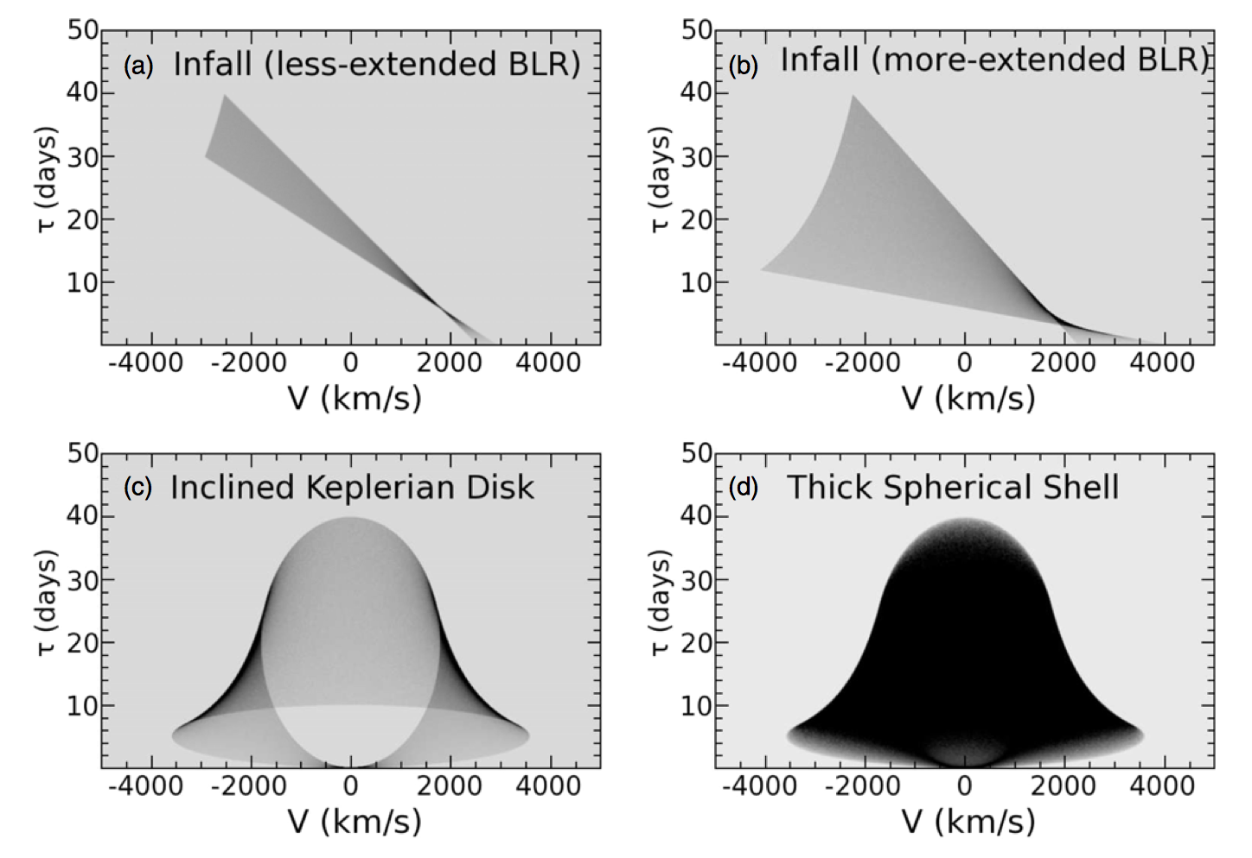
Reverberation Mapping Theory:
Transfer Functions & Velocity-Resolved Time Lags
Stuff here
More Stuff here.
Grier et al. 2012

Slide 16
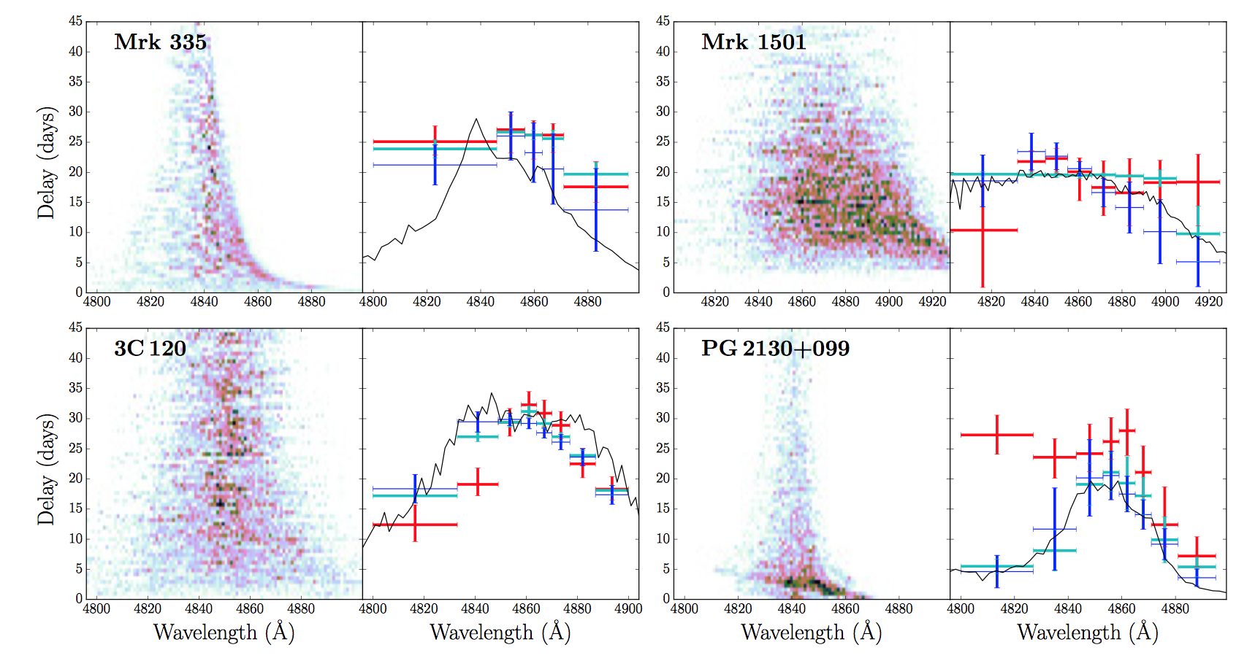
Recent Developments:
Transfer Functions & Velocity-Resolved Time Lags
Stuff here
More Stuff here.
Grier et al. 2017a

Slide 17
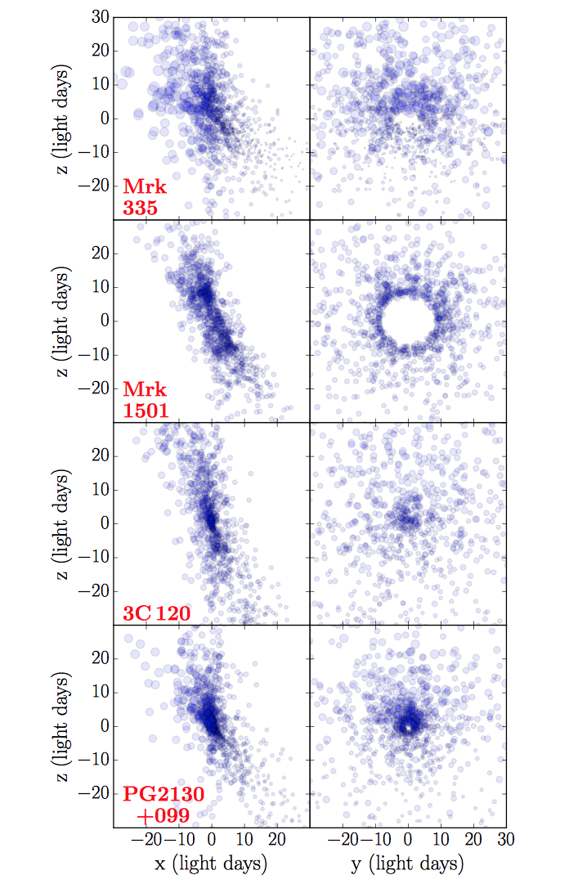
Recent Developments: Dynamical Modeling
Stuff here
More Stuff here.
Grier et al. 2017a

Slide 18
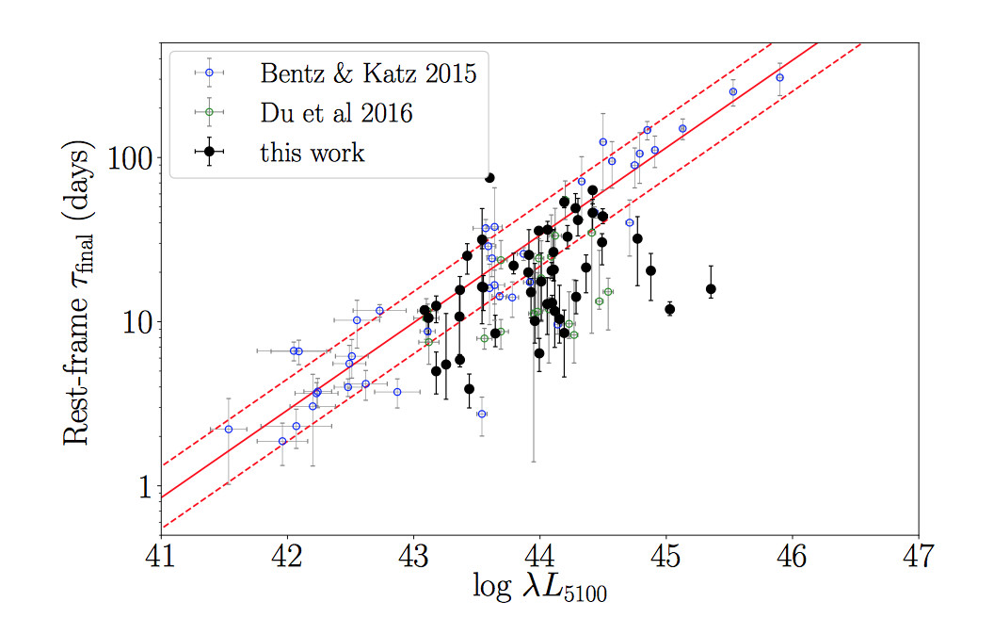
Recent Developments: The R-L Relationship
Grier et al. 2017a

Slide 19
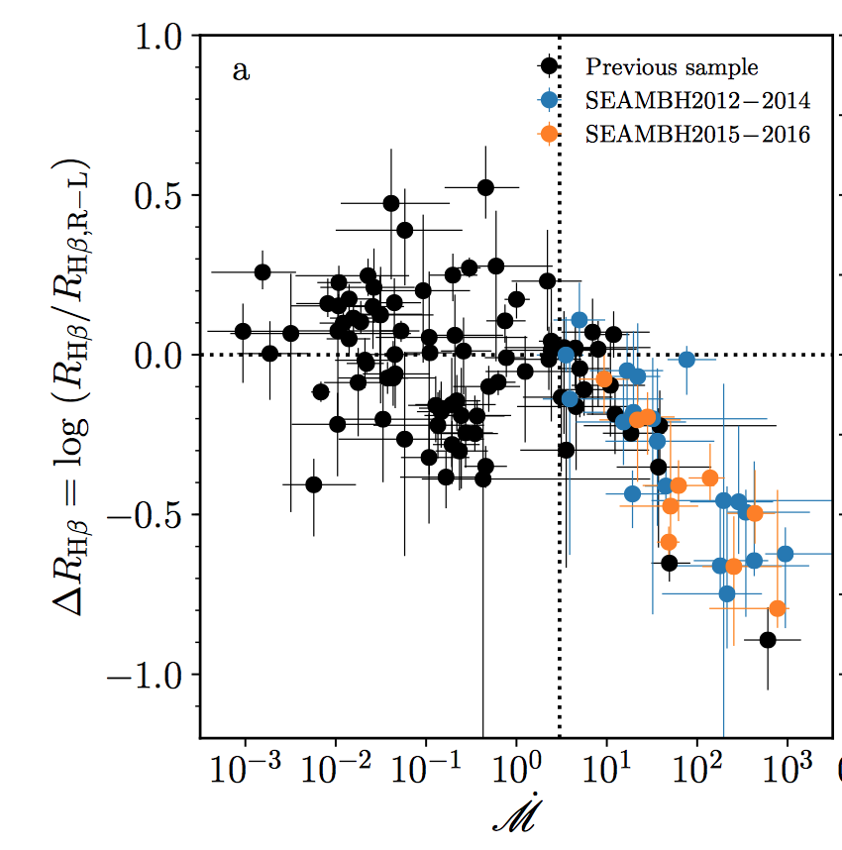
Recent Developments: The R-L Relationship
Grier et al. 2017a
Du et al. 2018

Slide 20
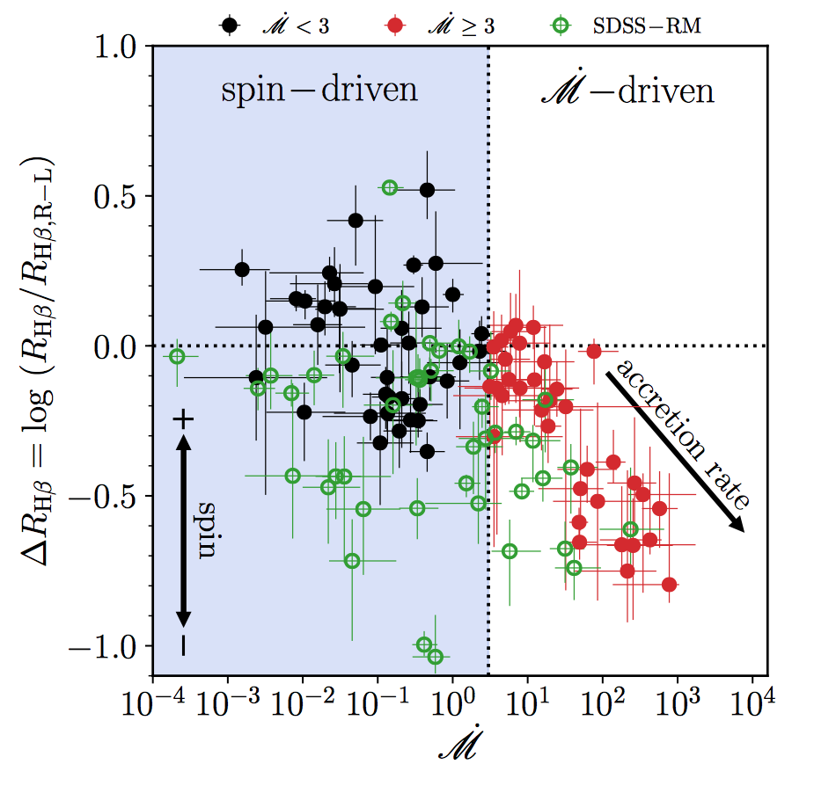
Recent Developments: The R-L Relationship
Du et al. 2018

Slide 21
Recall: Black Hole Mass from Quasar Spectra
e.g., Vestergaard et al. (2006, 2009)
A more sophisticated R-L relationship is definitely needed. Du et al. (2018) provides one for accretion rate effect based on spectral properties. A possible spin effect correction is not yet formulated.
Many more RM programs underway. SDSS, Du et al., WIRO, etc.
Notes:
Another important parameter in AGN is the black hole mass, which isn’t necessarily a typical SED project but I can really get at this with my quasi-simultaneous spectra.
How do you measure M in AGN?
Spectrum, CIV at high redshift and Hβ at low.
Ideally measurements using these lines in the same object would agree, but there’s scatter of a factor of a few between them.
I’m interested in understanding this scatter so that I can reduce it.

Slide 22
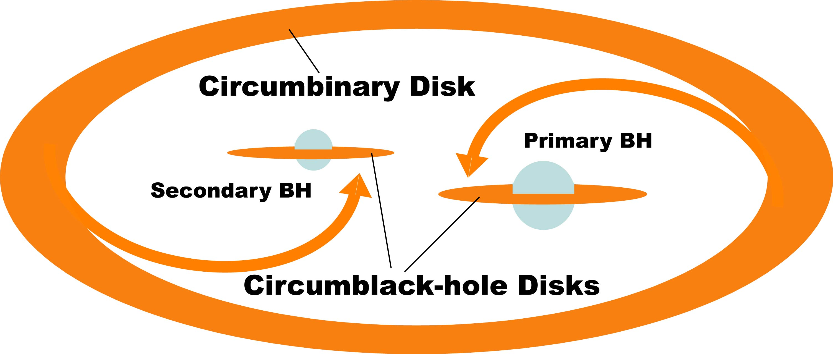
The Future of RM: Binary Black Holes

Slide 23
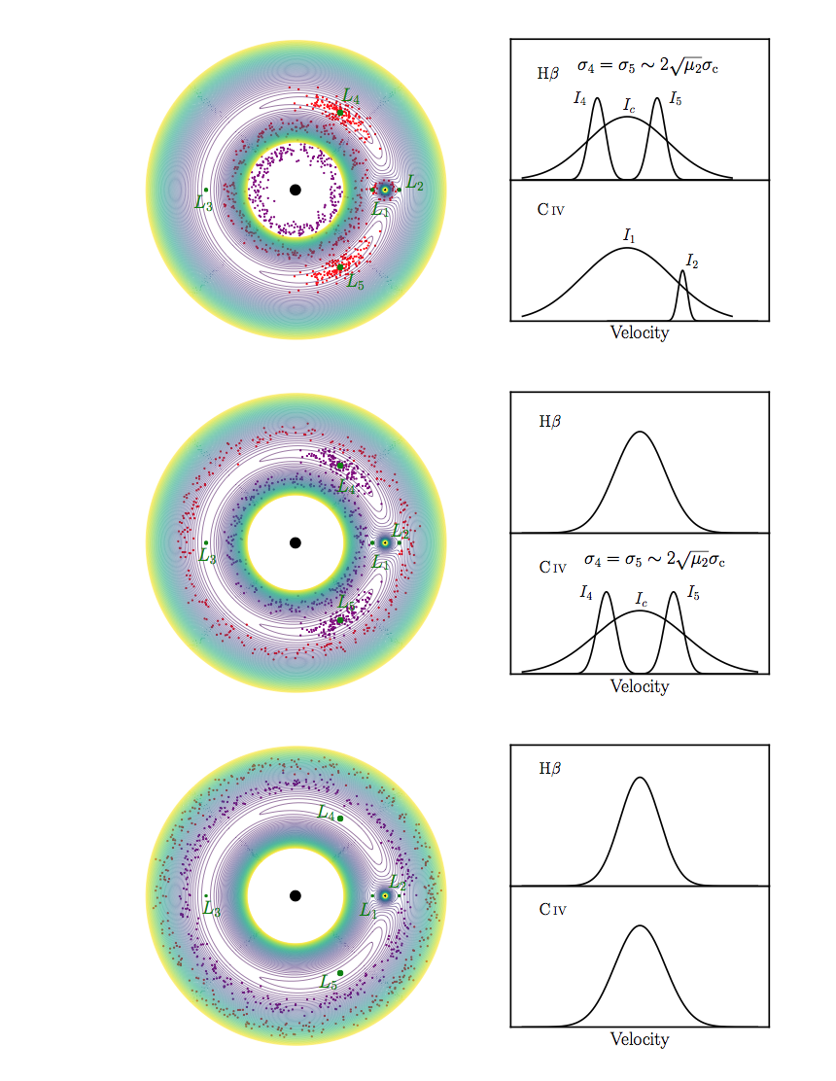
The Future of RM: Binary Black Holes
Small mass ratio
Wang et al. 2018

Slide 24
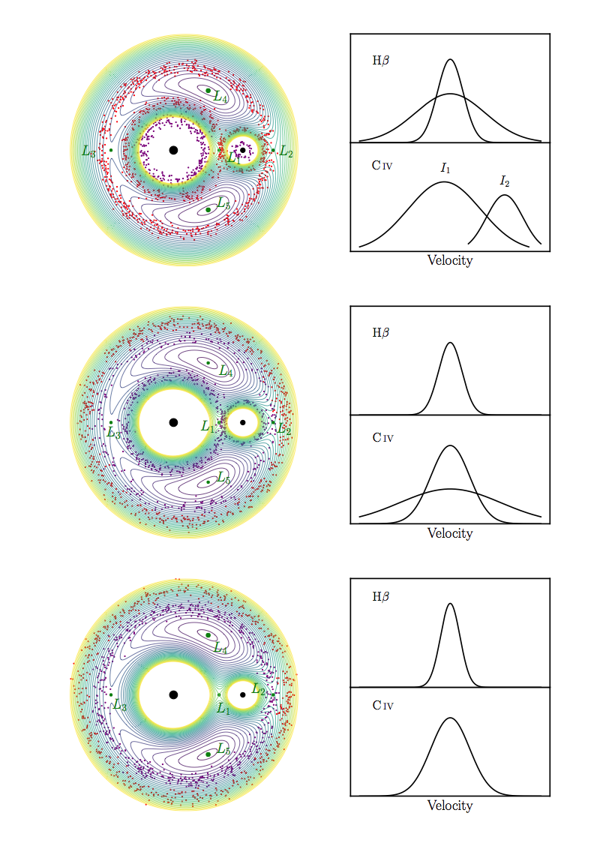
The Future of RM: Binary Black Holes
Large mass ratio
Wang et al. 2018

Slide 25
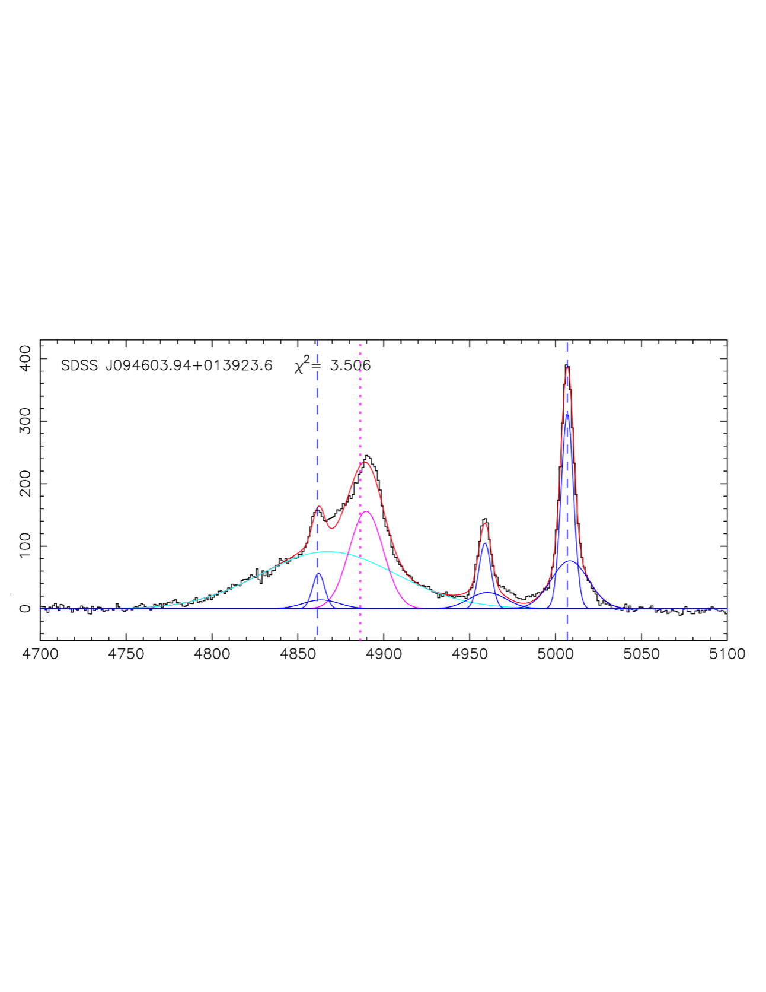
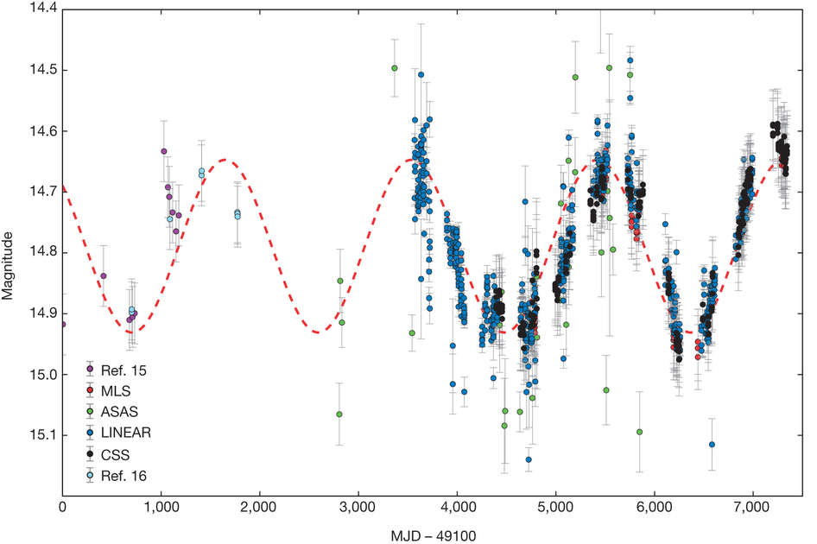
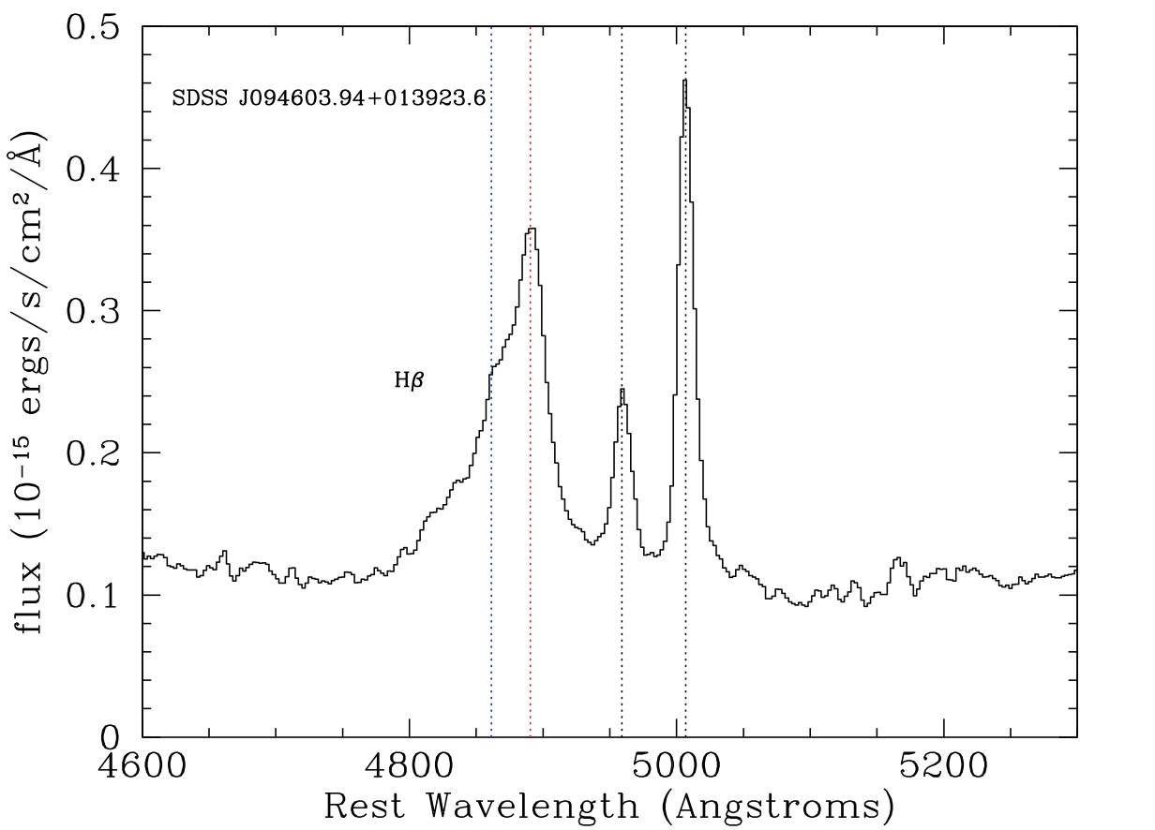
The Future of RM: Binary Black Holes
PG 1302-102
Runnoe et al. 2016
Graham et al. 2015
WIRO 2017

Slide 26
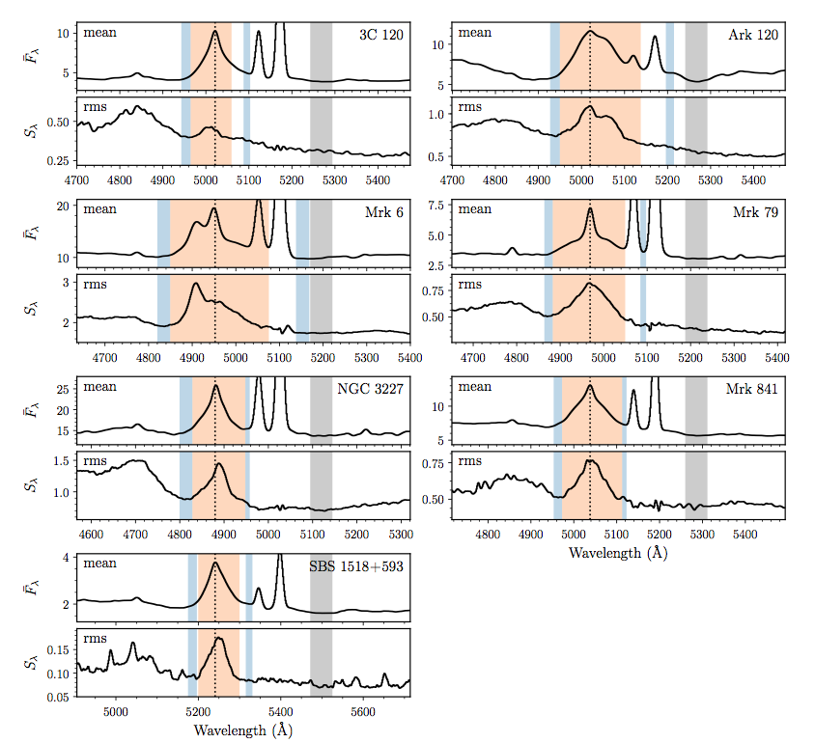
The Future of RM: MAHA and WIRO
Stuff here
More Stuff here.

Slide 27
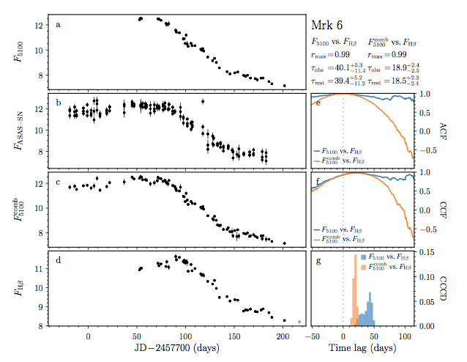
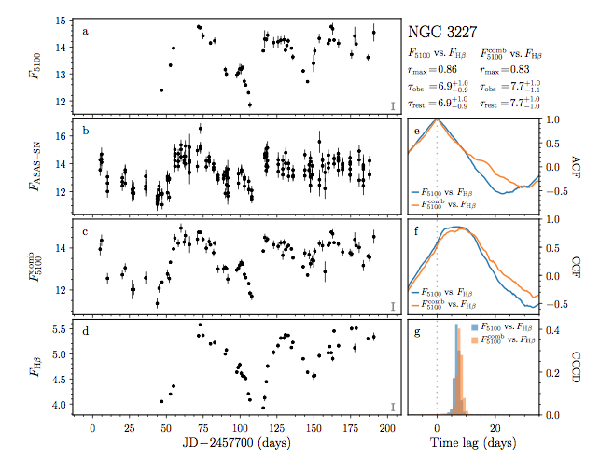
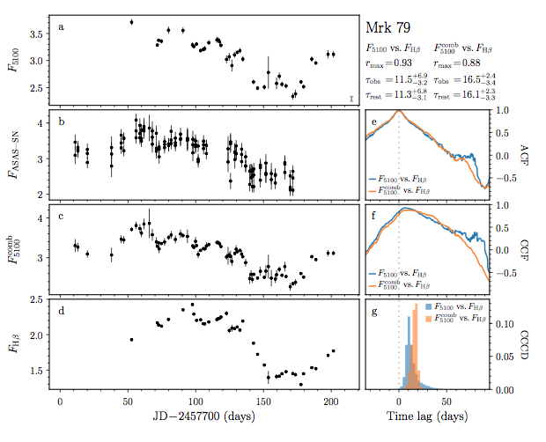
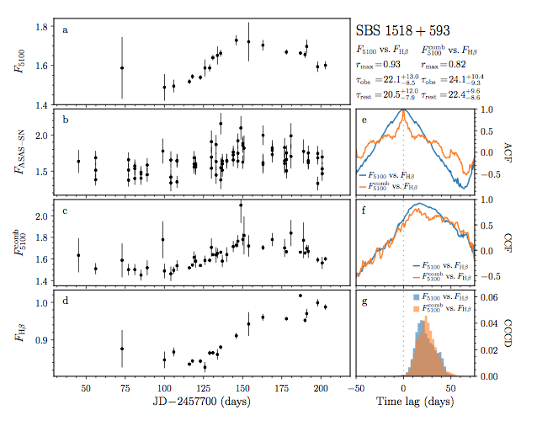
The Future of RM: MAHA and WIRO

Slide 28
Summary
AGN structures not yet understood in detail.
The details are important for understanding black hole masses.
The details are important for understanding inflow, outflow, and rotational motions around supermassive blackholes.
The potential exists for identifying and understanding binary black holes.

Slide 29


Slide 30
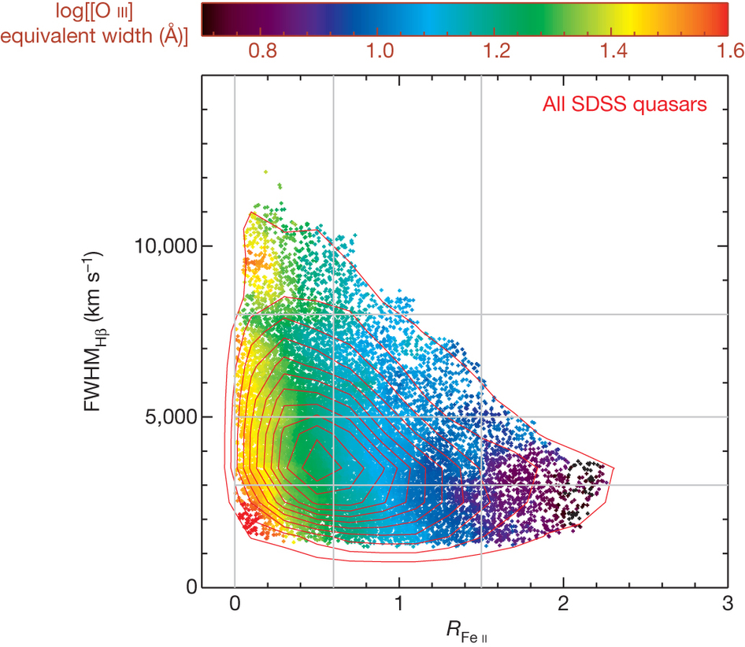
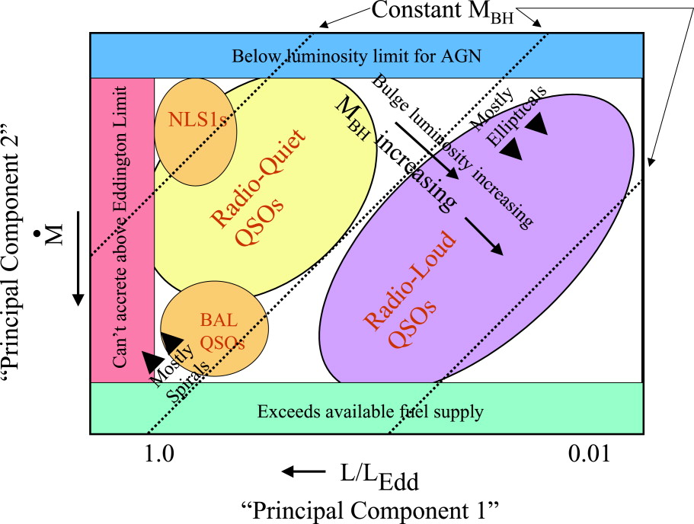
Eddington Fraction Relationships
Shen & Ho (2014)
Boroson (2002)

