Slide 1
ASTR 2310
General Astronomy I: Solar System
Professor Mike Brotherton
Chapter 1 – Selected Introductory Material

Slide 2
Shape of the Earth
Some history / background:
  Early Greek Astronomy
  Ptolemaic Astronomy
  Copernican Astronomy (Copernicus, Tycho, Galileo)
  Kepler's Laws of Planetary Motion
  Newton and some useful equations for gravitational motion
• Celestial mechanics; Lagrange points; Tides
•relativity
•forces and elementary particles
•light & spectra; atomic spectra, molecular spectra, excitation energies
•nucleosynthesis

Slide 3
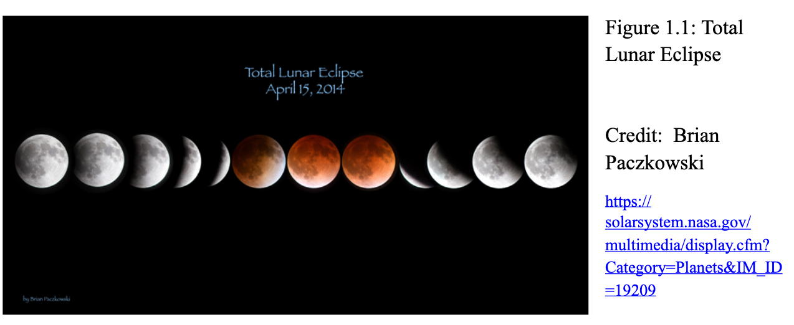
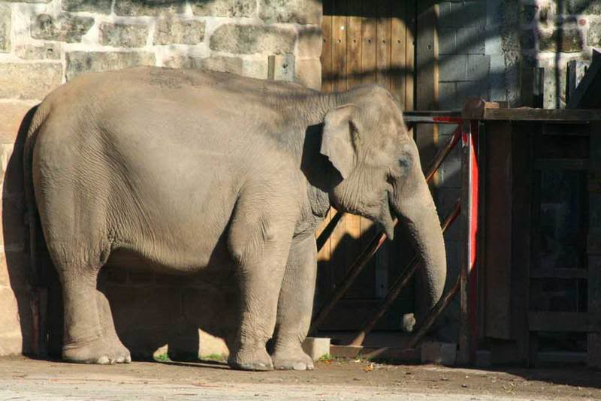
Some early Greek successes
Spherical Earth
  Different stars visible moving south, shadow of Earth during lunar eclipse
  But wait, there’s more! Consider the elephant… https://www.lockhaven.edu/~dsimanek/flat/flateart.htm

Slide 4
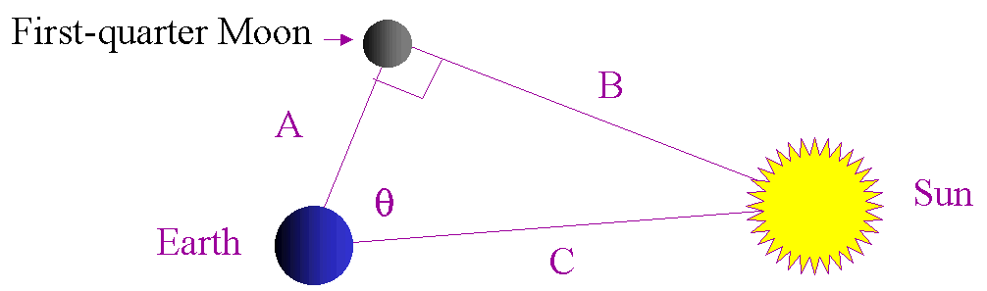
Some early Greek successes
Aristarchus: Relative Distances and Sizes of Moon, Earth, Sun
  A/C=cosine theta. Theta=87degrees means C=19A
  If theta =89.853 degrees (modern value) then C=390A
  For relative sizes, add geometry involving eclipses
  Wiki:http://en.wikipedia.org/wiki/Aristarchus_On_the_Sizes_and_Distances#Lunar_eclipse
  Came up with 1:3:19 (modern values 1:4:390) for ratios of diameters.

Slide 5
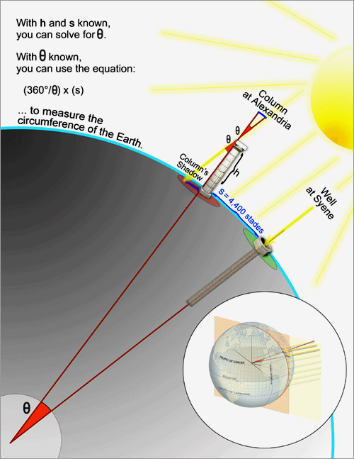
Some early Greek successes
Eratosthenes: Size of the Earth
  Geometry involving the sun
  Wiki: http://en.wikipedia.org/wiki/Eratosthenes
  Figured out what fraction (1/50) of the Earth's circumference corresponded to the distance between Alexandria and Syene
  Figure from Wired Magazine
  Theta is about 7 degrees
  Answer is the circumference is 46,000 km
  Modern value closer to 40,000 km

Slide 6
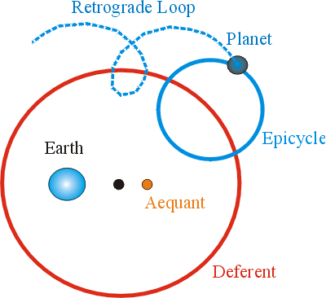
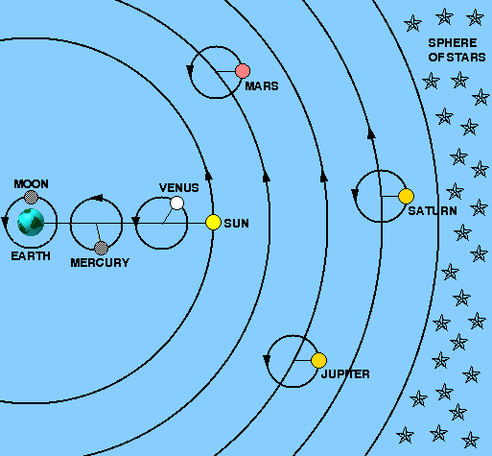
Some early Greek failures
Aristotle
  No parallax, so Earth must be stationary (technology matters!)
Ptolemy
  Conceptually flawed based on this idea, but nicely predictive

Slide 7
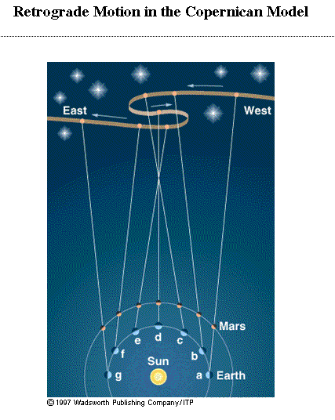
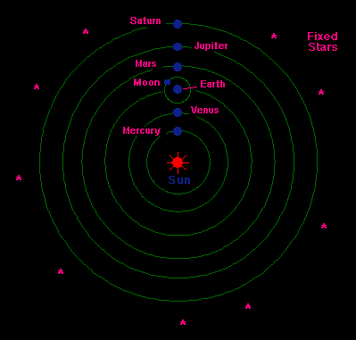
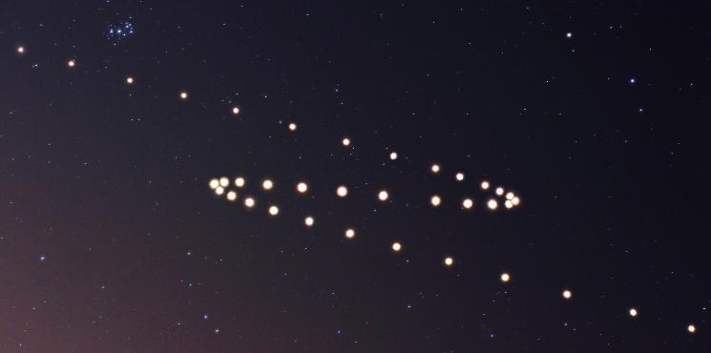
Copernican Revolution
Copernicus – Heliocentric with circular orbits

Slide 8
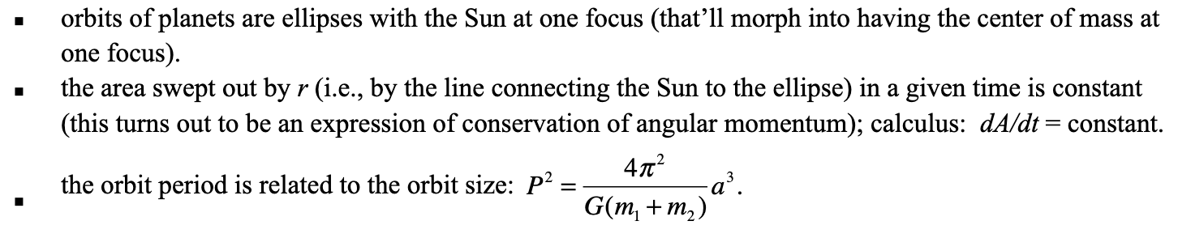
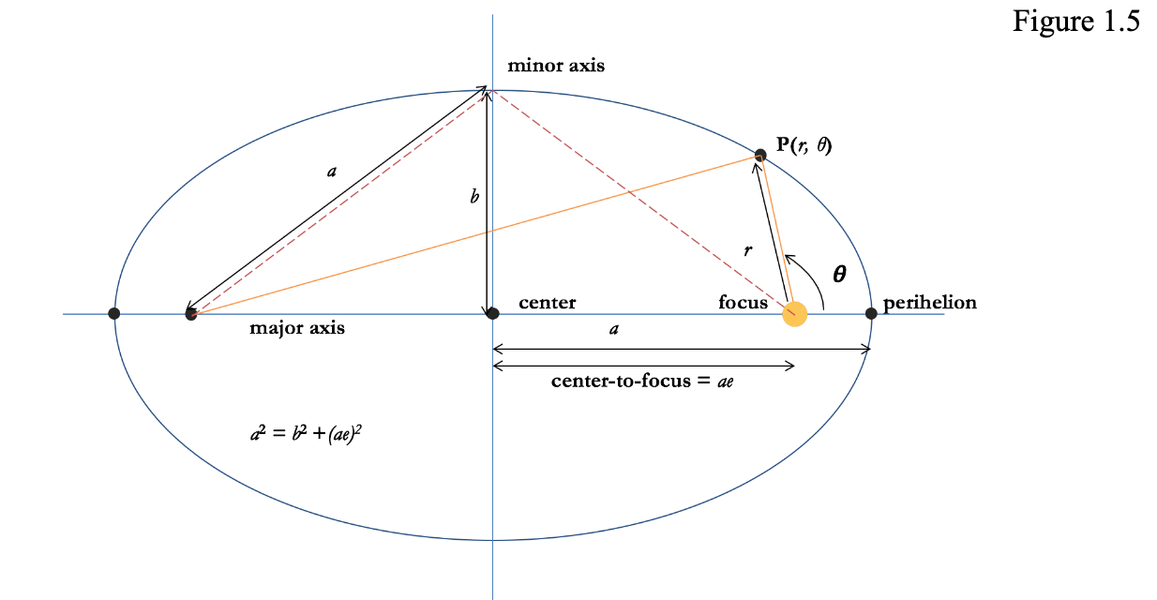

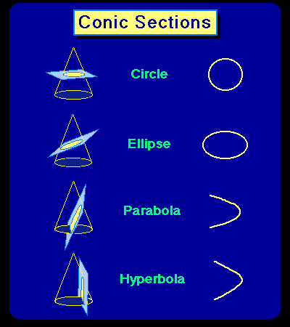

Copernican Revolution
Tycho Brahe – best pre-telescope dataset, planetary positions vs. time
Johannes Kepler – Tycho’s data set leads to Kepler’s three laws

Slide 9
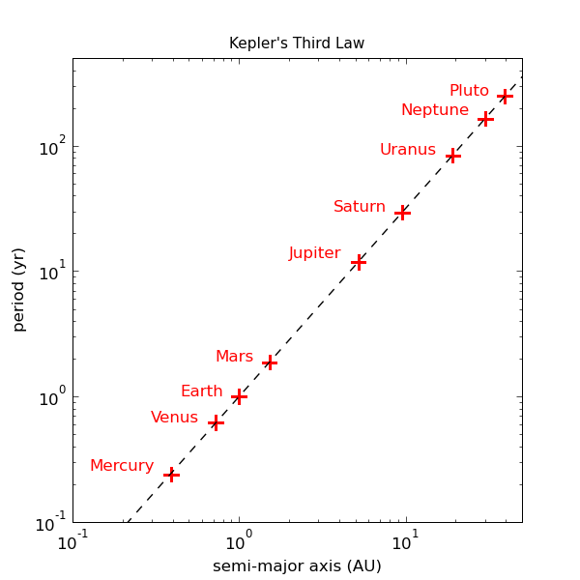
Copernican Revolution
Application of Kepler’s 3rd law
For objects in motion around the sun: (P/years)²=(a/AU)³
Asteroid has a semi-major axis of 4 AU (in asteroid belt), what is P?
Would this work for the Galilean Moons?
“Keplerian motion”: Any system following
the proportionality of the 3rd law, can also
Be expressed with velocity and radius.

Slide 10
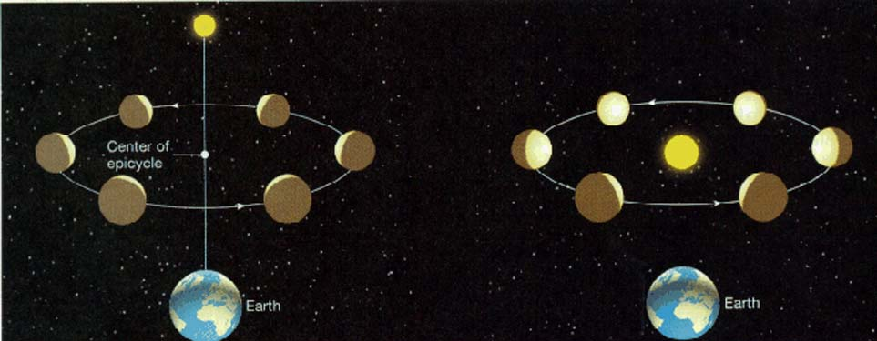
Copernican Revolution
Both Ptolemaic model and Copernican model (with elliptical orbits!) make good predictions of planetary positions. How to test? Phases!

Slide 11
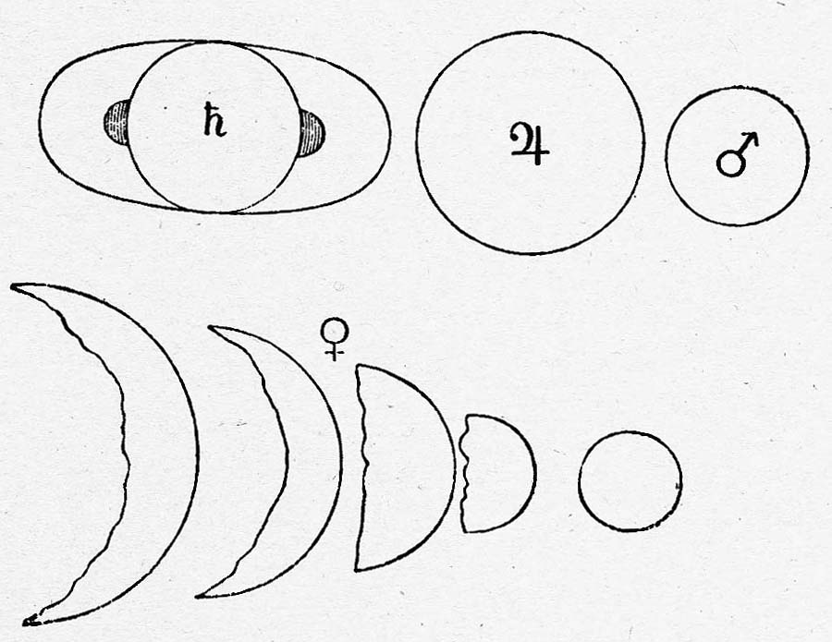
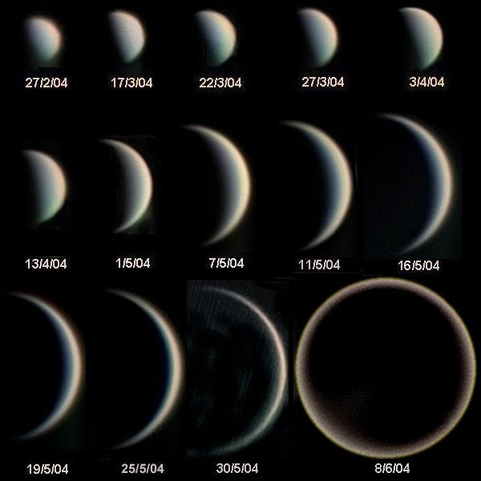
Copernican Revolution
Venus too small to resolve without telescope, but the technology is on track for Galileo to do the experiment!
Galileo’s drawings of planet shapes, NASA.
Venus images, Statis Kalyvas

Slide 12
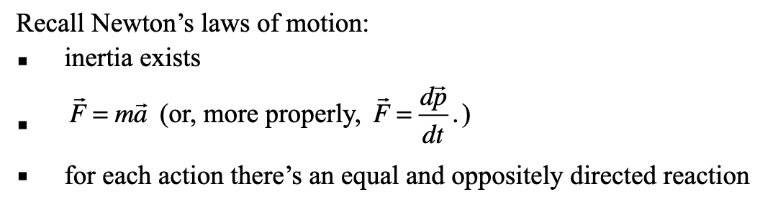

Orbital Dynamics
Newton – theory to explain Kepler’s laws and to go beyond
Most of the derivations a bit too advanced for this class, but…check them out!
Circular orbits not too hard with this information, I hope? Let’s write that down and discuss. But what about elliptical orbits?

Slide 13
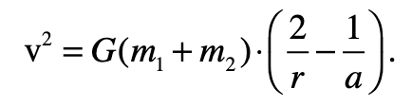
Orbital Dynamics
Vis viva equation:
Is it clear how to use this equation? Also keep in mind center of mass issues, m₁r₁=m₂r₂.
Dobson makes the derivation sound really hard, and says to memorize it, but let’s try conservation principles for a less general case. (For the calculus-based derivation of this and Kepler’s laws, see: http://faculty.fiu.edu/~vanhamme/ast3213/orbits.pdf )
Nice summary page for orbital mechanics: http://www.braeunig.us/space/orbmech.htm

Slide 14
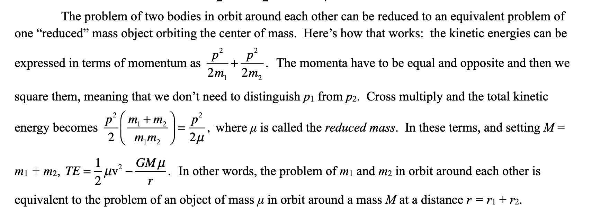
Orbital Dynamics
Reduced mass

Slide 15
Orbital Dynamics
Virial Theorem (needs vector calculus to derive, in previous link of derivations)
For gravitational systems in equilibrium:
Will be handy in many astronomical situations, not just orbits in the solar system. Very general, works for systems of objects (e.g., star clusters, galaxy clusters).
Kinetic Energy = -½ Potential Energy

Slide 16
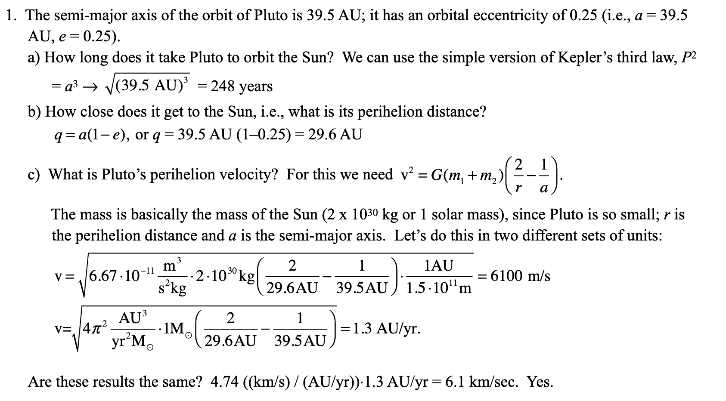
Orbital Dynamics
Example problem in textbook:

Slide 17
Orbital Dynamics
Example problem in textbook:

Slide 18
Orbital Dynamics
Example problem in textbook:

Slide 19
Orbital Dynamics
Another example problem:
Io is the innermost Galilean satellite of Jupiter. The orbital period of Io is P = 1.769 days; the semi-major axis of its orbit is a = 421, 600 km (slightly larger than the Moon’s orbit about the Earth). Given this information, find the mass of Jupiter.
1 day = 86,400 seconds. Use Kepler's 3rd Law
P² = (4π²)/G(Mj+Mi))a³
Solve for mass, M = 4pi² a³ P⁻² G⁻¹ = 1.90x10²⁷ kg.

Slide 20
Orbital Dynamics
Another example problem:
Io is the innermost Galilean satellite of Jupiter. The orbital period of Io is P = 1.769 days; the semi-major axis of its orbit is a = 421, 600 km (slightly larger than the Moon’s orbit about the Earth). Given this information, find the mass of Jupiter.

Slide 21
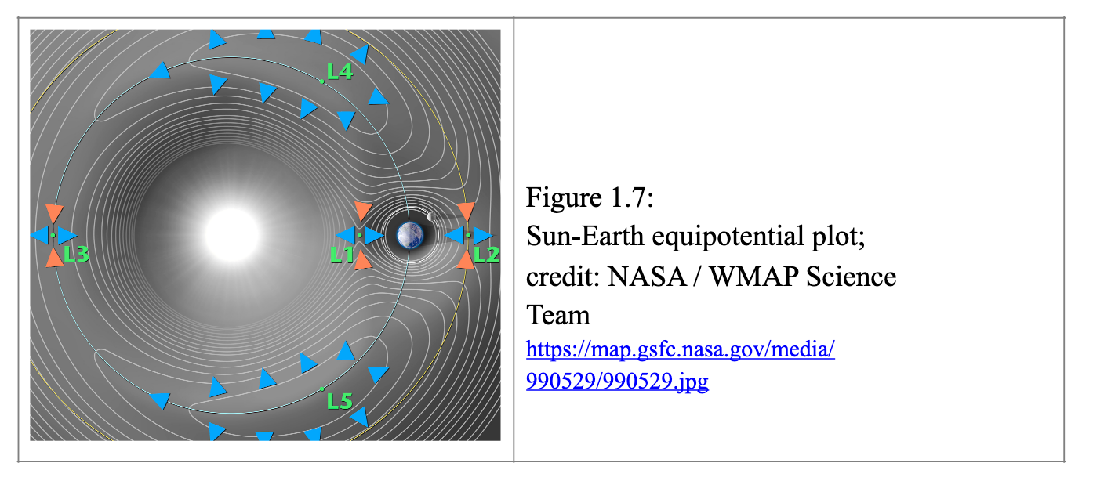
Lagrangian Points
Great 4m video: https://www.youtube.com/watch?v=2LjGgJ4ST60

Slide 22
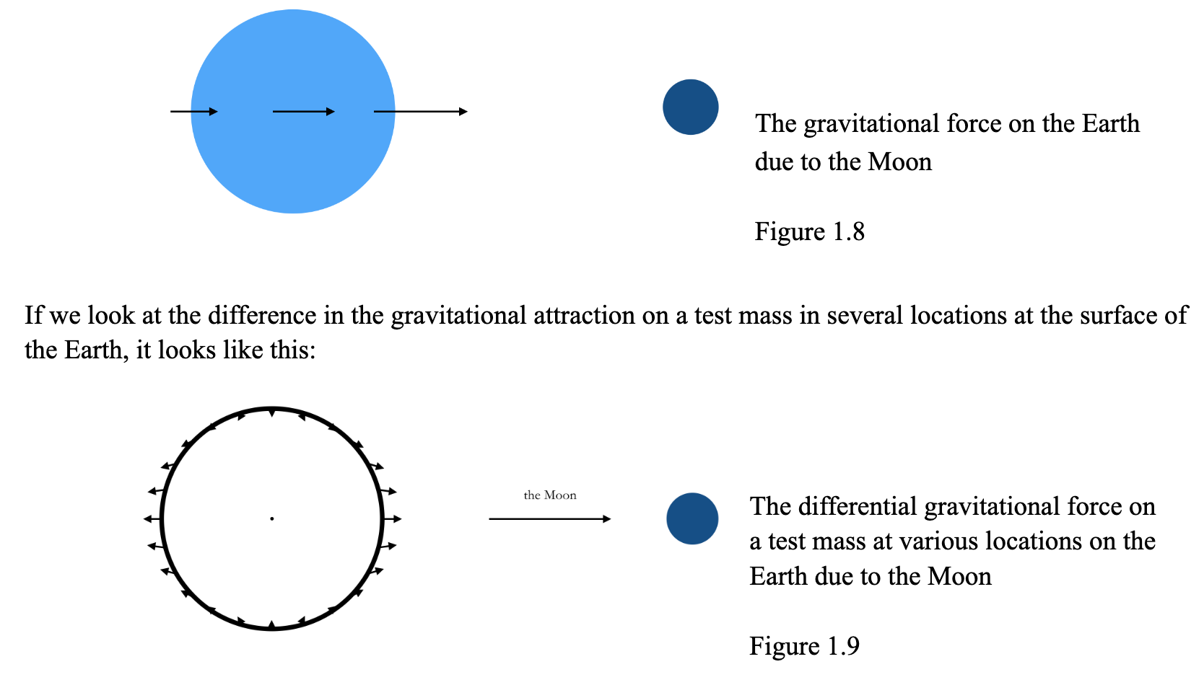
Intro to
Tides

Slide 23
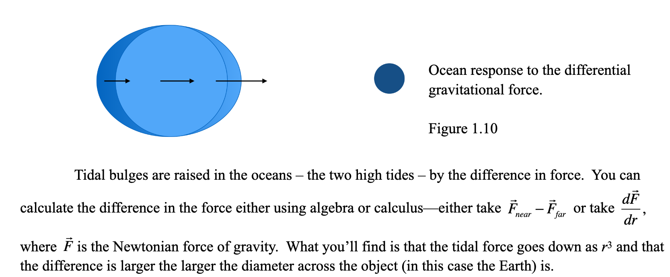
Intro to
Tides
Great 9m video: https://www.youtube.com/watch?v=KlWpFLfLFBI

